Slide 1


Resource Specialty Training
Building safe, stable and connected placements for children and families
Day 2
Notes:
RESOURCE SPECIALTY TRAINING DAY 2

Slide 2

Resource Specialty: Kinship
Notes:
RESOURCE SPECIALITY: KINSHIP

Slide 3

Target Outcomes
Explain the importance of kinship placements in
promoting safety, permanency, and well-being
Differentiate between the traditional resource home process and the kinship approval process
Describe the Resource Specialist's role in opening and licensing kinship homes
Apply policies related to background checks, provisional placement, and alternative compliance
Conduct an initial relative home consultation using professional judgement
Identify strategies to support newly approved resource families and promote placement stability
Notes:
TARGET OUTCOMES
Time: 2 Minutes
Purpose: To provide specialists with a clear connection between child safety, family connections, and the Resource Specialist’s role in opening and supporting kinship resource homes
Say:
Today builds directly on what you learned yesterday. Yesterday, we focused on opening a traditional home. Today, you will learn a very different pathway, one that often begins with a child entering foster care unexpectedly and a family member stepping forward to help.
You will notice that while the paperwork and timelines may differ, the goal remains the same: ensuring children have safe, stable, and nurturing homes.
By the end of today, you won't just understand the policies, you will have practiced applying them through another hands-on simulation. Just like yesterday, we are going to move beyond learning the process to actually using it.
Facilitator Question: (ask the following question and validate responses)
Looking at these objectives, which one feels the most unfamiliar or intimidating to you?
By the end of today, you will have the opportunity to practice these skills, not just hear about them.
Facilitator Note:
Revisit this slide during day 2. Ask participants to identify which they feel more confident in and which they might need additional practice with.

Slide 4
Day 2
Yesterday...
A family wanted to be a resource placement.
You guided them through the licensing process.
You conducted an Initial In-Home Consultation.
You applied the Minimum Licensing Standards.
You referred the family for pre-service training.
Notes:
YESTERDAY
Time: 3 Minutes
Purpose: Transition participants from the traditional licensing process to the unique role of opening kinship homes, emphasizing the urgency, complexity, and importance of placing children with safe family connections whenever possible
Say:
Yesterday, we focused on a family that decided to become resource parents. They raised their hand and said, “We want to help children.”

Slide 5

Day 2
Today... Everything changes.
A child has entered out-of-home care.
Now, your responsibility is to help determine whether a safe relative or fictive kin placement can be established while balancing:
Child safety
Timeliness
Family connections
Licensing requirements
Professional judgement
Notes:
TODAY
Time: 3 Minutes
Purpose: Continue with the transition to opening a kinship home
Say:
Today’s work begins differently. Today begins with a child. A child has entered foster care, often unexpectedly. The child may have experienced abuse or neglect, may have been removed in the middle of the night, and may have no idea what is going to happen next.
Now the question becomes: “Who already loves this child?” That is the foundation of kinship work.
As Resource Specialists, we don’t always identify relatives at the start; however, once relatives or fictive kin have been identified, your role begins. You help assess whether the home can safely meet the child’s needs, guide the family through the approval and licensing process, and provide the support they need to be successful.
Today’s training is about balancing urgency with safety.
Sometimes you will be asked to assess a home where the child needs to be placed that very night. Other times, you will be helping relatives who never imagined becoming caregivers but are willing to step forward because the family needs them.
Throughout the day, keep one question in mind: “How can I safely help this child remain connected to family?” That question should guide every decision you make.

Slide 6
Who Was There for You?
Write the person’s name or relationship to you.
Why did you choose that person?
What made you feel safe with that person?
ACTIVITY
Notes:
ACTIVITY: WHO WAS THERE FOR YOU?
Time: 10 Minutes
Purpose: To help participants recognize the importance of trusted relationships by reflecting on the qualities that make a caregiver feel safe, reinforcing why kinship and fictive kin placements are prioritized whenever they can be made safely
Facilitator Note:
Put participants in small groups at their tables if they are not currently and assign them a partner. Participants will also need additional paper if they do not already have it.
Say:
Think back to when you were growing up. If something happened to your parents and you couldn’t stay at home, who would be the first person you would have wanted to live with?
Activity Instructions:
Think and write the person's name or relationship to you on your sheet of paper
Why you choose that person
What made you feel safe with that person
Facilitator Note:
After participants have done the following on the PowerPoint, facilitate a large group discussion.
Ask the following debrief questions:
What qualities made that person feel safe?
Was it because they had the nicest house?
Or was it because you already trusted them?
How might that relate to children entering foster care?
Paraphrase:
Almost no one chooses someone because they have the biggest house or the newest furniture. You choose the person who made you feel safe. Children entering foster care often feel the same way.
Research and experience have shown us that, when it is safe and appropriate, children generally experience less trauma when they can remain connected to family or other trusted adults.
That doesn't mean every relative placement is appropriate. Safety always comes first. But today’s job is learning how to balance those two priorities:
Protecting children, and
Preserving important family connections whenever safely possible
Now that we have discussed why kinship placements matter, let’s take a closer look at how Arkansas defines relatives and fictive kin and why these placements are prioritized.

Slide 7
Traditional Homes vs. Kinship Homes
Traditional Resource Home | Kinship Resource Home
No existing relationship with the child | Existing Relationship with the child
Licensed prior to placement | Often opened quickly to support placement
Provides care for children needing placement | Helps preserve family connections and reduce trauma
Usually recruiting and referred through established processes | Often identified during a child’s removal or early case activity
Notes:
TRADITIONAL RESOURCE HOMES VS. KINSHIP HOMES
Time: 15 Minutes
Purpose: Help participants compare the two approval pathways and recognize how the Resource Specialist’s responsibilities change depending on how the home enters the licensing process
Both have the same goals:
Safe children
Strong families
Stable placements
Timely licensing
Ongoing support
Key takeaway: The path may look different, but the Resource Specialist’s commitment to child safety and supporting families remains the same.
Say:
Yesterday, we followed the journey of a family who decided they wanted to become resource parents.
That process was fairly structured. Families expressed interest, completed paperwork, participated in pre-service training, and worked toward becoming a licensed home before a child was ever placed in their home.
Today, that timeline changes dramatically. A child has already entered foster care. A relative or fictive kin has been identified who may be able to provide care. That means your work often begins under much tighter timelines.
Instead of asking, “Can this family become licensed someday?” we are often asking, “Can this child safely stay with family tonight while we continue the licensing process?”
Although the pathway changes, our priorities do not. We still focus on child safety, supporting families, and helping children remain connected to those who know and love them whenever it is safe to do so.

Slide 8
Comparing Placement Pathways
Activity
Divide a sheet of chart paper into two columns: Traditional Resource Home and Relative/ Kinship Home
List any characteristics, requirements, or responsibilities that apply to each pathway
Identify any similarities that both pathways share with an asterisk
Notes:
COMPARING PLACEMENT PATHWAYS
Time: 5 Minutes
Purpose: To help participants distinguish the similarities and differences between the Traditional Resource Home and Relative/Kinship Home pathways and recognize the unique considerations associated with each
Facilitator Note:
Participants will need flip charts for this activity; they can work in groups at their tables.
Activity Instructions:
At your tables divide a sheet of chart paper into two columns: Traditional Resource Home and Relative/ Kinship Home
Based on what you learned yesterday and today, list the characteristics, requirements, or responsibilities that apply to each pathway.
Identify any similarities that both pathways share with an asterisk.
Say:
I will give you 5 minutes to do so. You may begin.
Debrief Questions:
Which pathway is more time sensitive?
Which pathway usually involves more uncertainty?
Which pathway presents more opportunities to preserve family connections?
What responsibilities stay the same regardless of the pathway?
Say:
Now that we understand how these pathways differ, let’s walk through the kinship process step by step. As we discuss more details today, feel free to add more notes to your chart paper as you recognize additional differences.
Source(s):
Internal Procedure 802.2 In-Home Consultation Contact
Internal Procedure 802.4 Initiation of Pre-Service Training
Internal Procedure 804: Opening Kinship Homes

Slide 9

15-Minute
Brain Break
Notes:
BRAIN BREAK

Slide 10
The Kinship Home Approval Process
Opening a Kinship Home
Child enters out-of-home care.
Potential relative or fictive kin identified.
Resource Specialist receives the referral and CFS-450.
Complete expedited background checks.
Conduct the Initial Home Consultation (within 48 hours of placement).
Determine provisional placement needs, alternative compliance, etc.
Support the caregiver through the 45-day approval process.
Notes:
THE KINSHIP HOME APPROVAL PROCESS
Time: 5 Minutes
Purpose: Introduce participants to the overall workflow for opening a kinship home, establish where the Resource Specialist enters the process, and provide a roadmap that will be followed throughout the remainder of Day 2
Say:
Before we discuss individual forms or procedures, I want you to understand the entire process.
Think back to yesterday. We followed a traditional Resource Family from inquiry through licensing. Today, we will do the same thing, but through the lens of a relative or fictive kin caregiver.
One important thing to notice is where your work begins. The case-carrying specialist has already identified a potential caregiver and completed an initial assessment of whether that person is an appropriate placement option.
Your responsibility begins when you receive the referral. From that point forward, you’re responsible for helping move the home through the approval process while ensuring all required safety steps, background checks, consultations, and documentation are completed.
Throughout today, we will keep coming back to this timeline. Every new topic we discuss fits somewhere in this process.

Slide 11

Who Does What?
Activity
Notes:
ACTIVITY: WHO DOES WHAT?
Time: 10 Minutes
Facilitator Resource: Activity: Who Does What? CARDS
Activity Instructions:
Provide each table with labeled mixed-up cards, the cards are labeled as follows:
Child enters care
Relatives identified
CFS-450 completed
Background checks
Initial home consultation
Alternative compliance/ Waiver
Training referral
Home approved
Say:
For this next activity, you will work together to arrange a series of process cards in the order you believe each step occurs. The cards are labeled but are intentionally out of sequence.
You will have 5 minutes to discuss and arrange the cards into what you believe is the correct order. Once everyone has finished, we will review the correct sequence together.
Debrief Questions:
Which steps were easiest to place?
Which steps caused the most discussion?
Where does the Resource Specialist first become involved?
Why is it important to understand where your role begins and ends?
Facilitator Notes:
Emphasize through the discussion that:
The case carrying specialist or investigator identifies potential relatives
The Resource Specialist’s role begins once the referral is received
Many of these steps occur under very tight timelines because a child may be waiting for placement
Say:
Now that we have looked at the overall workflow, let’s examine the very first step that you complete after receiving the referral-the CFS-450 and the information it provides to begin the approval process.

Slide 12
Receiving a Kinship Referral
The Resource Specialist’s work begins with a referral.
A quality referral will include:
CFS-450: Prospective Provisional Resource Parent Information
Child information
Caregiver information and relationship to the child
Household members
Known safety concerns
Relevant case information
Urgency of the placement
Notes:
RECEIVING A KINSHIP REFERRAL
Time: 10 Minutes
Purpose: Explain how a Resource Specialist becomes involved in the kinship approval process, what information should be received from the case-carrying specialist, and why a complete referral is essential to timely decision-making
Say:
Although your work begins when you receive the referral, you don’t simply start completing paperwork.
The first thing you should do is review the information you’ve been provided and determine whether you have enough information to move forward. Sometimes you’ll receive a complete referral with everything you need. Other times you’ll have questions.
You may need clarification about household members, the caregiver’s relationship to the child, known safety concerns, or whether there are additional adults living in the home.
Strong communication between the case-carrying specialist and the Resource Specialist is essential. Both roles have distinct responsibilities, but both work toward the same goal of finding a safe, timely placement for the child.

Slide 13

Activity
Activity
What Else Would You Need?
Activity
Notes:
ACTIVITY: WHAT ELSE WOULD YOU NEED?
Time: 20 Minutes
Participant Manual : Reyes Family CFS-450 , What Else Would You Need?
Facilitator Resource: What Else Would You Need? MOCK REFERRAL
Say: (Activity Instructions)
Imagine you’ve just received a referral for a grandmother who would like placement of her two grandchildren.
What additional information would you need before you could confidently begin the approval process?
(Give groups five minutes to brainstorm.)
Debrief: Create a master list on a flip chart.
Guide participants toward:
Relationship to the child
Other household members
Criminal history concerns
Child’s medical or behavioral needs
Immediate placement timeline
Safety concerns identified by the case-carrying specialist
Whether the child is already in the home
Contact information
Existing supports
Say:
Receiving a referral is more than receiving paperwork. It’s receiving the information you need to make informed decisions.
The CFS-450 is one of the primary documents you’ll use throughout this process. On the next slide, we’ll walk through it section by section.

Slide 14
The CFS-450: Your Roadmap for Opening a Kinship Home
The CFS-450 helps you:
Gather information about the caregiver and household
Identify immediate safety concerns
Document the initial home consultation
Determine training needs
Evaluate the home using licensing standards
Make recommendations regarding provisional approval, alternative compliance, and licensing
Notes:
THE CFS-450: YOUR ROADMAP FOR OPENING A KINSHIP HOME
Time: 3 Minutes
Purpose: Introduce participants to the purpose of the CFS-450, explain how it supports the kinship approval process, and prepare participants to use the form throughout the remainder of the day’s instruction
Say:
Yesterday, we introduced the CFS-446, which starts the traditional resource home licensing process. Today, we’re working with a different document because we’re working with a different process.
The CFS-450 is much more than an application. It becomes your working document throughout the provisional approval process.
You’ll notice it contains information collected by the case-carrying specialist, sections completed by the Resource Specialist, safety checklists, training decisions, and ultimately your recommendation.
Rather than reviewing every page today, we’re going to use the form exactly the way you would in the field. As we move through each step of the approval process, we’ll refer back to the appropriate section of the CFS-450 and discuss how it supports your work.
By the end of today’s training, you’ll understand not only what is included in the form, but why each section matters and how it supports safe, timely decision-making.

Slide 15

Lunch Break
Notes:
LUNCH BREAK

Slide 16

Activity: Explore the CFS-450 Form
Notes:
ACTIVITY: EXPLORE THE CFS-450 FORM
Time: 10 Minutes
Purpose: Familiarize participants with the physical structure of the CFS-450 and help them identify key sections related to safety assessments and professional recommendations
Participant Resource: CFS-450: Prospective Provisional Resource Parent Information and Questionnaire & Highlighters
Say:
Before we walk through the process together, spend five minutes becoming familiar with the
form.
Ask them to identify and mark with a highlighter:
Sections completed by the case-carrying specialist (Yellow)
Sections completed by the Resource Specialist (Green)
Sections that focus on home safety (Blue)
Sections that involve recommendations or next steps (Pink)
After five minutes, discuss as a group.
Debrief Questions:
What surprised you about the form?
Which sections appear to require the most professional judgment?
Which sections support immediate child safety?
How does this form differ from the CFS-446 you used yesterday?
Facilitator Notes:
Do not review the form line by line.
Instead, tell participants:
Keep this form with you throughout today’s training. We will return to it repeatedly as we work through each stage of opening a kinship home.
This allows participants to see how each section connects to the Resource Specialist’s workflow, rather than treating the form as a stand-alone document.
Say:
The first piece of information you’ll review on the CFS-450 helps determine whether it is safe to proceed with the approval process. Let’s begin with the expedited background checks and the information you’ll evaluate before placement.

Slide 17
Before Provisional Placement:
Required Expedited Background Checks
Completed:
CFS-316: Request for Child Maltreatment Central Registry Checks
CFS-342: State Police Criminal Record Check
CFS-593: Arkansas State Vehicle Safety Program (ASVSP)
Initiated:
FBI Criminal Background Check
Notes:
BEFORE PLACEMENT: EXPEDITED BACKGROUND CHECKS
Time: 3 Minutes
Purpose: Outline the specific expedited background checks required for provisional kinship placement and explain the Specialist's role in evaluating results before a child enters the home
Say:
One of your very first responsibilities after receiving a kinship referral is to ensure that the required background checks have been initiated and reviewed.
Notice I didn’t say ‘completed.’ In provisional placements, we often work under very tight timelines. Some checks can be expedited, while others, like the FBI fingerprint results, may still be pending. FBI results do not have to be received to open the provisional home, but results must be received and cleared to approve as a regular DCFS Resource Home. Your job is to understand what policy requires before placement, what can remain pending, and what would prevent a child from being placed in the home.
According to DCFS Internal Procedure 804: Opening Kinship Homes, prior to placement of the child the Resource Social Services Specialist will:
Process all necessary background checks:
Expedited Child Maltreatment Central Registry Check (via CFS-316: Request for Arkansas Child Maltreatment Central Registry Check)
Expedited State Police Criminal Record Check (via CFS-342: State Police Criminal Record Check)
Vehicle Safety Program (DMV) Check (see DCFS Internal Procedure 815.4 for forms to be completed)
Submit the FBI Criminal Record Check (FBI results do not have to be received to open the provisional home, but results must be received and cleared to approve as a regular DCFS Resource Home)
Also, remember that a clear background check doesn’t automatically mean a home is appropriate, and a history doesn’t automatically mean a placement is impossible. Your role is to review the information, apply the policy, and assess its impact on the child's safety in the context of the overall situation.
This is why Resource Specialists need both technical knowledge and professional judgment.
Source: DCFS Internal Procedure 804: Opening Kinship Homes; DCFS Internal Procedure 815.4: Resource Family Support System

Slide 18
Would You Move Forward?
Scenario 1: Grandmother’s background checks are completely clear. Can the child be placed today?
Scenario 2: Grandfather has a speeding ticket from three years ago. Does this automatically prevent placement?
Scenario 3: A result from the Child Maltreatment Central Registry has not yet been received. What should you do next?
Scenario 4: A criminal history appears that may affect approval. Who do you consult before making a decision?
Notes:
1ACTIVITY: WOULD YOU MOVE FORWARD?
Time: 10 Minutes
Purpose: Provide participants the opportunity to apply background check policies to realistic situations and practice exercising professional judgment when determining whether to move forward with a placement
Say:
I’m going to give you four situations. Don’t answer immediately. Talk with your table first. (Display one scenario at a time, as this slide does contain animations.)
Scenario 1: Grandmother’s background checks are completely clear.
Question: Can the child be placed today?
Expected Discussion: Maybe. Background checks are only one piece of the assessment.
Scenario 2: Grandfather has a speeding ticket from three years ago.
Question: Does this automatically prevent placement?
Expected Discussion: No. Consider the nature of the offense and applicable policy.
Scenario 3: A result from the Child Maltreatment Central Registry has not yet been received.
Question: What should you do next?
Expected Discussion: Follow policy regarding required checks before placement. Don’t guess or bypass required steps.
Scenario 4: A criminal history appears that may affect approval.
Question: Who do you consult before making a decision?
Expected Discussion: Supervisor, policy, legal guidance if applicable, not making the decision in isolation.
Debrief. Ask:
Which situations required the most judgment?
What additional information would you want before making a recommendation?
Why is it important not to rely on one piece of information alone?
Facilitator Notes:
Important: This is not intended to teach disqualifying offenses or every detail of background check policy.
The objective is for participants to understand:
Which checks are required.
When they occur.
How the information contributes to the overall safety assessment.
When to seek supervisory guidance.
If participants ask highly specific policy questions (e.g., “Is offense X automatically disqualifying?”), acknowledge the question, explain where that information is found in policy, and keep the discussion focused on the Resource Specialist’s decision-making process.
Say:
If concerns are identified during the background checks, the next step is to determine whether the issue can be resolved through the approval process.

Slide 19
When A Concern is Identified
Not Every Concern Has the Same Solution. As a Resource Specialist, your role is to identify concerns, evaluate their impact on child safety, and determine the appropriate next step.
Concern Identified. ➔ Can the issue be corrected immediately?
Consult supervisor and follow DCFS internal procedure.
Yes. Correct before approval.
Alternative Compliance
No. Does policy allow another option?
Policy Waiver
Notes:
WHEN A CONCERN IS IDENTIFIED: WHAT HAPPENS NEXT?
Time: 5 Minutes
Purpose: Help participants understand how Resource Specialists respond when concerns are identified during the approval process by introducing the decision-making framework for correcting deficiencies, requesting Alternative Compliance, or requesting a Policy Waiver
Say:
Yesterday, many of the homes we looked at either met the licensing standards or needed simple corrections before moving forward. Kinship homes are different.
Because a child may already be in the home or need placement immediately, you’ll sometimes encounter situations where a licensing standard or policy cannot be met exactly as written. That doesn’t automatically mean the answer is ‘no.’
Your responsibility is to assess the concern, determine whether it can be corrected immediately, and if not, determine whether policy allows another path forward.
Notice I keep using the word ‘determine.’ I am not saying you approve it. You identify the issue, gather the necessary information, consult with your supervisor, and follow the established approval process.
You will become more comfortable recognizing which issues are simple corrections, which may require Alternative Compliance, and which may require a Policy Waiver.

Slide 20
Which Path Would You Take?
Which Path Would You Take?
Scenario 1: During the home consultation, you discover prescription medications stored on the kitchen counter.
Scenario 2: The home has a walk-through bedroom that may not meet the standard for sleeping arrangements.
Scenario 3: A background check reveals a misdemeanor from many years ago with no additional criminal history.
Scenario 4: The family has not installed a smoke detector in one of the bedrooms.
Scenario 5: Grandmother has three biological children under the age of six already living in the home.
Notes:
ACTIVITY: WHICH PATH WOULD YOU TAKE?
Time: 15 Minutes
Purpose: Guide participants in analyzing identified concerns to determine whether they require immediate correction, a request for alternative compliance, or a formal policy waiver
Facilitator Resource: Internal Procedure 805: Alternate Compliance and Policy Waiver Protocol (See DCFS Internal Procedures)
Say: (Activity Instructions)
Work with your table. For each scenario, don’t worry about whether you know the exact policy. Instead, decide what your next step would be.
For each scenario, choose:
Correct Before Approval
Consider Alternative Compliance
Consider a Policy Waiver
Need More Information / Consult Supervisor
Scenario 1: During the home consultation, you discover prescription medications are stored on the kitchen counter.
Expected Discussion: Correct before approval.
Scenario 2: The home has a walk-through bedroom that may not meet the standard for sleeping arrangements.
Expected Discussion: Consider Alternative Compliance.
Scenario 3: A background check reveals a misdemeanor from many years ago with no additional criminal history.
Expected Discussion: May require a Policy Waiver depending on the offense and policy; consult supervisor and review Internal Procedure 805.
Scenario 4: The family has not installed a smoke detector in one of the bedrooms.
Expected Discussion: Correct before approval.
Scenario 5: Grandmother has three biological children under the age of six already living in the home.
Expected Discussion: Participants should recognize that this may require a Policy Waiver under the kinship process rather than automatically denying the placement.
Debrief Questions:
Which scenarios were straightforward?
Which required more professional judgment?
Why is it important not to immediately tell a family “yes” or “no” when a concern is identified?
When should you involve your supervisor?
Facilitator Notes:
Do not spend time memorizing lists of offenses or waiver criteria.
Instead, emphasize these core principles:
Child safety is always the priority.
Not every concern has the same solution.
Know when to stop, consult, and follow policy.
Resource Specialists initiate and support the process; they do not make approval decisions independently.
Say:
On the next slide, we’ll take a closer look at the difference between Alternative Compliance and Policy Waivers and walk through how those requests move through the approval process.

Slide 21
Alternative Compliance vs. Policy Waiver
Alternative Compliance | Policy Waiver
Request to deviate from a licensing regulation while still meeting the intent | Request to deviate from DCFS policy or procedure when permitted
Used when child safety can be maintained through another acceptable method | Used when policy allows an exception after review and approval
Reviewed through the Child Welfare Agency Review Board process | Approved by the DCFS Director or designee
Commonly used to support timely kinship placements while maintaining safety | Typically requested when specific policy requirements cannot otherwise be met
Notes:
ALTERNATIVE COMPLIANCE VS. POLICY WAIVER
Time: 5 Minutes
Purpose: Differentiate between Alternative Compliance and Policy Waivers, explain when each may be appropriate, and reinforce the Resource Specialist’s role in initiating, not approving, the request process
Participant Resource: DCFS Internal Procedure 805 (Table Copy)
Paraphrase:
Your Role as the Resource Specialist
✔ Identify the concern.
✔ Assess child safety.
✔ Gather supporting documentation.
✔ Consult with your supervisor.
✔ Submit the request through the established approval process.
❌ Do not independently approve Alternative Compliance or Policy Waivers.
Remember, the goal is not to find a way around policy. The goal is to safely achieve the intent of the regulation or policy whenever possible.
One of the most common questions new Resource Specialists ask is, ‘What’s the difference between Alternative Compliance and a Policy Waiver?’
They’re related, but they’re not the same. A Policy Waiver asks for permission to deviate from a DCFS policy.
Alternative Compliance asks whether the intent of a licensing regulation can still be met through another safe approach.
Neither process is intended to bypass child safety. In fact, both exist because kinship placements often present unique situations that require careful professional judgment.
Your responsibility is to recognize when one of these options may be appropriate, gather the information needed to support the request, and follow the approval process.

Slide 22

Activity
Let’s Think Like a Resource Specialist
      Focus on:
Understanding the difference between the two processes.
Knowing when additional review may be appropriate.
Following the correct chain of approval.
Notes:
ACTIVITY: LET’S THINK LIKE A RESOURCE SPECIALIST
Time: 15 Minutes
Purpose: To provide participants with an opportunity to apply policy and critical thinking skills by evaluating common licensing scenarios and identifying the information needed to make informed recommendations
Facilitator Resource: Scenarios A-D Let’s think like a resource specialist
Facilitator Note:
For this next activity participants will need an additional sheet of paper to write on, if they do not have it already. You will also need to cut out the scenarios linked in the Facilitator Resource. Use Scenario “D” if there is an uneven number of tables or participants and an additional scenario is needed.
Activity Instructions:
I will provide each table one scenario along with questions to answer, and you will work collaboratively as a group to complete the questions.
You will have 8 Minutes to read the scenario and answer the questions on your additional sheet of paper.
Scenario A: A grandmother’s home has a walk-through bedroom that would normally not meet the licensing standard.
What is the concern?
Can it be corrected?
Would you consider Alternative Compliance?
What additional information would you gather?
Scenario B: A caregiver has a misdemeanor DUI from 12 years ago with no subsequent criminal history.
Would this automatically disqualify the home?
Would additional review be needed?
What documentation might support a request?
Scenario C: The family meets all licensing standards except that they exceed the typical household composition limits.
What questions would you ask?
Would this be a correction, an Alternative Compliance request, or a Policy Waiver?
Who would you consult?
Scenario D: A relative caregiver's home has only one full bathroom, and the hot water heater stopped working the day before the Initial Home Consultation. The caregiver explains that a repair company is scheduled to replace it in 3 days.
What is the concern?
Can the issue be corrected?
Would this be appropriate for an Alternative Compliance request of a Policy Waiver?
What additional information would you gather before making a recommendation?
What would your next step be?
Debrief Questions:
Ask each group to explain:
Their reasoning
The information they would still need
Their next step, not their final decision
Then reinforce: Good Resource Specialists don’t rush to answer. They gather information, apply policy, consult when needed, and document their recommendations.
Facilitator Notes:
Do not teach every offense listed in Procedure 805. Instead, show participants where the procedure is located and explain that it will guide their work in the field.
Say:
You’ll never be expected to memorize every offense, every exception, or every approval pathway. What you do need to know is when to stop, ask questions, consult your supervisor, and follow the process.
Now that we’ve discussed how concerns are evaluated, let’s move to one of the Resource Specialist’s most important responsibilities, the Initial Home Consultation, and assessing whether the home can safely support the child.

Slide 23
The Initial Home Consultation: A Kinship Prospective
For kinship homes, the Initial Home Consultation is conducted as soon as possible to assess the home's safety, identify immediate needs, and begin the approval process.
During the Consultation, the Resource Specialist will:
Complete a visual inspection of the home.
Discuss the household composition and support system.
Verify sleeping arrangements.
Assess medication storage and other safety concerns.
Identify any licensing concerns or potential need for Alternative Compliance or Waivers.
Explain the approval process and next steps to the caregiver.
Notes:
THE INITIAL HOME CONSULTATION: A KINSHIP PROSPECTIVE
Time: 10 Minutes
Purpose: Build upon participants’ knowledge of the Initial Home Consultation by focusing on the unique considerations when assessing a kinship home for provisional placement.
Participant Resource: CFS-450: Prospective Provisional Resource Parent Information and Questionnaire (Blank)
Say:
Yesterday, we practiced conducting an Initial Home Consultation with a family who had spent weeks preparing to become resource parents. Today’s consultation is different. This caregiver may have received a phone call just hours ago asking them to care for a child they love.
The home may not be ‘licensing ready,’ but your responsibility is to determine whether it is safe, identify what still needs to happen, and help the caregiver understand the approval process.
Notice that your role isn’t simply to inspect the home. You’re also educating, supporting, answering questions, and helping reduce the family’s anxiety while ensuring child safety remains your top priority.
This is often the first relationship the caregiver builds with DCFS, so how you communicate during this visit matters.

Slide 24
Activity
What are you looking for?
Consider:
What safety factors need to be assessed?
What information do you need from the caregiver?
What areas may require additional follow-up?
Notes:
ACTIVITY: WHAT ARE YOU LOOKING FOR?
Time: 10 minutes
Purpose: For participants to practice identifying key safety, licensing, and support considerations during a kinship home consultation by applying observation and assessment skills
Participant Manual: CFS-450: Prospective Provisional Resource Parent Information and Questionnaire
Say: (Activity Instructions)
Think back to the traditional home consultation from Day 1. Working with your table, create a list of everything you would want to observe, verify, or discuss during a kinship home consultation.
While you are thinking, consider: the safety factors that would need to be assess, the information do you need from the caregiver, and what areas may require additional follow-up. You will have 5 minutes to complete this.
Facilitator Note:
After 5-7 minutes, create a master list with the class.
Use the following areas to guide the participants:
Safe sleeping arrangements
Household members and relationships
Medication storage
Firearms and ammunition storage
Smoke detectors and home safety features
Utilities and basic needs
Food availability
Transportation resources
Caregiver support system
Child-specific needs and considerations
Immediate safety concerns
Potential licensing deficiencies
Areas requiring Alternative Compliance or a Policy Waiver
After the discussion have participants to compare their list to the applicable sections of CFS-450. Reinforce that the form is a tool to guide the consultation process; however, professional judgement and observation are essential in identifying safety concerns and caregiver support needs.
Say:
In just a little while, you’ll have the opportunity to conduct this simulation. Everything we’ve discussed so far, from the referral and background checks to identifying concerns and using the CFS-450, will come together in that activity.
Now that we’ve discussed what happens during the Initial Home Consultation, let’s look at what comes next, supporting the caregiver through training, documentation, and the remainder of the 45-day approval process.

Slide 25

Guiding the Family Through the Next Steps
Notes:
GUIDING THE FAMILY THROUGH THE NEXT STEPS

Slide 26
Your Work Doesn't End After the Home Visit
Following the Initial Home Consultation, the Resource Specialist continues to partner with the caregiver throughout the approval process.
Next steps include:
Determine the appropriate training pathway: MidSouth Group training OR Individual 1:1 training, when appropriate.
Provide the Kinship Support Resource Guide.
Explain required documentation and timelines.
Monitor progress toward the 45-day approval deadline.
Notes:
GUIDING THE FAMILY THROUGH THE NEXT STEPS
Time: 10 Minutes
Purpose: Explain the Resource Specialist’s responsibility for educating, supporting, and guiding relative caregivers through the approval process following the Initial Home Consultation
Say:
Think about Grandma from our scenario. Yesterday, she wasn’t planning to become a caregiver. Today, she’s trying to figure out where her grandchild will sleep, whether she has enough clothes, how she’ll get the child to school, and what all these forms mean.
It’s easy to become focused on completing paperwork and meeting deadlines, but families remember how they were treated during this process.
One of the Resource Specialist’s most important responsibilities is helping caregivers understand what comes next and making sure they don’t feel like they’re navigating the system alone. That doesn’t mean doing everything for them. It means explaining expectations, connecting them with resources, and checking in before small problems become bigger ones.

Slide 27

What Would Grandma Ask?
Activity
Skill: Communicating Next Steps to Kinship Caregivers
What information would be helpful to reduce uncertainty?
What would Grandma need to know before your next visit?
Notes:
ACTIVITY: WHAT WOULD GRANDMA ASK?
Time: 15 Minutes
Purpose: To help participants practice anticipating caregiver questions and communicating clear next steps that build trust, reduce uncertainty, and support successful kinship placements
Say:
Imagine you have just completed an Initial In-Home Consultation with a grandma who has agreed to care for her two grandchildren. Working with your table, brainstorm the questions you think Grandma would ask before you leave. Record your responses on an additional sheet of paper and be prepared to share with the class after 5 minutes.
Facilitator Note:
Guide participants by using questions such as:
What happens next?
When will someone come back?
Do I have to attend training?
Will I receive financial assistance?
What documents do I still need?
How long does the process take?
Who do I call if I have questions?
What if I need help before my next visit?
Emphasize that Resource Specialists support caregivers by providing clear expectations, introducing the Kinship Support Guide, and explaining next steps. Effective communication helps reduce uncertainty, builds trust, and supports families in meeting the 45-day approval timeline.
Say:
Notice that very few of the questions are about policy. They’re about uncertainty. One of the best ways to support kinship caregivers is to ensure they understand exactly what will happen next and who they can call if they need help. Good communication builds trust, reduces anxiety, and often prevents placement disruptions before they happen.
Paraphrase:
At this point, introduce the Kinship Support Resource Guide and briefly explain its purpose. Participants do not need to review it page by page; they simply need to know what it is, when to provide it, and how it supports caregivers.
Also, remind participants that, per your internal procedure, they are responsible for helping families stay on track with the 45-day approval timeline by monitoring documentation, training, and follow-up.
Say:
Now that we’ve walked through the entire approval process, it’s time to put everything together. In our next activity, you’ll step into the role of a Resource Specialist and work through a kinship home from referral to recommendation.

Slide 28

Supporting Resource Families One Table at a Time
Partner with families to create plans that respect their differences.
Build shared understanding and agreement through family engagement.
Consistent communication.
Value the families formal and informal supports (you’ll need them).
Notes:
SUPPORTING RESOURCE FAMILIES ONE TABLE AT A TIME
Time: 5 Minutes
Purpose: To reinforce the Specialist's role in curating collaborative relationships with resource families
Say:
There is much more to your role as a Resource Specialist, and we’ll continue to build on that throughout this training. Many of you may already be familiar with the ‘At One Table Model’ and its seven guiding values. As you think about your responsibilities, it’s important to also keep those principles at the center of your work.
Paraphrase:
A key part of your role is to intentionally create opportunities for biological and resource families to communicate, collaborate, and support one another in ways that serve the child's best interests. This includes involving resource families in family-centered meetings such as circles of safety and support to strengthen connections, ensuring they have access to relevant information and education, and helping establish clear expectations that promote safety, permanency, and well-being.
It’s also important to recognize that both the resource family and the biological family bring value. They are reciprocal supports for one another. While a child may be in out-of-home care, that does not mean connections with their family lose importance. In fact, maintaining and strengthening those connections can be critical.
For example, a biological family member, such as a grandparent, may still be a supportive presence, assisting with transportation or attending activities. These are the moments where collaboration matters most, and where both families rely on each other to meet the child’s needs.
Key Points: (ensure these are covered)
Utilize Guided Principles from the At One Table Model.
Include resource families in family-centered meetings to strengthen connections.
Provide families with information and support to meet children’s needs effectively.
Maintain and encourage ongoing family connections, even during out-of-home placement.

Slide 29

Supporting Resource Parents
Notes:
SUPPORTING RESOURCE PARENTS
Time: 1 Minutes
Purpose: To transition into the topic of supporting resource parents
Say:
While it is important to recruit resource parents, it is equally important to retain them, and we do so by providing consistent support. This can be done by communicating with the family to identify their support network members by answering texts and calls in a timely manner.

Slide 30
Resource Parent Coaching Call
Activity
Tanya is a licensed resource parent who has cared for 6-year-old Jason for four months. Jason has experienced significant trauma and several placement disruptions. Over the last three weeks, his behaviors have intensified. He refuses bedtime, has frequent emotional outbursts, and has begun lying more often.
Tanya works full time, has two biological children, and has started contacting you more frequently because she feels overwhelmed and unsure she can continue. Today, she calls you asking for help.
Notes:
ACTIVITY: RESOURCE PARENT COACHING CALL
Time: 20 Minutes
Purpose: To help specialists recognize the importance of supporting families and retaining resource families through consistent communication, validation, structured decision-making, and practical support, which strengthens placement stability and permanence
Say:
Providing realistic timelines instead of overpromising and under delivering, helping them problem solve, advocating for them internally, using plain language, and a host of other things. Let’s try something. I will give you 3 minutes to read the background information on the board and think about what you would say to support this parent.
Activity Instructions:
You will work in pairs. One participant will assume the role of the Resource Specialist and the other will role-play Tanya, the resource parent.
The Resource Specialist has 5 minutes to conduct the phone call.
Your goal is not to solve every problem. Your goal is to:
Build trust
Validate Tanya’s concern
Gather information
Identify immediate needs
Offer realistic supports
Create a follow-up plan that encourages placement stability
You may not:
Promise services you cannot guarantee.
Promise the child will be moved.
Tell Tanya to “just stick with it”.
Minimize her concerns.
Debrief questions:
What emotions did you hear from Tanya?
What statements helped build trust?
What responses unintentionally shut the conversation down?
What supports could you begin arranging today?
What follow-up should occur within the next 24-48 hours?
At what point would you involve your supervisor?
Facilitator Note:
Emphasize that Resource Specialists are often the first people a resource parent calls when considering requesting a disruption. Their response during that first conversation can significantly influence whether the placement stabilizes or disrupts.
Participants should demonstrate active listening, empathy, validation, solution-focused problem-solving, timely follow-up, and appropriate documentation. They should avoid seeking the “perfect” answer and instead focus on building a relationship while accurately assessing the family’s needs.
Say:
One of the strongest predictors of placement stability isn't that families never struggle. It is whether they feel supported when they do. Resource Specialists cannot prevent every disruption, but they can often prevent families from feeling they must face those challenges alone.

Slide 31
Summary of Action Items
Locate Your Core Kinship Resources: Know where to access relevant forms, publications, and procedures to quickly navigate background checks, alternative compliances, and waivers.
Build the Collaborative 'Table' Early: Establish strong, proactive communication with other Specialists and family/network members to support one another in the child's best interests.
Establish a Systematic Follow-Up Process: Create a checklist that helps you monitor and support families through the intensive 45-day approval timeline.
Notes:
WRAP-UP & REFLECTION
Time: 2 Minutes
Purpose: To summarize learning outcomes, provide new Resource Specialists with actionable next steps in the field, and facilitate a closing reflection on balancing safety with family connection
Say:
Today, we transitioned from yesterday’s highly structured, proactive traditional licensing pathway to the fast-paced, emotionally complex world of kinship care. We learned that our role starts the moment we receive a referral, requiring us to partner closely with the case-carrying specialist to obtain complete information and immediately guide relative caregivers through the CFS-450.
We practiced evaluating background checks and home safety concerns through the lens of policy and professional judgment. We discussed how to identify deficiencies during our initial home consultations and determine the proper solution—whether that means requiring an immediate correction, considering Alternative Compliance, or requesting a Policy Waiver in consultation with our supervisors.
Most importantly, we emphasized that kinship care is about relationships. Relative caregivers usually did not plan to become resource parents overnight. How we communicate, how we support them with tools like the Kinship Support Guide, and how we manage the strict 45-day approval timeline will directly impact placement stability. Paperwork is never JUST paperwork. You are doing the work to preserve a child's family connections while ensuring safety remains the absolute priority.
As we prepare to transition into the CHRIS Lab for our final section I want you to remember: Safety is always non-negotiable, but rigidity is not safety. Empathy and rules are not opposing forces. Providing clear expectations, walking a caregiver through the CFS-450 step-by-step, and offering a concrete follow-up plan within 24 to 48 hours is actually how we enforce safety while keeping children connected to the families who know and love them.

Slide 32
15-Minute
Brain Break
Notes:
BRAIN BREAK

Slide 33

CHRIS LAB: Resource Screens
Notes:
CHRIS LAB: RESOURCE SCREENS

Slide 34
Target Outcomes
Navigation steps required to add a provider and enter household member information.
Procedures for documenting background checks for both provisional and IV-E eligible services.
Steps for requesting and receiving supervisory approval for service openings.
Notes:
TARGET OUTCOMES
Time: 2 Minutes
Purpose: Identify target outcomes for the CHRIS Lab Module on Resource Screens.
Specialists will understand how:
· A new provider is added and configured in CHRIS.
· Household members and required background checks are documented.
· Provisional and IV-E eligible services are approved through the service management screen.
· Provisional services are properly closed when a child transitions to an IV-E eligible placement.
Specialists can apply:
· Navigation steps required to add a provider and enter household member information.
· Procedures for documenting background checks for both provisional and IV-E eligible services.
· Steps for requesting and receiving supervisory approval for service openings.
Specialists can assess:
· Whether all required background checks are entered and marked eligible.
· Whether the service is properly configured and ready for supervisory approval.
· Whether the provisional service has been correctly closed after transition to IV-E.

Slide 35

ADDING A PROVIDER
Notes:
ADDING A PROVIDER

Slide 36
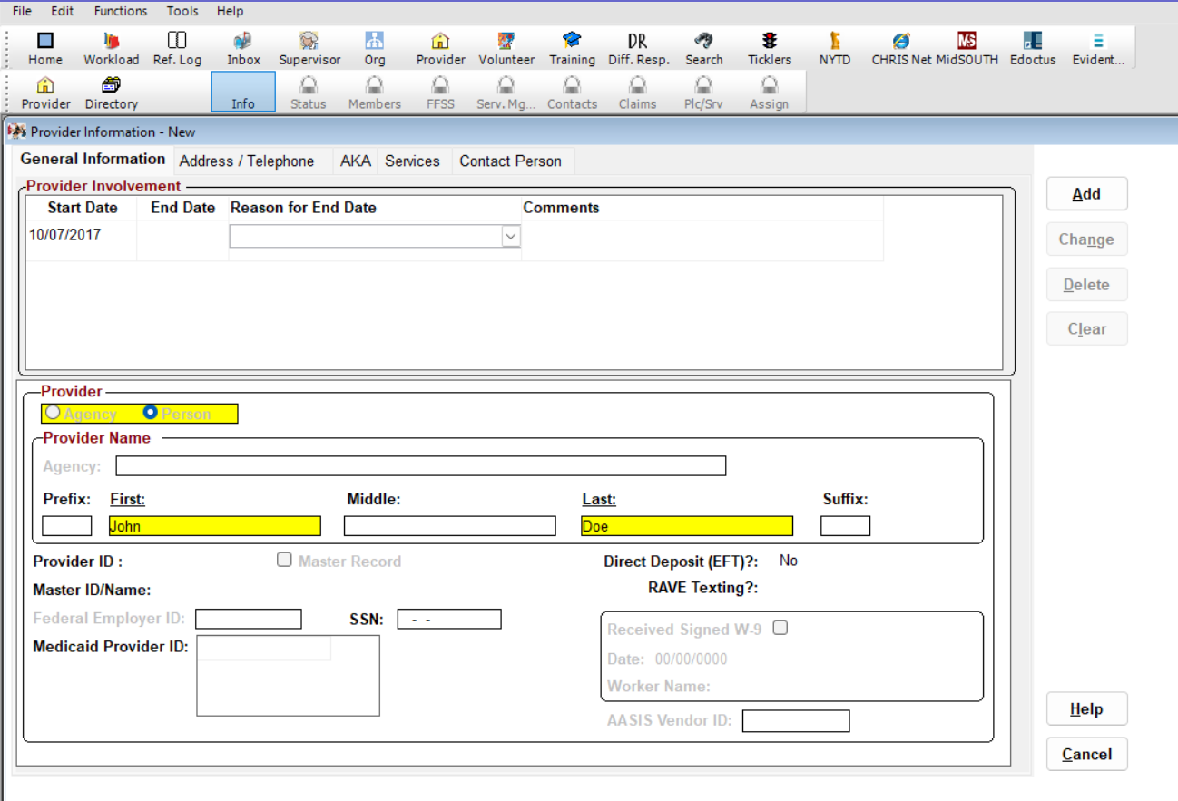
Notes:
ADDING A PROVIDER: GENERAL INFORMATION
Time: 5 Minutes
Purpose: To introduce the first steps for adding a new provider in CHRIS.
Navigation:
Provider > Directory > New
Say:
When a new resource home is identified, the first step is adding the provider in CHRIS. This process begins in the Provider Directory.
Paraphrase:
Start by selecting the radio button for Person; then enter the name of the caregiver identified as the primary contact for the resource home. This is not a formal process, just whoever the usual contact person is.
Then select the Address/Telephone tab to continue.
The AKA and Contact Person screens are rarely used and not required. The Contact Person screen is used for private agencies and other service providers that have a specific individual to contact for their services.
Facilitator Questions:
· What is the first step when adding a new provider in CHRIS?
· Which radio button should be selected on the General Information screen?
· When would the Contact Person screen be used?
Key Points:
· Select the Person radio button.
· Enter the name of the primary contact for the resource home.
· AKA and Contact Person screens are rarely used and not required.
· Proceed to the Address/Telephone tab after entering general information.
(CONTINUE TO THE NEXT SLIDE)

Slide 37
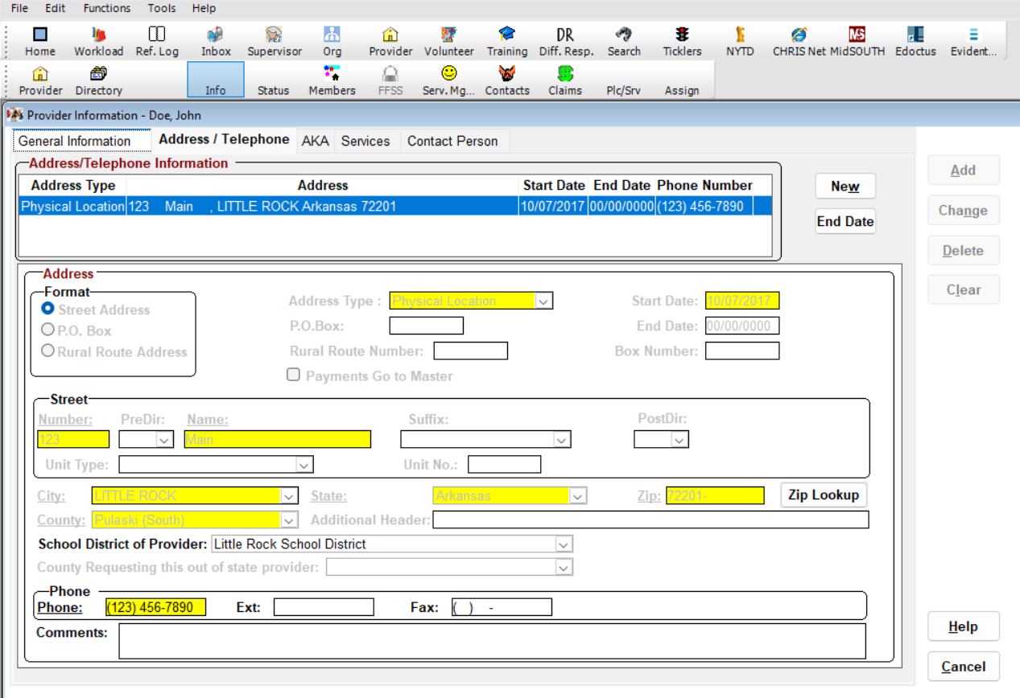
Notes:
ADDING A PROVIDER: GENERAL INFORMATION (CONT.)

Slide 38
SERVICES TAB
Notes:
SERVICES TAB

Slide 39
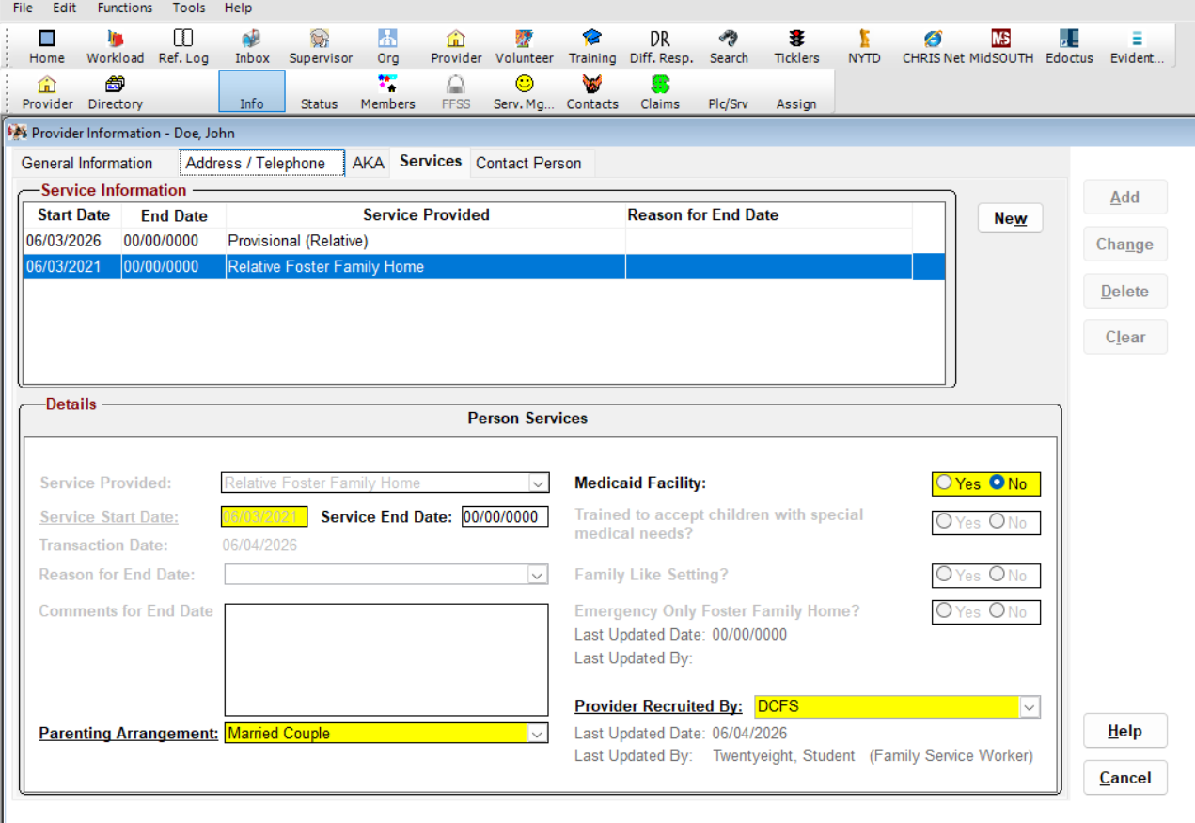
Notes:
SERVICES TAB
Time: 5 Minutes
Purpose: To guide Specialists through entering address information and services for the provider.
Say:
On the Address/Telephone tab, enter the physical address of the resource home and the primary contact's phone number. School district is not a yellow box but is also required. If the home has a different mailing address, such as a PO box, it can also be added at this time by saving the physical address and selecting New to add a second address. If a provider moves to a new location, end the date for the first address and add a new physical address on this screen.
Paraphrase:
The Services screen is where all services for any home are entered. For provisional homes, enter both the appropriate provisional service as well as the appropriate relative or fictive kin foster family home service for the easiest processing. Ensure the service start date is back-dated to the date of the background checks if the background checks were done before the provisional was assessed. Ensure that "No" is selected for Medicaid Facility, and, if required, check that the provider was recruited by DCFS.
Facilitator Questions:
· What services should be entered for a provisional home?
· Why is the service start date back-dated for some provisional homes?
Key Points:
· Enter the physical address, phone number, and school district — school district is required even though it is not a yellow box.
· For provisional homes, enter both the provisional service and the appropriate foster family home service.
· Back-date the service start date to the date of the background checks if applicable.
· Select No for Medicaid Facility.

Slide 40
ASSIGNMENT TO WORKLOAD TAB
Notes:
ASSIGNMENT TO WORKLOAD TAB

Slide 41
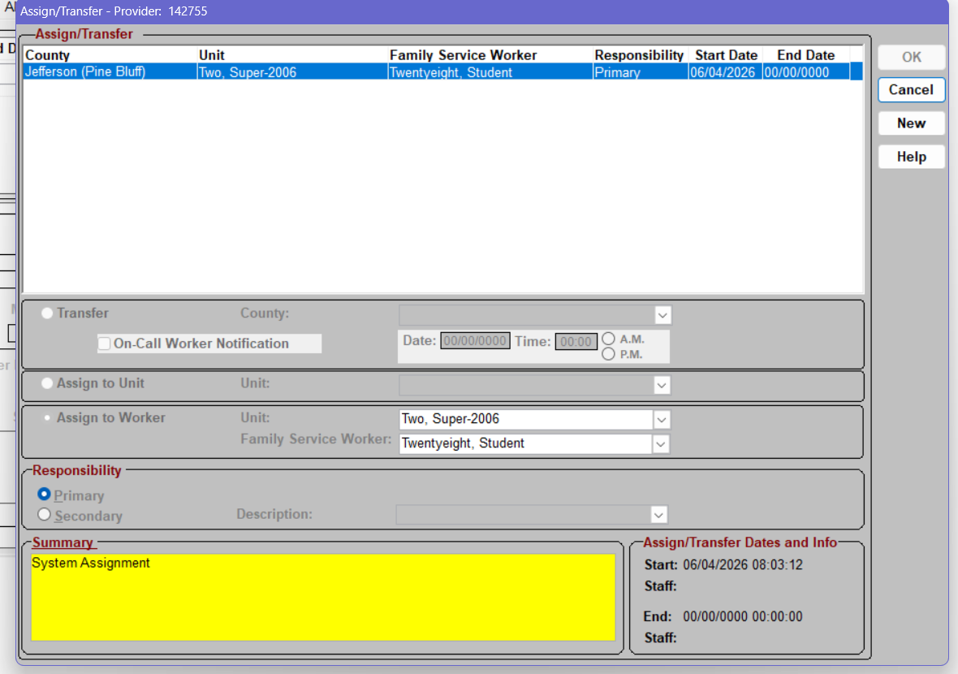
Notes:
ASSIGNMENT TO WORKLOAD
Time: 2 Minutes
Purpose: To explain how a provider is automatically assigned to a specialist's workload in CHRIS.
Paraphrase:
After all required information is completed and the provider is added, the provider is automatically assigned to the specialist who clicks Add.
Key Points:
· Once all required information is entered and the specialist clicks Add, the provider automatically assigns it to that specialist's workload.
· No additional steps are needed to assign the provider; the assignment is automatic.

Slide 42
STATUS TAB
Notes:
STATUS TAB

Slide 43
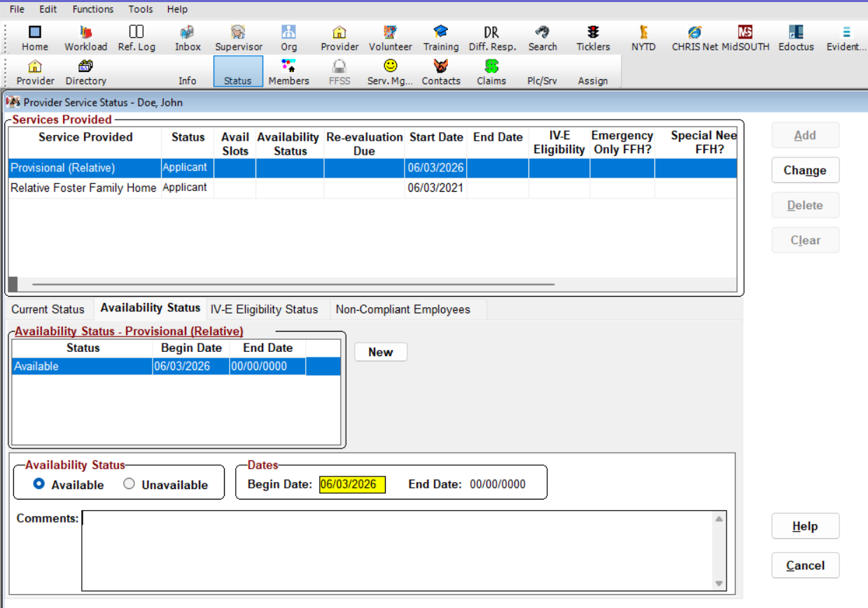
Notes:
STATUS TAB
Time: 2 Minutes
Purpose: To explain how to prepare a service for use by marking it available in CHRIS.
Paraphrase:
To prepare the service to be used; move to the Status tab and ensure that the appropriate services are marked available. If the home has already received a provisional placement; ensure the begin date reflects at least the first date of placement.
Facilitator Questions:
· What must be done on the Status tab before a provisional home can be used for placement?
· What date should be used as the begin date if the home has already received a placement?
Key Points:
· Move to the Status tab and mark appropriate services as available.
· If the home has already received a placement; ensure the begin date reflects at least the first date of placement.

Slide 44
MEMBER SCREENS
Notes:
MEMBER SCREENS

Slide 45
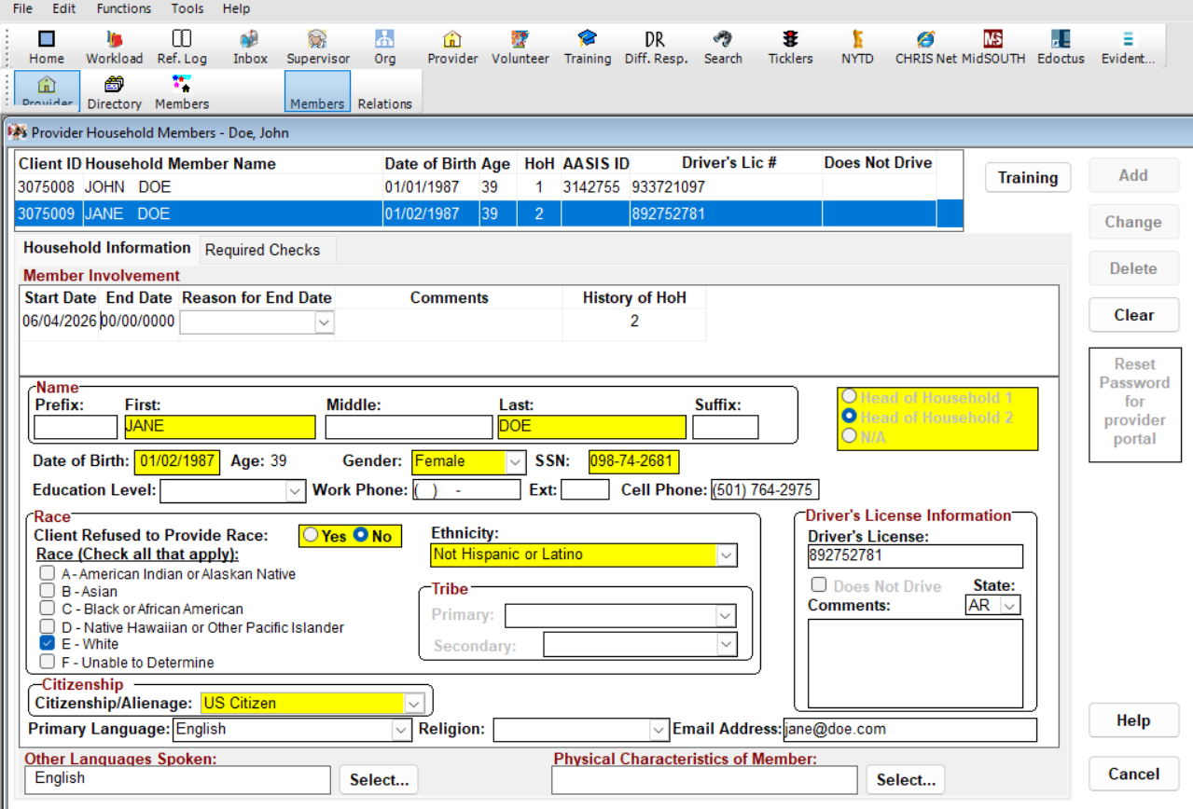
Notes:
MEMBERS
Time: 5 Minutes
Purpose: To guide Specialists through entering household member information in CHRIS.
Paraphrase:
In the Members screen, first enter all required personal information for each household member, including name, date of birth, Social Security number, gender, race and ethnicity, email, phone number, and driver's license number. The individual whose name is entered initially will default to being HOH 1. If there is another adult HOH, they must be manually selected as HOH 2. Any other individual will be N/A.
Facilitator Questions:
· What personal information is required for each household member?
· How is the second head of household designated in CHRIS?
Key Points:
· Enter all required personal information for every household member.
· The first individual entered defaults to HOH 1.
· HOH 2 must be manually selected if there is a second adult head of household.
· All other individuals will be marked N/A.

Slide 46
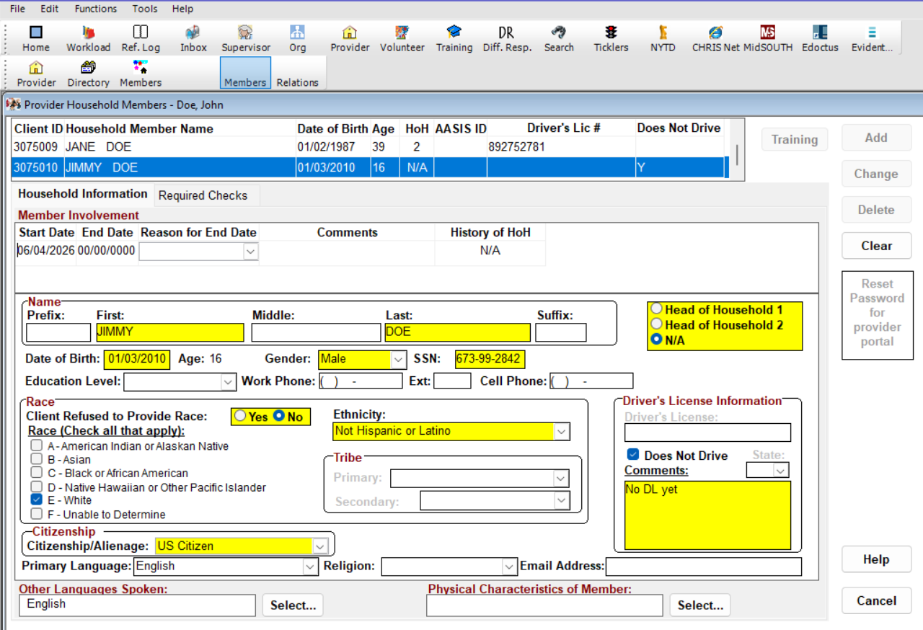
Notes:
MINOR HOUSEHOLD MEMBER
Time: 3 Minutes
Purpose: To explain DMV background check requirements for household members, including minors aged 16 and older.
Paraphrase:
If the household includes any adult or minor age 16 or older, CHRIS will require DMV background checks unless Does Not Drive is selected on this screen. If the individual does not have a driver's license and has never been licensed, select Does Not Drive and enter a comment reflecting that information. If that individual has a license, but it is suspended or otherwise ineligible, add their driver's license information as usual, but document their DMV background check as ineligible on the Required Checks tab.
Facilitator Questions:
· What should be selected if a household member has never been licensed?
· How should a suspended or ineligible license be handled in CHRIS?
Key Points:
· DMV background checks are required for adults and minors age 16 or older.
· Select Does Not Drive and enter a comment if the individual has never been licensed.
· If a license is suspended or ineligible, add the license information but document the DMV check as ineligible on the Required Checks tab.

Slide 47
BACKGROUND CHECKS
Notes:
BACKGROUND CHECKS

Slide 48
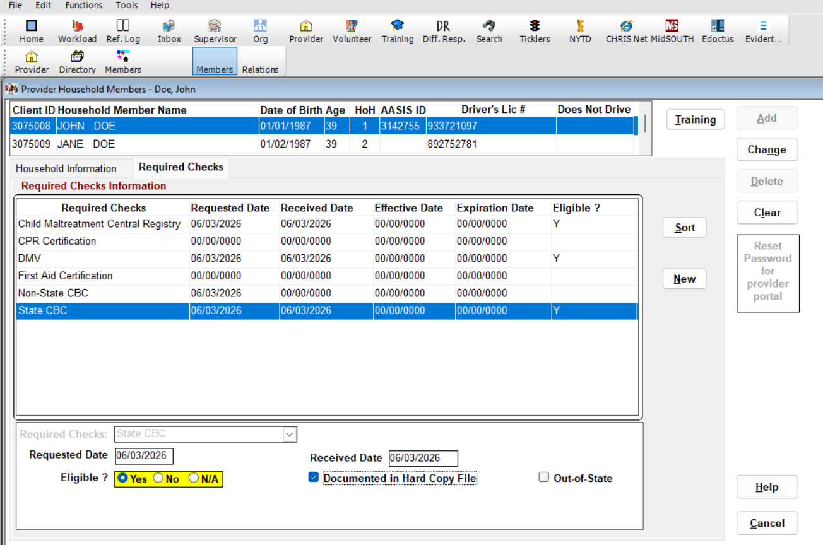
Notes:
BACKGROUND CHECKS
Time: 5 Minutes
Purpose: To explain the background check requirements needed to open a provisional service in CHRIS.
Paraphrase:
Document all background checks in the Required Checks sub-tab of the Member screen. For a provisional service to be opened in CHRIS, at least State CBC, DMV, and Central Registry must be received and marked eligible. If a check is ineligible, it must still be marked eligible on this screen, with the appropriate waiver documented on the PolWai/AC screen in service management. To open any IV-E-eligible service, CPR, First Aid, and Non-State CBC (FBI check) must also be entered, and be eligible for all adults.
Ensure the box Documented in Hard Copy File is checked and that a physical copy of all checks is included in the paper file stored securely. When keying CPR and First Aid, they generally expire two years from the date of issue, so ensure the expiration date is properly keyed.
Facilitator Questions:
· What three background checks are required at a minimum to open a provisional service?
· What should be done if a background check returns ineligible?
Key Points:
· Provisional requires at minimum: State CBC, DMV, and Central Registry, all received and marked eligible.
· If a check is ineligible, mark it eligible in CHRIS and document the waiver in PolWai/AC.
· IV-E services also require CPR, First Aid, and Non-State CBC (FBI check) for all adults.
· Check the Documented in Hard Copy File box and store physical copies securely.
· CPR and First Aid generally expire two years from the date of issue; key the expiration date correctly.

Slide 49
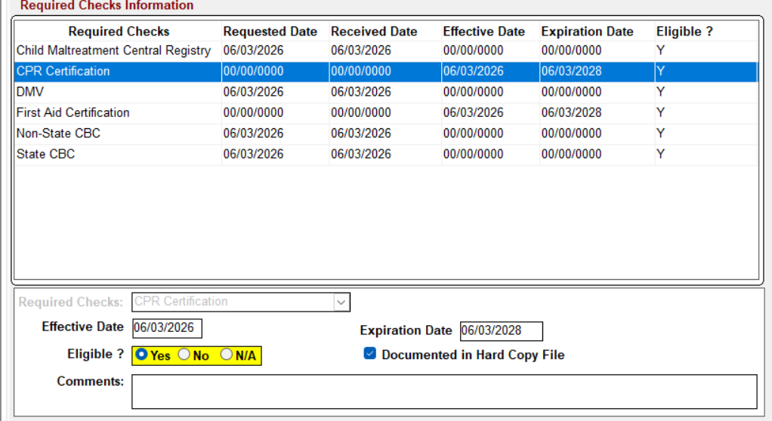
Notes:
BACKGROUND CHECKS: FOR IV-E SERVICE
Time: 3 Minutes
Purpose: To explain background check requirements by age for IV-E eligible services.
Paraphrase:
For minors under 14; no background checks are required. Beginning at age 14; Child Maltreatment Central Registry checks are documented. At age 16; DMV checks should be completed or Does Not Drive should be documented.
Facilitator Questions:
· At what age do background check requirements begin for minors?
· What check is added at age 16?
Key Points:
· Minors under 14: no background checks required.
· Age 14 and older: Child Maltreatment Central Registry check required.
· Age 16 and older: DMV check required or Does Not Drive must be documented.

Slide 50
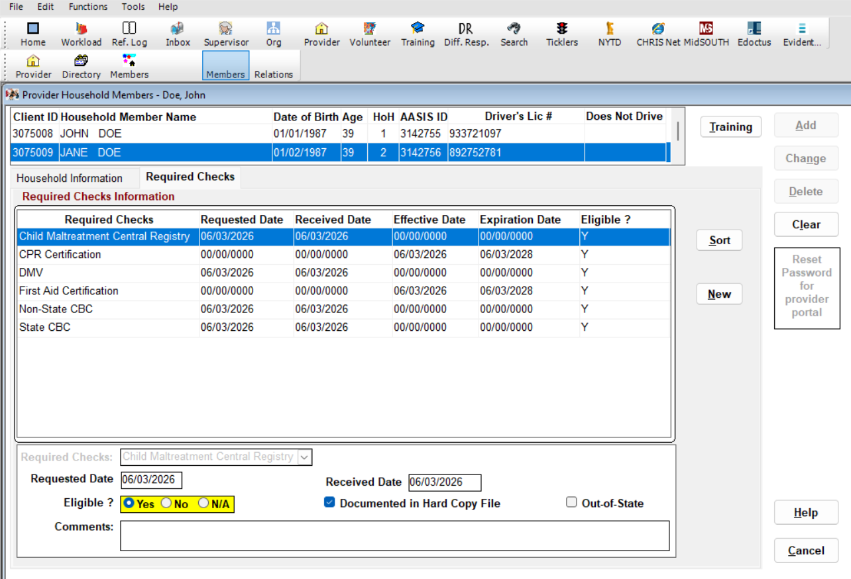
Notes:
BACKGROUND CHECKS: IV-E SERVICES (CONT’D)
Paraphrase:
An IV-E service must have ALL required background checks entered and be eligible for each household member; unlike a provisional, which does not require CPR/First Aid or the Non-State CBC to be received for the service to be approved.
Facilitator Note:
If there are any background check hits, DO NOT include any specifics in the comment boxes, as these boxes are viewable by anyone with CHRIS access, which may constitute a security violation.
Facilitator Questions:
· How do background check requirements differ between a provisional and an IV-E service?
· What should never be entered in the comment boxes when a check returns a hit?
Key Points:
· IV-E service requires ALL background checks to be entered and eligible for each household member.
· Provisional does not require CPR/First Aid or Non-State CBC, IV-E does.
· Never enter background check hit specifics in comment boxes; this may be a security violation.

Slide 51
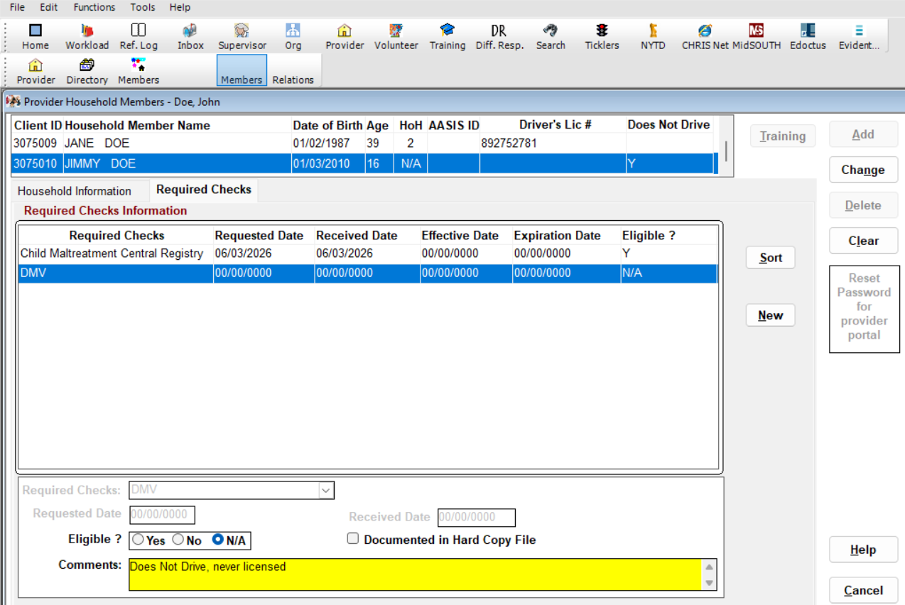
Notes:
MINOR BACKGROUND CHECKS
Time: 3 Minutes
Purpose: To explain how to document background checks for a non-driver minor in CHRIS.
Paraphrase:
For a non-driver minor, the Child Maltreatment Central Registry is still required, but select N/A for the DMV check and note that the teen is not licensed and does not drive. Ensure resource parents keep you informed if their teen gets a driver's license so that the proper DMV check can be done at that time. Once all background checks have been entered for each person, click Change to save them. Click Directory to go back to the provider information screen.
Facilitator Note:
If there are any background check hits, DO NOT include any specifics in the comment boxes, as these boxes are viewable by anyone with CHRIS access, which may constitute a security violation.
Facilitator Questions:
· What should be selected for the DMV check for a non-driver minor?
· Why should specifics never be entered in the comment boxes when a check returns a hit?
Key Points:
· Non-driver minor: Child Maltreatment Central Registry still required; select N/A for DMV.
· Note in comments that the teen is not licensed and does not drive.
· Remind resource parents to notify you when their teen gets a driver's license.
· Click Change to save all background checks; then click Directory to return to the provider screen.
· NEVER enter background check hit specifics in the comment boxes, this may be a security violation.

Slide 52
PROVISIONAL SERVICES SCREENS
Notes:
PROVISIONAL SERVICE SCREENS

Slide 53
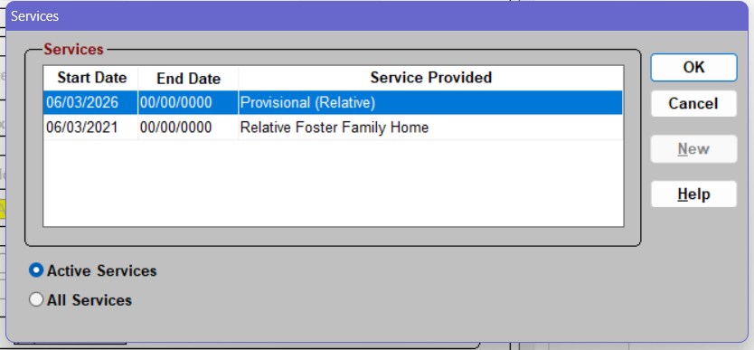
Notes:
PROVISIONAL SERVICE APPROVAL
Time: 3 Minutes
Purpose: To introduce the service management navigation for approving a provisional service.
Navigation:
Serv. Mg. > Provisional Service > OK
Say:
Once all household member information and background checks are entered, the next step is to move through the service management screens to approve the provisional service.

Slide 54
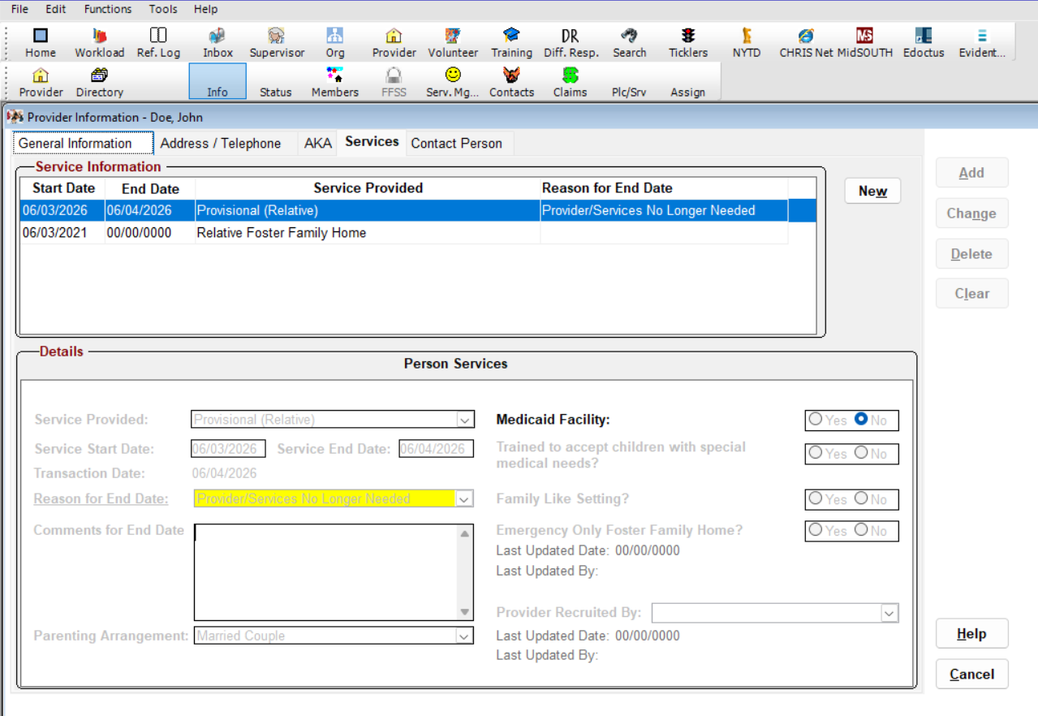
Notes:
PROVISIONAL SERVICE CLOSURE
Time: 3 Minutes
Purpose: To explain how to correctly close a provisional service once a child transitions to an IV-E eligible service.
Navigation:
Info > Services > Provisional (Relative)
Paraphrase:
Once a child is keyed out of the provisional service and into the IV-E service for a provider; the provisional service must be closed. To close a service; go to Info > Services > Provisional (Relative). Enter the date that the service needs to end in the Service End Date box and click Change. This cannot be undone without a CHRIS Support ticket so be sure to do this intentionally. For the Reason for End Date field; Provider/Service No Longer Needed is adequate when moving the child into a different service within the same provider.
This process is the same when closing any service in any provider. When all services are end-dated within a provider, that provider is considered closed and will fall off that specialist's workload. New services can always be opened within the same provider in the future, but the previous services will not be able to be reopened easily without a CHRIS Support ticket.
Facilitator Questions:
· What reason should be used in the Reason for End Date field when closing a provisional after a child moves to an IV-E service within the same provider?
· What happens to a provider's workload assignment when all services are end dated?
· What is required to reopen a previously closed service?
Key Points:
· Navigate to Info > Services > Provisional (Relative).
· Enter the service end date and click Change — this cannot be undone without a CHRIS Support ticket.
· Use Provider/Service No Longer Needed as the reason when transitioning within the same provider.
· When all services are end dated; the provider falls off the specialist's workload.
· New services can be opened in the future, but previous services cannot be easily reopened.

Slide 55
ADMISSION TAB
Notes:
ADMISSION TAB

Slide 56
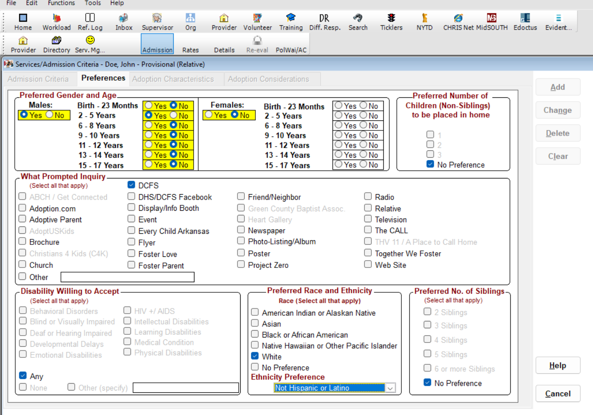
Notes:
ADMISSION TAB
Time: 3 Minutes
Purpose: To guide Specialists through completing the Admission tab for a provisional service.
Paraphrase:
The first screen that opens in the service management screen is the Admissions screen. This is a
child-specific service so Specialists should enter the age and gender that matches the child or children to be placed in the home. Click the DCFS box for the What Prompted Inquiry field and enter the correct number of children and siblings to be placed where it applies.
Facilitator Questions:
· What information is entered on the Admission tab?
· What should be selected in the What Prompted Inquiry field?
Key Points:
· Enter the age and gender matching the child or children to be placed.
· Click the DCFS box for What Prompted Inquiry.
· Enter the correct number of children and siblings to be placed.

Slide 57
DETAILS TAB
Notes:
DETAILS TAB

Slide 58
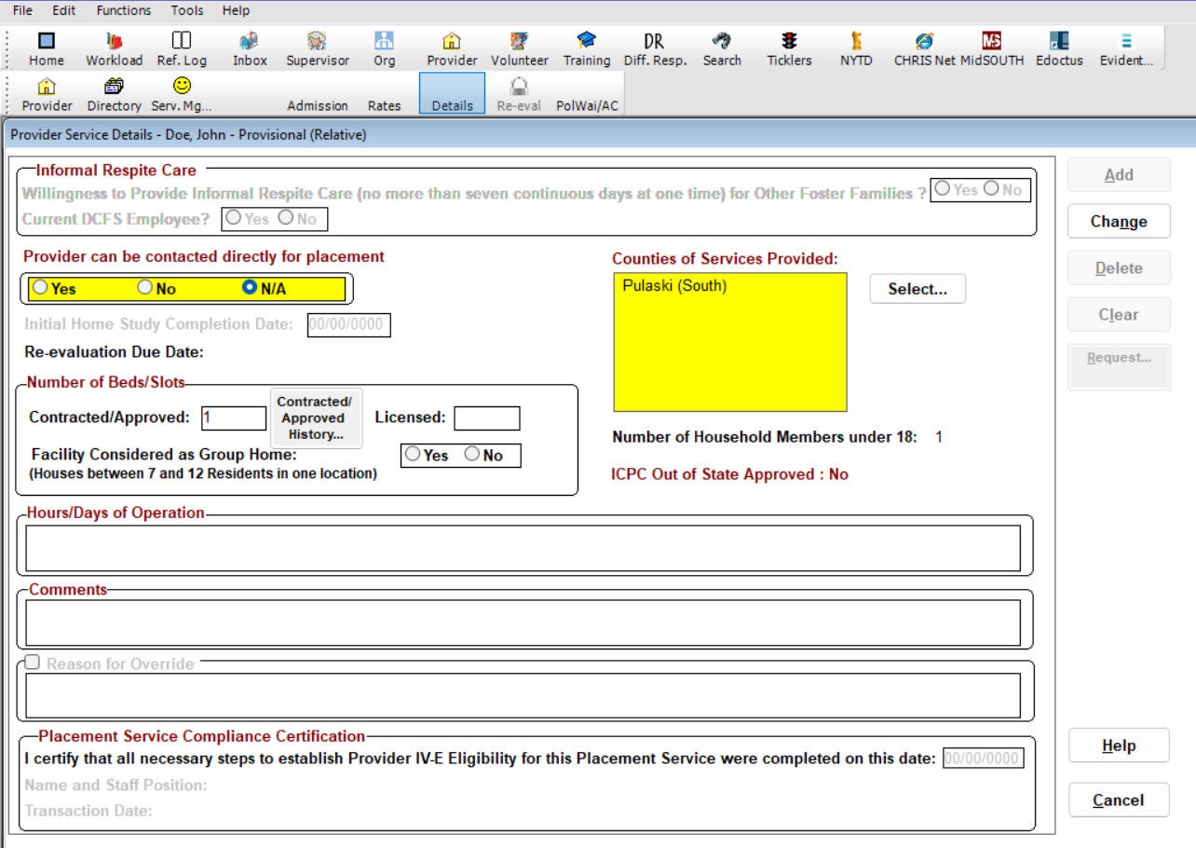
Notes:
DETAILS TAB
Time: 3 Minutes
Purpose: To guide Specialists through completing the Details tab for a provisional service.
Paraphrase:
In this tab; Specialists should select N/A on Provider Can Be Contacted Directly for Placement; enter the correct number of beds in the Contracted/Approved box; and enter the county that the children to be placed were removed from in Counties of Service.
Facilitator Questions:
· What should be selected for Provider Can Be Contacted Directly for Placement?
· What county should be entered in Counties of Service?
Key Points:
· Select N/A for Provider Can Be Contacted Directly for Placement.
· Enter the correct number of beds in the Contracted/Approved box.
· Enter the county the children were removed from in Counties of Service.

Slide 59
POLICY WAIVER SCREENS
Notes:
POLICY WAIVER SCREENS

Slide 60
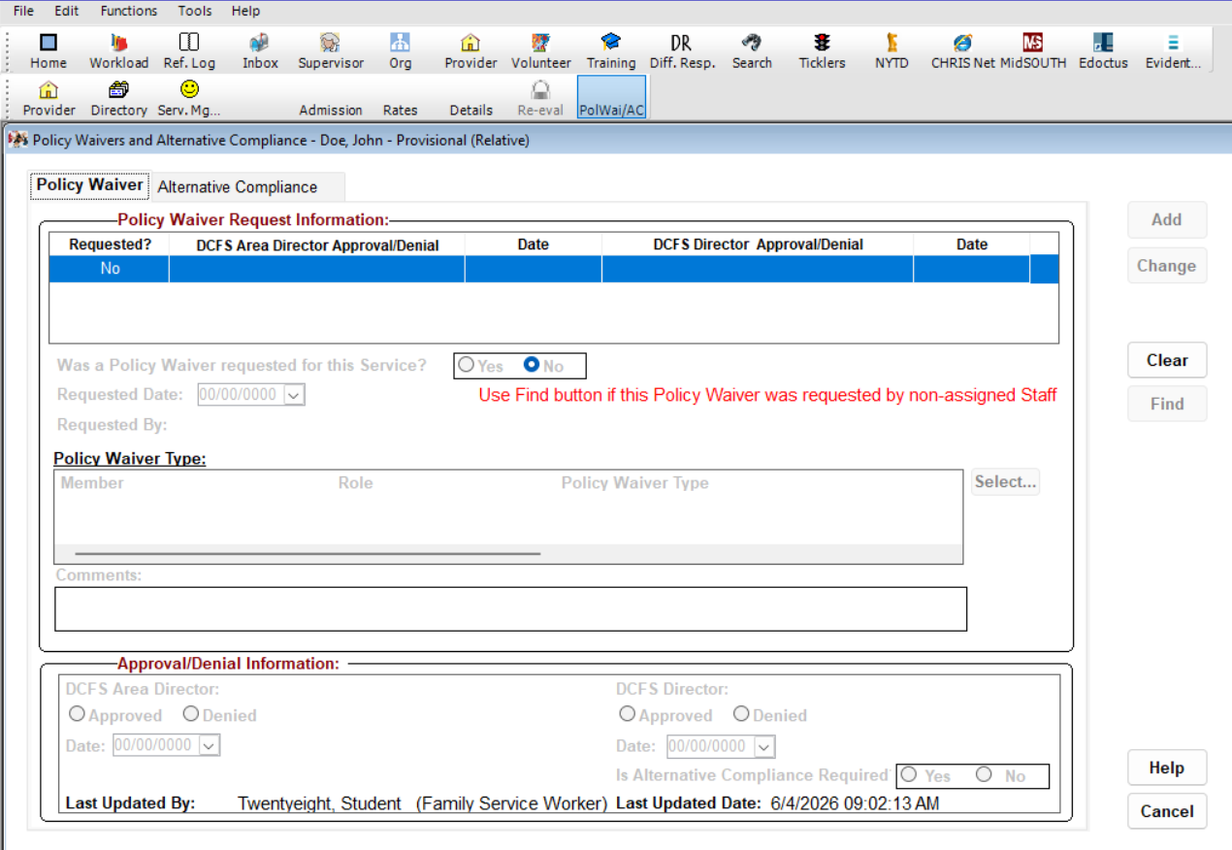
Notes:
POLICY WAIVER SCREENS
Time: 4 Minutes
Purpose: To explain how to complete the Policy Waiver and Alternative Compliance screens for service approval.
Say:
For service approval, both the Policy Waiver and Alternative Compliance screens must be completed. When neither waiver is required, simply select No on these screens. When a waiver is required, enter that information.
(CONTINUE TO THE NEXT SLIDE)

Slide 61
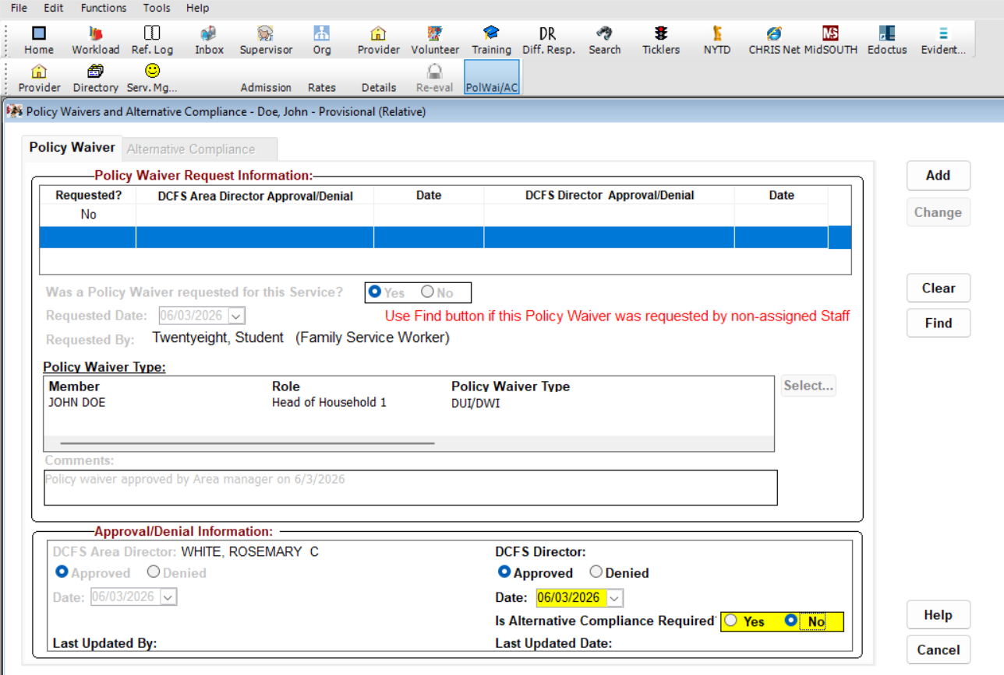
Notes:
POLICY WAIVER SCREEN (CONT’D)
Paraphrase:
Even when a waiver can be approved at the area manager level, CHRIS requires Specialists to indicate that the DCFS Director approved the waiver. In this case, select the Approved radio button and enter the same date that the waiver was approved by the area manager. If an alternative compliance is needed, select Yes. After all these steps are completed, the provisional service is ready for approval.
Facilitator Questions:
· What should be selected on the PolWai/AC screens when no waiver is required?
· What approval level must be entered in CHRIS even when the area manager approves the waiver?
Key Points:
· Complete both the Policy Waiver and Alternative Compliance screens for every service approval.
· When no waiver is required, select No on both screens.
· When a waiver is approved at the area manager level, still enter DCFS Director approval in CHRIS.
· Select the Approved radio button and enter the area manager's approval date.

Slide 62
SUPERVISORY APPROVAL SCREENS
Notes:
SUPERVISORY APPROVAL SCREENS

Slide 63
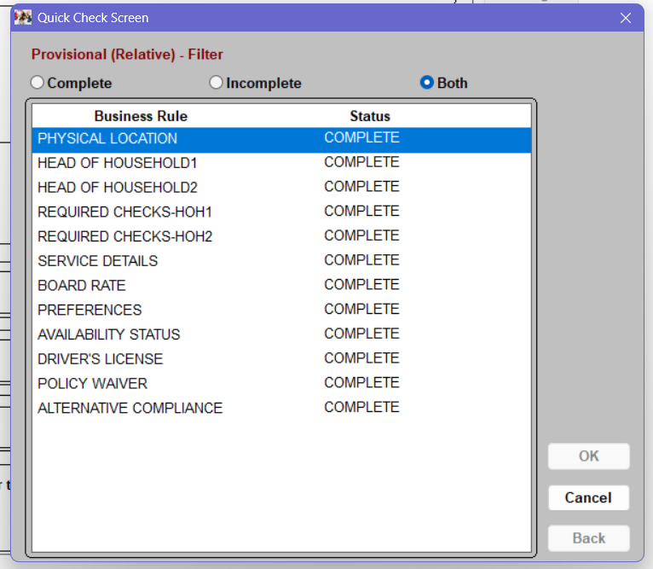
Notes:
SUPERVISORY APPROVAL
Time: 4 Minutes
Purpose: To walk Specialists through requesting supervisory approval for a provisional service.
Paraphrase:
Select the Details tab, click Request, and if all steps have been completed correctly, the provisional service should be ready to go. A checklist will show what items CHRIS is checking for approval. If this list says Complete on each item, click Cancel, and the Supervisor Request tab will pop up.
(CONTINUE TO THE NEXT SLIDE)

Slide 64
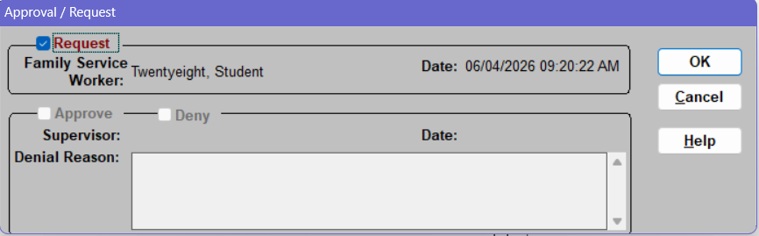
Notes:
SUPERVISORY APPROVAL (CONT’D)
Paraphrase:
Check the box next to Request, then select OK to request your supervisor's approval for the service. Once this service is approved, the child's assigned Social Services Specialist can key the placement in the provisional home. Same-day placements often happen before the provider is entered into CHRIS so it is of the utmost importance that the provisional is keyed open the next business day if possible. Once the IV-E-eligible service is approved, the child must be keyed out of the provisional service and into the IV-E-eligible service so the board payment can begin being paid out of IV-E funds rather than state general revenue.
Facilitator Questions:
· What should you do if the approval checklist shows Complete on each item?
· Why must the provisional be keyed the next business day for same-day placements?
· Why must the child be keyed out of the provisional once the IV-E service is approved?
Key Points:
· Click Request on the Details tab; if all items show Complete, click Cancel, and the Supervisor Request tab appears.
· Check the Request box and click OK to send the approval request to your supervisor.
· Same-day placements must be keyed in CHRIS the next business day if possible.
· Once the IV-E service is approved, key the child out of the provisional and into the IV-E service.

Slide 65
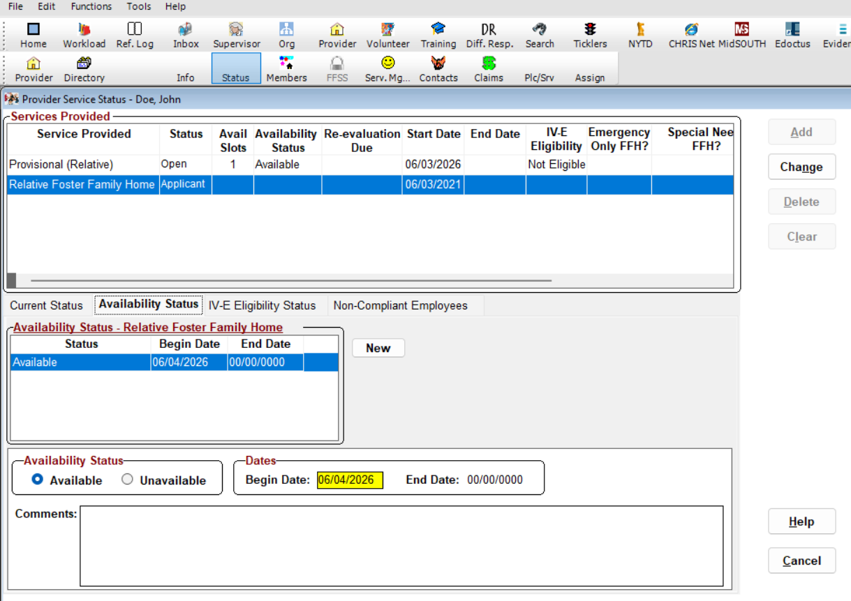
Notes:
IV-E SERVICE APPROVAL
Time: 3 Minutes
Purpose: To introduce the IV-E service approval process and required paper file documents.
Navigation:
(From the provider information screen) Serv. Mg. > Relative Foster Family Home > OK
Say:
To approve a service for an IV-E-eligible service, Relative or Fictive Kin Foster Family Home, Adopt Only, or Foster Family Home, the process is very similar but requires a few additional steps to ensure IV-E eligibility.
Paraphrase:
All documents that are not documented in CHRIS must be placed in the provider's paper file. These include the CFS-446; references; home study; home and auto insurance; physical copies of background checks; CPR and First Aid; home safety plans; and any other required documents indicated on the CFS-475-A. This module covers only the CHRIS opening processes, not the paperwork processes.
Key Points:
· Navigate from the provider information screen: Serv. Mg. > Relative Foster Family Home > OK.
· All documents not in CHRIS must be in the provider's paper file: CFS-446; references; home study; insurance; background checks; CPR/First Aid; home safety plans; CFS-475-A.
· This module covers CHRIS processes only, not the paperwork processes.

Slide 66
TRAINING HOURS SCREENS
Notes:
TRAINING HOURS SCREENS

Slide 67
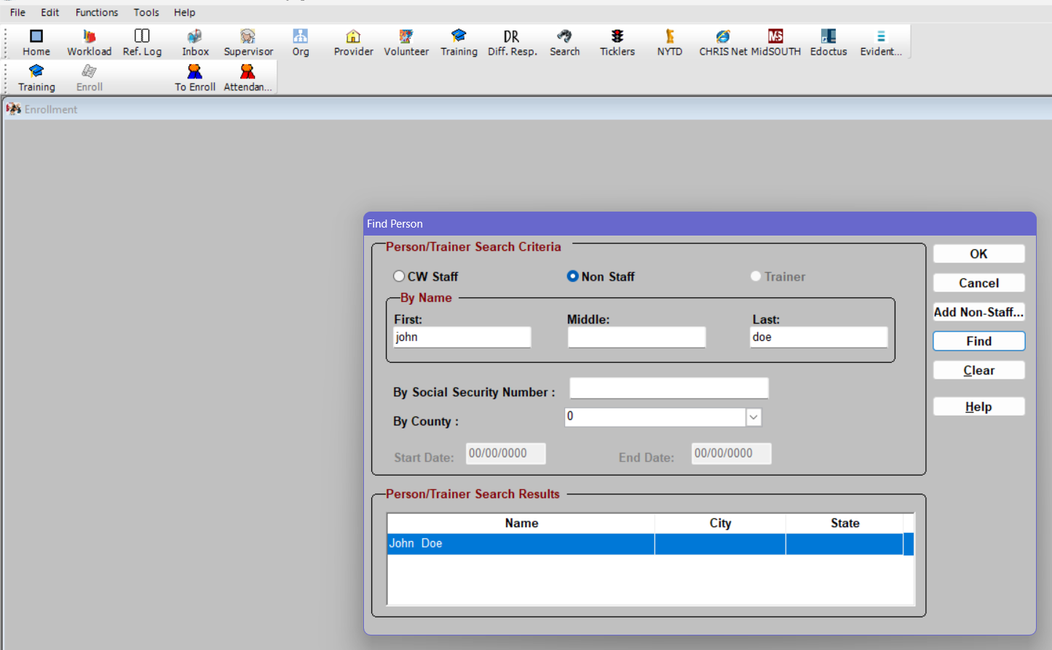
Notes:
TRAINING HOURS
Time: 4 Minutes
Purpose: To explain how training hours are entered and verified in CHRIS for IV-E eligible services.
Paraphrase:
Usually, training hours are automatically entered into CHRIS when the resource parent completes training with MidSOUTH. In the event that they do not, follow these steps:
Navigation:
Home > Training > Enroll > Attendance
Search for your provider by name or SSN, select Find, click the correct individual, then click OK.
(CONTINUE TO THE NEXT SLIDE)

Slide 68
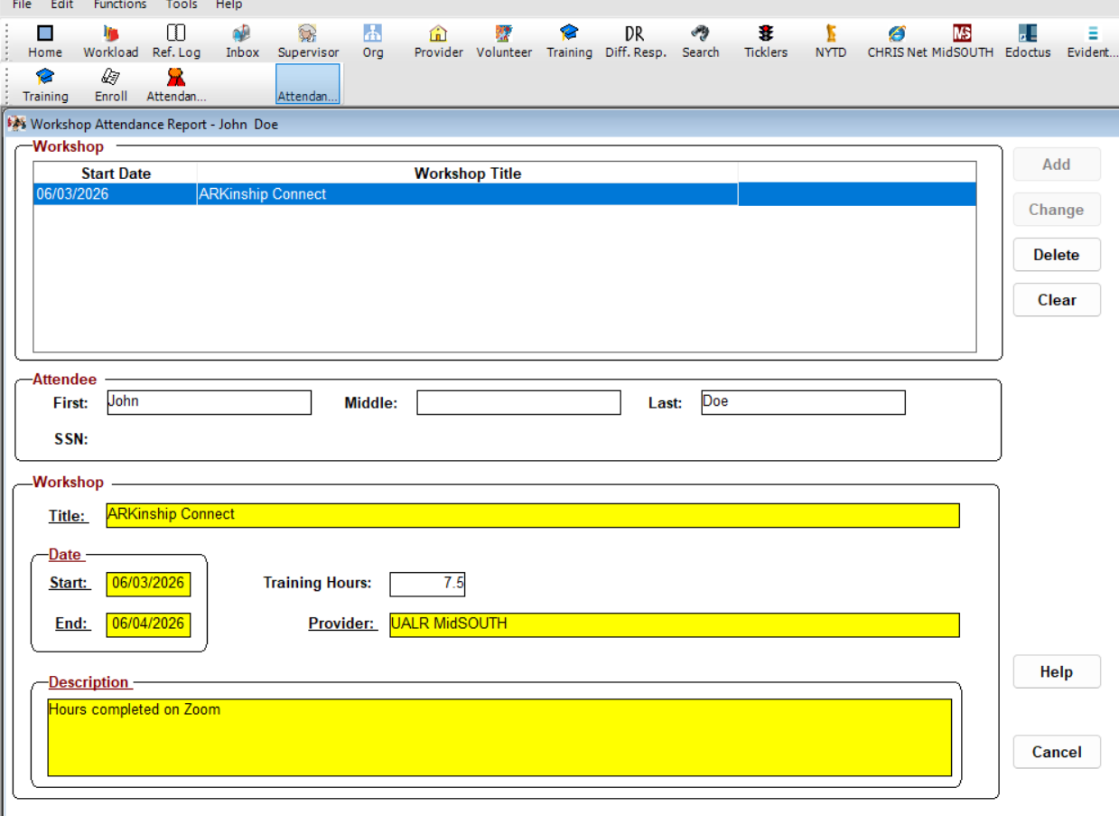
Notes:
TRAINING HOURS (CONT’D)
Paraphrase:
Enter the provider's completed hours as indicated on their training certificate. Different services have different training requirements, so ensure the hours are entered exactly as the certificate says when entering a provider's hours manually.
(CONTINUE TO THE NEXT SLIDE)

Slide 69
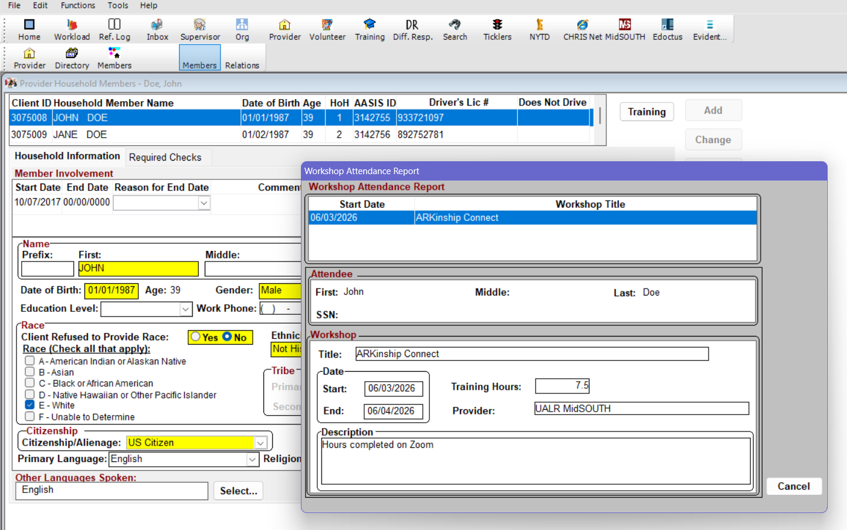
Notes:
TRAINING HOURS (CONT’D)
Paraphrase:
Specialists can confirm that their household members have completed the required number of hours by clicking the Training button on the Members screen. If the correct training is in this screen, the previous steps are not needed.
Facilitator Questions:
· How can Specialists confirm that a resource parent's training hours have been entered correctly?
· What navigation path is used to manually enter training hours?
Key Points:
· Training hours are usually entered automatically when MidSOUTH training is completed.
· If not automatic, navigate to Home > Training > Enroll > Attendance.
· Search by name or SSN; click Find; select the individual; click OK.
· Enter hours exactly as shown on the training certificate.
· Verify hours by clicking the Training button in the Members screen.

Slide 70
DETAILS SCREEN
Notes:
DETAILS SCREEN

Slide 71
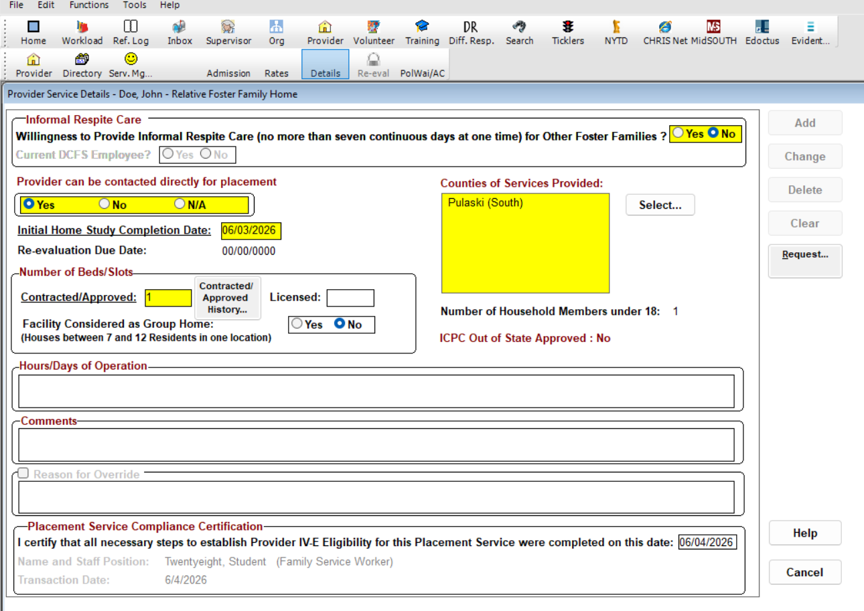
Notes:
DETAILS: IV-E SERVICE
Time: 4 Minutes
Purpose: To walk Specialists through the IV-E service approval screens and the Details tab requirements.
Paraphrase:
This process is generally the same for all IV-E eligible services. Enter the preferences for the home reflecting the child or children to be placed. In a traditional home, these preferences will come from the CFS-409 Resource Family Preference Checklist completed by the resource home. The PolWai/AC screen should be completed in the same way as it is completed for provisionals.
Details Screen
The Details screen for an IV-E service is similar to a provisional but the Willingness to Provide Informal Respite Care box is now required and the Placement Service Compliance Certification must be entered at the bottom. This is the date that the home completed all steps to become IV-E eligible.
For kinship homes, the County of Service will still be the county of removal for the children. Traditional homes will generally be available statewide. Traditional homes must also decide whether to provide respite. Kinship homes are not available to provide respite because they are child-specific services.
Once these steps are complete, specialists can click Approve to open the same approval checklist seen with the provisional service and request approval from their supervisor. Once approved, the children must be keyed out of the provisional service and into the Relative Foster Family Home service to ensure their board payments are paid from IV-E funds.
Facilitator Questions:
· What two fields are required on the IV-E Details tab that are not required on the provisional Details tab?
· Why are kinship homes not available to provide respite?
Key Points:
· Willingness to Provide Informal Respite Care is required on the Details tab for IV-E services.
· Enter the Placement Service Compliance Certification date — the date of the final walkthrough.
· Kinship homes are child-specific and not available to provide respite.
· Traditional homes are generally available statewide and must indicate respite preference.
· Once approved, key children out of the provisional and into the IV-E service.

Slide 72
CHRIS LAB WRAP UP
Notes:
CHRIS LAB WRAP UP
Time: 5 Minutes
Purpose: Participants will demonstrate understanding of the CHRIS navigation steps for adding providers, documenting background checks, approving services, and closing provisional placements.
Facilitator Questions:
· What is the navigation path to begin adding a new provider in CHRIS?
· What three background checks are required at a minimum to open a provisional service?
· What additional checks are required to open an IV-E eligible service?
· What should you do if a background check returns a hit?
· What two additional fields are required on the Details tab for IV-E services that are not required for provisionals?
· What happens to a provider's workload assignment when all services are end-dated?
Facilitator Answers:
· Provider > Directory > New.
· State CBC, DMV, and Central Registry must be received and marked eligible.
· CPR, First Aid, and Non-State CBC (FBI check) must also be entered and be eligible for all adults.
· Mark the check eligible in CHRIS; document the appropriate waiver in the PolWai/AC screen; and do NOT enter specifics in the comment boxes as they are viewable by anyone with CHRIS access.
· Willingness to Provide Informal Respite Care and Placement Service Compliance Certification date.
· When all services are end-dated, the provider falls off the specialist's workload.
Say:
Throughout this section, we covered the full sequence for adding a provider in CHRIS — from entering general information and household members, to documenting background checks, approving provisional and IV-E eligible services, and closing out the provisional once a child transitions. Each step in this process is connected to IV-E compliance, accurate board payments, and the overall integrity of the child's case record. As you continue to gain experience, this navigation sequence will become more familiar — but the importance of accuracy and timeliness will always remain the same.

Slide 73

Target Outcomes Evaluation
Notes:
TARGET OUTCOMES EVALUATION
Time: 2 Minutes
Purpose: To assess the learning outcomes for this training day
Facilitator Note: Before ending the day, instruct participants on the QR code on the slide. Participants will need to use their phones to scan the code to complete the section target outcomes evaluation in Qualtrics.

