Slide 1
Foundations Unit 2 Day 1 Arkansas Practice Model: Safety Organized Practice Overview
Revised 4/2025

Slide 2
Notes:
Introductions:
Name
County
Field trainer
Supervisor
Unit (e.g., investigations, protective services, foster care, resource)

Slide 3
Name
County
Field trainer
Supervisor
Unit (e.g., investigations, protective services, foster care, resource)
Introductions

Slide 4
Accessing Online Trainings and Resources:
MidSOUTH Training Academy Website
Student Name

Slide 5
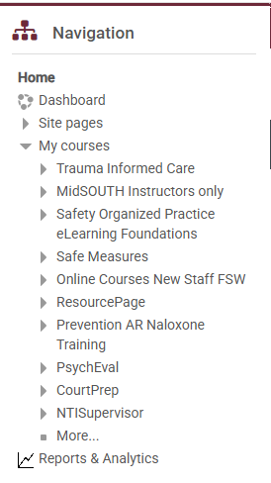
MidSOUTH Online Training Resources
Student Name
Did you know?
Online training handouts for each are located in Moodle under Resource Page
Make sure to save and revisit these handouts as needed!

Slide 6
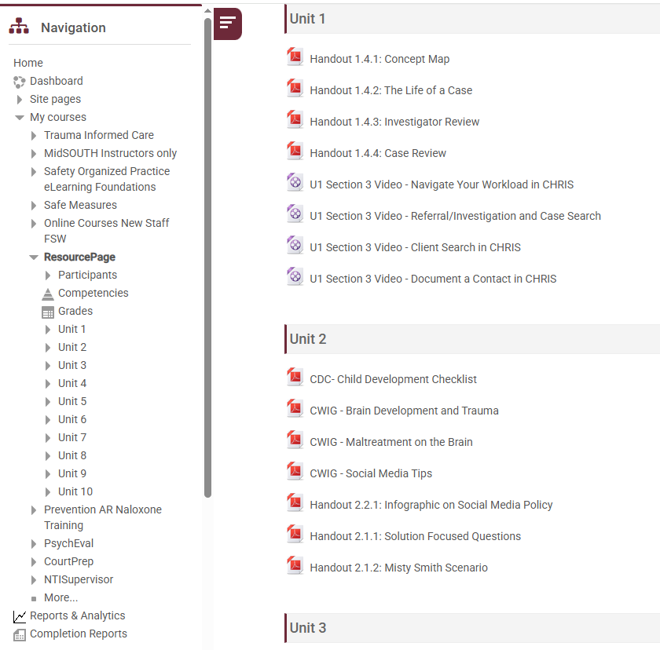
Click on Resource Page and then the Unit for more drop downs…

Slide 7
Other Training Resources
Student Name
REMEMBER:
In Unit 1 online training you learned about other online courses available on the MidSOUTH online training website
These are incredible resources on a variety of topics available as additional tools in your FSW toolkit!

Slide 8
Classroom Schedule:
Units 2 - 5 Online: 2 hrs each
Units 2 - 5 Classroom: 18 hours each
Unit 6 Online: 4 hours
Unit 6 Classroom: 12 hours
Weekly Overview of Training Model:
Week 1: Unit 2: Foundational Practice Values for Child Welfare Professionals
Week 2: Unit 3: Dynamics of Child Maltreatment - Identification and Legal Issues
Week 3: No Classroom - OJT Week
Week 4: Unit 4: Assessment Strategies and Preparing for On-call Duties
Week 5: No Classroom - OJT Week
Week 6: Unit 5 & Unit 6: Engaging Families & Recruitment, Retention, Resource/Adoption
FOUNDATIONS TRAINING SCHEDULE:
84 HOURS TOTAL

Slide 9
Complete prior to attending Concentrations
Unit 7 (Online)
Complete online trainings as you attend each concentration
Investigations Concentration
In-Home Concentration
Out-of-Home Concentration
Classroom Sessions (5 days each):
Investigations Concentration
In-Home Concentration
Out-of-Home Concentration
CONCENTRATIONS
TRAINING SCHEDULE:
30 HOURS EACH

Slide 10
Shared Agreements
What will help you to be fully present?
How do we want to work together throughout Foundations Training?

Slide 11
Share the Floor
Disagree respectfully
Listen and Engage
Sidebar Conversations
Confidentiality Limitations
Addressing Triggers/Activators
Embrace Ambiguity in the Learning Process
Silence Technology
Time-Keeper
Brain Breaks
Parking Lot
Shared Agreements

Slide 12
Guidelines for Effective Communication
“Try on”
Notice both process and content
Okay to disagree;
not okay to blame, shame,
or attack ourselves or others
Practice “both/and” thinking
Confidentiality
Practice “self-focus” and use “I” statements
Be aware of intent and impact
Source: Used in part: from Visions Inc. & Evident Change

Slide 13
Personal Learning
What specifically is going well with your job? What are some useful things you’ve learned so far? | What specifically are you worried about? | What needs to happen in training?
Activity
Flip Chart
0
10
On a scale of 0 through 10, where 0 is “I don’t feel like I know how to do my current job at all” and 10 is “I feel confident about all aspects of my current job,” where would you put yourself?
What do you think it would take bring this score up by one?
Notes:
Note the one thing you have learned since starting your job that you have found most useful.
On a scale of 0 through 10, where 0 is “I don’t feel like I know how to do my current job at all” and 10 is “I feel confident about all aspects of my current job,” where would you put yourself?
What do you think it would take bring this score up by one?
What, specifically, are you worried about?
What, specifically, is going well?
What needs to happen in training? (What are your learning goals?)

Slide 15
What is your “Why?”
Notes:
Quickwrite

Slide 16
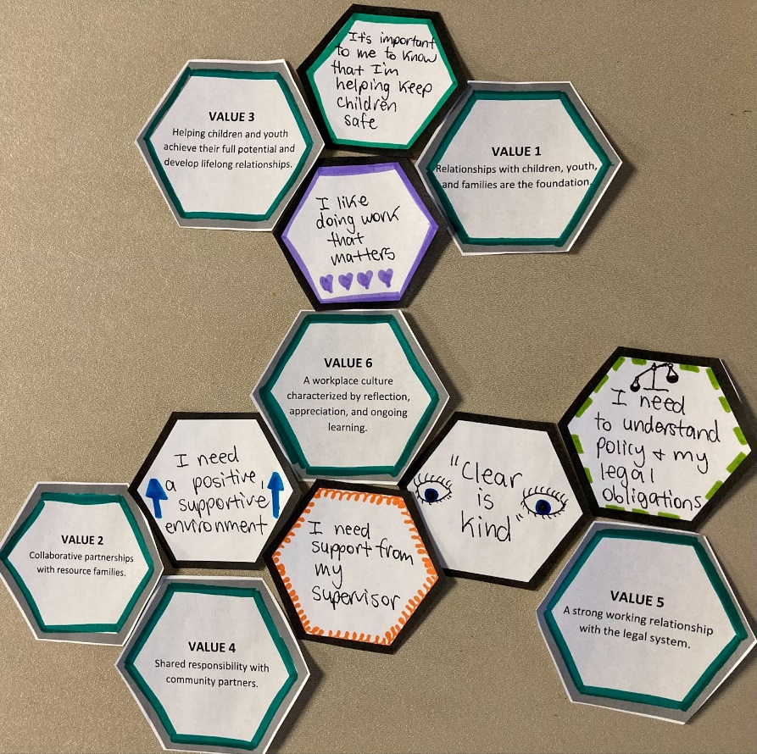
Hexagonal Thinking: Instructions
Start making connections between the hexagons you wrote on, the Practice Model value ones, and the DCFS Mission.
Arrange the hexagons by connecting the sides where there is some kind of commonality of ideas, with the understanding that there are likely several combinations you could make. The goal is to have all the hexagons touching at least one other side, and every point that is touching should have some sort of connection or relationship that you can explain.
Once each of the hexagons has a place, tape the whole thing together.

Slide 18
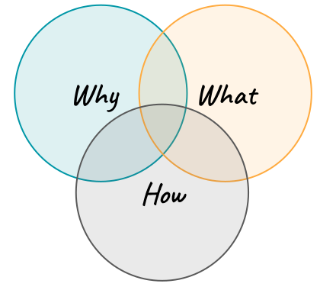
Mission: The “Why” - Tells us why we do what we do. Practice Model/Values: The “What” - Tell us what we need to do in order to fulfill the Mission. Safety Organized Practice: The “How” - Provides us with tools and techniques to use every day to ensure the safety of children.

Slide 19
Mission, Model, and Practice Values:
Practice Scenario: Sierra, Leon, and Brianna
Read and analyze the case scenario in the Participant Manual
In your group, discuss, debate, and record answers to the questions your group is assigned.
Make notes of any conflicting answers or varying opinions.
Elect a spokesperson to share your findings with the large group.

Slide 20
Practice With an Arkansas Practice Model Scenario

Slide 21
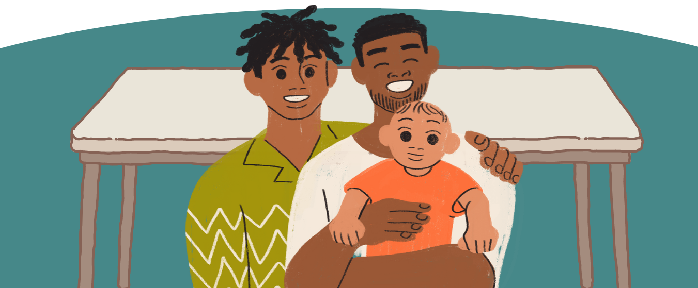
At One Table: A framework for guiding child welfare practice
This new practice model was developed by Arkansas DCFS with the intention of keeping relationships as the foundation of our work.
The idea of sitting together “at one table” is meant to evoke the feeling of a close-knit family solving problems together at a kitchen table.
It symbolizes bringing the family and network to the table to complete our daily work.

Slide 23
DCFS Mission Statement
Our mission is to keep children safe and help families. DCFS will respectfully engage families and youth and use community-based services and supports to assist parents in successfully caring for their children. We will focus on the safety, permanency, and well-being for all children and youth.

Slide 25
What is Structured Decision Making:

Slide 26
Notes:
This portion of the training is specifically designed to orient participants to the Family Case Plan tool assessment, one of the Ongoing Tools currently in use by DCFS. Before delving too deeply into the Family Case Plan Tool, we need to take a step back and look at the foundational concepts of the SDM SYSTEM and how assessments occur within the framework of DCFS's work.
The SDM SYSTEM is a decision support system informed by research, policy, and best practices.
The SDM model is a comprehensive case management framework for child protection that uses a series of assessments to help FSWs assess families and make critical decisions throughout the life of a child protection case. The assessments themselves are just one component of the SDM model. The SDM system’s assessments and tools integrate and blend together effectively with good social work practices to allow the assessment and decision-making processes to occur in partnership with families.
SDM SYSTEM 6 KEY CONCEPTS
The SDM system focuses on 6 key concepts:
• Decision- Key clear, concise, and intentional decision points.
• Support- Assessments are structured to SUPPORT decision-making, but they do not make the decisions. The FSW makes the most informed decision based on the information gathered.
• System—All assessments fit together, each with a different functionality and purpose. It is important to fully understand each assessment in order to get the best results from it.
• Research- It is important to include all emerging research and evidence in the work.
• Policy- The SDM tools are tailored to individual state jurisdictions, based on legal and agency considerations.
• Best Practices- Assessments Support FSWs in understanding the most effective practices and strategies in the social services field.

Slide 27
What is Safety Organized Practice

Slide 28
DCFS Priorities
Safely stabilize and preserve families; and if that is not possible…
Safely care for children and quickly reunify children to their families of origin. If children must be removed from the home, relative and fictive kin caregivers will be considered immediately and throughout the entire engagement with the family; and if reunification is not possible…
Safely support the permanency, well-being, and development of culturally safe lifelong relationships for children and youth.

Slide 29
Three Goals of the SOP Approach
Develop good working relationships that lead to a shared focus among all stakeholders, including the child, family, kin, caseworker, supervisor, and extended community.
Use critical thinking and decision-support tools to enhance consistency, validity, and equity in the key case decisions that child welfare practitioners have to make every day.
Build collaborative plans to enhance daily child safety.

Slide 31
Worry Scaling Question
How worried do you feel? Stand in the spot of the room that best represents your rating.
0
10
Not worried
Very worried

Slide 32
Tier 1 - Assessments:
C+B+I
Important note:
C+B+I formula =
Harm/Danger or Safety
Rigorous, Balanced Assessment

Slide 33
Introduction to SOP Tools
Notes:
Quickwrite

Slide 34
Permanency
Reassessment & Planning
Family Planning
Safety & Supports
Well=Being
SOP Toolkit
Rigorous & Balanced Assessment
Safety

Slide 35
Tier 1 – Rigorous and Balanced Assessments
Hotline Assessment
SDM Safety Assessment (14 Safety Threats)
SDM Risk Assessment
C+B+I and the Rule of Three
Harm, Worry, & Goal Statements
Permanency
Well-Being
SDM® System at Each Decision Point
Rigorous & Balanced
Assessment
Safety

Slide 36
Tier 2 - SOP Toolkit
Three Questions
Three Column Map
Solution Focused Questions
Three Houses
The Safety House
Circles of Safety and Support
Support Network Grid
Genogram
Ecomap
Permanency
Well-Being
SOP Toolkit
Safety

Slide 37
Tier 3 - Safety & Supports
Permanency
Immediate Safety Plan
SMART Goals
Family Time Planning and Reflection
Sibling Time and Placement Plan
Safety & Supports
Well-Being
Safety

Slide 38
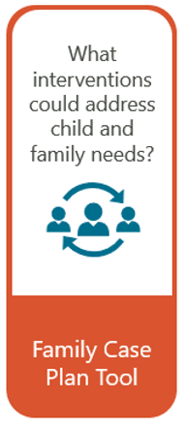
Tier 4 - Family Planning
Family Case Plan Tool
Family Case Plan Including:
Sibling time and placement plan
Family time plan
Transition plan
Aftercare plan
Transitional youth services
CAP Framework
Permanency
Family Planning
Well-Being
SDM® System at Each Decision Point
Safety

Slide 39
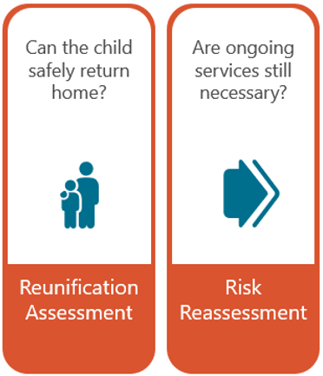
Tier 5 – Reassessment & Planning
Reassessment & Planning
Permanency
Risk Reassessment Tool
Reunification Tool
Transition Plan
Aftercare Plan
Transitional Youth Services
Well-Being
SDM® System at Each Decision Point
Safety

Slide 40
REMEMBER:
Tools don’t make decisions, people do!

Slide 41
Introduction to SOP Tools
The Three Questions & the Three Column Map
C+B+I and the Rule of Three
Harm, Worry, and Goal Statements

Slide 42
Tier 1 – Three Questions & the Three Column Map
Three-Column Mapping Using the Three Questions
What are we worried about? | What is working well? | What needs to happen next?
0
10
Unsafe
(Child cannot be home)
Very Safe
(Close case)
Rigorous, Balanced Assessment

Slide 43
“People support what they create.”
- Margaret Wheatley
Rigorous, Balanced Assessment

Slide 44
ACTIVITY: Harm, Worry, & Goal Statements
Readings for each group:
Harm Statements
Worry Statements
Goal Statements
Each group teach back poster should include:
The name of the tool
A definition/purpose of the tool
Some kind of visual (if available)
An example of when the tool would be useful in your work

Slide 45
Tier 1 - Assessments
Harm, Worry, & Goal Statements
Harm Statements
Worry Statements
Goal Statements
SMART Goals = Behaviorally Specific

