Slide 1
TRIPS made EZ!
humanservices.arkansas.gov

Slide 2
Division of Children & Family Services
Before you leave for Training
Go out and reserve a state vehicle.
humanservices.arkansas.gov

Slide 3
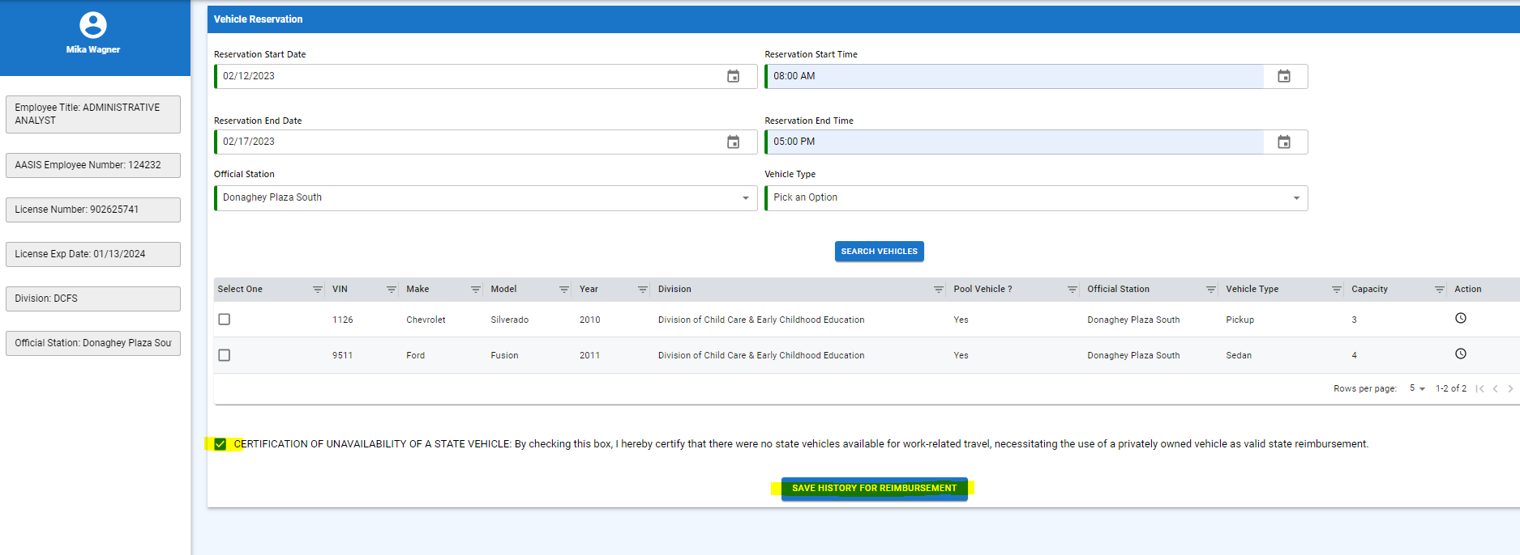
Division of Children & Family Services
Before you leave for Training
Make sure you check this box and Save History for Reimbursement, if you do not reserve a vehicle!
humanservices.arkansas.gov

Slide 4
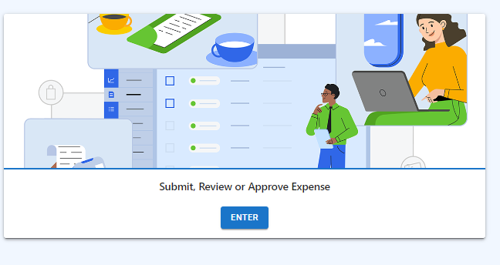
Division of Children & Family Services
Before you leave for Training
If traveling Sunday
Fill out any Pre-Approval
humanservices.arkansas.gov

Slide 5
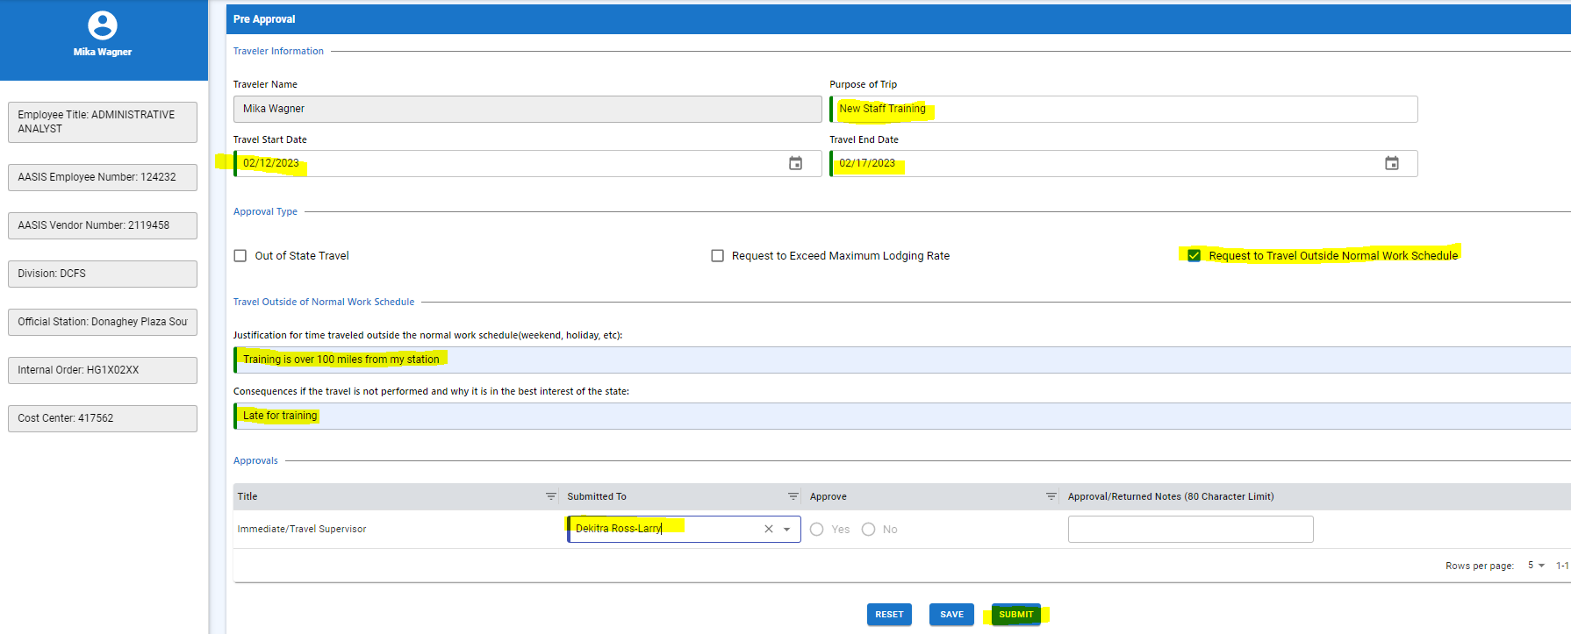
Division of Children & Family Services
Before you leave for Training
This will be sent to your supervisor for approval and stored in TRIPS system
humanservices.arkansas.gov

Slide 6
Division of Children & Family Services
Helpful Hints
Submit all New Staff Training travel reimbursements request to PDU Training Coordinator not your direct supervisor
Submit no later than 30 days after travel.
Please put the entire week of training under one entry in TRIPS
Reason for Expense should be “GENERAL BUSINESS” not “Training/Conference”
Training Travel Requires that you submit a copy of the Certificate of Completion or Agenda
humanservices.arkansas.gov

Slide 7
Division of Children & Family Services
Helpful Hints
If you stay in a Hotel while in training, you must fill out a TRIPS entry and include it under lodging with a signed copy of the Hotel FOLIO.
All Lodging should be keyed as “Direct Bill” unless you are told otherwise
humanservices.arkansas.gov

Slide 8
Division of Children & Family Services
Helpful Hints
When you stay overnight(Hotel) you can be reimbursed for your meals at a Per Diem Rate of
Breakfast $13.00, Lunch $15.00, and Dinner $26.00 including tax and tip
All Receipts must be for your meal only.
All Receipts must be an itemized Receipt.
If you choose to drink alcoholic beverage you must put this on a receipt by itself and not on the receipt, you turn in for reimbursement.
humanservices.arkansas.gov

Slide 9
Division of Children & Family Services
Helpful Hints
You can find the complete travel policy in the DHS Administrative Procedures Manual, Chapter 304.
The DCFS Internal Procedure 110 is also posted online on CHRISNET and explains all the DCFS policy for travel.
humanservices.arkansas.gov

Slide 10
Division of Children & Family Services
Helpful Hints
We realize this is a great deal of information, but it is critical that we as state employees understand and follow these requirements. They will not only help ensure consistent statewide practice related to travel reimbursement but also ensure we are handling taxpayer dollars in the most responsible way possible.
If you have any questions, I am here to help you.
LaConstance Hune
Training Coordinator
P: 501.628.6248
LaConstance.R.Hune@dhs.arkansas.gov
DeKitra Ross-Larry
Training Project Manager
P: 501.320.6448
dekitra.ross-larry@dhs.arkansas.gov
humanservices.arkansas.gov

Slide 11
Title Line
We Care. We Act. We Change Lives.
humanservices.arkansas.gov

