Slide 1
AR CANS/FAST TRAINING
ARKANSAS
Child and Adolescent Needs and Strengths Family Advocacy and Support Tool
Developed by Arkansas Department of Human Services • Division of Children and Family Services • In Partnership With UA-Little Rock/Midsouth

Slide 2
Notes:
Welcome and Introductions Script here
Name
Position
County
Supervisor
Field Trainer
Something unique about yourself

Slide 3
SDM Safety Assessment review
Family Services Workers (FSWs) must conduct this assessment immediately upon the first visit to the home.
Assess the danger of imminent harm to a child.
4 Main Sections | Decisions
Section 1: Factors Influencing Child Vulnerability (page 14) | Safe
Section 2: Current Safety Threats (pages 7-8)
 | Unsafe
Section 3: Safety- Planning Capacities and Safety Interventions
 | Immediate Safety Plan
Section 4: Placement Intervention - Safety Decision
DCFS will always be the agency to complete Section 3 and beyond in this tool, regardless of which agency is holding the investigation.
If CACD is involved, DCFS does not always have to agree with potential the Safety Threats Identified by CACD during their investigation.

Slide 4
How does the safety assessment help guide decision making?
The child may remain in the placement with no intervention (SAFE).
If a change in placement must occur (UNSAFE).
Child should remain in placement with safety interventions in place (SAFE WITH IMMEDIATE
SAFETY PLAN).

Slide 5
SDM risk Assessment review
The Risk Assessment must be completed:
Within the first 30 days of ANY DCFS involvement
Before any decision to open or not open any new investigation cases or DR referrals.
2 Main Sections | Final Risk Level | Recommended Decisions |  | Action
Section 1: Factors Influencing Child Vulnerability (page 14) | Low Moderate High Very High | Safe | Do not open a case | Refer to services.
 |  |  | Refer to supportive service
 |  | Safe with Immediate Safety Plan | Refer to protective service | Do not open a case.
Section 2: Current Safety Threats (pages 7-8)
 |  | Unsafe | Refer to foster care services
The Risk Level determines the likelihood that the children will face further maltreatment within the next 6 months to a year while living in a household.

Slide 6
How does the Risk Assessment help guide decision making?
Determines whether a case should be opened.
Determines whether the family should be referred to other prevention services.

Slide 7
ACTIVITY: Safety Threat Scenarios
Notes:
Title slide sample 1

Slide 8
SDM family case plan tool
Family Services Workers (FSWs) must complete this Assessment:
For every referral that is promoted to a case within the first 30 days.
Prior to the initial Family Case Plan
Reviewed every 90 days to inform the Family Case Plan update
2 Main Sections | Priority Needs And Strengths
Section 1: Caregiver Strengths And Needs Assessment | Caregiver NEEDS
 | Caregiver STRENGTHS
Section 2: Child Strengths And Needs Assessment | Child NEEDS
 | Child STRENGTHS
Helps determine frequency of DCFS contact.

Slide 9
How does the Family Case Plan Tool help guide decision making?
This Tool Is Used With Caregivers To:
Identify critical family strengths and needs that should be addressed in the Family Case Plan.
Help with planning effective interventions with the family.
Identify critical family needs that prevent safety in the family and conditions related to worries about possible future harm.

Slide 10
SDM family
case plan tool AREAs
The Family Case Plan Tool identifies Priority Areas to address in the Family Case Plan.
The items of the Family Case Plan Tool include Caregiver Areas and Child Areas:
CAREGIVER AREAS | CHILD AREAS
SN1. Resource Management/Basic Needs SN2. Physical Health SN3. Parenting Practices SN4. Social Support System SN5. Household and Family Relationships SN6. Intimate Partner Violence SN7. Substance Use SN8. Mental Health SN9. Prior Adverse Experiences/Trauma SN10. Coping Skills SN11. Cognitive/Developmental Abilities SN12. Other Identified Caregiver Strength or Need (not covered in SN1 – SN11) | CSN1. Emotional/Behavioral Health CSN2. Trauma CSN3. Child Development CSN4. Education CSN5. Social Relationships CSN6. Physical Health CSN7. Alcohol/Drugs CSN8. Delinquent Behavior CSN9. Family of Origin Relationships CSN10. Relationship With Substitute Care Provider (if child is in care) CSN11. Transitional Youth Services (if age 14 or older) CSN12. Other Identified Child Strength or Need (not covered in CSN1 – CSN11)
Each of the assessment's areas represents a significant area of family functioning that may support or impede a family’s ability to maintain a child’s safety, permanency, and
well-being.

Slide 11
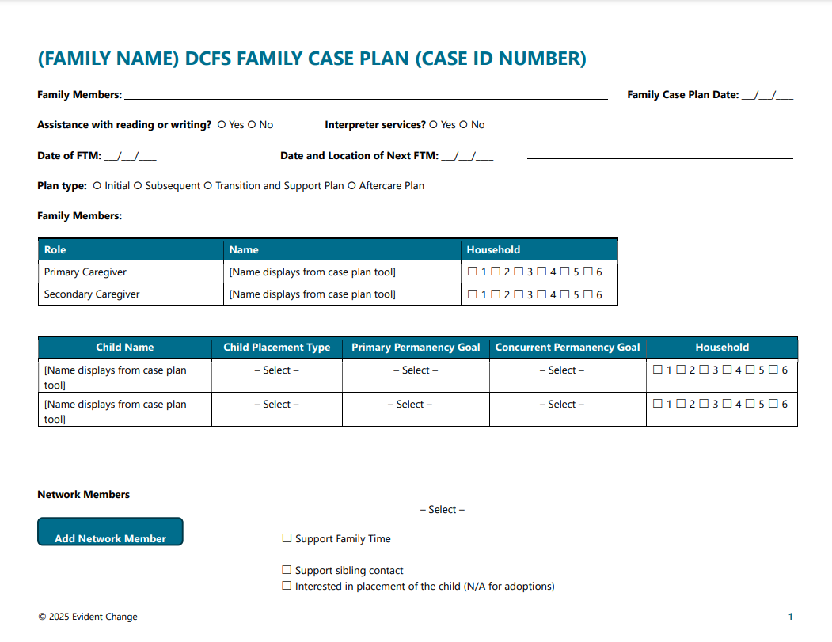
SDM family case plan
Family Case Plan Example
The ultimate goal for the FSW is to use the information gathered with the Family Case plan tool to create a Family Case Plan with the family.
The family case plan should be written with:
Measurable goals
Behaviorally specific objectives
Objectives that incorporate the caregiver’s priority strengths and must address the caregiver’s priority needs.

Slide 12
SDM risk ReAssessment
A Risk Reassessment must be completed every 90 days for cases in which:
2 Main Sections | Scored Risk Level |  | Overrides |  | Final Risk Level
R1-R4: Based on conditions present at the time of the referral, that resulted in the case opening. | Low- | 0-1 | Policy Overrides | Incidents or conditions that have occurred since the initial Risk Assessment /Reassessment. | Low Moderate High Very High
 | Moderate- | 2-4
R5-R10: Case observations that pertain to the period since the last assessment or reassessment. |  |  | Discretionary Overrides - Only used 5% of the time | Used when facts indicate that the risk score does not accurately portray the family’s actual risk level.
 | High- | 5-7
 | Very High- | 8+
All children remain in the home
A child has been returned home, and family maintenance services are being provided
This Risk Reassessment evaluates whether the caregiver's behaviors and actions have changed as a result of the Family Case Plan.

Slide 13
SDM risk
ReAssessment Items
The Risk Reassessment combines items from the initial Risk Assessment with additional items that evaluate a family’s progress toward Family Case Plan goals.
10 items that are included in the Risk Reassessment, and they are accompanied by definitions.
R1-R4 | R5-R10
 | The following case observations pertain to the period since the last assessment or reassessment.
R1. Prior investigations R2. Household previously received ongoing child protection services R3. Primary caregiver has a history of abuse or neglect as a child R4. Current or historical characteristics of children in the household | R5. New investigation of abuse or neglect since the initial risk assessment or the last reassessment R6. Primary or secondary caregiver alcohol and/or drug misuse since the last assessment or reassessment R7. Adult relationships in the home R8. Primary caregiver mental health since the last assessment or reassessment R9. Primary caregiver provides physical care of the child R10. Caregiver’s progress with family case plan goals (as indicated by behavioral change)
The Recommended Decision is based on the Scored Risk Level
If any overrides apply, total the score of the risk items and determine the final risk level.
If none apply, the score and final risk level are the same.
Note: The first 4 items are scored the same way as the first four items on the initial risk assessment UNLESS new information has become available regarding the conditions that existed at the time of the initial risk assessment.

Slide 14
SDM Reunification Assessment
DCFS requires a Family Case Plan review at least every 90 days.
Each review should begin with an
SDM Reunification Assessment
5 Main Sections
Section 1: Reunification Safety Assessment- Safety Threats and Safety Decision
Section 2: Family Case Plan Progress- Caregiver’s behavior change, progress with family case plan goals since the last assessment/reassessment
Section 3: Family Time Assessment- Caregiver’s success with the planned frequency of family time with each child in care, as well as the quality of family time.
Section 4: Reunification Guidelines And Recommendation-
Section 5: Post-Reunification Service Intensity Recommendation- post-reunification service intensity recommendation is displayed to help determine the level of in-home intervention/services post-reunification.
Notes:
Inform participants that they will go more in depth with the Reunification Assessment during concentrations training.

Slide 15
How does the Reunification Assessment help guide decision making?
Helps to assess whether children in care who have a reunification goal should:
Reunify with the removal household or another household with a legal right to care.
Remain in care while reunification services continue.
Transition to a concurrent goal for permanency

Slide 16
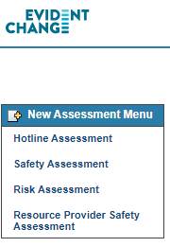
DCS Practice in CHRIS Lab
Notes:
Participants will access the practice site in the lab by directly clicking on the app on their lab desktop computer.

Slide 17
BREAK TIME
Notes:
Trainer Instructions
Begin the count
Call STOP

Slide 18
What is your definition of planning?
Planning is a thoughtful process of determining a method to achieve a goal or solve a problem.
It involves gathering information, evaluating the outcomes information, defining and planning for obstacles, prioritizing, and assigning activities, timeframes, and methods.
Planning also includes a provision for monitoring and follow-up of the plan that is developed.

Slide 19
What is your definition of Reacting?
Reacting is responding without fully evaluating or thinking about the situation before acting. It often involves emotion and is determined by others' demands.
Reacting to families experiencing abuse or neglect may not result in actions that decrease the risk of harm or help them move toward solutions.
Planning is gathering adequate information and thinking about the desired outcomes based on the information available at the time.
Plans change as more information is gathered. The more information, the better the chance of making a plan that will work.
Notes:
Reaction is not always a bad thing – imagine a child running into a busy street….

Slide 20
Planning
Gathering and evaluating information
Notes:
Title slide sample 1

Slide 21
Scenario
DCFS has been working with a mother who has two children in foster care. She has a history of drug and alcohol use.
The children came into care after she left them for 3 weeks with a friend who could not take care of them and who did not know when or if she would return. All of you are at the 2nd case staffing (approximately 6 months into the case).
DCFS sent mother a written reminder of the staffing. It is 10 minutes after the scheduled start time and mother is not there.

Slide 22
Steps in the planning Process
Identify the problem
(Investigation)
Is there Maltreatment?
If so, Plan?
Assess Situation
(CANS/FAST)
What are Needs/Strengths?
Why Is there Maltreatment?
Protection
Findings
Identify goals & behaviors
Case Plan
Identify Intervention Tasks
Reassess
How Are We Doing?
Staffings/Court Hearings
Close
Initial
Subsequent
Permanency

Slide 23
Assessment: critical step in the planning process
If the assessment is faulty, the information used to make the plan is faulty or inadequate.
If the information is faulty, the plan may look beautiful on paper, but it probably won’t work in the real world.
If assessment does not continue the process of involving the family in the problem-solving process, then the plan may not work.
You have information to inform the assessment.
Assessment goes on from the time the report is made to the Hotline until the day the case is closed.

Slide 24
UNDERSTANDING
CANS
Child and Adolescent Needs and Strengths
&
FAST
Family Advocacy & Support Tool
Notes:
Group Activity Time Sample Slide 1

Slide 25
Why cans & Fast?
The CANS/FAST Assessment Model:
Is evidence-based
Provides a way to track progress
On An Individual Case Level and A System-Wide Level.
CANS will help DCFS identify gaps and successes in services.
CANS will help FSWs to prioritize child/family needs to address the most imminent needs first.
Information from family and providers is essential to this prioritization.

Slide 26
Why cans & Fast?
CANS is being used in Child Welfare agencies in at least 25 states across the country.
Arkansas has benefitted from collaborating with other states using the tools to improve successful implementation.
Providers within Arkansas are beginning to use, i.e., Methodist Children’s Homes

Slide 27
The CANS helps Family Service Workers to prioritize or “triage” the family’s service needs to ensure that the safety/risk factors are addressed first.
When safety/risk factors have been addressed, the Division/court can
reevaluate the family situation and determine if the child can safely be returned while the Division continues to work with the family.

Slide 28
The FAST Assessment provides a more in-depth look at our in-home cases
Ensures that we are addressing family needs
NOT “putting a band-aid” on the problem, or only addressing the specific reason the case is open (I.E., The ‘true finding’).
FAST Assessments prevent families from having repeat/multiple involvements with DCFS and prevent children from eventually entering foster care.
Notes:
Individual Activity Time Sample Slide 2

Slide 29
ULTIMATE GOAL?
To reduce the number of children in foster care by:
Preventing entry into foster care in the first place (FAST)
Shorten the length of stay in foster care by addressing specific safety factors/high-priority needs first (CANS)
Notes:
Group Activity Time Sample Slide 2

Slide 30
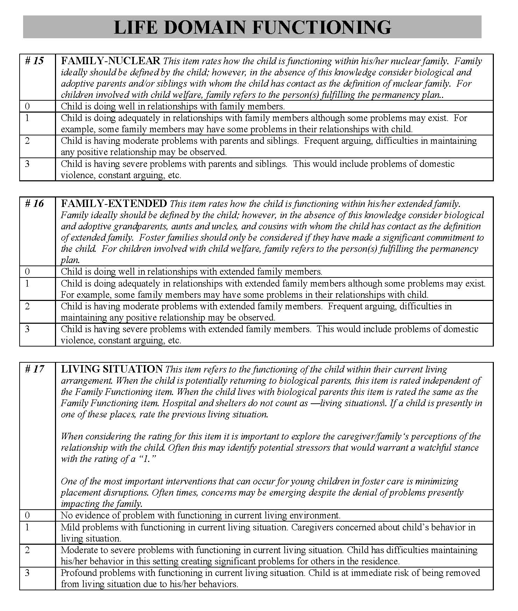
Domain
Anchor Definitions
Action Levels
(Ratings)
Item
Item
Definitions
CANS Assessment Dissection

Slide 31
Pause for CANS Videos:
1- Dr Lyons on CANS (3:25)
2- A Conversation with Dr. John Lyons (8:02)
Notes:
The trainer will open two video links from the MidSOUTH staff site and have them ready to show. During the videos, please have participants jot down a few ideas that “jump out at you” from the video to share with the class afterward.

Slide 32
BRAIN BOOST
On my count begin moving until I say STOP
Turn to your neighbor and talk about 1 thing you learned from the video about the CANS/FAST
Notes:
Trainer Instructions
Begin the count
Call STOP

Slide 33
The purpose of cans-Fast
The purpose of the CANS-FAST is to identify and communicate a shared vision of strengths and needs for children and families across different child servicing systems.
The CANS-FAST allows for different parties to communicate the shared vision.
Ratings in a CANS-FAST allow for the creation of a collaborative case plan that is measurable.

Slide 34
The purpose of cans-Fast
The CANS-FAST Assessments are outcomes management tools.
To manage needs, we need to be able to measure them.
Use the CANS-FAST Assessments:
To create more collaboration with families and with other people involved, i.e., Therapists, school, court teams, etc.
At every staffing,
To “build transparency”
To share the full picture of what is going on
To share strengths.
“We can’t manage what we don’t measure.”

Slide 35
AR DCFS Has 3 Child Welfare Assessment Tools
For every child in Foster Care (Out-of-Home) Cases
1. AR CANS for Birth-4 years
2. AR CANS for Children & Youth 5 years and Older
For Protective Services (In-Home) Cases
3. AR FAST
Notes:
Optional Knowledge check slide

Slide 36
WHAT’S IN THIS FOR ME?

Slide 37
Workers can use this approach to work smarter rather than harder by avoiding problems ahead of time.
Workers can better engage families and youth by creating a shared vision where all of our perspectives matter.
CANS-FAST Benefits for a Case Worker
Workers can organize a personalized case plan.
Workers can measure the progress of children and families based on their specific needs.
Workers can use a common language with others in the systems serving children and families. This is where stakeholders come in.

Slide 38
The CANS-FAST helps parents understand their child and family better.
The CANS-FAST is an approach where the parent’s perspective matters too.
CANS-FAST Benefits for a Parent or Guardian
The CANS-FAST helps families and DCFS agree on what they need to work on together.

Slide 39
CANS-FAST BENEFITS FOR A STAKEHOLDER
What benefits do YOU see from the CANS/FAST?
Notes:
Optional Knowledge check slide

Slide 40
6 Key Characteristics of the cans-fast
Items are included because they might impact service [case] planning
Consider culture and development
The level of items translates immediately into action levels
It is agnostic as to etiology (it is not based on the cause)—it is about the ‘what’ not about the ‘why’ (2 exceptions: trauma and child behavior)
It is about the child not about the service
The 30-day window is to remind us to keep assessments relevant and ‘fresh’
Click the Sign

Slide 41
STRENGTHS RANKING
NEEDS RANKING
0
Centerpiece Strength
No Evidence
1
Useful Strength
Watchful Waiting
2
Potential Strength
Action Needed
3
None Identified
Immediate Action Needed
Notes:
Individual Activity Time Sample Slide 1

Slide 42
Strengths/needs are not on opposite ends of a spectrum
This is a change in some of our linear thinking
CHANGE IN THINKING
The absence of a need does not equal a strength
Likewise, the absence of a strength does not equal a need
Notes:
Dr. Lyons’ example is a suicidal youth. Obviously an actively suicidal youth would be a 3 – need for immediate action. But the absence of suicidal ideation isn’t a strength. We are not going to build a plan around the fact that this youth is not suicidal. So, the relationship between strengths and needs in the CANS/FAST is not linear.

Slide 43
AR CANS-FAST
CANS-FAST User Guides And Forms
Notes:
Individual Activity Time Sample Slide 1

Slide 44
Child Strengths domain items
Family-Nuclear
Family-Extended
Interpersonal
Educational
Talents/Interests
Spiritual/Religious
Community Life
Relationship Permanence
Child Involvement with Care
Natural Supports
Adaptability
Building Relationships
Resilience
Resourcefulness
Notes:
Optional Knowledge check slide

Slide 45
Life Functioning Domain items
Family-Nuclear
Family Extended
Living Situation
Sleep
Social Functioning-Peer
Social Functioning-Adult
Sexual Development
Developmental
Communication
Cultural
Legal
Medical
Physical Health
Daily Functioning
Notes:
Optional Knowledge check slide

Slide 46
SCHOOL DOMAIN ITEMS
School Behavior
School Achievement
School Attendance
Special Education
Notes:
Optional Knowledge check slide

Slide 47
CHILD BEHAVIORAL/
EMOTIONAL NEEDS DOMAIN ITEMS:
OPPOSITIONAL
CONDUCT
ADJUSTMENT TO TRAUMA
ANGER CONTROL
SUBSTANCE USE
Psychosis
Attachment
Impulsivity/Hyperactivity
Depression
Anxiety
Notes:
Optional Knowledge check slide

Slide 48
SUICIDE RISK
SELF-INJURIOUS BEHAVIOR
OTHER SELF-HARM
DANGER TO OTHERS
SEXUAL AGGRESSION
RUNAWAY
CHILD RISK BEHAVIORS DOMAIN ITEMS:
Delinquent Behavior
Bullying
Intentional Misbehavior
Aggressive Behavior
Exploited
Notes:
Optional Knowledge check slide

Slide 49
TRAUMA DOMAIN ITEMS:
SEXUAL ABUSE
PHYSICAL ABUSE
EMOTIONAL ABUSE
NEGLECT
MEDICAL TRAUMA
NATURAL DISASTER
Witness to Family Violence
Witness to Community Violence
Witness/Victim to Criminal Activity
War/Terrorism
Disruption in Caregiver
Grief and Loss
Notes:
Optional Knowledge check slide

Slide 50
PERMANENCY PLANNING - CAREGIVER STRENGTHS & NEEDS DOMAIN ITEMS:
Empathy with Children
Boundaries
Involvement
Posttraumatic Reactions
Knowledge of Family/Child Needs
Knowledge of Service Options
Ability to Listen
Ability to Communicate
Satisfaction with Services Arrangement
SUPERVISION
PARENTING SKILLS
KNOWLEDGE OF CHILD
KNOWLEDGE OF RIGHTS & RESPONSIBILITIES
ORGANIZATION
SOCIAL RESOURCES
RESIDENTIAL STABILITY
Notes:
Optional Knowledge check slide

Slide 51
PERMANENCY PLANNING - CAREGIVER STRENGTHS & NEEDS DOMAIN ITEMS:
PHYSICAL HEALTH
MENTAL HEALTH
SUBSTANCE USE
DEVELOPMENTAL
ACCESSIBILITY TO CHILD CARE ARRANGEMENT
FAMILY STRESS
Employment/Educational Functioning
Educational Attainment
Legal
Financial Resources
Transportation
Safety
Marital/Partner Violence
Notes:
Optional Knowledge check slide

Slide 52
Modules for CANS (0-4)
MODULES Complete any specific module ONLY if indicated on the initial page | ¹ Developmental Needs (DD) Module
 | ² Acculturation Module
 | ³ Sexual Abuse Module
 | ⁴ Substance User Disorder (SUD) Module-Caregiver
Modules are completed only if selected Items are given a ‘1’, ‘2’, or ‘3’ rating .

Slide 53
Modules for CANS (0-4)
MODULES Complete any specific module ONLY if indicated on the initial page | ¹ Transition Age Module-Triggered by DOB
 | ² Developmental Needs (DD) Module
 | ³ Acculturation Module
 | ⁴ Substance User Disorder (SUD) Module-Caregiver
 | ⁵ Runaway Module
 | ⁶ Sexual Abuse Module
 | ⁷Substance User Disorder (SUD) Module-Caregiver
Automatically triggered based on the child’s date of birth (if a child is 14 yrs or older).
Automatically triggered with a rating of “Yes” or “Suspected”
Modules are completed only if selected Items are given a 1, 2, or 3 rating EXCEPT for the “Transition Age Module” and the “Sexual Abuse Module”

Slide 54
AR FAST
Family Advocacy and Support Tool

Slide 55
THE FAMILY TOGETHER DOMAIN ITEMS
PARENTAL/CAREGIVER COLLABORATION
RELATIONSHIPS AMONG SIBLINGS
EXTENDED FAMILY RELATIONSHIPS
FAMILY CONFLICT
FAMILY COMMUNICATION
Family Role Appropriateness
Family Safety
Financial Resources
Residential Stability
Home Maintenance
Notes:
Optional Knowledge check slide

Slide 56
CAREGIVER STATUS DOMAIN ITEMS
EMPATHY WITH CHILD
BOUNDARIES
INVOLVEMENT
SUPERVISION
DISCIPLINE
PARTNER RELATIONSHIPS
VOCATIONAL FUNCTIONING
MENTAL HEALTH
ALCOHOL AND/OR DRUG USE
POSTTRAUMATIC REACTIONS
Knowledge of Child
Organization
Physical Health
Developmental
Accessibility to Child Care Services
Family Stress
Educational Attainment
Legal
Transportation
Safety
Notes:
Optional Knowledge check slide

Slide 57
CAREGIVER ADVOCACY DOMAIN ITEMS
KNOWLEDGE OF SERVICE OPTIONS
KNOWLEDGE OF RIGHTS & RESPONSIBILITIES
ABILITY TO LISTEN
ABILITY TO COMMUNICATE
Natural Supports
Satisfaction with Youth’s Living Arrangement
Satisfaction with Youth’s Educational Arrangement
Satisfaction with Services Arrangement
Notes:
Optional Knowledge check slide

Slide 58
Youth Status domain items
Relationship w/ Bio Mother
Relationship w/ Bio Father
Relationship w/ Primary Caregiver
Relationship with other Adult Family Members
Health Status
Mental Health Status
Adjustment to Trauma
Cognitive Skills
Self-Regulation Skills
Interpersonal Skills
Educational Status
Notes:
Optional Knowledge check slide

Slide 59
BREAK
TIME
Notes:
Break Slide Option 2

Slide 60
Notes:
During the video, please jot down a few ideas that “jump out at you” from the video to share with the class afterward.

Slide 61
COLLABORATION AND TEAMWORK
It’s easy to miss what you are NOT looking for.
The shared vision approach helps DCFS to NOT miss important details when working with families.
DCFS assessments will be better if they gather information from multiple sources. This means YOU!
We need your help to really do the CANS-FAST correctly.
Notes:
Group Activity Time Sample Slide 1

Slide 62
EFFECTIVE COMMUNICATION WITH FAMILIES USING THE CANS
Read pages 19-20 of your Participant Manual
Choose 3 key points from this reading you see as important and prepare to share them with the group.
Notes:
Group Activity Time Sample Slide 2

Slide 63
Practice SCENARIO
Sarah Padgett Scenario
Difficulties with scenarios and vignettes when scoring – if you don’t have all the information and cannot get it.
No mention = No evidence

Slide 64
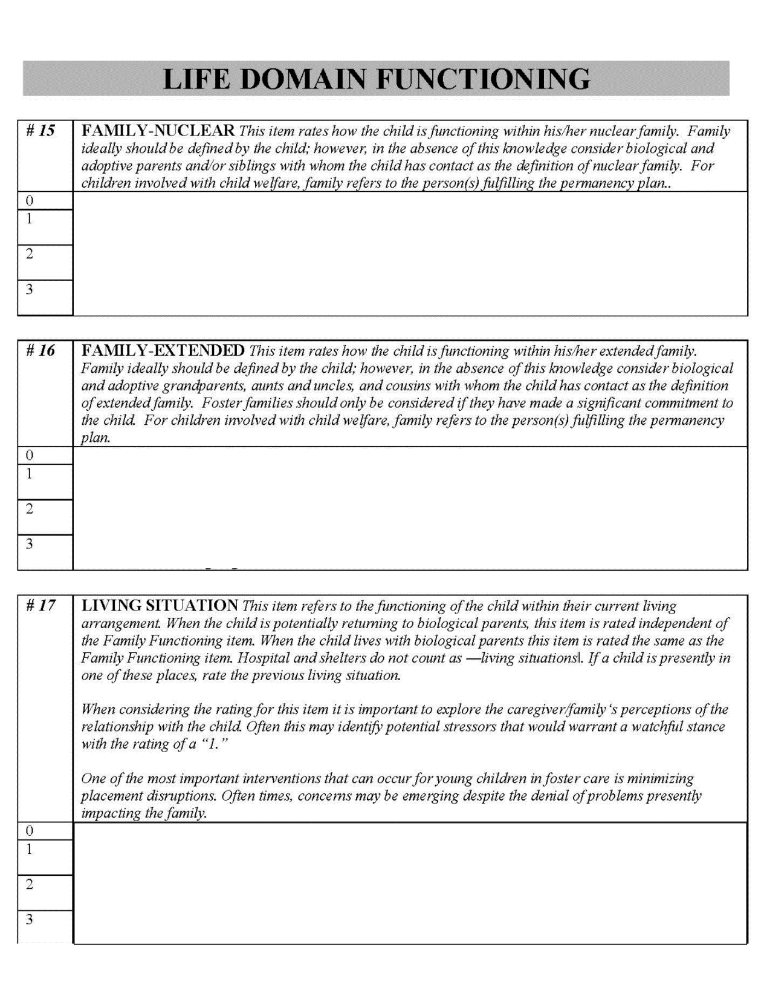
Item
Understand the meaning of the Item and the Action Levels.
Action Levels
(Ratings)
Don’t get bogged down in the individual Anchor Definitions.
Tips When Scoring a CANS-FAST

Slide 65
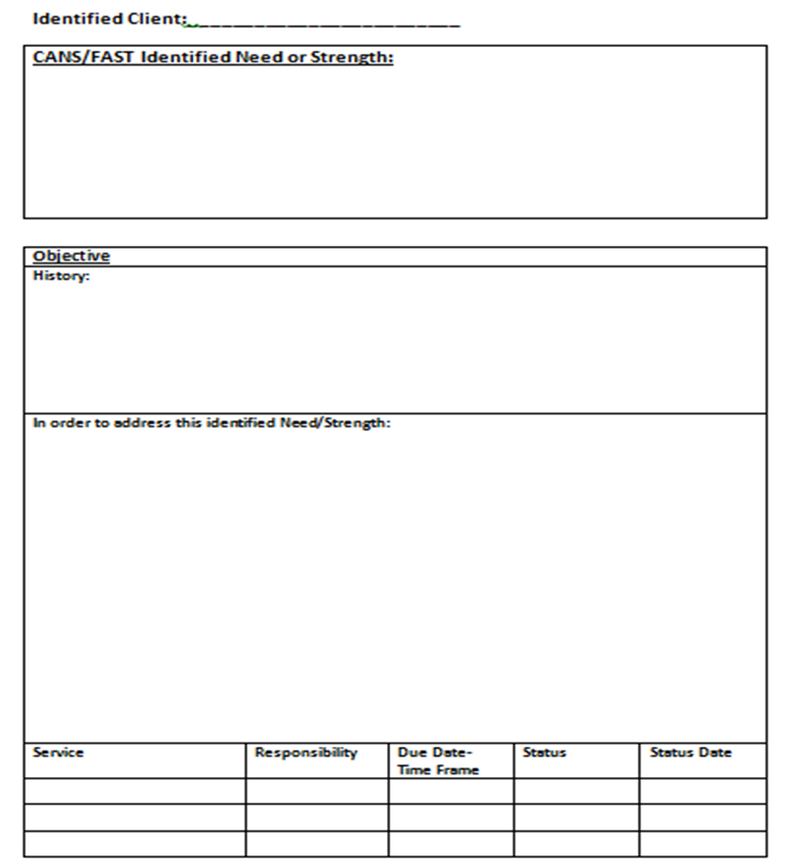
Arkansas is the first state to directly link the CANS assessment to the Case Plan.
There is a section of the new case plan for “additional or court-ordered services,” which we can use for any service requested by the court or a party to the case- but cannot be directly linked to a CANS-identified need (such as a paternity/DNA test).
AR Case Plan

Slide 66
CANS-FAST: Informed Case Planning
Identify CANS-FAST Need items with action levels of ‘2’ or ‘3’.
Identify Need Items that may need preventive services with a Watchful status of 1.
Prioritize these needs with the child and family to develop short-term and long-term goals.
Identify action steps that support the short-term and long-term goals.
Collaborate and partner with the child and family.

Slide 67
CANS-FAST: Informed Case Planning
Identify CANS-FAST Strength Items with a ‘0’ or ‘1’ for strengths-based case planning
Strength items with ‘2’ or ‘3’ are those attributes and skills that can be built.
Identify action steps that support the short-term and long-term goals.
Collaborate and partner with the child and family.

Slide 68
CANS CERTIFICATION
Workers must be certified before they can complete a CANS/FAST or a Case Plan.
Workers must score a 70% to certify.
Workers must recertify every year.

