Slide 1
Unit 5
Engaging Families using the Safety Organized Practice (SOP) Approach

Slide 2
Welcome

Slide 3
Agenda
Day 1
Day 2
Day 3
 | Welcome, Agenda, OJT, and Online Review Engaging Children and Adolescents Involving Children in Safety Planning Stages of an Interview Documentation
 | Safety Organized Practice Genograms Three Questions, Three Column Mapping and Three Houses Caregiver + Behavior + Impact on the Child Harm, Worry, and Goal Statements
 | Circles of Safety and Support Collaborative Assessment and Planning (CAP) Framework On-Call Essentials and Strategies Skillful Use of Authority, De-escalation Strategies, and Worker Safety Procedures and Protocol Review

Slide 4
Agreements
Are these still working?
<<<Add group agreements .>>>

Slide 5
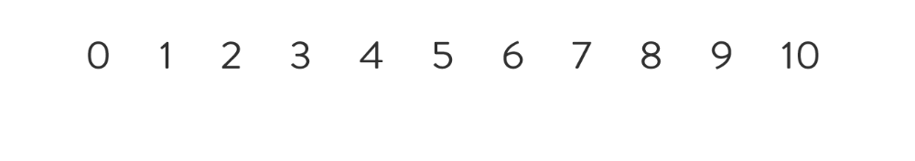
How present are you?

Slide 6

OJT
What went well? What concerns do you have?
What is one thing you learned?
Something that surprised you.

Slide 7
The Power of Words
What is the impact of these kinds of language shifts?
Clients Families
Staffings Family Team Meetings
Visitation Family Time

Slide 8
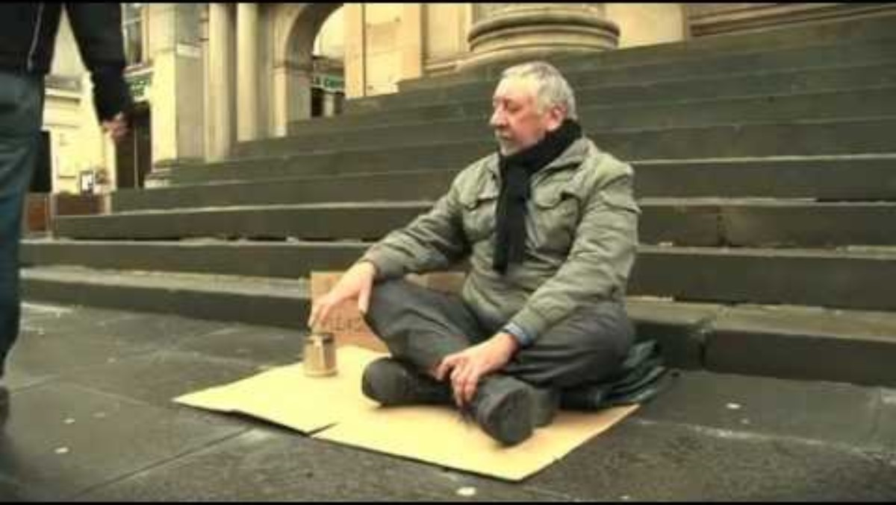
The Power Of Words

Slide 9


Slide 10
Strategies for Talking with Children
Talking with Children
Developing Good Working Relationships

Slide 11

Purpose of child interviews
Children’s perspectives are vital to gathering information about what is happening; therefore, children need to be our partners in assessment.
Children can be, and often need to be, partners in their own safety planning.
Talking with Children

Slide 12


Slide 13
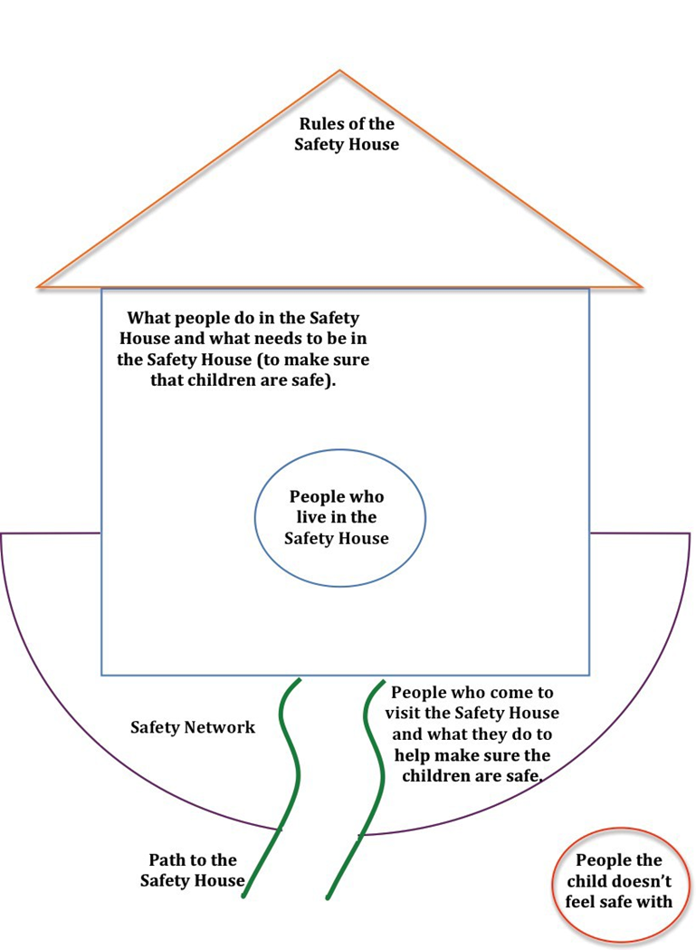
Safety House
Developed by
Sonja Parker
A tool to help children and young people understand and participate in the safety planning process.

Slide 14
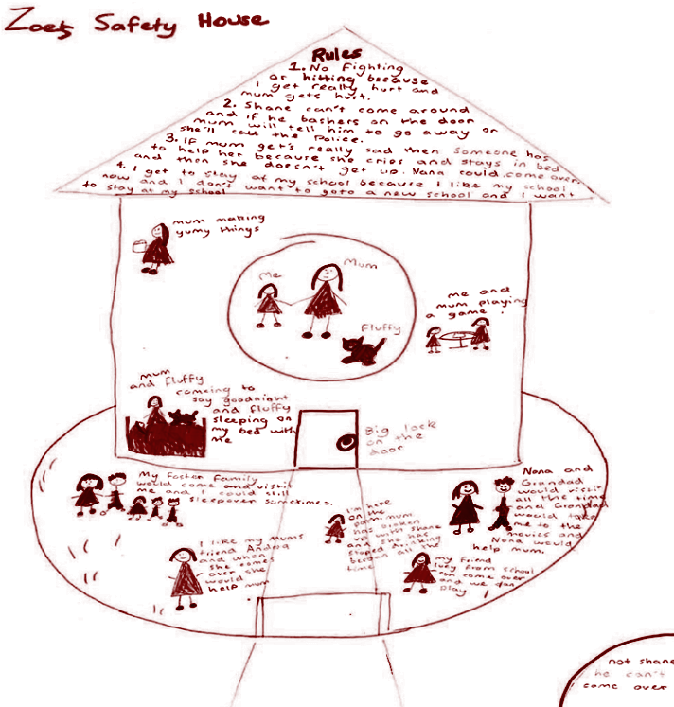
Safety House
Created by Zoe, age 10,
as part of the reunification program to inform the safety plan.
Talking with Children

Slide 15
Safety House
Rules:
1. No fighting or hitting because mum gets hurt.
2. Shane can’t come around and if he bashes on the door mum will tell him to go away or she’ll call the police.
3. If mum gets really sad then someone has to help her because she cries and stays in bed and then she doesn’t get up. Nana could come over.
I get to stay at my school because I like my school now and I don’t want to go to a new school and I want to stay at my school.
My foster family would come and visit me and I could still sleepover sometimes.
I like my mum’s friend Andrea and when she comes over she would help mum.
Nana and Grandad would visit all the time and Grandad would take me to the movies and Nana would help mum.
My friend Every from school would come over and we would play
Me, Mum, Fluffy
Mum making yummy things
Me and mum playing a game
Mum and Fluffy coming to say goodnight and Fluffy sleeping on my bed with me
I’m here on the path. Mum has broken up with Shane and she has stopped drinking bourbon all the time.
Not Shane. He can’t come over.
Talking with Children

Slide 17
Stages of the Interview

Slide 18

Optional: Stages of the Interview Video
This interview example has sections you can navigate using the playbar at the bottom of the video, including Introducing and Exploring Agency Involvement, Three Questions, Scaling Questions, Case History, Intro to Mapping, Safety Circles, etc

Slide 20
Documentation

Slide 21

Documentation
How are you managing at staying current in your documentation and getting everything done that is required?
What do you struggle with? (It is always helpful to know that we are not alone in something we find difficult.)

Slide 22
Welcome

Slide 23



Purposes of Safety Organized Practice
Develop good working relationships that lead to a shared focus among stakeholders
Use critical thinking and decision-support tools to enhance consistency, validity, and equity in key case decisions
Build collaborative plans to enhance daily child safety

Slide 24
Introducing the Genogram

Slide 25
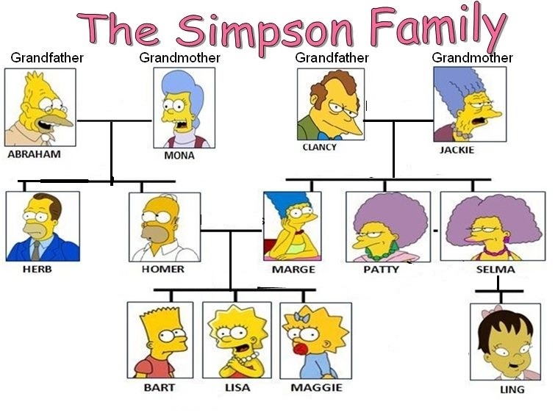

Slide 26
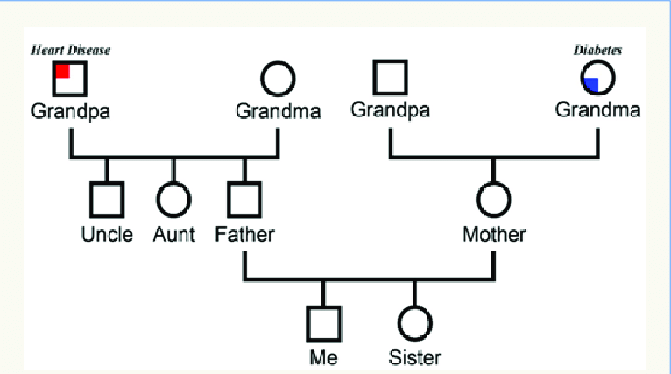
Genogram – It’s all about connections

Slide 27

Genogram

Slide 29
Three Questions and Three Column Map

Slide 30


Three-Column Mapping
What are we worried about? | What is working well? | What needs to happen next?
0
10
Unsafe
(Child cannot be home)
Very Safe
(Close case)
Rigorous, Balanced Assessment

Slide 31
Five Solution-Focused Questions
Exception
  Has there ever been a time when the problem could have happened, but it did not?
Scaling
  On a scale from 0 to 10, where 10 is your child was totally sand 0 is real danger, where were things when ...
Position
  If your child were here right now, what do you think your child would say they are worried about?
Coping
  What you are going through is not easy. How have you survived?
Preferred Future
  In six months, if all the things we are working on were
  taken care of, what would be different in your family?
Rigorous, Balanced Assessment

Slide 33




Strategies for talking with children
Three Houses
Engaging children
in safety assessment
Safety House
Engaging children in safety planning
Talking with Children

Slide 34
Three houses for children
House of Worries
House of
Good Things
House of
Hopes and Dreams
Talking with Children

Slide 35
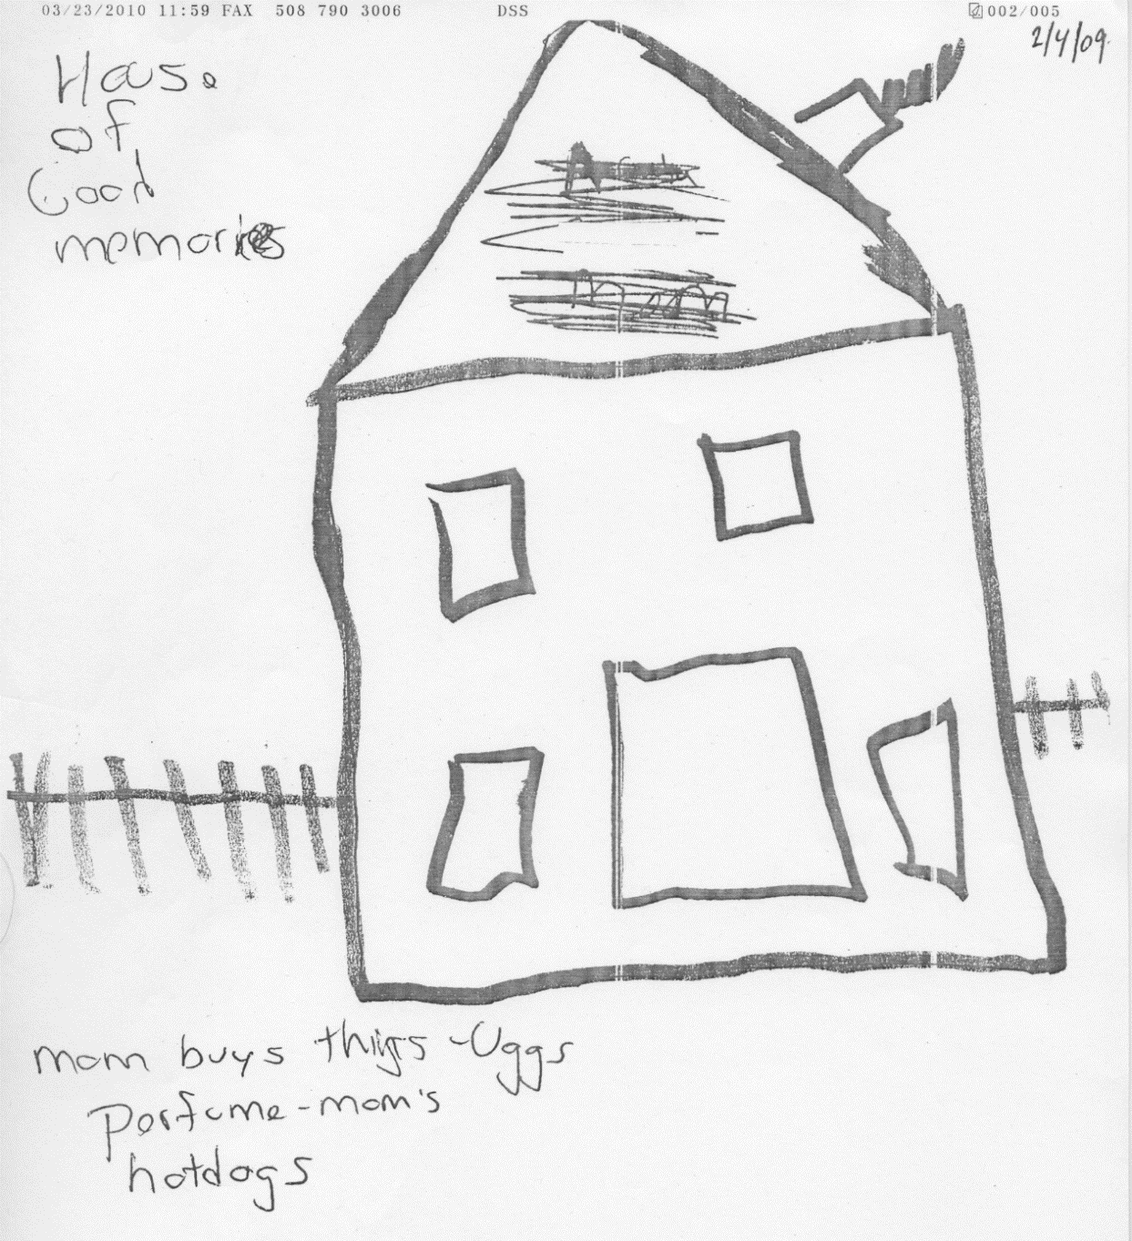
House of Good Things
Talking with Children

Slide 36
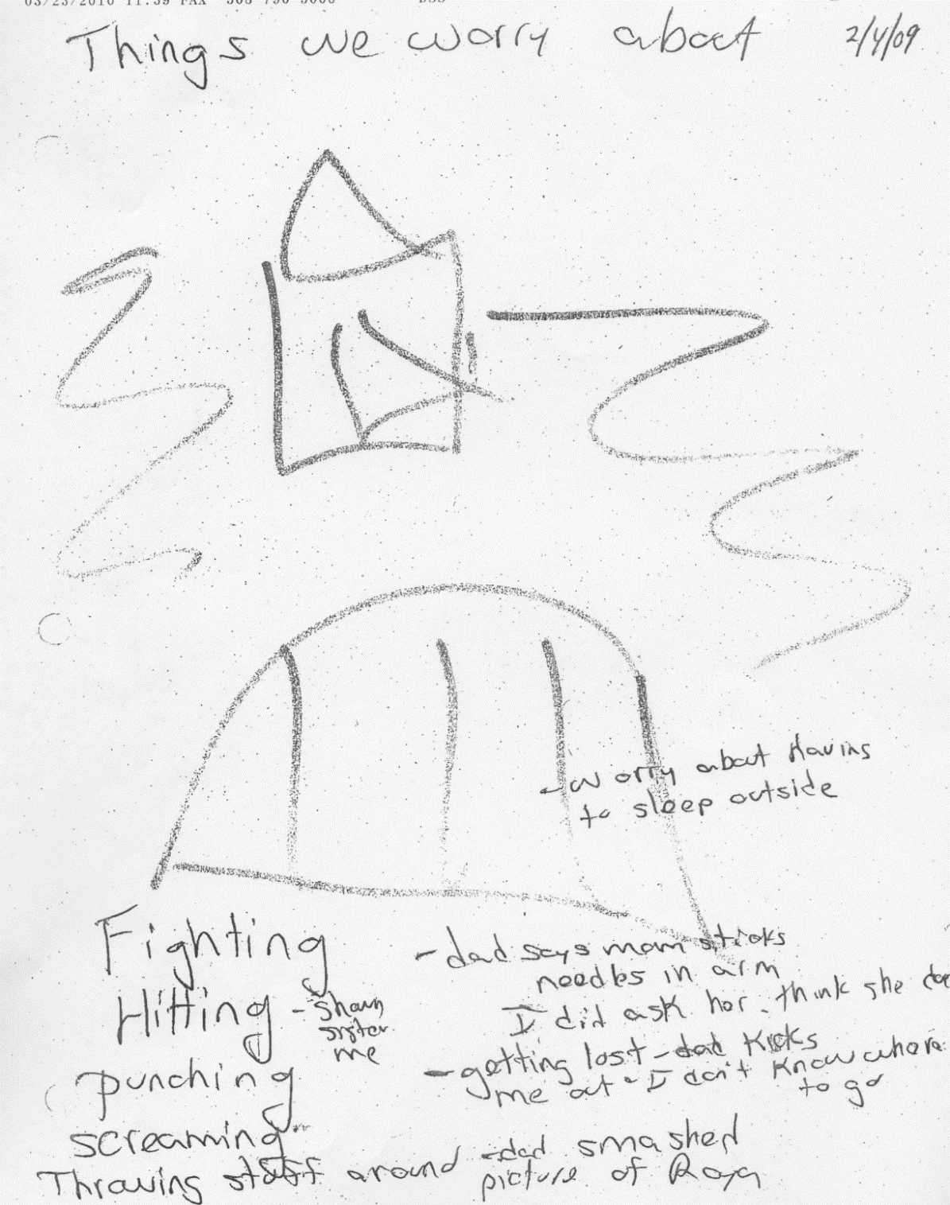
House of Worries
Talking with Children

Slide 37
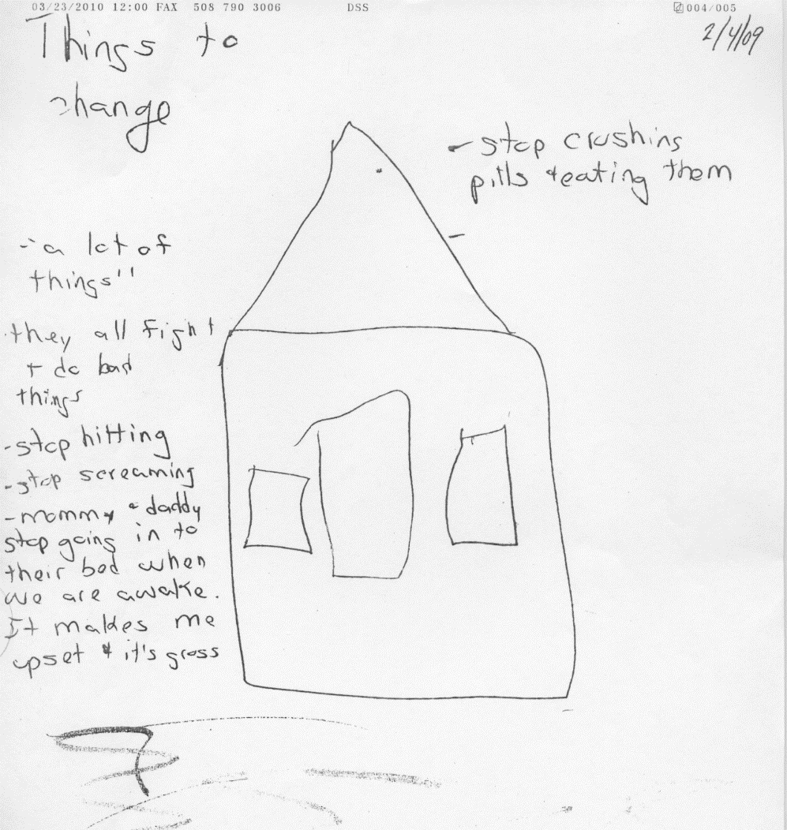
House of Hopes and Dreams
Talking with Children

Slide 38
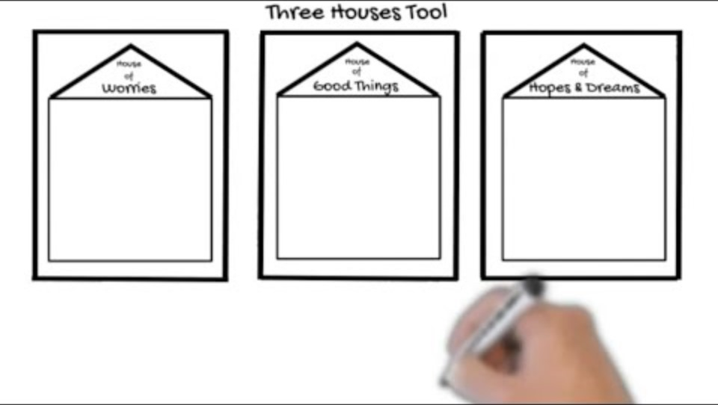
Three Houses

Slide 40



Ask questions that reveal
Caregiver
Behavior
Impact on the Child
Rigorous, Balanced Assessment

Slide 41
Scenario
The hospital social worker and the doctor at the hospital told DCFS that Neveah (12 mos.) was brought in to the hospital yesterday by her paternal uncle, who told the receptionist that he thinks Neveah’s parents, Jessica and Alex, are using meth and not feeding Neveah enough. Uncle said that when he went to their house yesterday, no one was home, the front door was open, and Neveah was on the floor crying. She appeared to not have been bathed for several days and had a dirty diaper with a severe rash. The doctor said that Neveah is extremely underweight and appears to be developmentally delayed.

Slide 42

Harm, Worry, and Goal Statements
Using Critical Thinking and Decision-Support Tools

Slide 43


Review:
Basic Terms
Harm:
Past
Safety threat:
Present
Worry:
Future
CAP Framework

Slide 44



Harm/danger statements
Clear, specific statements about the harm/maltreatment
that has happened to the child. Details, not judgment!
Who says (or it was reported)
What caregiver actions/inaction
Impact on the child
Harm, Worry, Goal

Slide 45
Harm/danger statement example
It was reported that on September 17, Cheryl Turner turned on the gas of her home stove and locked herself in the kitchen, exposing both the kitchen and the rest of the apartment to high levels of
toxic fumes. Cheryl’s two children, who were home at the time,
were exposed to the fumes and lost consciousness.
Harm, Worry, Goal

Slide 46

Two questions answered by the worry statement
What is the agency most worried will happen to the child if nothing changes?
When or in what context are they most worried this could happen?
Harm, Worry, Goal

Slide 47


Worry statements
Simple behavioral statements of the specific worry we have
about this child now and in the future.
may be
if/when
Child
Impacted how?
Context
Harm, Worry, Goal

Slide 48
Physical abuse
Worry statement example
Adam (age 7) may be injured when his dad, Matt, drinks alcohol, becomes angry, and hits him.
Harm, Worry, Goal

Slide 49
Goal statements:
The “what” of enhancing safety
Every case needs clear, well-formed goals that allow the agency
to believe safety is sufficient to leave a child in the home
while work on the case continues, or to close the case.
Too often, we ask clients to engage in services without defining the goals. Even if clients follow through with services, workers might not believe the dangers were addressed.
Goal statements could be part of the family service plan.
Be specific with each family.
Harm, Worry, Goal

Slide 50
What is it all about?
WORRY STATEMENT
What we worry will happen next
HARM
What already happened
GOAL STATEMENT
What we hope happens instead
NOW
Harm, Worry, Goal

Slide 51


Goal statements
Clear, simple statements about what the parent will do to convince everyone the child is safe now and will be in the future.
Child
What will be done differently
To address the danger?
Harm, Worry, Goal

Slide 52
Cheryl Goal Statement Example
Amanda and Lisa will be cared for by their mother, Cheryl, who
will always ask for help if sadness or depression starts to get in the way of taking care of the girls or if she starts thinking about hurting herself.
Harm, Worry, Goal

Slide 53
Welcome

Slide 54

Safety and Support Networks
Building Collaborative Plans

Slide 55

Rationale for building safety networks
Because our involvement
is temporary, a network of permanent support people
is needed to enhance child safety.
Safety and Support
Networks

Slide 56

No network, no plan …
Good network, good plan?
We cannot plan for safety
only with the people
we are worried about.
We must start with at least
one other person who could
not have caused the harm.
Safety and Support
Networks

Slide 57




Identify and engage the network
How do network members help?
Service providers
Faith community
Faith Community
Activities
Activities
Friends
Family
School
Friends
Safety and Support
Networks

Slide 58
Circles of safety and support
Name/photo/picture of child/children
Who already knows everything that has happened?
1
Who knows a little about what has happened?
2
3
Who knows nothing about what has happened?
4
Safety and Support
Networks

Slide 59
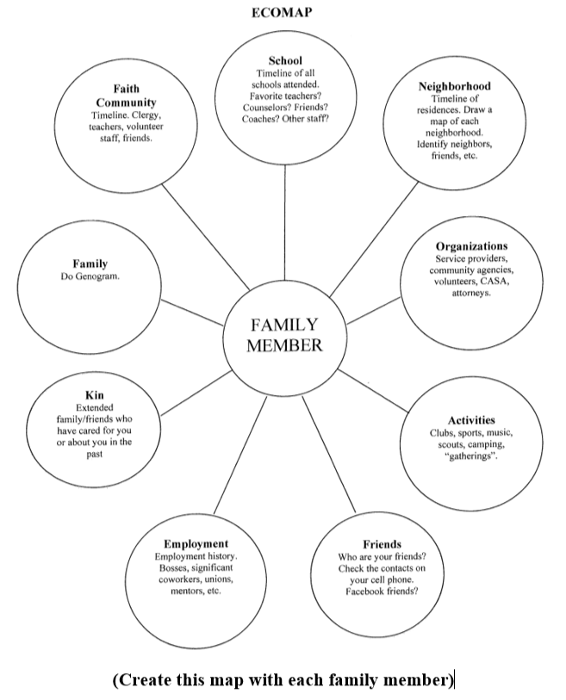

Slide 60
Collaborative Assessment and Planning (CAP) Framework
Using Critical Thinking and Decision-Support Tools

Slide 61






CAP Framework = Better Decisions
Collaboration
Common language
Organization
Consistency
Analysis
Clear next steps
CAP Framework

Slide 62
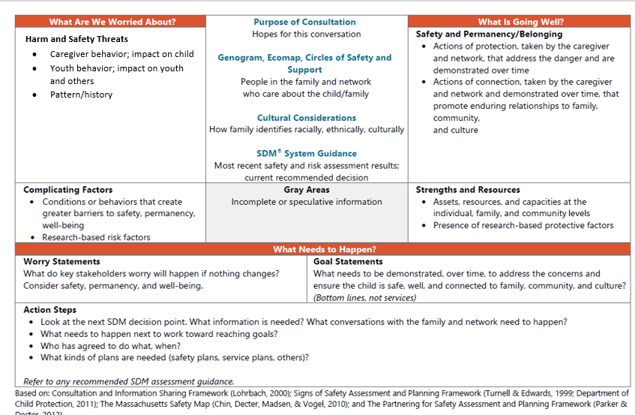
CAP Framework
Consultation
Information sharing
Socializing / educating
CAP Framework

Slide 63
Three Questions
What are we worried about?
What is going well?
What needs to happen?
CAP Framework

Slide 64

Detailed, Behavior-Based Plans
Building Collaborative Plans

Slide 65
Immediate Safety Plan | Family Case Plan
Temporary changes to how the child will be cared for and by whom | Describes daily and weekly actions parents and network will take to ensure child’s long-term safety and well-being
Not about behavior change! (no mannequin goals) | All about behavior change! (to achieve the goal statement)
Immediate/short term | Long term
Begins to involve a network (at least one additional person who could not have caused the harm) | Identifies who will be involved as part of the network and their role in maintaining and reviewing the plan
Identifies how the immediate safety plan will be monitored (daily to begin with) and what will happen if it isn’t followed | Identifies how DCFS (and others) will monitor the plan and describes what will happen if plan isn’t working
Date the plan will be reviewed | Updated when progress is made or new issues arise, especially if new immediate safety plan is needed
Detailed, Behavior-Based
Plans

Slide 66
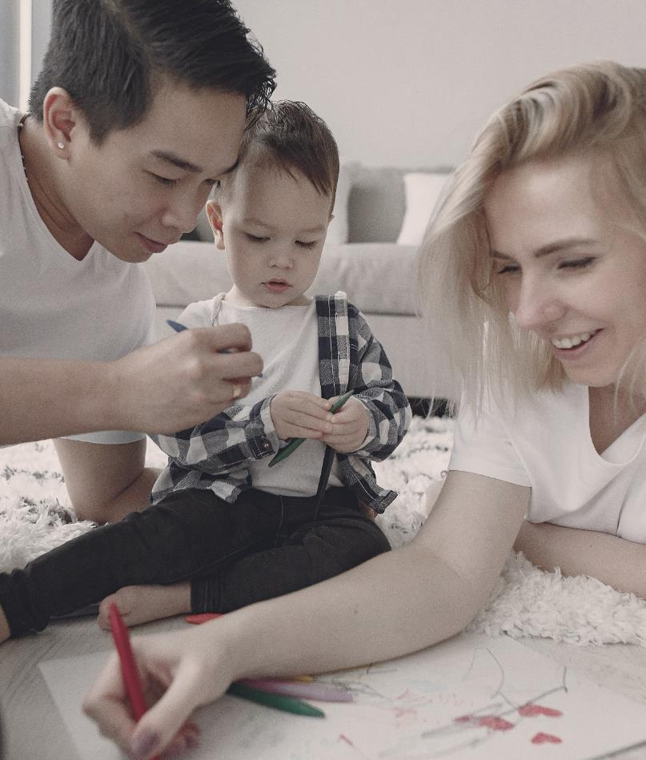
Start with actions
The best predictor of future maltreatment is past maltreatment.
The best predictor of future acts of protection are past acts of protection.
The sooner parents start demonstrating new protective actions that respond to the harm or safety threat, the better.
Detailed, Behavior-Based
Plans

Slide 67


Identify behaviors that achieve goals
Agree on three key behavior changes
Detail the presence of each behavior
How can the behavior be practiced and observed?
Detailed, Behavior-Based
Plans

Slide 68




Design activities and services
Actions, services
to establish and sustain behavior
Formal or informal activities/services?
How can the support network help?
Detailed, Behavior-Based
Plans

Slide 69
On-Call Essentials and Strategies

Slide 71
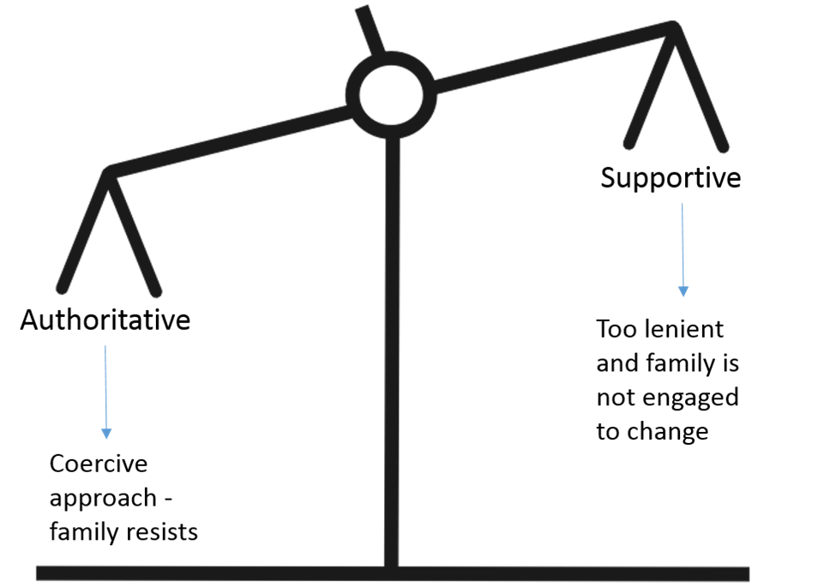

Slide 72
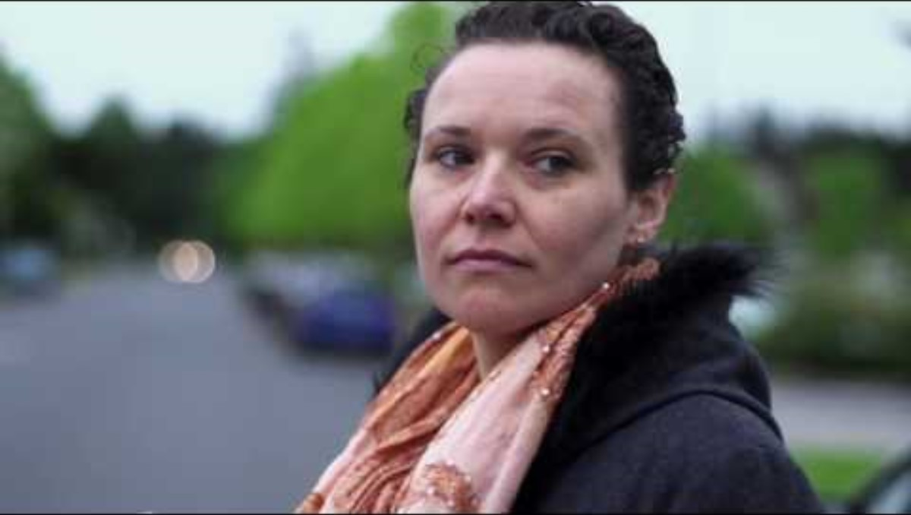
Home Visiting Safety: Staying Safe and Aware on the Job

Slide 73
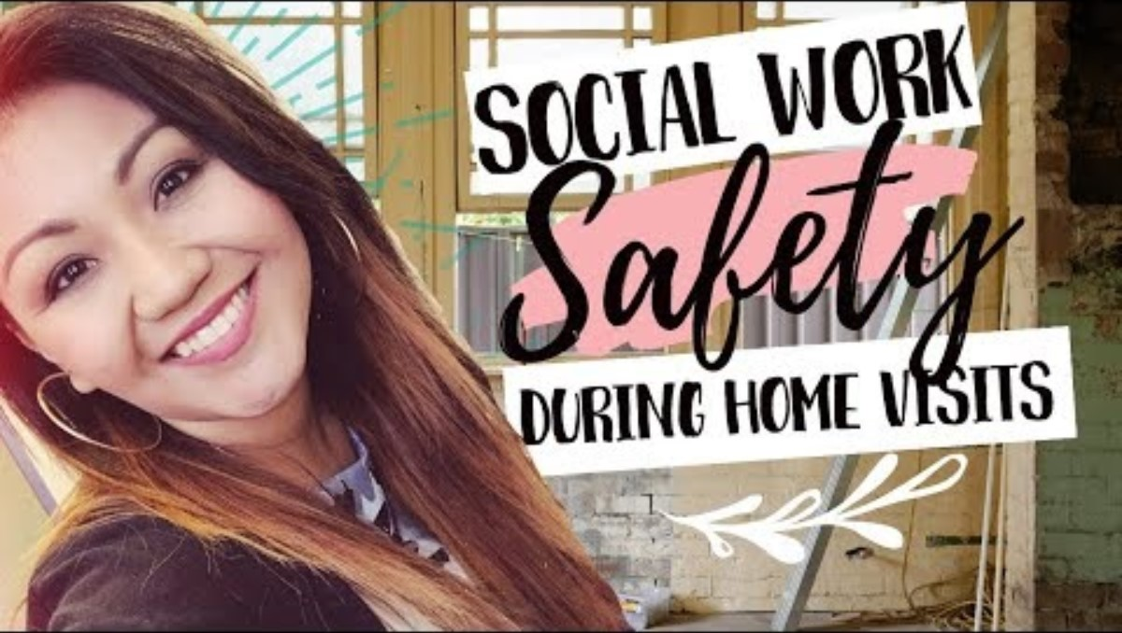
Home Visit Tag Along: Steps to Staying Safe During Home Visits

Slide 74
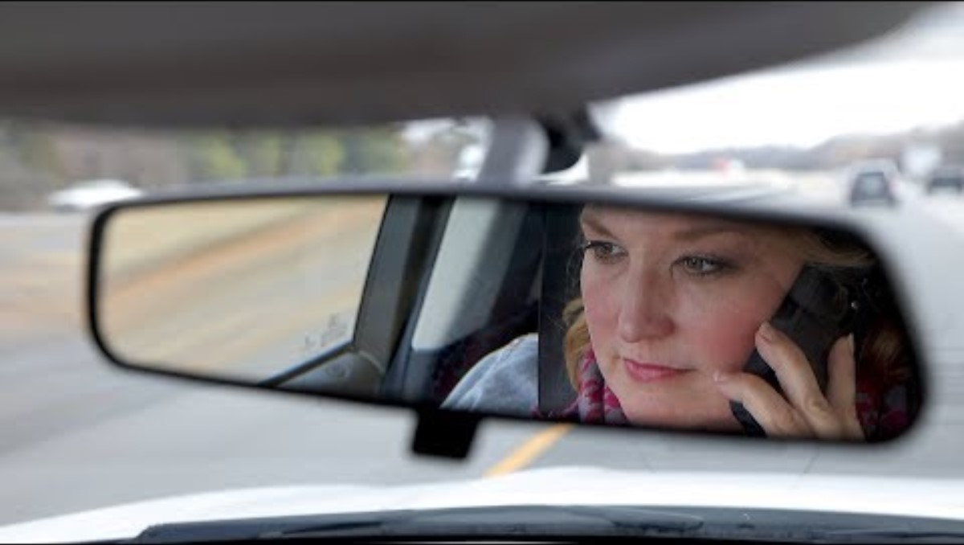
Day in the Life of DCFS Caseworkers

Slide 76


