Slide 1
Foundations Unit 2 Day 3
Working With and Across Differences
Revised 4/2025

Slide 2
Additional SOP Tools

Slide 3
Revisiting Safety Organized Practice
Developing good working relationships
Using critical thinking and decision-support tools
Building collaborative plans to enhance daily child safety
Evident Change

Slide 4
Tier 2 - SOP Toolkit
Three Questions
Three Column Map
Solution Focused Questions
Three Houses
The Safety House
Circles of Safety and Support
Support Network Grid
Genogram
Ecomap
Permanency
Well-Being
SOP Toolkit
Safety
Notes:
This model

Slide 5
ACTIVITY: SOP Tools Teach Back
Readings for each group:
Solution Focused Questions
The Three Houses
Safety House
Circles of Safety and Support
Support Network Grid
Genogram & Ecomap
Each group teach back poster should include:
The name of the tool
A definition/purpose of the tool
Some kind of visual (if available)
An example of when the tool would be useful in your work

Slide 6
Tool: Solution Focused Questions
EXCEPTION
These questions are prompted by a problem, but help to focus on an individual’s strengths and abilities in a “near-miss” situation
PREFERRED FUTURE
These questions will surface what an individual would like to see for themselves or their family.
COPING
These questions will bring up another set of strengths and resources, but they will be more closely related to the problem and how someone deals with it OR who else helps them in this situation.
SCALING
With these questions, we are trying to show that the situation is not as black and white as an individual might think or to help them notice the difference between their desire/importance score and their ability score.
POSITION
This is an attempt to get people out of their own perspective and to consider the concerns and perspectives of others.

Slide 7
Tool: Three Houses
Notes:
This is a version of the three questions for children. This tool can be used to write or allow the children to draw.

Slide 8
Tool: Safety House

Slide 9
Tool: Circles of Safety and Support
1.Name/photo/picture of child(ren)
2. Who already knows everything that has happened?
3. Who knows a little about what has happened?
4. Who knows nothing about what has happened?

Slide 10
Tier 3 - Safety & Supports
REMEMBER:
No network, no plan!

Slide 11
Tier 2 - SOP Toolkit:
Ecomap and Genogram

Slide 12
Cultural Humility

Slide 13
Multicultural Guidelines Reflection: How can we demonstrate cultural humility in our family-centered practice?
“Try on”
Notice both process and content
Practice “both/and” thinking
Okay to disagree;
not okay to blame, shame,
or attack ourselves or others
Confidentiality
Practice “self-focus” and use “I” statements
Be aware of intent and impact
Visions Inc. & Evident Change

Slide 14
The Heart of ICWA: Becky

Slide 15
Review
What is cultural humility?

Slide 16
Cultural Humility
Cultural humility is the ongoing practice of respectful engagement, self awareness, and openness to learning about the diverse backgrounds and experiences of others.
It involves an openness and willingness to learn and is not a final stopping place, but rather is a commitment to a lifelong process with children, families, communities, coworkers, and with yourself.
An important part of cultural humility is making the effort to learn as much as you can about the acceptable behaviors, courtesies, customs, and expectations of the diverse families you help.

Slide 17
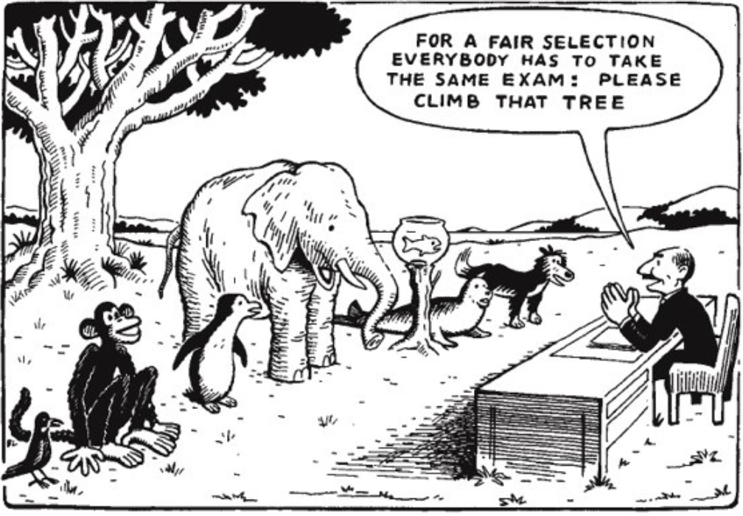
What do you think this comic is meant to show?

Slide 18
How could this relate to how we approach families?

Slide 19
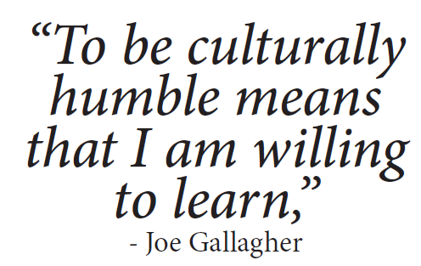

Slide 20
Just by Looking at Me
One thing you cannot tell just by looking at me is _________.
This is important for me to tell you because _________.

Slide 21
Debrief
Just by Looking at Me
How did you decide what to share about yourself?
Did any of your peers’ responses surprise you? Why?
How can you find out “below-the-surface” information about the families you work with in the future? What is the value in that?

Slide 23
Our Intersecting Identities:
Universal
Human nature: “Like all other people”
Group
“Like some other people”
Individual
“Like no other
person”
The primary basis for inclusion and exclusion.
Inherited and learned (caught and taught).
Think
Religion
Culture
Smile
Personality, style, looks, etc.
Gender
Ethnicity
Talk
Feel
Race
J.P. Sonn, 2009 & Visions Inc.

Slide 24
Rigorous and balanced assessment?
Multiple, complex identities
Experiences and Knowledge
Evident Change

Slide 25
Working With and Across Differences
Necessary, difficult, painful dialogue can improve understanding and strengthen relationships.
Multicultural agreements help cross-cultural interactions to incorporate cultural perspectives and expertise.
Evident Change

Slide 26
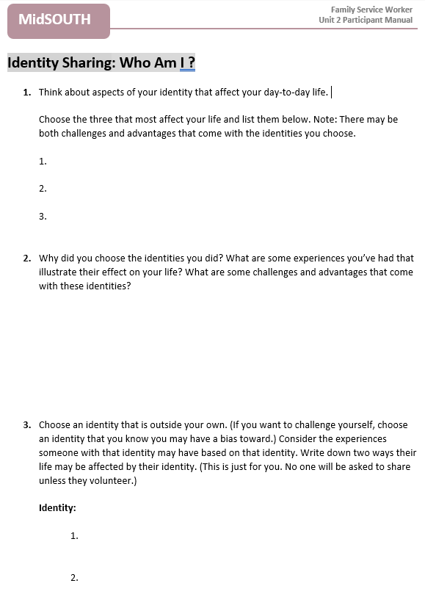
Identity Sharing Activity

Slide 27
Thinking about the identities you described, can you characterize which ones show up at various times?
For example, which identities do you inhabit (or use):
When interacting with your supervisor?
With a family you’re meeting for the first time?
With your own family?
When Do You Inhabit (Use) These Identities?

Slide 28
How Long is the Bridge?
Scenario: Given your identity, what challenges can you foresee in working with an upper-middle class family—in which the caregivers are a lawyer and a college professor—who has relocated to Arkansas from Chicago? In other words, how long is the bridge you need to build/cross and why is it this long?
Would it be different for you if the family were multigenerational?
What if the family were Muslim?
What if the family was mixed race?

Slide 30
Video: Culturally Responsive Child Welfare

Slide 31
Video: What is Cultural Humility?

Slide 32
Can you think of an example of something that you grew up feeling that was a “normal” family practice that all families did, only to find as you grew older that it was not something that all families practiced.
When you learned that it wasn’t normal to everyone, how did you feel about the interaction?
What were your takeaways?
Reflection Queston

Slide 33
The Danger of a Single Story

Slide 34
What is the “danger” of a single story?
Why is recognizing this danger important for you as an FSW?
Have you ever been the “teller” of a single story? How did that feel?
Have you ever been a “character” in someone else’s single story? How did that feel?
How can this information be helpful to you as a family service worker?
Questions to Inform Your Viewing
(PM pg. 71)

Slide 36
Bridging Differences
Appreciate experiences and worldviews of people who are different from you.
Assume the role of learner.

Slide 37
Learner Mindset
Lean in and let family guide.
Realize that culture of each youth/family is unique.
Try to see family as they see themselves.

Slide 38
Differing World Views
A mother is working on reunifying with her infant son. Her lack of stable housing is complicating reunification efforts.
The FSW explains to the mother that her homelessness is impacting her progression of family time. The mother quickly explains that she is not homeless; she has a place to stay over every night. She’s able to stay with a different friend or relative every night but is just not living at one specific address. She does have a consistent schedule for when she will be at each location.

Slide 39
Differing World Views
How does the mother interpret “stable housing”? How does the FSW interpret “stable housing”?
Why might each person think the way she does? In other words, what might be the source(s) of each person’s interpretation?
How do you think the case has been impacted by this difference in interpretation?
What would you have done to address this misunderstanding earlier in the process?

Slide 40
Differing World Views
A father who does not reside in the family home but maintains contact and visits regularly with his children.
The children were subsequently removed from the mother after DCFS responded to a referral of general neglect and the home was condemned by local code enforcement and found to be uninhabitable. The father asserted that he was unaware of the living conditions as the visit exchanges occur as quickly as possible outside of the family home. The father has been sober for the past several years. As the mother lived in a neighborhood with a lot of drug and gang activity, the father never left his car to avoid any opportunity for conflict with the mother or anyone in her neighborhood.

Slide 41
Differing World Views
What were some potential assumptions that could have been made and ways that case decisions could have been impacted?
Will the father be described as neglectful or dishonest because he lacked awareness of the problem with the mother’s home?
What about placement considerations with the father?

Slide 42
You are following up with an Asian bio mother who returned her 5-year-old son to the resource parent after his weekend family time.
Previously, the foster mother reported that the bio mother failed to give the child his cold medicine during the child’s weekend family time. The bio mother tells you that the resource parent is “giving my son bad medicine and making him sick.”
Cold Medicine Scenario

Slide 43
Strategy: Express Interest
Engage in friendly conversation. Be genuine.
State the explicit goal for the interaction: Tell your cultural guide what you’re doing.
Express your interest in understanding their culture.

Slide 44
Write a statement expressing cultural interest to be used with the bio mother, setting the tone with friendly language and stating the goal of the conversation, which is ultimately to ensure better cooperation/coordination between the bio mother and the resource family about weekend family time.
How might this message change if you were starting a conversation with the five-year-old son? Write a statement of interest to use with the son. The goal of this interaction is to find out if there’s anything that can be done to make the handoffs between the resource family and bio mom at the beginning and ending of the weekend family time easier on him.
Cold Medicine Scenario: Expressing Interest

Slide 45
Strategy: Admit Ignorance
Admit that you lack sufficient cultural knowledge.
Use family’s guidance about their lived experience throughout the conversation.

Slide 46
Write a statement that admits you are ignorant about the bio mom’s culture. This statement should work to establish her as the cultural expert and guide. Consider targeting this statement for the issue at hand.
How might this message change if you were starting a conversation with the five-year-old son? Write a statement that admits your lack of knowledge to use with the son.
Cold Medicine Scenario: Admitting Ignorance

Slide 47
I am uncertain of how people in your culture respond when a child is ill. Could you guide me through how you deal with this problem?
Bio Mom’s Response
That is something I think you Americans do not have but it is important to Cambodian people to be careful about what we feed our family when they are sick. Sometimes when they get sick they do not have a balance, when they have too much bile, or too much wind. That is how you know what to feed them. Bile is hot so I give him cold food to make a balance. I gave him bananas because they are cold which are good to give when he is sick that way. But I don’t know about that medicine the resource home gave me, so I don’t use it during family time.

Slide 48
Let’s Review!
Kahoot!
Available for phones, tablets, or laptops.
Free app for iPhone and Android.
Access it in your browser and play online without downloading an app.
https://kahoot.it

Slide 49
Share an example of how you currently incorporate cultural humility into your practice.
What challenges will you have incorporating cultural humility into your practice?
What can be done to overcome the challenges?
Practice Implications

Slide 50
As a result of this training, when I return to work, I plan to
_____________________.
Transfer of Learning

