Slide 1
Legal Definitions of Child Maltreatment
Updated 3-2024

Slide 2
Learning Objectives
Objective 1: Understanding the legal definitions for child maltreatment.
Objective 2: Learning the child maltreatment categories.
Notes:
Trainer Note: Inform the participants that all definitions can be found in the PUB – 357.

Slide 3
Child maltreatment means abuse, neglect, or abandonment of a child by the caretaker.
Child maltreatment occurs when the caretaker harms the child, lets harm come to the child, or fails to meet the child’s basic needs.
What is Child Maltreatment

Slide 4
WHO IS THE Caretaker?
“Caretaker” means a parent, guardian, custodian, resource parent, or any person fourteen (14) years of age or older who is entrusted with a child’s care by a parent, guardian, custodian, or resource parent, including, but not limited to without limitation, an agent or employee of a public or private school, or any person responsible for a child’s welfare, but excluding the spouse of a minor.

Slide 5
What is considered Severe Maltreatment?
Notes:
Trainer Note: See if the participants can list the acts that are considered severe maltreatment.
The following acts are noted as severe maltreatment:
Sexual abuse
Sexual exploitation
Acts, or omissions which may or do result in death
Abuse involving the use of a deadly weapon
Bone fractures
Internal injuries
Brain Damage/Skull Fracture
Burns
Immersions
Suffocation
Abandonment
Medical diagnosis of failure to thrive
Subdural Hematoma
Mental Injury
Human Trafficking

Slide 6
The five categories of maltreatment
Abandonment
Abuse
Neglect
Sexual Abuse
Sexual Exploitation
Notes:
An investigator can only make a true finding as to one (1) or more of the five (5) categories of child maltreatment and only then if the investigator finds that each of the elements for the applicable child maltreatment category type are established by a preponderance of the evidence. “Preponderance of the evidence” is a legal standard of proof that means that it is “more likely than not” that child maltreatment occurred based on all the evidence that the investigator is able to collect during the given investigation

Slide 7
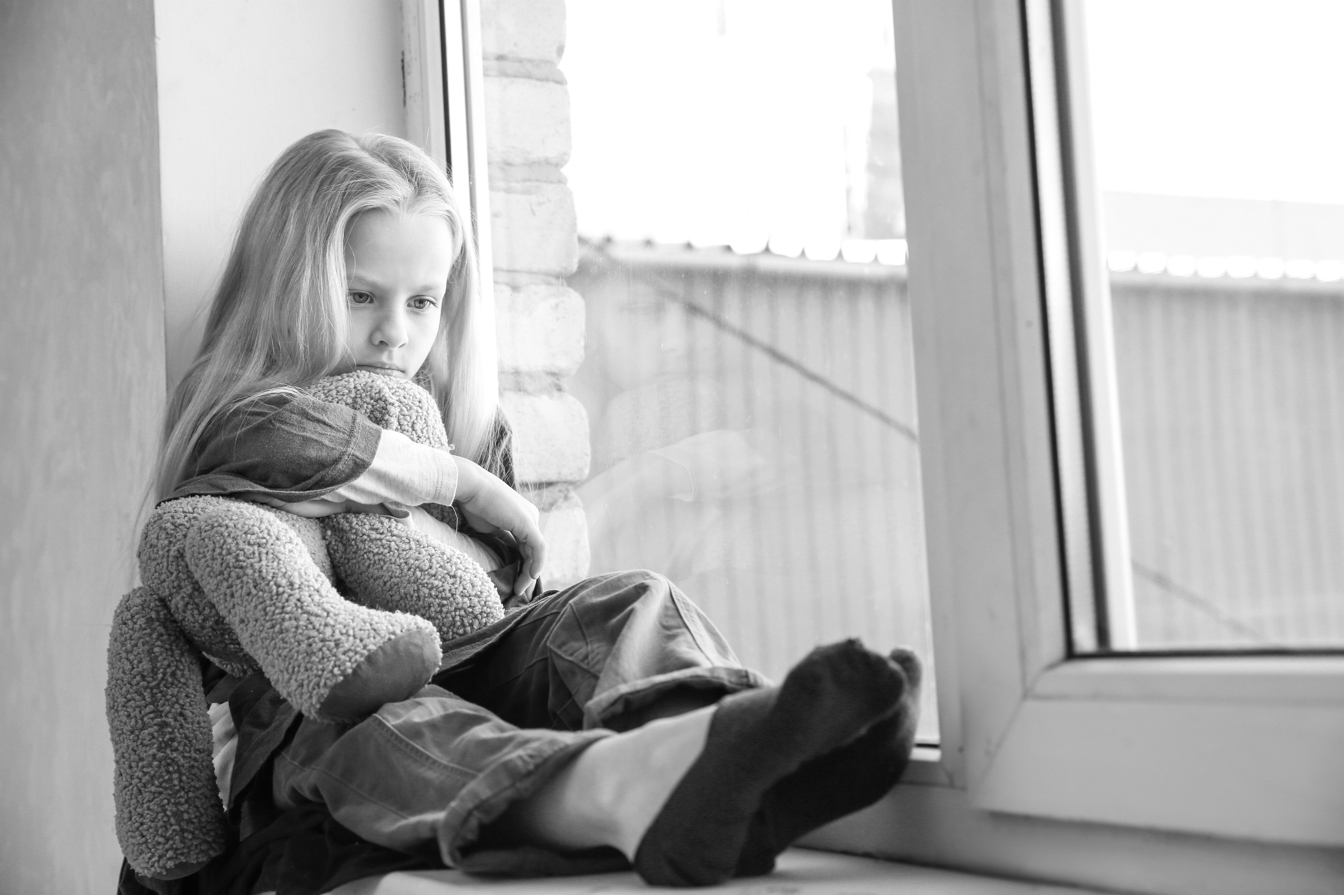
Category 1: abandonment

Slide 8
Category 1: Abandonment
A parent who fails to provide reasonable support and to maintain regular contact with their child.
Notes:
Based on the definition above, unless an exception applies, an investigator may determine that an allegation of abandonment is true if the preponderance of the evidence establishes each of the elements for at least one type of abandonment:
A/O intends for this to go on indefinitely;
A/O fails to support or maintain contact without just cause; or
A/O articulated intent to forego parental responsibility.
Discuss the two exceptions with the class: married minor exception and disrupted adoption exception.
A/O = Alleged Offender

Slide 9
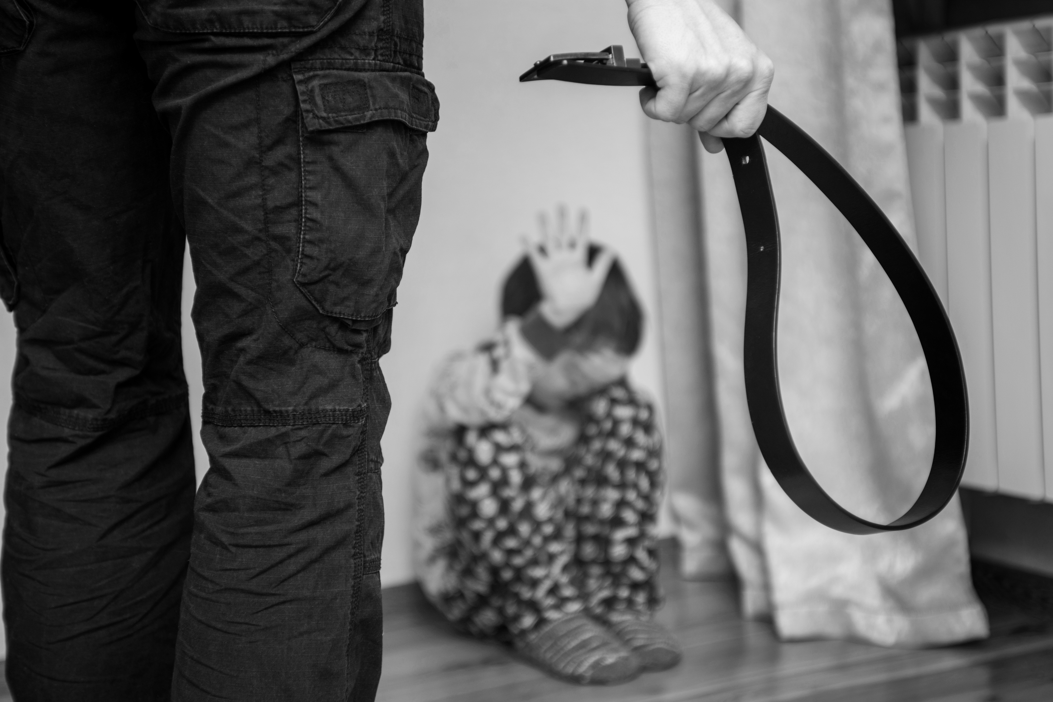
Category 2: abUSE
Notes:
Trainer note:
Abuse means any of the following acts or omissions by
A parent, guardian, custodian, foster parent; OR
Person 18 years of age or older living in the same home with a child (related or unrelated); OR
Any person that is entrusted with the child’s care including, but not limited to an agent or employee of a public or private school, a significant other of the child’s parent, or any person legally responsible for child’s welfare.

Slide 10
Category 2: Abuse
Extreme or repeated cruelty to a child;
Creating a realistic and serious threat of death, permanent or temporary disfigurement, or impairment of any bodily organ;
Injury to child’s intellectual, emotional, or psychological development;
Any injury that is at variance with history given;
Any non accidental physical injury;
Notes:
Trainer Note:

Slide 11
CATEGORY 2: Abuse
Recruiting, harboring, transporting, or obtaining a child for labor
Giving a child or permitting a child to consume or inhale a poisonous or noxious substance not prescribed by a physician;
Female genital mutilation.
Notes:
Bullet 1 continued:
or services through force, fraud, or coercion for the purpose of subjugation to involuntary servitude, peonage, debt bondage, or slavery.
Bullet 2 continued:
that has the capacity to interfere with normal physiological functions

Slide 12
CATEGORY 2: Abuse
Any of the following intentional or knowing acts, with or without physical injury:
striking a child the face or head;
shaking a child three (3) years of age or younger;
interfering with a child’s breathing;
pinching, biting, or striking a child in the genital area;
tying a child to a fixed or heavy object or binding or tying a child’s limbs together;
Notes:
Discuss & list the noted forms of abuse for the class:
Any of the following intentional or knowing acts with physical injury and without justifiable cause:
- throwing, kicking, burning, biting, or cutting a child;
- striking a child with a closed fist;
- shaking a child; or
- striking a child on the face or head.
ASK: What may ne considered justifiable cause?

Slide 13
Category 2: Abuse
Giving a child or permitting a child to consume or inhale a substance not prescribed by a physician that has the capacity to alter the mood of a child, including but not limited to;
Marijuana
Alcohol (except for religious reasons)
Narcotics;
Over-the-counter drugs
Notes:
Discuss with the class that giving a child:
- alcohol excludes alcohol given to a child during a recognized and established religious ceremony or service; AND
- over the counter drugs is considered abuse if given to the child purposely with the intention of overdose OR over the counter drugs that are inappropriate for the child that has detrimental impact.

Slide 14
Category 2: Abuse
Exposing a child to chemicals that have the capacity to interfere with normal physiological function, including chemicals used or generated during the manufacture of methamphetamine;
Subjecting a child to Munchausen’s Syndrome by Proxy or a Factitious Illness by Proxy if the incident is reported and confirmed by medical personnel.
Notes:
Trainer Note:
Discuss MSBP Maltreatment. What is MSBP Maltreatment?

Slide 15
CATERGORY 2: Abuse knowledge check
Question: What are the two exceptions listed in the PUB 357 for abuse?
Notes:
Trainer Note:
Discuss with the class the exceptions –
- physical discipline of a child when it is reasonable and moderate and is inflicted by a parent or guardian for purposes of restraining or correcting a child.
- when a child suffers transient pain or minor temporary marks as a result of an appropriate restraint.
ASK THE CLASS: How do you determine reasonable / moderate physical discipline and appropriate restraint?

Slide 16
Category 2: abuse Reasonable and Moderate?
Age, size and condition of the child
Location of the injury
Frequency/reoccurrence
DOES NOT cause injury more serious than transient pain or minor, temporary marks
Notes:
Reasonable and moderate physical discipline inflicted by a parent or a guardian does not include any act that is likely to cause, and which does cause, injury more serious than transient pain or minor temporary marks. The age, size, and condition of the child and the location of the injury and the frequency or recurrence of injuries shall be considered when determining whether the physical discipline is reasonable or moderate.

Slide 17
CATEGORY 2: Abuse IS IT APPROPRIATE?
Notes:
See if the class can guess and list what is considered appropriate restraint rules & guidelines:
Abuse does not include when a child suffers transient pain or minor temporary marks as a result of an appropriate restraint if:
Restrainer is employee of licensed agency;
Restrainer is acting in her/her official capacity while on duty;
The agency has policy regarding restraints;
Child is in danger of hurting self or others;
There are no other alternatives;
The Restrainer has been trained properly; and
Restraint is for reasonable period of time
Restraint used complies with training, policy & procedures

Slide 18
Category 3: NEGLECT
Notes:
Parents or guardians are held responsible by law to take care of their children’s basic needs. If the caretakers do not see that children’s basic needs are met, this is called neglect.
Neglect means acts or any person who is entrusted with the child’s care by a parent, guardian, custodian, or foster parent or any person who entrusted with the care child’s care by a parent, guardian, custodian, or foster parent that constitute one (1) of the following:

Slide 19
Category 3: Neglect
Failure or refusal to:
prevent the abuse of the child when the person knows or has reasonable cause to know the child is or has been abused;
provide necessary food, clothing, shelter, or medical treatment;
take reasonable action to protect the child from abandonment, abuse, sexual abuse, sexual exploitation, or neglect when the existence of the condition was known or should have been known;
Notes:
TRAINER NOTE:
Discuss the caveat for the second bullet point on parents providing food, clothing, shelter, or medical treatment -
“except when the failure or refusal is caused primarily by the financial inability of the person legally responsible and no services for relief have been offered.”

Slide 20
Category 3: Neglect
Failure or irremediable inability to:
provide for the essential and necessary physical, mental, or emotional needs of the child, including the failure to provide a shelter that does not pose a risk to the health or safety of the child;
provide for the child’s care and maintenance, proper or necessary support, or medical, surgical, or other necessary care;
although able, to assume responsibility for the care and custody of the child or to participate in a plan to assume such responsibility;
Notes:
Trainer Note:
ASK CLASS & DISCUSS – What does policy mean by irremediable inability?

Slide 21
Category 3: Neglect
Failure to:
appropriately supervise the child that results in the child’s being left alone at an inappropriate age creating a dangerous situation, or, in inappropriate circumstances creating a dangerous situation;
appropriately supervise the child that results in the child’s being placed in inappropriate circumstances creating a dangerous situation;
ensure a child between six (6) years of age and seventeen (17) years of age is enrolled in school or is being legally home schooled;
Notes:
Other forms of Neglect:
An act or omission by the child’s parent, custodian, or guardian resulting in the child being habitually and without justification absent from school;
Causing a child to be born with an illegal substance present in the child’s bodily fluids or bodily substances as a result of the pregnant mother knowingly using an illegal substance before the birth of the child; or
At the time of the birth of a child, the presence of an illegal substance in the mother’s bodily fluids or bodily substances as a result of the pregnant mother knowingly using an illegal substance before the birth of the child.

Slide 22
Summary of Garrett’s law
Notes:
The 2005 Regular Session of the 85th General Assembly of the Arkansas Legislature expanded the legal definition of child neglect in the state of Arkansas. Under the provisions of Act 1176, the term “neglect” was expanded to include the following:
The causing of a newborn child to be born with:
An illegal substance present in the newborn’s bodily fluids or bodily substances as a result of the pregnant mother’s knowingly using an illegal substance before the birth of the child; or
A health problem as a result of the pregnant mother’s use before birth of an illegal substance.

Slide 23
Garrett’s Law
Requires initiation of the investigation in 24 hours even though it is not defined as “severe” maltreatment.
When making the determination, there is now a category of “True but Exempted” for Garrett’s Law cases.
Summary of Garrett’s Law Referrals - State Fiscal Year 2023 Annual (state.ar.us)
Notes:
Trainer Note: Take a moment to review the 2023 Garrett Law Referral report with the class. Pick out key points that you would like them to notate for that come from the report.
https://www.arkleg.state.ar.us/Home/FTPDocument?path=%2FAssembly%2FMeeting+Attachments%2F550%2F26235%2FEXHIBIT+D6+-+Garretts+Law+Summary+-+SFY2023.pdf

Slide 24
CATEGORY 3: neglect knowledge check
Question: What exceptions FOR neglect are listed in the PUB 357?
Notes:
TRAINER NOTE:
ANSWER: There is one exception
PUB 357, page 17 - “except when the failure or refusal is caused primarily by the financial inability of the person legally responsible and no services for relief have been offered”. Therefore, if the neglect allegations are pertaining to food, clothing, shelter, or medical treatment, there is an exception.
**IF THE CLASS SEEMS RESTLESS – FEEL FREE TO TAKE A BREAK AT THIS POINT BEFORE CONTINUING THE POWERPOINT.

Slide 25
Category 4: Sexual abuse
Notes:
Sexual abuse is defined as sexual intercourse, sexual activity, or sexual contact by forcible compulsion. Attempted sexual intercourse, sexual activity, or sexual contact by forcible compulsion:

Slide 26
Category 4: Sexual Abuse
By a person fourteen (14) years of age or older to a person younger than eighteen (18) years of age:
Actual or attempted sexual intercourse, deviate sexual activity, or sexual contact by forcible compulsion; indecent exposure; or forcing the watching of pornography or live sexual activity;
By a person eighteen (18) years of age or older to a person not his or her spouse who is younger than fourteen (14) years of age & by a caretaker to a person younger than fourteen (14) years of age:
Grooming;
Notes:
TRAINER NOTE:
Discuss with the class that as of August 1, 2023, ACT 364 adds “grooming” to the definition of “Sexual Abuse”.
Grooming means to knowingly disseminate to a child 13 or younger with or without consideration a visual or print medium depicting sexually explicit content with the purpose to entice, induce, or groom the child to engage in the following with a person: sexual intercourse, sexually explicit conduct, or deviant sexual activity.
Not limited to an act that takes place in the physical presence of a child
Affirmative defense that the actor is not more than 3 years older than the victim

Slide 27
Category 4: Sexual Abuse
By a person eighteen (18) years of age or older to a person not his or her spouse who is younger than fifteen (15) years of age:
Actual or attempt sexual intercourse, deviate sexual activity, or sexual contact; or the solicitation of sexual intercourse, deviate sexual activity, or sexual contact;
By a person twenty (20) years of age or older to a person not his or her spouse who is younger than sixteen (16) years of age:
Actual or attempt sexual intercourse, deviate sexual activity, or sexual contact; or the solicitation of sexual intercourse, deviate sexual activity, or sexual contact;

Slide 28
Category 4: Sexual Abuse
By a caretaker to a person younger than eighteen (18) years of age:
actual or attempted sexual intercourse, deviate sexual activity, or sexual contact;
forcing or encouraging the watching of pornography;
forcing, permitting, or encouraging the watching of live sexual activity;
forcing the listening to a phone sex line;
an act of voyeurism;
or the solicitation of sexual intercourse, deviate sexual activity, or sexual contact;

Slide 29
Category 4: Sexual Abuse
By a person younger than fourteen (14) years of age to a person younger than eighteen (18) years of age:
Actual or attempted sexual intercourse, deviate sexual activity, or sexual contact by forcible compulsion; or
By a person eighteen (18) years of age or older to a person who is younger than (18) years of age, the recruiting, harboring, transporting, obtaining, patronizing, or soliciting of a child for the purpose of a commercial sex act.

Slide 30
CATEGORY 4: sexual abuse knowledge check
Question: What is the exception listed in the pub 357 for sexual abuse?
Notes:
TRAINER NOTE:
ANSWER:
Defense and Affirmative Defense Exceptions. Pursuant to 12-18-804, for any act or omission of child maltreatment that would be a criminal offense or an act of delinquency, any defense or affirmative defense, including the burden of proof regarding the affirmative defense, that would apply to the criminal offense or delinquent act is also cognizable in a child maltreatment proceeding with the exception of: a statute of limitation; lack of capacity as a result of mental disease or defect under § 5-2-312; and affirmative defenses under §§ 5-1-112 — 5-1-114.
For example, if a teacher and a student have a sexual relationship, an affirmative defense may apply. If the teacher engages in sexual intercourse or deviate sexual activity with a student less than 21 years of age and the teacher uses his or her position of trust or authority over the victim, then the conduct would fall under the definition of sexual abuse. However, if the teacher was no more than 3 years older than the student, then the affirmative defense would apply.
Staff must consult with local OCC attorney regarding possible defense and affirmative defense exceptions.

Slide 31
Category 5: Sexual exploitation

Slide 32
Category 5: Sexual Exploitation
Sexual exploitation means:
By a person eighteen (18) years of age or older to a child who is not his or her spouse:
Allowing, permitting, or encouraging participation or depiction of the child in prostitution, obscene photography, or obscene filming;
or obscenely depicting, obscenely posing,
or obscenely posturing the child for any use or purpose.

Slide 33
Category 5: Sexual Exploitation
Sexual exploitation means:
By a caretaker to a child:
Allowing, permitting, or encouraging participation or depiction of the child in prostitution, obscene photography, or obscene filming;
or obscenely depicting, obscenely posing,
or obscenely posturing the child for any use or purpose.

Slide 34
other definitions

Slide 35
Who is consider an Underage Juvenile Offender?
Any child younger than 14-years-old from whom a report of sexual abuse has been determined to be true for sexual abuse to another child.

Slide 36
What is the definition of Sexual Contact?
Sexual contact is defined as any act of sexual gratification involving:
Touching, directly or through clothing, of the sex organs, buttocks, or anus of a person or breast of a female;
Encouraging a child to touch the offender in a sexual manner; or
Offender requesting to touch the child in a sexual manner;

Slide 37
Arkansas Department of Human Services
Division of Children and Family Services
Child Maltreatment Investigation Determination Guide
PUB 357, August 2023
Training material source

