Slide 1
initial Differential Response(DR) In-home visit:
Lots to do and a short time do to it!

Slide 2
Activity Time
What We Do & Why We Do It
Notes:
Policy II-B Review – Prior to sharing the next slide participants should have completed the corresponding activity “What We Do & Why We Do It” in the Participant Manual and discussed the correct answers found in the Answer Key in the Trainer Resources
DR Referral Criteria
Identifying information for the family members/address or a means to locate;
Alleged perpetrators are parents, birth or adoptive, legal guardians, custodians, or any person standing in loco parentis;
Family has no pending investigations or open cases;
Alleged victims, siblings, or other household members are not currently in DCFS custody or wards of the court;
Protective custody of the children has not been taken/required in the current investigation; and,
Allegations is one of the 13 identified maltreatment types identified in policy
Conditions for Acceptance (DR)
Inadequate supervision
Inadequate food
Inadequate clothing
Inadequate shelter
Educational neglect
Environmental neglect
Lockout
Medical neglect
Human bites
Sprains/Dislocations
Striking a child age seven or older on the face
Striking a child with a closed fist
Throwing a child

Slide 3
Exceptions that Prohibit DR Referral
Policy II-B
A. Inadequate Supervision reports involving a child or children under the age of five or a child five years of age and older with a physical or mental disability which limits his or her skills in the areas of communication, self- care, self-direction, and safety will be assigned the investigative pathway.
B. Educational Neglect reports involving a child that was never enrolled in an educational program.
C. Environmental Neglect reports involving a child or children under the age of three; and those situations in which the hotline assesses an immediate danger to the child’s health or physical well-being based upon the severity. Division of Children and Family Services 27
Notes:
Policy II-B Review – Prior to sharing this slide participants should have completed the corresponding activity “What We Do & Why We Do It” in the Participant Manual and discussed the correct answers found in the Answer Key in the Trainer Resources
DR Referral Criteria
Identifying information for the family members/address or a means to locate;
Alleged perpetrators are parents, birth or adoptive, legal guardians, custodians, or any person standing in loco parentis;
Family has no pending investigations or open cases;
Alleged victims, siblings, or other household members are not currently in DCFS custody or wards of the court;
Protective custody of the children has not been taken/required in the current investigation; and,
Allegations is one of the 13 identified maltreatment types identified in policy
Conditions for Acceptance (DR)
Inadequate supervision
Inadequate food
Inadequate clothing
Inadequate shelter
Educational neglect
Environmental neglect
Lockout
Medical neglect
Human bites
Sprains/Dislocations
Striking a child age seven or older on the face
Striking a child with a closed fist
Throwing a child

Slide 4
DR Referral Exceptions (cont.)
Policy II-B
D. Lock out reports involving a child or children under the age of ten; and those situations in which the hotline assesses an immediate danger to the child’s health or physical wellbeing based upon the severity.
E. Medical Neglect reports involving a child or children under the age of 13 or a child with a severe medical condition that could become serious enough to cause long-term harm to the child if untreated will be assigned the investigative pathway.
F. Reports of human bites, sprains/dislocations, striking a child age seven or older on the face, striking a child with a closed fist, and throwing a child when these allegations occurred:
1) Less than one year ago; and/or,
2) If the caller to the hotline can verify an injury either through physical signs (e.g., scarring), medical information, dated photographs, etc.

Slide 5
Before you go out be sure to:
Interview collaterals
Complete a CLEAR search
Familiarize yourself with DCO Records
Complete a search in the Division Information Management System
Identify household members
Call the family

Slide 6
First Home Visit (72-Hours)
Upon meeting the family, explain what Differential Response (DR) is to the family and your requirement to assess for worries about safety and potential need for services.
Be sure to obtain the full names and birth dates of all household members, relationships of household members, and any children not listed in the report.
Obtain information on non-custodial parent(s)
Full name
Birthdate
Address(es)
Assess the health and safety of the family and children at the residence

Slide 7
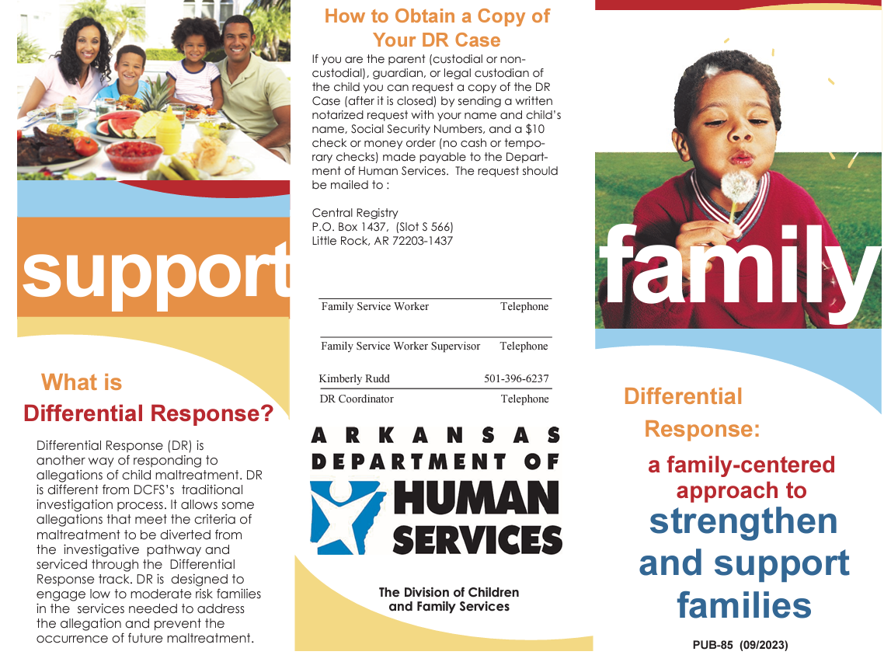
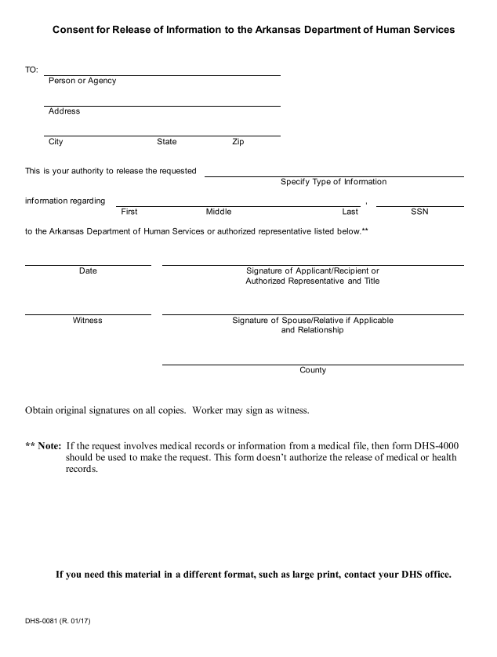
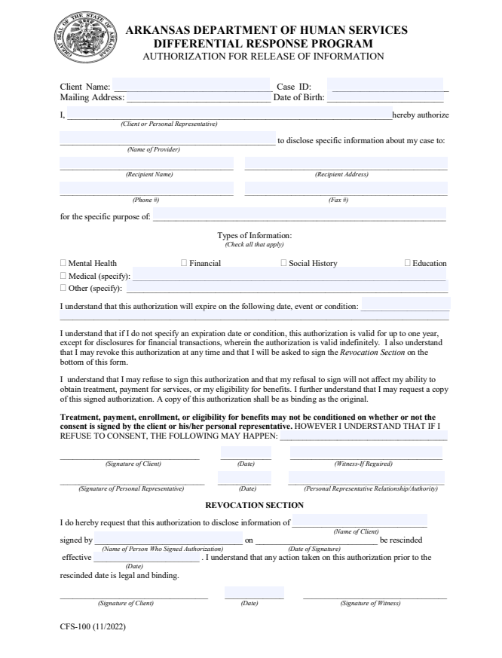
Take and review the following forms/publications:
PUB-85
CFS-0081
CFS-100

Slide 8
After the visit
Conference with the DRT (Differential Response Team) Supervisor
Within 24 hours, document all activities in the Division Information Management System (CHRIS)
Within 5 days, visit all other household members
Within 14 days, complete the Family Assessment and the Family Plan and conduct subsequent home visits

Slide 9
working the case
Family Assessment be sure to do it WITH the family
Initiate and provide the services
Identity formal and informal supports
Visit the family at minimum 2 times per week
Develop Community Partnerships
Collaborate with the family to develop an Aftercare plan
Be sure to document the entire process

Slide 10
Important timeframes
Within the first 30 days, complete the plan or get an extension if needed
Within the first 45 days, if the plan has not progressed complete the plan or get a 2nd extension
Check the policy and consult with your supervisor if the plan is not complete within 60 days from the date of the report.

