Slide 1
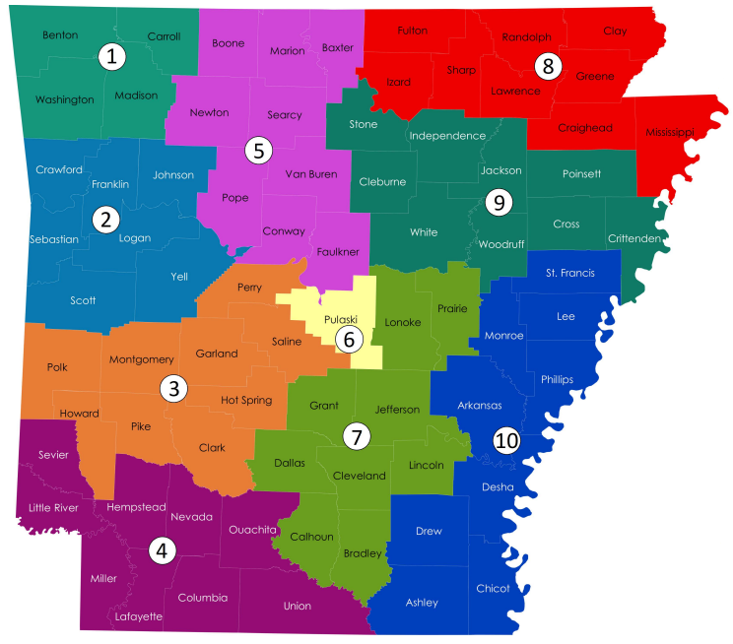
AR Department of Human Services – Division of Children and Family Services - Area Map
DCFS Area Directors
Area 1 Natosha Lowrey - Washington Co.
479-304-8949 (w) / 479-422-1355 (c)
Area 2 Sarah Sharum - Sebastian Co.
479-424-5601 (w) / 479-650-4283 (c)
Area 3 Patrice Judd – Clark County
870-246-9886 ext.117 (w) / 870-260-0326 (c)
Area 4 Chalonda Williamson - Miller Co.
870-330-8202 ext. 111(w) / 870-918-1619 (c)
Area 5 Latrinia Joyner - Faulkner Co.
870-449-4058 ext. 111(w) / 501-786-5172 (c)
Area 6 Sandra Hawkins- Pulaski Co.
501-682-9265 (w) / 501-551-9706 (c)
Area 7 Angela Newcomb – Jefferson Co.
870-535-7000 (w) / 870-917-8850 (c)
Area 8 April Faughn - Craighead Co.
870-910-8473 (w) / 870-335-5587 (c)
Area 9 Andrea Ferren- White Co.
501-203-2823 (w) 870-270-6889 (c)
Area 10 Cassandra Scott - Arkansas Co.
870-456-5103 (w) / 501-626-1728 (c)

