Slide 1
Testimony
Being the Best Witness

Slide 2
10 Characteristics of Professionalism
Dress for success
Be confident, not cocky
Do what you say you will do
Be an expert in your field
Behave morally and ethically
Maintain your poise
Have good phone etiquette
Strike the right tone
Be structured and organized
Own up to mistakes
Source: Characteristics of Professionalism, by Chris Joseph. Used in part from DCFS Court Prep Training (Heather Fendley)

Slide 3
Maintain DCFS values
While working with households

Slide 4
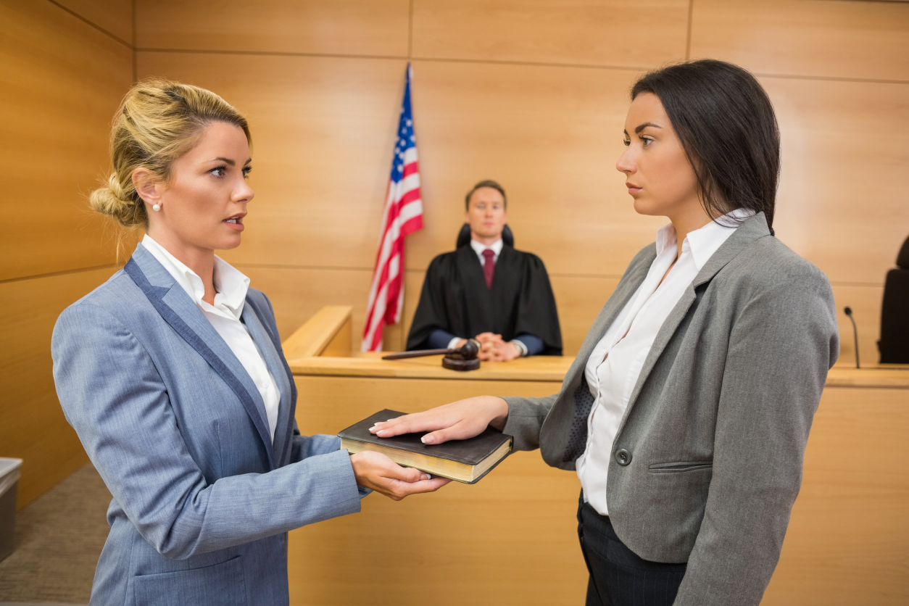
DIRECT EXAMINATION BY AN ATTORNEY
Answer only the question posed to you by the attorney in a concise manner
Do not volunteer information that was not asked
If interrupted by the attorney, move on and answer the next question
Answer questions in your own words to tell your story about this child and family
Testimony should flow smoothly in a question-and-answer format.
Notes:
DIRECT EXAMINATION BY ATTORNEY WHO CALLS YOU AS A WITNESS
On direct examination, answer the question posed to you by the OCC attorney. He or she will give you the freedom to explain your answers in some detail.
Answer questions in your own words. This is your opportunity to tell your story about this child and family.
If the attorney cuts you off, do not pick up where you left off. Answer the next question posed to you in a concise manner.
Answer only the question posed. Do not volunteer information that was not asked.
Remember: Testimony should flow smoothly in a question-and-answer format.

Slide 5
Know DCFS Policy, if it applies to the case
If you use policy, use it correctly.

Slide 6
WHAT IF I KNOW SOMETHING THAT IS NOT FAVORABLE TO THE DEPARTMENT?
What do to…

Slide 7
Give your OCC attorney a heads up before court if you know of any unfavorable facts regarding DCFS casework the case
This allows the OCC to prepare and draw out the information in the most favorable light for everyone involved
This ensures opposing counsel cannot get as much “shock value” out of a negative answer or bad facts.
On direct examination, you can explain the WHY behind the negative information and the plan of action
If you say you are going to do something, follow through.
Notes:
Prior to Court, you must share any bad facts with the OCC attorney. If you discover something was not done let them know and have a plan to address it when asked by the court. Then, the attorney can draw this information out in the most favorable light for everyone involved. The OCC attorney is not “selling you out” by doing this, but rather is trying to make the best case he or she can for the Agency. That way, opposing counsel cannot get as much “shock value” out of a negative answer or bad facts.
Also, on direct examination, you can explain the WHY behind the negative information and the plan of action.
Remember if you say you are going to do something within a specific timeframe

Slide 8
Answer questions posed by the other attorney with a simple "YES" or "NO" unless the question CANNOT be truthfully answered with a simple “YES" or “NO.“
If the other attorney tries to force you to answer only "yes" or "no" and that answer would not be truthful, SAY SO. The Court will probably allow you to explain your answer under those circumstances.
If the question the attorney asks is improper, the other attorney, or even the judge himself, will object.
Otherwise, just answer the question truthfully.
Notes:
Prior to Court, you must share any bad facts with the OCC attorney. If you discover something was not done let them know and have a plan to address it when asked by the court. Then, the attorney can draw this information out in the most favorable light for everyone involved. The OCC attorney is not “selling you out” by doing this, but rather is trying to make the best case he or she can for the Agency. That way, opposing counsel cannot get as much “shock value” out of a negative answer or bad facts.
Also, on direct examination, you can explain the WHY behind the negative information and the plan of action.
Remember if you say you are going to do something within a specific timeframe

Slide 9
CROSS EXAMINATION
Answer questions posed by the other attorney with a simple "YES" or "NO" unless the question CANNOT be truthfully answered with a simple “YES" or “NO."
If the other attorney tries to force you to answer only "yes" or "no" and that answer would not be truthful, SAY SO. The Court will probably allow you to explain your answer under those circumstances.
If the question the attorney asks is improper, the other attorney, or even the judge himself, will object.
Otherwise, just answer the question truthfully.

Slide 10
Effective Testimony: On the witness stand

Slide 11
Effective Testimony
While on the witness stand, try not to get upset or seem argumentative with the attorneys.
Use your professional voice and proper grammar when testifying. Your tone and grammar, like your posture and dress, are indicators of your credibility.
Your tone should be conversational, but loud enough to include everyone in the courtroom in your conversation.
Do not nod your head in response to a question. Always verbalize your responses in a confident voice. The court reporter must record your every word in order to make an accurate record of the hearing.

Slide 12
Effective Testimony
Make sure you understand the question before you attempt to answer it.
Do not rush into answering a question. It's okay to take a moment to make sure you understand the question. However, do not take an unnaturally long time to respond either. This makes you appear to not know the answer.
If you don't understand the question, SAY SO.
Ask the attorney to repeat the question, if necessary.

Slide 13
Effective Testimony
After you have fully answered a question, if any attorney continues to press you for more information, answer in the following manner: "That is all that I recall," or "That's all I remember happening.“
That way, if counsel has more information about what has occurred or was provided with erroneous information about what occurred, you will only appear to have forgotten a detail.

Slide 14
Silence/Turn Off Cell phones
Phone Etiquette
Notes:
Preferably, you should not have cell phones or Bluetooth headsets in the Courtroom at all.
However, if you do bring your cell phone into the courtroom, make sure it is OFF or on SILENT.
Absolutely, no answering of cell phones while inside the courtroom. Step into the conference room or hallway to make and receive calls.

Slide 15
Effective Testimony
Preferably, you should not have cell phones or Bluetooth headsets in the Courtroom at all.
However, if you do bring your cell phone into the courtroom, make sure it is OFF or on SILENT.
Absolutely, no answering of cell phones while inside the courtroom. Step into the conference room or hallway to make and receive calls.

Slide 16
When the Judge Speaks, Remain Silent
No one, not even the attorneys, should speak when the judge is speaking.
This rule applies even if the judge cuts you off in the middle of testimony.
Never argue with the judge. It is OPLS’s job to advocate for the Agency’s position.
The judge is the trier of fact in your cases. You do not want to fall out of his or her favor.
If you fall out of the judge's favor, you can expect: your cases to be scrutinized more closely, the judge himself will question you more often, your mistakes may stand out more.
This does not necessarily mean the judge is biased against you. It does mean you have called attention to yourself in some negative manner which causes the judge scrutinize you more closely.

Slide 17
Credible Testimony
Tell the TRUTH! When you are a witness you take an oath to tell the truth, so make sure you do so.
Lying in court is referred to as Perjury. This is a crime. If you commit this crime and are held in contempt, OCC attorneys are not obligated to represent you.
Every MATERIAL TRUTH (true facts which are pertinent to the case) should be readily admitted, even if the fact is detrimental to the Department.
DO NOT EXAGGERATE! Just answer the questions to the best of your ability.

Slide 18
Credible Testimony
When testifying, DO NOT LOOK AT OTHERS FOR HELP! You are on your own. If anyone even appears to assist, they could be accused of WITNESS TAMPERING. This, like perjury, is a crime. If you commit this crime and are held in contempt, OCC attorneys are not obligated to represent you.
Answer the question in the same calm, reserved, straightforward manner in which you answer all other questions. It hurts the Department more when you try to avoid answering.

Slide 19
Effective Testimony
Speak loudly enough for everyone in the courtroom to hear the response, but not so loud as to be obnoxious.
Your tone and grammar, like your posture and dress, are also indicators of your credibility.
Your tone should be conversational, but loud enough to include everyone in the courtroom in your conversation.

Slide 20
Effective Testimony Best practices

Slide 21
Best Practices
Use phrases such as, “As the Family Service Worker assigned to the case, I observed…” “The Department’s recommendation is…”
Avoid using the following phrases: "I think," "I believe," or "In my opinion.“
Remember: The Court is only interested in FACTS. The Judge should be left to draw his or her own conclusions and make his or her own decisions.

Slide 22
Best Practices
Don't offer your opinion unless specifically asked for it, especially if your personal opinion differs from DHS policy and procedures.
NOTE: Your personal opinion should NEVER be given at all. When asked your opinion, it should ALWAYS be your PROFESSIONAL opinion. And your professional opinion should ALWAYS BE BASED ON DHS POLICY & PROCEDURES.

