Slide 1
Deep dive module 6: Immediate safety planning
No network, no plan; STRONG NETWORK, STRONG PLAN
Notes:
Example
Those of you in resource and adoptions may be wondering why you are sitting in on a training for immediate safety planning. Immediate safety planning can be used in several ways in resource and adoptions. It could be used to help maintain a child in a resource home or pre-adopt if a report has been called in to the hotline. They can also be used to work with a family who has adopted a child and shows signs of a potential disruption. Immediate safety planning can be used when siblings are being placed together and one child previously harmed the other child. A safety plan needs to be in place to ensure it doesn’t happen again. An immediate safety plan is also useful for a child who struggles with self-harm.
Trainer Note
Immediate safety plan (formerly protection plan)

Slide 2

Land Acknowledgment
Notes:
Example
It is important for each of us to reflect on our place on the land, its history, and how we affect the land and its people.
In Arkansas, we recognize the Caddo, Chickasaw, Osage, Quapaw, and Tunica peoples as the original stewards of the land. The mural on the screen shows which regions of Arkansas each tribe inhabited.
We further recognize that a portion of the Trail of Tears runs through what is now Arkansas and that the Cherokee, Choctaw, Muscogee (Creek), Chickasaw, and Seminole Nations crossed the land during this forced removal.

Slide 3
WELCOME AND INTRODUCTIONS
Notes:
Example
Introduce yourself and have participants do quick introductions.

Slide 4

Review and reflect
What have you tried from the last module?
What worked well? What were the challenges?
How did you handle those challenges?
Notes:
Trainer Note
Remind participants the previous module was on building safety and support networks and is crucial to today’s module. If we cannot help families build their safety and support networks, we cannot create successful immediate safety plans.
As people report on their experiences, take note so that you can build on them during this module.
Pay particular attention to how challenges were handled. Make suggestions about where there might be challenges in this new module and how to build on strengths from last month.
One idea is to have participants write their experiences on notecards. On one side of the notecard, they can write what worked well when they tried a new practice. On the other side, they can write a challenge they had. These notecards can be collected and some can be read out loud, or participants can volunteer to read their cards. Notecards can be collected and posted on a storyboard in your office.

Slide 5
Shared Agreements
Notes:
Example
We should always take a few minutes to check in and agree on how we will work with one another to help prevent miscommunication. During this time, how do we want to work together? How do you want to be treated? How do you want to treat others?
Give time for participants to create some shared agreements. You may mention a few standard shared agreements to help them start thinking.
Taking time to build strong agreements for our work with families is an essential first step. It sends the message that:
We (the caseworker and family members) are in this together;
We respect family members by inviting them to shape our process for working together; and
We want to start the conversation about how to work and communicate across difference.
The process of building agreements is also a time to ask family members about their perspectives and needs related to trauma. How might it feel for a family member when you take time to hear their thoughts about the best ways for them to interact with you and work together?
As we discuss Safety-Organized Practice (SOP) today, think about the differences in the room that may affect how we talk openly about this important topic that has such huge implications for the children and families in our communities.

Slide 6
Immediate safety plans
Notes:
Trainer Note
Ask participants to think about and discuss the following in small groups.
Think about the best immediate safety plan you have written or seen.
Think about an immediate safety plan that you struggled with or that was not effective at controlling the safety threat.
What makes the difference?
In the large group, elicit the highlights of the discussion.
Immediate safety plans take time to develop. It can be difficult for staff to shift from being in a hurry to do everything post-removal to slowing down to invest in a pre-removal plan to keep the child safely in the home.
Supervisors must remember not to approve plans without at least one network member involved in the action planning and supports.
Supervisors and resource staff: If kin are being considered for provisional placement after a removal, question why those same kin could not be part of a plan to maintain a child safely in the home. Helping one another slow down and consider the possibilities could help support a family in the long term.

Slide 7

What is aN immediate safety plan?
Notes:
Trainer Note
Ask participants to take a few moments in their small groups to answer the question: What is an immediate safety plan? In a large-group discussion format, look for responses like these and record them.
An agreement with the caregiver and network about actions they will take to mitigate the safety threat to the child. Remember, no network, no plan.
To help ensure child safety, supervisors should not sign off on immediate safety plans if there is not at least one responsible adult who was not part of the suspected maltreatment.
If there isn’t at least one safety and support network member available and a safety threat has been identified, the child must enter foster care and be placed in a resource home until a network can be developed. (In all situations, consider kin as an option in immediate safety planning prior to considering the family unsafe and moving toward removal.)
A plan that controls the safety threat and lets the child stay in the family’s care when the child would otherwise be placed in protective custody or, if child was in a pre-adoptive home or resource home, moved to a different placement.
Resource and Adoptions
Immediate safety plans may look a little different for resource and adoptive families. The harm/worries may not rise completely to a safety threat; however, we hold our resource and adoptive families to a higher standard. It may be more about getting a network in place for the resource/adoptive family who is overwhelmed or about helping to keep children who are a danger to themselves safe. When we get a report on a resource family—especially provisionals—what immediate actions can the family and their network take to help the child remain safely in the home? Having to move resource homes can be very traumatic for a child, and we want to reduce their moves as much as possible. We must be diligent in our assessments to ensure we have done everything we can to maintain placements. Despite this, there will be times when it is not safe for the child to remain in a resource home and it is in their best interest to move.

Slide 8





AN Immediate safety plan . . .
Is an action plan for controlling the threat
Responds
to clearly identified safety threats
Is short term
Must include
family, network,
and older children
Has clear backup
and monitoring plans
Designates a clear time for review
Notes:
Trainer Note
Explain the main points from the slide.
Is an action plan for controlling the threat: The plan clearly states the action that each person will do to immediately contribute to the child’s safety. We are not looking at behavior change here (remember, we cannot plan only with the caregiver who was responsible for the safety threat); we are looking at immediate actions that the network, child, and family can take to promote safety. This is not just about what the caregiver will not do. For example, we cannot just say that the caregiver will not use corporal punishment, or the caregiver will not use illegal substances. If they were not going to do those things, they wouldn't have done them to begin with. We need to focus on what everyone WILL do to promote immediate safety.
Resource and adoptions staff: What actions can be taken by a network to support the resource family and child while keeping the child safe and preserving the resource or adoptive placement? Can DCFS offer additional supports (intensive in-home services, qualified behavioral health professional, respite, etc.)?
Responds to clearly identified safety threats: The plan clearly states the safety threat in the “caregiver, behavior, impact on the child” format and states each involved person’s immediate next steps to control or mitigate that safety threat. Remember that generally, there is a specific context for when the maltreatment happens. Make sure action steps clearly respond to this context. For example, a mother gets overwhelmed at bedtime due to her 5-year-old refusing to go to bed and she beats him, leaving marks on his legs and back. We would want to make sure that a network member or non-offending caregiver is there at bedtime to help her get the child to sleep. This action would directly respond to the identified safety threat.
Is short term: Immediate safety plans should not last any longer than 30 days. During that 30 days, help the family build a strong safety and support network capable of ensuring child safety.
Must include family, network, and older children: Immediate safety plans should include the family and any children who are old enough to contribute to their own safety. For example, a child who has a phone and can call DCFS or a network member if the immediate safety plan is not working, or who can call to check in three times a day with a network member or DCFS. Plans should also always include at least one network member. We cannot plan for safety only with the people we are worried about. There has to be at least one other person who could not have caused the harm.
Has clear backup plan and monitoring plans: There needs to be a clear backup plan if the original plan begins to fail. We need to know exactly what everyone involved in the plan is going to do if things fall apart. We also need to know who is going to be checking in, when, and what everyone’s roles will be. For example, the neighbor may stop by in the mornings, the grandmother may come four nights a week to help care for the children, and the landlord may come over the other three nights, and these people will call DCFS if they have any worries or the plan is not working.
Resource and adoptions staff: Is it necessary for monitoring to focus on a specific time of day when the child may be reacting to specific stimuli and the resource/adoptive parent is reacting to the child’s behavior? Build education and understanding while demonstrating appropriate responses through the network members who are assisting. Consider professionals as network supports when necessary.
Designates a clear time for review: Everyone involved in the plan should know the review date. They should be reviewed no more than every 14 days (policy is currently 30 days; however, best practice is 14 days). They should be reviewed sooner if there are worries that the plan is not working.
Things to consider when reviewing the plan: Who put the immediate safety plan in place? Are they to remain responsible for monitoring on behalf of DCFS or will someone else be introduced through a warm handoff? Make sure DCFS knows who will initiate reviews of the plan and who will monitor the plan. Plans that must remain in place after 30 days to ensure child safety must be filed with the court.

Slide 9
CFS-200: Immediate safety Plan
Notes:
Example
Let’s turn to the CFS-200: Immediate Safety Plan in your participant guide. Review the form in groups (facilitator can choose small groups or a large group review)
How is this plan different than plans you have done or have seen in the past?
What works about this plan?
What are you worried about?
As a Reminder: Your participant manual contains Tips for Writing a Strong Immediate Safety Plan and Steps for Immediate Safety Planning to help when you’re in the field.

Slide 10


What is an immediate safety plan?
Content
Process
Notes:
Example
The process of creating an immediate safety plan is as important as what is written on the immediate safety plan—or even more so. Engaging the family and developing the immediate safety plan with them will help make the plan more than a piece of paper. Process supersedes content every single time! If the family does not understand the process, they most likely will not be able understand the content.
Most agencies have an immediate safety plan document that requires caregiver signatures, but getting a signature at the end is not engagement. We must work with the family every step of the way to the extent that they will let us. We cannot wait for the family to engage us; we must lead them into engagement. Their prior experiences may have taught them what we will do to them. We must extend ourselves to show them that we want to work with them. As we do this, we cannot lose sight of child safety.
Demonstrating a desire to maintain their children in the family home through actively building safety and support networks takes time and requires building of rapport. This is frustrating when you are standing in a home at 2:00 a.m., but the long-term benefits are worth the work on the front end. Build trust with the family so you don’t have to locate foster home placement for the children, thereby preserving the family; encourage the family to find their own solutions now and empower them to find solutions in the future, thus decreasing DCFS involvement. Go slow now to go fast later.

Slide 11

Words matter
How can we help the caregiver and network understand what we mean by “safety threat” and “actions of protection”?
Notes:
Example
Immediate safety planning is an intervention, not just a document. Part of immediate safety planning is reaching clarity with the caregiver and network about the specific safety threats that are the focus of our intervention. We can offer a clear explanation about the purpose, process, and structure of an immediate safety plan, but first, we must reach agreement with everyone about the safety threat that the plan will focus on controlling.

Slide 12

SAFETY AND BELONGING
Safety: Actions of protection, taken by the caregiver and network, that address the safety threats and are demonstrated over time.
For older youth: Strengths demonstrated as protection
and connection.
Notes:
Trainer Note
Remind participants that:
Safety is a verb/action—something that the caregiver does;
Safety reflects the behavior we want to see (i.e., what is done in place of the behavior we are worried about);
Belonging is feeling connected to others and, for youth, fitting into their environment; and
Safety is “north” on the compass that guides our work.
In most cases, we are working with a caregiver and we define safety as actions of protection, taken by the caregiver and network, that address the safety threats and are demonstrated over time. First, we need to get a shared understanding of child safety.
For older youth: Strengths demonstrated as protection are when a youth’s behaviors begin to promote their own safety and well-being. When thinking about their sense of belonging, it could be defined as “actions of connection, taken by the caregiver and network, that promote enduring relationships to family, community, and culture and are demonstrated over time.”
Boffa, J., & Podesta, H. (2004). Partnership with families and risk assessment in child protection practice. Protecting Children, 19(2), 36–48.
Adapted over time by Andrew Turnell and members of the Massachusetts Child Welfare Institute.

Slide 13

How can we help families think, plan, and work with us to build a bridge to child safety, especially when everyone is frightened about what might happen next?
Notes:
Example
We want to collaborate with families and their networks to develop rigorous plans that ensure child safety within the household or family system.
Engagement begins from the moment you knock on the door, as the family develops impressions of how you will be working with them. The way you approach the family and ask questions during the structured safety assessment communicates whether you are interested in them as a family and whether they will be given a voice. This does not mean that you abandon responsibility for child safety. It is possible to engage the family and focus on child safety. Even in circumstances with several serious safety threats, you can be respectful, empathetic, objective, and culturally responsive. Engagement does not mean ignoring danger.
After you have completed your assessment of immediate child safety, and there is at least one safety threat confirmed, you must address that threat immediately, before you do anything else. You need to get the family engaged in immediate safety planning. Everyone, including you, may feel frightened and anxious about what comes next.
What are some ways that you engage the family when there is a safety threat to the child? How do you show respect, empathy, objectivity, and cultural responsiveness?

Slide 14
immediate safety plan Building Blocks
Notes:
Example
Let’s consider how using SOP tools and practices with families can help make immediate safety plan creation a collaborative process that supports strong commitment and understanding of the plan.

Slide 15


What Are We Worried About?
Ask questions that reveal . . .
Caregiver
Behavior
Impact on the Child
Notes:
Example
All of our work should revolve around the caregiver, behavior, and impact on the child. This is extremely helpful in identifying whether there is truly a safety threat. If the caregiver’s behavior doesn’t have significant impact on the child, then it does not rise to a safety threat and there is no need for an immediate safety plan.
However, if the caregiver’s behavior does have significant impact on the child, we need to focus on creating our immediate safety plan around that behavior, its impact on the child, and how we can immediately mitigate the safety threat and promote the child’s safety through immediate actions taken by the family, network, and older children. This framework helps to articulate what is going on to the family and network. This also is the base for the worry statement you will include in the immediate safety plan.

Slide 16

Assess safety and Safety Threat
Worries
Working well
Next steps
From “assessment on” to “assessment with”
Notes:
Example
You can use the simple three-column map and solution-focused questions to gather and organize information and to support critical thinking with the family around the Three Questions.
As we ask the Three Questions, we want to really focus on caregiver, behavior, and impact on child. For a rigorous and balanced assessment and to build a strong immediate safety plan, we need to know what caregiver behaviors positively impact and promote safety of the child and their behaviors that are dangerous to the child.
Each family and each circumstance is different. A collaborative brainstorming process is ideal as you begin planning, and the steps we will discuss reflect this. In some instances, the danger is so immediate or the family so unwilling, unable, or unready to engage in a collaborative process that you simply have to take more control. But you should do so only when necessary and only for as long as necessary, and you should be deliberate about your choice of style. For example, some families may be direct and immediately use a to-the-point approach. You may need to help such families adopt a more collaborative approach to avoid becoming deadlocked.
Once you have the information and are reaching clarity about the barriers and most important areas to address, then you can talk with the family about next steps. While there will always be “bottom lines” and non-negotiables, most of the time, you and the family will try to build a plan together that the family can feel ownership of. This spirit is captured in Margaret Wheatley’s idea: People support what they have a hand in creating.

Slide 17
Three-Column Mapping
What are we worried about? | What is working well? | What needs to happen next?
Harm, safety threat(s), risk, and complicating factors | Safety, protective capacities, and strengths | Creating and sharing a worry statement, enhancing a network, and planning
0
10
Notes:
Example
Let’s assume you have a reasonably cooperative family and a legal caregiver to create an immediate safety plan with. Now we are going to analyze the information we have to develop a safety intervention.
First, identify what the family can build on. We are looking for protective capacities and safety interventions, which are not the same thing. Protective capacities are specific, immediately available skills or characteristics that can directly mitigate the existing safety threat. Build the plan’s supports around exceptions and actions of protection that the family has used well in the past to address current child safety.
If you cannot identify protective capacities in the caregiver, child, or network, either because the caregiver cannot be located or will not cooperate at all, you cannot create an immediate safety plan.
If there is no engaged caregiver who can understand the safety threat, it is hard to imagine how to build a plan without bringing in outside individuals to protect the child. An example might be a hospitalized caregiver in a coma who will likely recover.
Worker convenience and workload issues put pressure on to complete an immediate safety plan quickly. This is understandable but best to avoid whenever possible. You might finish an immediate safety plan quickly, but without buy-in, it is more likely to fail, requiring placement. Rushing through immediate safety planning costs more time and money in the long run. Immediate safety planning with the family also sets the stage for longer‑term planning.
Remind the family of the specific safety threats that must be addressed and what they have to work with and ask them what they could do or arrange for to ensure the child is protected from the safety threat. Asking the family first does not mean you will accept their suggestion; it indicates that you are willing to listen, see their capability, and recognize that they may have a great idea.
One starter phrase is “Some families have tried this . . .” What are some other options? (“I heard about . . .” “What would you think of . . . ?”)

Slide 18

Solution-focused questions
Exception
Scaling
Relationship
Coping
Preferred future
Notes:
Example
Solution-focused questions (SFQ) are a starting point for a more detailed discussion with families about these plans. Remember SFQs are at the root of all safety-organized practice.
Exception questions: These are the cornerstone SFQs. They can reveal instances where the problem could have occurred but did not, help us see a balanced picture of the family, and help everyone (including the family) see that change is possible.
Scaling questions: Yes-or-no questions can pigeonhole someone. For example: When you were high last night, do you think your child was safe? A scaling question can lead you to engage in further discussion. For example: On a scale from 1 to 10, 1 being not safe at all and 10 being totally and completely safe, when you were high last night, how safe was your child? Always use scaling questions for willingness, confidence, and capacity before making a plan. A person can be willing and confident but have no capacity. Scaling questions are a good way to gauge whether a person will work with the plan.
Relationship questions: Who do you think your parents would want to know? What do you think they would do with the knowledge? If your 5-year-old were here, what would he say he was worried about? What would your network say should happen next?
Coping questions: What has helped you get through this difficult time? How can we use the ways you have coped to help build short-term safety?
Preferred future questions: For now, the focus is on immediate safety, but preferred future questions can describe what safety looks like in the short term. For example: If we put a plan together to control the safety threat we have been talking about and felt really confident that your child would be safe tonight, what would we notice?

Slide 19

GEMS OF CLARITY
Harm statements
Worry statements
Notes:
Example
Using harm and worry statements to support shared understanding of the safety threat can serve as a starting place for deep, meaningful discussions with families about a plan to control for that safety threat.
As a reminder: Harm statements refer to the past maltreatment that has already occurred. Worry statements are what we are worried will happen if nothing changes.
Worry statements also help keep everyone focused on the specific safety threat and the context in which we are worried it may happen.
Focus everyone on the impact on the child so we can mitigate the worries as a team.
Be sure to include the worry statement in the immediate safety plan so that the family and everyone involved knows exactly what the worry is.

Slide 20

Cornerstone of SOP: Building Networks
You cannot create safety solely with the people you are worried about.
Notes:
Example
Raise your hand if you’ve ever had a sleepless night worrying about a family where you made a plan only with the caregiver who caused the harm.
A cornerstone of SOP is to engage at least one additional person who could not have caused the harm in the immediate safety plan. The investigator or differential response worker gets the first network member involved, and ongoing workers can build on that and add as many network members as needed to cover all the worries. DCFS is doing a great job of locating kin as provisional placements for children entering foster care; let’s see if we can use those same kin to build a safety and support network and maintain children safely in their homes.
Immediate safety plans rely upon the actions taken by caregivers with support and accountability from their networks. When it comes to controlling the immediate safety threat, remember that without at least one network member participating, there cannot be an immediate safety plan. “No network, no plan!” Supervisors should not approve immediate safety plans without at least one network member involved in the plan’s creation and implementation.
We cannot plan for safety only with the people we are worried about. We must start with at least one other person who could not have caused the harm.
The goal of building networks is that the family will . . .
Become less isolated;
Have people in their life, by choice, who can help them reduce risk and increase safety;
Reduce dependence upon professional supports who will eventually go away;
Reduce the likelihood of a new referral because the network stepped in; and
Reduce the likelihood of resource and adoptive parents becoming overwhelmed by child behaviors.

Slide 21
The Safety House
DEVELOPED BY
SONJA PARKER
A tool to help children and young people understand and participate in the safety planning process.
v
v
Notes:
Example
This technique was developed by Sonja Parker of SP Consultancy based in Perth, Australia.
The rules that the child creates should be considered in developing action steps in immediate safety planning.
The people who are in the house and helping should be contacted as potential network members.
The people who aren’t allowed in the house should also be planned around to ensure the child’s worries are addressed.
Resource and Adoptions
Resource and adoption staff should consider everything about the safety house. DCFS becomes “comfortable” in thinking that resource homes are safe for children. Resource and adoptive parents experience frustrations and anger, as do all humans. Don’t forget that resource homes generally are safe because they have a lot of support from DCFS and other agencies. Building a good safety and support network and monitoring through tools like the Safety House and three-column mapping are integral parts of ensuring child safety during placement and adoption, as applicable.

Slide 22



Network Member Requirements
A person the child/family cares about
Cares about child/family and their physical/ psychological safety
Knows and understands the safety worries that DCFS and others have about the child/family
Willing and able to support child/family in attaining the safety outcome; willing to work closely with DCFS
Notes:
Example
The requirements to be a safety and support network member are a little more stringent than for the other networks. For people to be counted as network members, they must be invested in the child and family’s safety, well-being, and permanency. The last two requirements on the slide are minimum requirements for network membership.
Networks are critical to immediate safety planning in child protective services and a key component of safety-organized practice. Each network member takes on a critical role to keep the child safe, and the worker “case manages” the network’s ability to keep the child safe. Remember, safety and services are not the same thing. Communication with networks allows a worker to determine whether a family is making progress toward enhancing safety. It also helps take some of the pressure off of the worker.
Don’t automatically exclude anyone from the network. Someone may have past or current justice system involvement that is unrelated to their ability to care for children, and someone with no system involvement may still be an unsuitable caregiver. Another person may be eager to help but have limited capacity. Consider each person’s individual capacity and appropriateness more broadly. Can they transport a caregiver while another network member is with the child? Can they accept a weekly phone call from the child to hear how things are going? Be creative in helping and monitoring a family, but always be safe!
The safety and support network helps by:
Participating in immediate safety plans; and
Ensuring ongoing, sustainable safety.
Would anyone like to share a story about a time they helped a family put together a network to help prevent a removal or maintain a child in their resource/adoptive home?

Slide 23
Steps for immediate safety planning

Slide 24
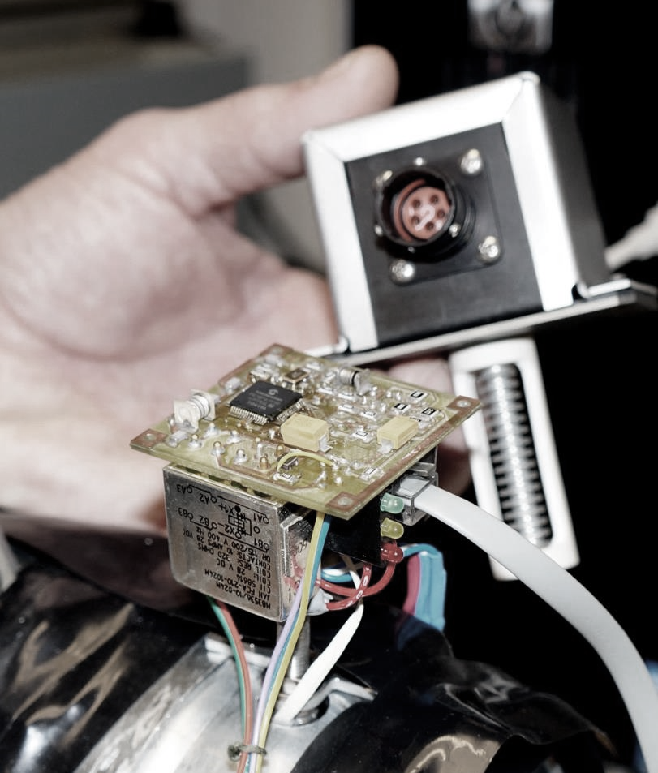
Exercise: Reverse engineering
Look at the immediate safety plan example in the participant guide
Create the steps you would take with the family and network to arrive at this plan
Assign a spokesperson to report out
Notes:
Example
The purpose of this small-group exercise is to examine an immediate safety plan and understand its components. Then, take 15 minutes at your tables or in your breakout rooms (groups of four) to create the steps you would take with the family and network to arrive at this plan.
Trainer Note
Refer to the immediate safety plan example (Gina and John Thomas) in the participant guide.

Slide 25




STEPS FOR IMMEDIATE SAFETY PLANNING
1. Assess for safety threats and presence of protection
5. Build rigorous
action steps with contingencies
2. Construct clear
worry statements
6. Reach agreement
3. Orient the family
to the task
7. Bring it back
to the child
4. Identify and involve the network
8. Monitor, adapt,
and strengthen
Notes:
Example
Plans start with the worker, family, network, and child (when appropriate) thinking through the critical question, “What needs to change in the care of these children so we know they will be safe?” Below are some stages to consider with the family, network, and children when designing this plan. These plans are a process, not an event, and will likely need to be adjusted.
Assessing harm and safety: Be aware of the list of safety threats and accompanying definitions so you know if you need to try to create an immediate safety plan. Use Appreciative Inquiry and SFQs to help build a good working relationship with the family, gather information, and increase shared critical thinking. Work with the family to determine the caregiver’s specific dangerous actions, how these actions have impacted the child, and exceptions—times in similar situations in the past when the family has been able to be protective.
Construct clear worry statements: Create at least one worry statement from every safety threat you identify as present in the household based on the safety assessment. When feasible, work with the family to create statements based on worries for the children and get the family’s feedback on the statements. Work with the family to incorporate their ideas into the worry statements and refine them, but keep in mind that ultimately, they must address agency worries.
Orient the family to the task: Be clear with the family about what an immediate safety plan is and why it is a necessity at this time. Explain how the immediate safety plan relates to the worry statement and how it should be made up of action steps that will mitigate the situation that led to the worry statement.
Talk to the family about the critical role the network must play in an immediate safety plan and assist them in beginning to generate ideas of who should be in their network.
Identify and involve the Circle of Safety and Support: Work with the family to determine whom they would like to include in their safety and support network. Remember, “no network, no plan.” If you are unable to bring a network into the immediate safety plan in real and meaningful ways that leave you confident that the child will be safe from the identified safety threat, you are not able to safely leave the child in the home. If you are having a difficult time creating a network, use tools (such as the genogram, ecomap, or Circles of Safety and Support) to help build the network, keep the focus on child safety, and initiate a conversation around how to support healing of relationships so that more people can become engaged. Keep in mind that you cannot create safety with only the people you are worried about. The alleged perpetrator (or people likely to have caused the harm) cannot be solely responsible for action steps or the execution of the plan.
Address critical worries through action steps: Ensure that the steps on the immediate safety plan are action steps being taken by the family and their network. There should not be services listed on an immediate safety plan unless they are going to take direct action that keeps the child safe from the safety threat. Ask the family and network difficult questions such as, “What will happen if . . .” and “How will you handle it when . . . .” Seek clarifications for unusual circumstances, such as if the child is sick, needs to be transported to an unusual place, or network members cannot do what they said they would. Name the network member who is responsible for each action step. To create a more rigorous immediate safety plan, develop a backup plan for each major action item listed on the plan.
Reach agreement: Once you have a plan created, ask the family and network to rate their willingness, confidence, and capacity to evaluate their commitment to the steps you have created together and to elicit potential problems. After a plan is finalized, ask the family and network to rate safety for the children and get feedback to make the plan safer.
Bring it back to the child: When appropriate, make sure there are ways for the child to take action. Have the caregiver tell the child they have endorsed the plan. Ask the child for ideas or enhancements, giving them a sense of ownership. Finally, give the child a chance to draw out parts of the plan and write them in a Safety House.
Monitor, build on it, and continue to assess: Ask, “How will we know if the plan is working? Not working?” Create clear methods and timelines for measuring the plan. Create a clear timetable from the beginning for when you will be coming back together to review the plan. A family team meeting is the optimal way to review these plans and transition to a case plan whenever possible. Check in on the plan and make changes when needed.
Celebrate successes as they come!
Trainer Note
A copy of this infographic is included in the participant guide. Note how this may differ from current practice.

Slide 26

No promissory plans!
If caregivers could keep their children safe on their own,
they would have. For now, they need at least one other person to help or we cannot agree to an immediate safety plan.
Notes:
Example
It can be tempting to simply trust the caregiver’s word that they will not let the safety threat happen again. Explain that a network must be involved with any immediate safety plan, and we cannot create immediate safety plans only with the people who caused the harm. This is a new bottom line for DCFS.
Offer an example, if you have one, from your own life (e.g., New Year’s resolutions to go to the gym). You have the insight that you need to work out regularly to lose weight or stay fit, but somehow you stop going within three weeks. However, when you sign up for fitness classes with a buddy and work out in a group or with a trainer, you remain much more consistent and achieve your goals.
Again, immediate safety plans are not just stating what a caregiver will not do. We want to focus on what they will do instead.
Last, remind staff that all immediate plans must be focused on the household members at the time of the initial investigation. For example, if mom’s partner caused the harm to the child and is now in jail, we still plan as if they will get out soon and could return to the home. You will learn more about household- versus child-based safety assessment and planning when the SDM system rolls out.

Slide 27

Getting Started in a Crisis
Notes:
Example
When you are working with a family on immediate safety planning, they are likely in crisis, and activity in the brain has shifted to the “fight or flight” areas focused on surviving a threat. Immediate safety planning requires critical thinking, communication, and the ability to plan for the future—tasks that are normally processed in the prefrontal cortex of the brain.
Here are some things to remember when getting started with caregivers and children during this crisis.
Acknowledge the impact of the crisis, especially if/because you are triggering it.
Come with an attitude of “not knowing” or objective curiosity.
Notice what is working (strengths and protective capacities). Use solution-focused questions.
Slow down your communication and check for understanding. This is not a quick process.
Simplify your words and be concrete.
Give examples.
Use solution-focused questions that focus on finding a solution.

Slide 28
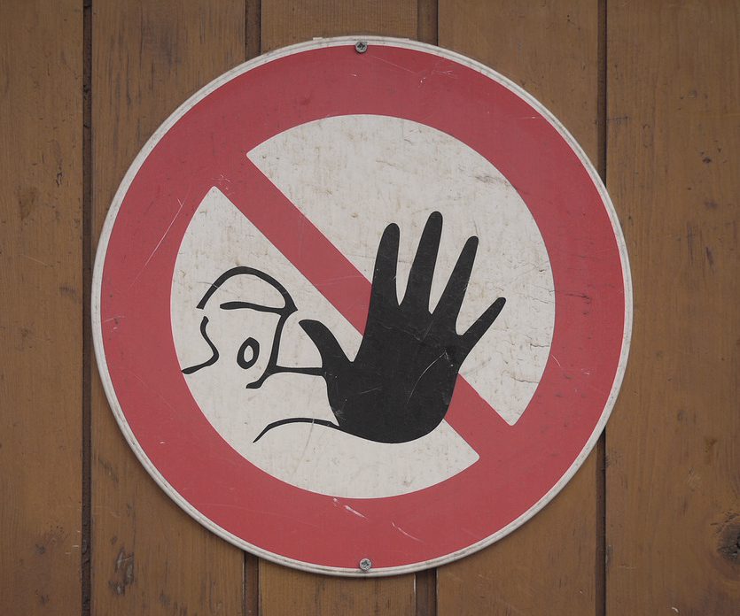
RESISTANCE AND SAFETY PLANNING
Resistance is a normal reaction to an abnormal circumstance.
Know the difference between a fearful family and a family who truly does not care.
When the family’s initial reaction is fear or reluctance to cooperate, remain curious to help them work through fear and build trust.
Notes:
Example
Remind staff that just because a family is slow to warm up or initially slams the door in their face does not mean we should walk away. We should meet families where they are and help them see the benefits of working together to build a network and enhance household safety.
When struggling with how to approach a family who is fearful, it’s best to begin with a statement like this: “You must be very anxious about sharing what’s been happening with others; I know I would be. But I can tell you many success stories of other families who were able to work together with DCFS and build an immediate safety plan that kept their family safe and together, while working through the next steps to get through this difficult time.” Or “Let’s think about what your family has to gain by agreeing to the agency’s bottom lines for immediate safety planning?”
Trainer Note
ASK: What strategies have worked for staff who have experienced this fearful reaction by families to sharing their story with network members or creating a safety plan with DCFS? Gather some responses in the chat or on a white board.

Slide 29
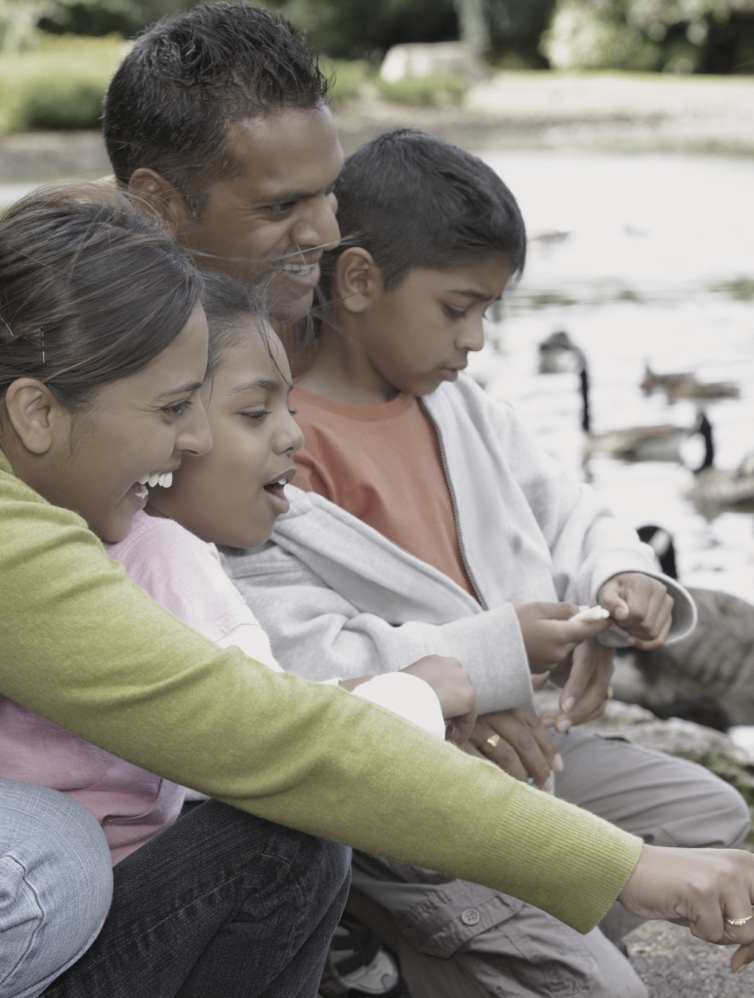
Orienting the family: Starting Safety Talks
Notes:
Trainer Note
Review these questions. Ask participants, “Why is it important to orient the family to the safety-planning process?” How can you work with the family to develop a successful immediate safety plan if they are unsure of the following?
What is an immediate safety plan?
Why do we need to do it?
What will it require?
Who needs to be involved?
How will it be done?
How will we know it is working?
When does it end?
Example
If you tell the family you are going to work together on an immediate safety plan, the family may not know what you mean. In our business, the term “immediate safety plan” means something. The words alone are not technical, so the family might think the meaning is obvious; but misconceptions about the purpose of immediate safety planning could cause problems later. Take a moment to explain what an immediate safety plan is, what it is and is not designed to do, how long it will last, and what will happen if it does not work.
It is important that the family understands the consequences of not agreeing on a plan. Assuming you used the definitions to decide that a safety threat existed, the safety threat is imminent and serious; if you and the family cannot agree on a plan, you have a basis for emergency removal. Removing the child from the home should be presented as a consequence, not a threat. Do not present emergency placement as a possible consequence if you stretched a definition. If you cannot legitimately make an emergency placement and do not have a reasonable expectation of filing for a temporary order, do not use an immediate safety plan to get the family to agree to services they do not want.
Ask the family who they want to help them develop a plan. This could be a friend, neighbor, relative, minister, therapist, etc. Remember, the initial plan needs to be put in place immediately. There may not be time to gather folks. You may need to make a temporary plan to get to a family meeting and then make a more complete plan at a meeting.
Here is an example of what you can say to help families understand the safety-planning process.
We want to make sure you understand the specific safety threat that needs to be controlled. We will try to think of ideas together for actions that can be taken immediately to stop the safety threat for now.
You have the right to inform those who are necessary to the plan about exactly what will happen. We will get agreement and commitment from everyone.
We will decide how everyone will know whether the plan is working or not, and we will write it all down, including concrete next steps and the timeline.
Inform the family that if a plan cannot be developed or agreed upon, their child may have to be temporarily placed in the agency’s custody. If that happens, it is the family’s right to have a judge decide whether the child can be in their care and to help DCFS locate kin to be considered as caregivers for the child while they cannot be in their home.

Slide 30

The dividing line between the safety threat and actions of protection
Notes:
Example
Start with a common definition of safety. Explain that creating safety is about actions and is specific to the family’s situation. Be clear about the specific safety threat that needs to be controlled. This can be done using C+B+I statements.
Lay out the specific safety threat, including the evidence you used to conclude that it is present. Use family-friendly language. This can be written right on the immediate safety plan document. We will practice using safety-focused worry statements as part of writing an immediate safety plan in a bit.
If the family disagrees with you, make a note that the family disagrees. If you believe the evidence supports the presence of the threat, then the threat is present. Engaging the family means listening to their point of view and giving it weight, not replacing every other perspective with the family’s. Your professional responsibility is to weigh all perspectives and make your decision.
Resource and Adoptions
Staff should weigh both the impact of a placement change on the child and the need for supporting the resource family prior to any change of placement or dissolution of adoptive placement.

Slide 31

Identifying and involving the Family’s Network
Circles of Safety and Support
Genogram
Ecomap
Safety and support network grid
Notes:
Example
Immediate safety plans rely on the actions caregivers take, with support and accountability from their networks. When it comes to controlling the immediate safety threat, remember that without at least one network member participating, there cannot be an immediate safety plan. Help family members identify network members whom they can bring into the discussion as part of immediate safety interventions and who can hold the caregiver accountable and call for help if the safety interventions are not working.
This slide lists the tools from Module 5. These can be useful in identifying a safety and support network for the family. These tools can also provide documentation of reasonable efforts to prevent removal and efforts to locate kin should child removal become necessary. Be sure to document use of these tools in the Division Information Management System (i.e., CHRIS) and place hard copies in your files.

Slide 32

Eliciting Family Knowledge and Know-How
Collaborate with the family
Ask good questions
Create monitoring and feedback loops
Involve the child
Notes:
Example
Building strong plans for child safety is a collaborative process, and the family members and their network are usually the ones who have the knowledge needed to create the strongest plan.
Solution-focused questions and strong facilitation skills can help you. The participant guide includes a short handout on solution-focused questions. We will practice designing safety interventions soon. Remember in immediate safety plans, we are looking for immediate actions the family, older children, and the network can take to promote safety. We cannot just put in services that may take several days or weeks to get started. The immediate safety plan is not about long-term behavioral change; the family case plan will focus on that. As part of the conversation, keep asking for ideas for monitoring and ensuring that everyone is doing what they agreed to in the immediate safety plan.
When it is developmentally appropriate, children can offer ideas and suggestions for how to create safety in their homes. The Safety House is a great tool for obtaining the child’s perspective, and can also be used with adults when developmentally appropriate (such as those with whom you have a difficult time communicating).
Remember: An immediate safety plan should not include things like “a caregiver will not use illegal substances” or “a caregiver will not leave the children unsupervised.” We need to have action steps and monitoring to ensure the child’s safety. It is unrealistic to expect a caregiver who has been using meth for five years to stop as soon as we create an immediate safety plan. However, we can do things like have someone come stay in the home with them and, if the child is old enough, make sure they can call someone if the caregiver starts using. Another option is to have several people come over throughout the day to check on them. You could also have the caregiver rate on a scale of 0 to 10 how much they want to use each hour of the day.
Trainer Note
Before moving on, review the participant guide handout Immediate Safety Plan Versus Family Case Plan and talk through the different points.
Refer to the participant guide handout Questions for a Rigorous and Balanced Assessment.

Slide 33

Brainstorming for Interventions
All ideas on the table
Test ideas
Develop contingencies
Notes:
Example
Ideally, get all ideas on the table first. This is a basic brainstorming technique. Critiquing ideas as they are presented tends to stifle them. Remember that in some situations, you must press forward faster because of the immediacy of the safety threat. When you can, wait until several ideas are on the table before testing them. Do not skip this step! Not all good ideas will work. Ask how each proposed idea will directly protect the child from the specific threat. Ask what could go wrong. Use this information to develop contingencies so that the plan is detailed and complete. Some ideas are rejected during this step because they are not feasible, would not provide sufficiently robust protection, or have some other limitation.
Now you can assemble the final plan. Write it on the immediate safety plan document. Be specific about who will do what and when.
A vital component of the plan is monitoring. How will you know that the plan is being carried out and is protecting the child? For each plan element, ask, “How will the worker know this is being done?” For the overall plan, ask, “How will the worker know the child is safe?”
Trainer Note
These are possible discussion prompts.
How would this change the questions you are asking?
How might this change the outcome of family engagement efforts?
How does this change the perspective?
Does anything stand out for you regarding how it is broken up?

Slide 34
Practice: Designing Interventions
Look at the “Immediate Safety Plan Versus Family Case Plan” exercise in your participant guide.
Write down at least one safety intervention idea (i.e., contributes immediately to safety) for each scenario.
Write down one intervention that could later become part of a family case plan (i.e., resolve the worry in the long-term) for each scenario.
Notes:
Example
Let’s start thinking about what goes into an immediate safety plan. The first important notion is that an immediate safety plan is not a family case plan. Key distinctions are that an immediate safety plan starts now. It addresses imminent danger of serious harm. It cannot rely on objectives or actions that will not begin for days or weeks. It cannot rely on waiting to understand the underlying dynamics, let alone waiting for fundamental life changes to take hold.
The immediate safety plan is straightforward and blunt. It is not subtle or nuanced. It declares, “Here is the safety threat. Here is how we will keep the child safe right now.”
The exercise Immediate Safety Plan Versus Family Case Plan in your participant guide lists several safety threats. Take a moment and jot down at least one idea for a possible safety intervention. Then think about possible underlying dynamics and write at least one intervention that could later become part of a family case plan.
Trainer Note
In this activity, participants will consider mini-scenarios describing the safety threat. They should discuss options for an intervention that would control the safety threat and an intervention that can resolve the concern long term—more like a family case plan intervention.
Break out into pairs or smalls groups of no more than four people to complete (10–15 minutes) and then debrief as large group.
Resource and Adoptions
When we are putting an immediate safety plan in place due to a child in a resource home or pre-adoptive home being a danger to themself or others, we need to include resource staff in the immediate safety planning process. They can help ensure the voice of the resource family is being heard and provide insight on any worries around the resource family’s abilities and preferences for bringing the child into their home.

Slide 35

Reach Agreement on the Plan
Willingness
Confidence
Capacity
Agreement
People support what they have had a hand in creating.
—Margaret Wheatley
Notes:
Example
Even though it may take a few extra minutes to ask the scaling questions to determine willingness, confidence, capacity, and agreement, it may save a lot of time in the long run.
To emphasize the importance of this: While immediate safety planning with a family who has a baby, you have identified Grandma as a network member. Grandma has offered to drive the 45 minutes to check on the baby every day in the evening. When you ask how willing she is to do this, she says, “10. I am totally willing to do this for my grandbaby.” When you ask how confident she is that she can do this, she says, “10. I know I can do this.” When you ask her if she has the capacity to do this (i.e., does she have everything she needs?), she says, “Yes. I have everything that I need to do this, except I don’t drive.”
Imagine not going through these questions and finding out a week later that Grandma had not checked on the baby because she does not drive.

Slide 36

Bringing it back to the children
Simple language
Developmentally appropriate strategies
Safety and support network
Notes:
Example
Once the plan has been developed and agreed to, it is important to explain to the child the plan for keeping them safe. The caregiver is often the best person to share the plan details with the child; this maintains the parental relationship and helps the caregiver feel strong commitment to the plan while explaining it.

Slide 37

Weather-, Situation-, and Time-Proof the Plan
Notes:
Example
Think about a time that you had to travel for something important, such as a wedding or a business trip. Did you consider what would happen if your plane was delayed or if you missed your train? We sometimes produce a Plan B naturally, without having to think about it much, because the stakes are low, or we have done the task before and know our alternatives. When the stakes are high—such as when a child’s safety is threatened—we need to ensure we are making a Plan B or “weather proofing” the plan.
The benefit to having early “weather proofing” conversations with the family and network is that we are acknowledging that life happens outside of these immediate safety plans. Maybe Grandma gets sick and cannot come over to check on the baby, or maybe the car breaks down. Sometimes immediate safety plans fail through no fault of the family’s, but they are concerned about “getting caught” or about the ramifications of the plan breaking down, so they are not open with us. Being transparent with the family and discussing what happens if the plan starts to break down demonstrates a willingness to communicate with them if things are not working as planned.

Slide 38

Monitor, Build, and Continue to Assess
Timelines
Next review
Follow up with the network
“Stepping down” to a family case plan
Celebrate successes!
Notes:
Trainer Note
Make the point that our plans need to be clear for the families and for us. Just stating “The plan will last 30 days” makes the timeline vague for everyone involved. Your plans need to have an end date and a review date to allow time for everyone to discuss what has and has not worked with the plan and how it can be enhanced.
We also want to move the plan from being monitored by the professionals to being monitored by the family's network over time.

Slide 39
Writing Strong immediate safety plans
Notes:
Example
Now that we have talked a bit about immediate safety planning practice with families, we are going to spend the rest of our time focusing on how to write a strong immediate safety plan.
Remember, all immediate safety plans have these elements in common. Refer to the Essential Elements of an Immediate Safety Plan handout in the participant guide. Keep discussions focused on the immediate impact on the child of the caregiver’s behavior causing the current safety threat. There will be time later to discuss all family dynamics impacting child safety and family functioning.
If there needs to be an immediate safety plan, work with the family to create an agreed-upon document prior to leaving. The family and each network member will need a copy of the final plan. You will need to have copies of the immediate safety plan with you so you can do this.
Indicate which safety threats are present. For each safety threat present, describe in the specific existing conditions in simple, family-friendly language. Consider using a worry statement format.
Next, for each intervention that will be used, describe specifically who will do what and by when. Remember that an immediate safety plan is not a family case plan. These activities are not meant to resolve an underlying problem but simply to control the safety threat for now. For example, if there is no food in the house, having the father get his diploma so he can get a better job and be more economically self-sufficient is not a safety intervention. Going to a food pantry tonight is a safety intervention.
Describe how you will know whether each part of the plan is working. Will the family report to you? Will you call another agency to be sure they can help? Will you make unannounced visits? Will the grandmother stop at the house every day and call the worker if there is a problem? Will the foster family network provide respite care one day per week?
Finally, obtain signatures. At least one caregiver should sign. The worker can use clinical judgment as to whether both should sign and whether to accept a plan if the caregiver refuses to sign. The worker and any children who are old enough to do so should also sign. Any other individuals you are relying on to participate in the plan must sign. For example, if part of the plan is for a neighbor to help with afterschool childcare, the neighbor must sign to verify willingness.

Slide 40
immediate safety plan: Before and After
Notes:
Trainer Note
Refer participants to the example immediate safety plan in their participant guide (Immediate Safety Plan: Before and After). This includes an original immediate safety plan that was written by a worker before learning about the essential elements of a strong immediate safety plan and a revised version that includes an example of how to write each of these essential elements.
Ask participants to read and compare the original and revised part of the example. Allow five to seven minutes. Then ask the following.
Example
What do you notice? What did you discover that will be helpful in writing your next immediate safety plan?

Slide 41

immediate safety plan Tips
No network, no plan. Strong network, strong plan.
Plans cannot interfere with custody of a child or restrict a person’s rights to a home they own or lease.
Plans must be filed with the court (30-day petition) if they need to be in place more than 30 days to ensure child safety.
Notes:
Trainer Note
Participants will have discovered many of the common issues or hot spots in writing strong immediate safety plans from the last exercise. Have them reference the Tips for Writing a Strong Immediate Safety Plan handout in the participant guide and walk them through each of the “hot spots” and how to fix them.

Slide 42

Skills Practice: Writing a Strong plan
Design a rigorous immediate safety plan.
Notes:
Trainer Note
Have participants break up into groups.
Participants will review the immediate safety plan case scenario from the participant guide, come to shared agreement on the safety threat by writing a worry statement, and create an immediate safety plan for the family. A list of people to make the immediate safety plan with is included. The scenario is on p.___ of the participant guide.
Encourage participants to use their existing skills and try out some of the new things that were discussed today, including crafting one or more worry statements. Once complete, have them display the immediate safety plans on the wall for the other groups to review. When participants begin to post their plans, encourage everyone to walk around the room and either place stickers or draw a star next to things that they agree with or that stand out to them. Engage participants in discussion about the items they marked on each other’s immediate safety plans.

Slide 43

immediate safety plans Can Evolve
Any significant change in circumstances for the child, family, DCFS, or network can warrant a review of the immediate safety plan. These plans are living documents, and new information may affect the plan.
Notes:
Example
It is important to view the immediate safety plan as a dynamic document. It is not logical to think that an immediate safety plan created one day is the same plan the family needs a week or a month later. Let’s talk about different situations in which the plan might change.
Child placed in foster care; immediate safety plan made the next day; child returns home.
Child remains home with preliminary immediate safety plan to get through one night; larger group gathers the next day to make a longer-term plan.
Plan developed with one caregiver on day one; later, include second caregiver and others in a more extensive plan.
Initial plan is falling apart; convene meeting to strengthen plan.
Trainer Note
Possible discussion scenario: You have developed an immediate safety plan with the family. As you monitor the immediate safety plan, you realize that it is not working. If you are willing to renegotiate the immediate safety plan, will the family think this means they can “call your bluff” and not follow the new immediate safety plan either? The discussion might include trying to determine why the family did not follow the original immediate safety plan. Did they completely disregard it? Did they try to follow the plan but meet with unexpected obstacles? It might be that the only solution is to remove the child. In such cases, it is important to emphasize to the family that this is not about punishment; sometimes a lack of safety cannot be resolved in the short term.
Example
There are also two situations where a worker needs to think carefully about whether an immediate safety plan is rigorous enough or even a wise idea.
Situation One
The family readily agrees to everything, but you are not sure they are really committed to the safety actions.
You have probably been in situations where the family says yes to everything. They are the most agreeable family ever. The problem is that the moment you leave, they do everything but what they just agreed to. If you have good reason to doubt that the family will really act to protect the child, the same principle applies: You are ultimately responsible now. It is not enough to just walk away and accept agreements at face value when your sound professional judgment tells you the child will not be safe. You have two choices: increase monitoring or recommend the child be placed briefly out of the home.
Consider whether increasing the monitoring would provide assurance that the family is really doing what they say they will. Are they agreeable to unannounced visits? Can the child call in every daytime hour for the first 48 hours? Can Grandma visit frequently for the weekend? Build the plan supports around exceptions and actions of protection already identified for the family. Use what has worked well in the past for the family to support current child safety.
Open up discussion on the issues around involving the child in the immediate safety plan. What is the difference between creating a safety net for the child and making the child responsible for their safety?
Let the family know that you are not convinced they will be able to carry out the plan. Be careful. Do not frame this as malicious intent—it may not be, and probably is not. Explain that the safety threat is so great and the plan so difficult that you will have the child in a safe place for the first few days while the family begins to put the plan in place. You can use this time to let the family demonstrate their follow-through. If possible, the child may go home quickly. If the family does not follow through, the placement was clearly necessary and remains so. If an example of how this might work is needed, consider the following hypothetical situation: There is a safety threat related to intimate partner violence. The immediate safety plan is for Mom to ask her boyfriend to leave the home and not let him return. However, Mom has a history of allowing this boyfriend to return to the home. You might discuss Mom’s history with her and ask if she is willing to go to a shelter with her child so she can demonstrate her ability to keep the boyfriend away. Ask if there is a network member who could stay with her to support her in keeping the boyfriend away. You would then set a timeline and a monitoring plan with meaningful indicators.
Situation Two
What if we don’t agree on the safety intervention?
We have already said that if the worker and the family disagree on whether the threat is present, the worker indicates that the threat is present and gives voice to the family’s perspective by noting their point of view. What if they disagree with the only plan that the worker thinks is viable?
The fundamental principal is that at this point, the worker is ultimately responsible for child safety. We cannot abdicate our professional responsibility by simply saying the family was unwilling so we will close the case or accept a plan we doubt will work. But we do not have to be rigid, either. Ask the family what they would be willing to do—how could this plan be acceptable to them? Ask yourself if their amendment would really compromise child safety. Sometimes it will not. For example, they might prefer Dad’s brother for the child’s safe place rather than Mom’s sister. Unless you have reason to think the paternal uncle would not be safe, there is no reason to object. (If the family was engaged along the way, you might not even get to this point; but the family may have been reluctant to express concerns previously.) There is no point in getting into an unnecessary power struggle. But if the uncle is a previous perpetrator, or if this is a family violence situation and the uncle may side with Dad over Mom and keep Mom away from the child, then you should not compromise.
Conversely, since you know that the family not agreeing to a plan will put the child into foster care, how hard should you try to persuade the caregivers? You know the plan could be easy, and you cannot understand why they will not say yes.
It is necessary to ensure you are not being coercive when presenting or developing the immediate safety plan. Caregivers must see and understand that the immediate safety plan is a voluntary agreement they are entering into and that interventions are time limited.
There is no substitute for good clinical judgment here. You want to be sure they understand how easy the plan would be and how much even one night in foster care will affect their child. See if you can figure out what motivates the caregivers and use it. But if you feel you are pushing them to just say yes when they mean no, and they are not really buying into the plan, then it is best to not push too hard or you may be setting up an immediate safety plan failure.
Immediate safety plans must be clear, voluntary, time-limited, and not coercive. Removal is a potential consequence of failure to comply with immediate safety planning, not presented as a threat.
Trainer Note
A case in the Illinois State Supreme Court challenged the constitutionality of immediate safety plans. While the court ultimately supported the practice of immediate safety plans in CPS, it did prompt several clarifications on practice expectations by the agency. Dupuy v. Samuels was brought in 1997 by 150,000 Illinois residents. For purposes of immediate safety planning, the crucial portion of the case concerned parents’ allegations that they were illegally and unconstitutionally forced to comply with immediate safety plans under threat of child removal. This issue was considered in the “Dupuy II” claim brought in 2002, in which the court found that immediate safety plans that last more than “a few days” violate families’ rights to due process. “A few days” was further defined as requiring an immediate safety plan review after 14 days. A 2006 appeal of the decision found that immediate safety plans must be uniformly voluntary, and it criticized coercive practices (e.g., threatening families with foster care placement) that the court found to be common in immediate safety planning. The issue remains subject to appeal, but clear, voluntary, time-limited, non-coercive immediate safety plans remain good practice.

Slide 44
IPV and immediate safety planning tips
Notes:
Example
Some families have intimate partner violence (IPV) co‑occurring with child maltreatment. Whether or not the intimate partner violence is at the level of a safety threat, when these dynamics are present, the worker needs to be aware of family safety even while focusing on child safety. Let’s review a few essential best practices on the handout in your participant guide.
Trainer Note
Refer to the handout Intimate Partner Violence Investigation: Supervisor Job Aid in the participant guide and walk through the key points.
There are a few special considerations. Though not always, there is usually one caregiver who is in a victim role and one who is in an aggressor role. Agency intervention, no matter how necessary, can increase the danger to the victim. Of course, you already would have conducted a private interview with the apparent adult victim. Likewise, you should discuss immediate safety planning with the adult victim (with or without support people of the victim’s choosing). Do not include the aggressor in these first discussions. Why? (Answer: If done jointly, the aggressor will influence the plan to their advantage and/or we will not be able to include elements to keep the victim safe.)
In some instances, where the violence or power imbalance has been minor and brief, the victim may be willing to develop a joint immediate safety plan. Use your professional judgment. Is the victim in denial about the safety threat (or too afraid to share what's going on with DCFS for fear of their child being removed)? Is the victim feeling coerced into sharing the plan? If so, do not do it. If you create a shared plan, partner separately with the victim for a personal immediate safety plan just in case. In other instances, you may need to have an immediate safety plan with the aggressor and an immediate safety plan with the victim.
Be careful about copies of written immediate safety plans that contain information that the aggressor should not see, such as escape plans. Always discuss an immediate safety plan with the victim first. Only discuss the immediate safety plan with the perpetrator if the victim agrees and, in your professional judgment, it is safe to do so.

Slide 45
immediate safety planning Consultation
Notes:
Trainer Note
Part 1: Ask participants to form consultation groups, appointing a facilitator and scribe. Have one person volunteer to share a recent or current investigation or in home case in which there was an immediate safety threat to a child in the household. Have a facilitator and scribe use the Collaborative Assessment and Planning (CAP) Framework to identify households, use one or more network tool to identify available network supports, and write one or more worry statements. Participants who are facilitating the CAP Framework can use the questions in the participant guide to help guide their conversation.
Part 2: When groups have completed this consultation, have each pair up with another team to ensure shared understanding of the safety threat (via the worry statement) and to get their feedback on how the statement language might feel for a family member.
Part 3: Have consultation groups brainstorm potential safety interventions (i.e., action steps) and how network members can be involved.
Large-Group Debriefing
What worked well?
What was challenging?
What are next steps for developing skills in the immediate safety planning conversation with a family and their network?

Slide 46
Consultation: Part 1
Break into consultation groups, appointing a facilitator and scribe.
Have a volunteer share a current investigation or in-home case with a safety threat to a child in the household.
The facilitator and scribe should use the collaborative assessment and planning (CAP) framework to identify households, use one or more network tools to identify available supports, and draft worry statements.
Use the questions in the participant guide to help guide the conversation.
Notes:
Trainer Note
Please advise the group against sharing a case that is too painful to talk about so that the work can be the focus. Ensure that at least one person per small group is case carrying.

Slide 47
Consultation: Part 2
Pair up with another team to ensure shared understanding of the safety threat (worry statement).
Elicit feedback on how the statement’s language might feel for a family member.
Make edits as needed.

Slide 48
Consultation: Part 3
In the Same Groups
Brainstorm potential safety interventions (i.e., action steps) and how network members can be involved in the immediate safety plan.
Be prepared to report out to large group.

Slide 49

Documentation
Division Information Management System
Court reports
Immediate safety plans
Affidavits
Family case plans
Preparing to testify
Submitting referrals
Communicating with providers
Notes:
Contacts in the Division Information Management System should detail discussions held with the family and network during attempts at immediately safety planning.
Court reports and affidavits must include information about efforts to locate kin and prevent removals. Also include use of SOP tools and creation (or attempts at creation) of immediate safety plans to meet these legal requirements.
Provide all participants with the immediate safety plan. Plans should be filed in case files, and plan agreements and action steps should be documented in Division Information Management System contacts.
Family case plans should contain action steps from immediate safety plans that continue to be necessary to ensure child safety. Family case plans should continue to build on developing the network to ensure the family has supports necessary to maintain child safety long-term and without DCFS intervention. Use information from the Safety House to build family case plans that address all worries for the child and family.
Testimony should include details about working with the family and their network and the worries identified not only by the family but also DCFS. If disagreements were encountered and shared agreement wasn’t reached, be prepared to provide testimony about why and to make a recommendation to the court about DCFS’s recommendations to ensure child safety. If a relative or fictive kin has been identified to serve as a kinship placement for the child, be prepared to provide testimony about why the kin could not participate in an immediate safety plan to prevent removal. Also consider whether an evolved safety plan could be created under current circumstances to return a child safely home (have more network members been added who could provide necessary supports?).
DCFS should not make referrals for services without clear reason. What actions did the immediate safety plan determine were necessary to ensure child safety? What did the network, family, and child identify as necessary to enhance family functioning? Submit referrals for those services. Make sure you practice a warm handoff with a family and service providers and encourage the family to be open with providers about the reasons for referrals and the needs of the family. Continue communication with providers routinely to ensure providers and DCFS learn from one another about the changing needs of the family and the impact of services for the family. Adjust service provision accordingly. DCFS should obtain written documentation of service provision and the changes for a family as a result of the services and place this documentation in case files and reports to the court, as appropriate.

Slide 50

Try it on!
Notes:
Example
Next time you have to create an immediate safety plan, try on some of the things we discussed today.

Slide 51

Things to Try
Notes:
Example
Get into pairs and review the Things To Try and Tips handouts in the participant guide. Select one or two items to try between now and the next deep dive module.
Trainer Note
Have a few people share with the large group what they are going to try in their casework.

Slide 52

WHAT’S NEXT
Upcoming training
Other resources
Notes:
Example
This is a process. SOP and SDM implementation is scheduled to take several years. Building field practice will take dedication. Try on the tools when working with families now, because use of the tools will become mandatory in the future, but everyone prefers to support what they have a hand in building. Workers should let SDM/SOP Project Manager Cassie Walker know if things are working well or if there is something that we are worried about.
Ensure all immediate safety plans include at least one adult who was not part of the alleged child maltreatment/safety threat or a plan cannot be put in place.
The next deep dive is Module 7: Behavior-Based Collaborative Family Case Plans. This module will focus on how to build family case plans with the family and other members of a case that focus on behavioral change rather than just being a list of services for the family to complete.
If you have questions, please feel free to drop them in the chat or unmute.

