Slide 1


Meeting THE Educational needs of clients in care

Slide 2
Agenda
Education statistics for children and youth in foster care
Ensuring Educational Stability
Section 504 and Special Education
Academic Supports and DCFS Policy
Dispute Resolution Process
Resources
Questions

Slide 3
Statistics for children and youth in foster care
Up to 75% change schools when they enter care
Unlikely to attend or graduate from college—of those who go, only 20% graduate
Behind in their credits and will use GED 6 times the rate of their peers
Twice as likely to be absent
2 times more likely to be suspended and 3 times more likely to be expelled
High risk of dropping out of high school—only 50% graduate

Slide 4




Ensuring Educational Stability
Maintain the child’s school of origin, which is the school the student is enrolled in at the time they come into foster care.
If the student is enrolled in a new school, that school becomes the school of origin.
Gather academic and behavioral information to address their educational needs.
Be proactive and involved.
Attend parent teacher conferences.
Monitor grades and attendance through online portal, like eSchoolPlus or Home Access Center. Ask for the child’s password.
Make sure the school is notified of absences.

Slide 5
Ensuring educational stability with Academic Supports
First Step: Ask the School what academic supports they can provide
Every school has strategies for addressing academic and behavior deficits for their students
Look for the School Improvement Plan under “State Required Information” on the school/district website for strategies
Examples
Before and After School Tutoring (Title 1/Targeted support schools)
Summer Programs
Reading Recovery Program, Read 180, Accelerated Reader
Reading Inventory Assessments 2x per year and results used to set goals
STAR Reading and Math Assessments
English Language Learner (ELL) Programs

Slide 6
Ensuring educational stability with Academic Supports
Response to Intervention (RTI) through the School Based Intervention Team (SBIT)
Dyslexia Screening
504 Accommodations or Special Education, when needed
Khan Academy
Private Tutoring
make sure 504 Plan or Individualized Education Program (IEP) is implemented
done annually for each student K-2
free online tutorials for every level and subject
khanacademy.org
Can DCFS assist with payment?
look at progress
update as needed
Practice Tip: Involve district foster care liaison or curriculum coaches to research supports

Slide 7
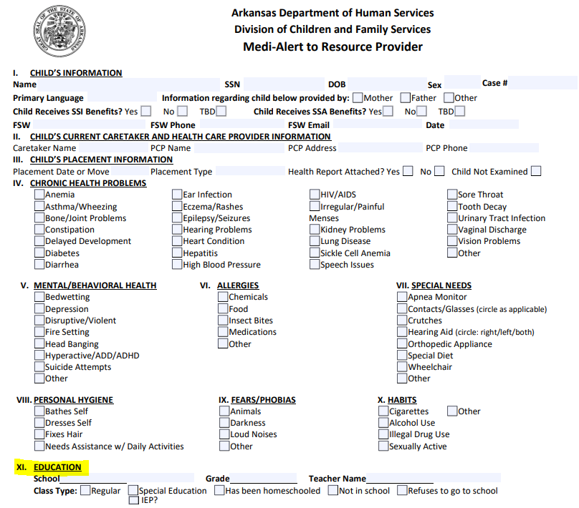
Maintain the Same School, When Possible
When a child is removed, work with the parent to complete the child’s education information on the medi-alert
Maintain a child in care in the school of origin whenever possible
When making placement decisions, consider continuity of educational services and school stability

Slide 8
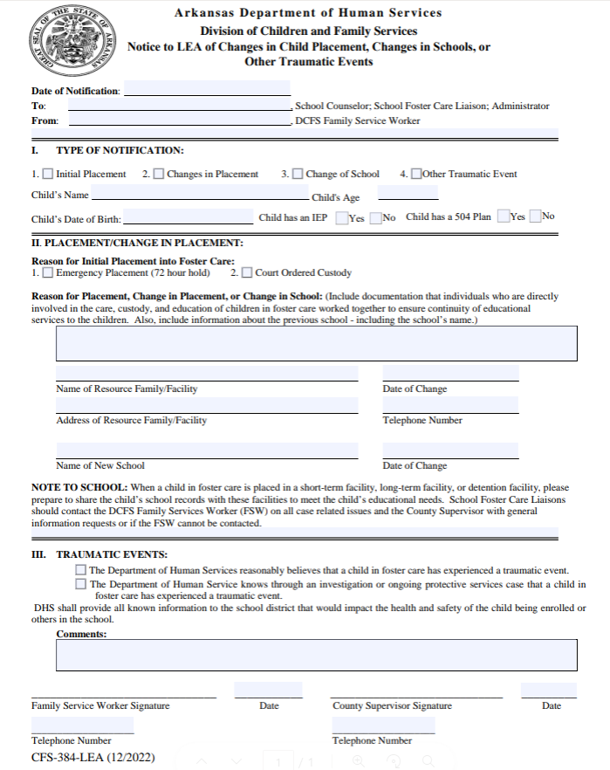
PROVIDE Notice to Schools
Use the CFS-384-LEA form to notify the school when a child:
  Is initially placed into foster care
  Has a change in placement
  Has a change in school, or
  Has experienced a traumatic event
Provide this notice to the school counselor, school administrator, and the district foster care liaison by the next business day

Slide 9
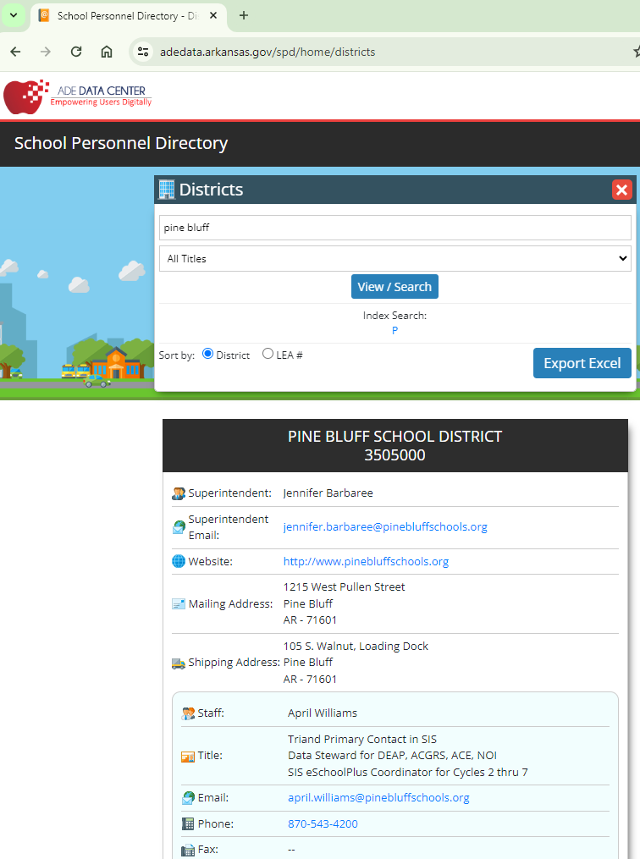
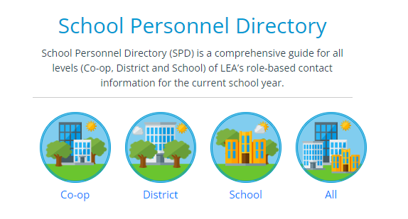
Practice Tip: How to search for DISTRICT OR SCHOOL personnel
Check ADE Data Center School Personnel Directory https://adedata.arkansas.gov/SPD/

Slide 10
Foster care liaison
School district employee who is the Primary point of contact for transfer of records and immediate enrollment of children in foster care
Every school district must have a staff member dedicated to this role
Responsibilities:
  Facilitates data sharing of a child’s educational records with DCFS
  Lead on best interest determination process, if any school change is being considered by DCFS and the School
  Coordinates local transportation procedures
  Coordinates efforts for referrals to health, mental health, dental, and other support services
  Can assist with referrals for educational services: ESL, Vocational, GT, remediation, school nutrition, Head Start/Preschool Programs, tutoring programs
Practice Tip: Stay connected with the foster care liaison as a resource and as required when school changes are considered and for notifications but continue to build relationships with your local schools as well.

Slide 11
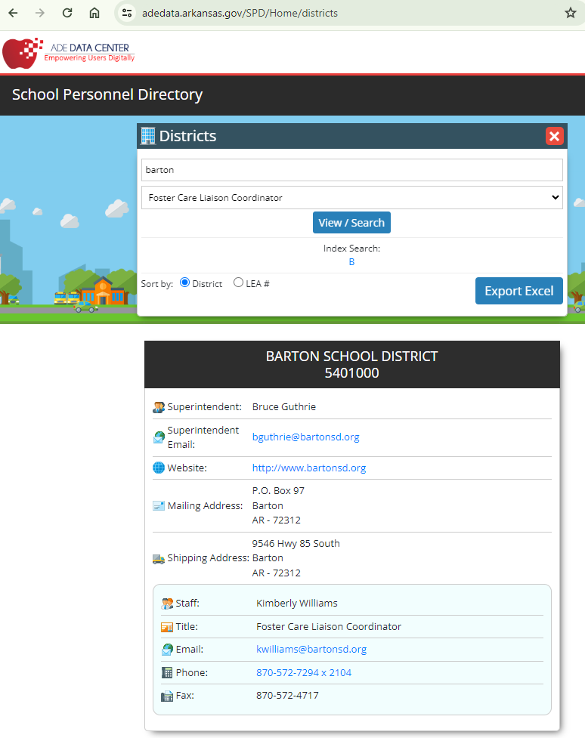
Practice Tip: How to search for DISTRICT foster care liaison and GET contact info
Search ADE Data Center School Personnel Directory on the Districts tab by Title, “Foster Care Liaison Coordinator”

Slide 12
PARENTS’ Access to School Records & Activities
Access is set by the circuit court’s order, which may give DCFS the discretion to decide
Determine whether the parent or guardian may:
Let the school know what is allowed by sending form CFS-383 to the school counselor, school administrator, and district foster care liaison
Have the child’s educational records upon request
Have information on the child’s placement (name, address, etc.)
Participate in school functions, activities, and conferences, and
Pick up the child from the educational facility or activity

Slide 13
YOUR ROLE AS THE CHILD’S FAMILY SERVICE WORKER
For a child with a disability or suspected disability, participate in Individualized Education Program (IEP) Conferences or 504 Meetings
Know when to reach out to your supervisor
If there are issues for a child who receives special education, reach out to the district foster care liaison, DCFS Education Program Manager, and/or DCFS Field Operations leaders for help
When a child is recommended for suspension or expulsion
When the school is not meeting the needs of a child with a disability
When issues are identified at school conferences
Practice Tip: If the child is struggling at school, try SOP strategy of the 3 classrooms with the child to learn more and find solutions

Slide 14
PUBLIC SCHOOL WAIVER REQUESTS
the child’s permanency goal and plan
what other children in the home are doing for education
payment of expenses and whether the resource/pre-adoptive parent will access an Education Freedom Account through the LEARNS Act, if able
best interest determination with all parties
stability of current school placement and point during the school year
Generally, children in foster care should attend public schools
A public school waiver request may be made to allow a different school Setting
3 types: private school, homeschool, or online school
For private school, is it accredited? How well does the school work with children under the idea and meeting their needs, if applicable?
For homeschool, Will the child participate in a co-op with other homeschool students for socialization?
For online school, what program will the student participate in, and will the local school district accept those credits? How will the student’s work be monitored?
Factors to Consider

Slide 15



Ensuring Educational NEEDS ARE MET FOR A CHILD WITH A DISABILITY
If the student has a disability that affects the student’s educational performance and/or ability to learn and benefit from the general education instruction, then the student qualifies for special education or related services and needs an Individualized Education Program (IEP) under the IDEA
If you aren’t sure, check the PACE report for recommendations for further testing for educational services
If the student has a disability/impairment that substantially limits the student’s access to his or her education, then the student qualifies for accommodations to meet his or her needs under Section 504
Anyone who is concerned can make a referral for supports under IDEA and Section 504

Slide 16
 | IEP | 504
What is it? | ABILITY to learn | ACCESS to learning
What does it do? | Provides individualized education and related services to the child | Provides services and changes to learning environment to meet needs of the child AS ADEQUATELY as other students
What law? | IDEA *Fed. Special Education law for children with disabilities | Section 504 of the Rehab Act of 1973 *Fed. Civil Rights law to stop discrimination against people with disabilities
Who uses it? | Child meets requirement for one or more of the 13 specific disability categories listed in IDEA. learning and attention issues may qualify | Child has mental or physical impairment which limits one or more major life activities Has a record of such impairment, or Is regarded as having such an impairment
  Differences Between an IEP under the IDEA and Section 504
Notes:
IEP: The disability must affect the child’s educational performance and/or ability to learn and benefit from general ed. Instruction
Autism
Deafness / HH
Deaf-Blindness
Hearing Impairment
Mental Retardation
Multiple Disabilities
Orthopedic Impairment
Other Health Impairment
Serious Emotional Disturbance
Specific Learning Disabilities
Speech or Language Impairment
Traumatic Brain Injury
Visual Impairment / Blindness
Just because a student has a diagnosed disability does not mean they are eligible
Mitigating Measures don’t matter….except glasses
The disability MUST interfere with the child’s ability to learn in a general classroom.
{much broader definition than IDEA}
Life activities: caring for oneself, performing manual tasks, walking, seeing, hearing, speaking, breathing, learning, working,
Courts have added: sitting, stooping, reaching, eating, procreating
2008 ADA added: communicating, concentrating, reading, lifting, standing, sleeping bending,
Standard for substantial limitation
Average performance in the General Population is
Student performing as well as average students in his class, regardless of presence of a physical or mental impairment is NOT eligible under 504…What is the comparison arm?

Slide 17
Section 504
Has a physical or mental impairment which substantially limits a life activity (learning)
Asthma
Diabetes
ADD/ ADHD
Obesity, if underlying medical condition
Epilepsy
Temporary disability impairment, like broken leg or illness
May be an option for students who do not qualify for Special Education services
Anything that substantially limits a child’s ACCESS to his/her education (also post high school education)
Qualifying handicaps are not as severe as the disabilities qualifying a student for an IEP/Special Education. The student may need extra help to access learning through accommodations that are put into place.
Impairment includes the impairment itself, having a record of the impairment, or being regarded as having the impairment

Slide 18
Process to get a child placed under 504
Make a written request to the school, and a referral conference is held, which the parent attends.
The 504 coordinator gathers information from a variety of sources. NO testing required.
Sources: grades, disciplinary referrals, health information, language surveys, parent information, standardized test scores, teacher comments & recommendations, attendance records, observation
Placement Conference is held (includes the parent) and a supportive accommodation plan is put in place w/ in 30 days.

Slide 19

SPECIAL EDUCATION

Slide 20
SPECIAL EDUCATION
Categories of Impairment
Autism
Dyslexia
Orthopaedic
Visual Impairment
Multiple Disabilities (Hearing & vision)
Specific Learning Disability (severe discrepancy between intellectual ability and achievement)
Speech or Language (communication disorder)
Emotional Disturbance (severe social deficit)
Hearing Impairment
Traumatic Brain Injury
Other Health Impairment (ex. severe ADHD, health problem)
Developmental Delay (ex. comm., motor, social, emotional)
Applies to students with a severe impairment/ disability who qualify for Special Education Services in the (LRE) Least Restrictive Environment possible.
The child’s DISABILITY affects his/her ABILITY to learn.

Slide 21
Special education
Individualized Education Program (IEP) is a written plan based on the child’s individual needs reflected through test results. An IEP is a plan that is developed to include academic goals, modifications, and supports to enable the child to receive his/her education in the regular education classroom.
The IEP may also include
An Annual IEP Review is conducted by the IEP Team, and a complete re-evaluation is conducted every third year to update the IEP Plan.
specialized transportation,
related services,
supplementary aids, and
assistive technology.

Slide 22
Process to get a child placed under Special Education
From the date of the Referral Conference, the district has a total of 90 CALENDAR DAYS to complete the assessment(s), develop the IEP, and place the student in Special Education.
Submit a request in writing in the form of an email to the child’s school principal or designee to initiate the process for the child to be considered for special education.
Within 21 days, the Referral Conference is held with the parent to determine actions to be taken and sign documents giving the school permission to test for services.
Within 60 calendar days, the school will have completed the testing.
Within 30 days after the testing, a Programming Review Conference is held. Qualified school professionals and the parent meet to discuss whether the child is eligible for Special Education services, and if so, to develop and implement the child’s IEP.

Slide 23
Sample EMAIL request for Testing/Placement under Special Education
To: Child’s Principal
CC: Child’s counselor, teacher, District Special Education Director, District Foster Care Liaison
Subject: Special Education Referral for (Student’s Name)
Dear (Principal’s name),
I would like to refer (insert student’s name) for special education testing. (Student’s name) is in foster care, and I am his/her DHS Family Service Worker.
(If Applicable) The student’s PACE results recommended a referral to the school for special education testing. I’ve attached the PACE report to this email.
I have some concerns that I would like to discuss at a referral conference. Please let me know when this conference can be scheduled. I look forward to meeting within the next 3 weeks.
Thank you for your attention to this matter.
Sincerely,
Your name
(Include signature block with title and work cell phone number listed)

Slide 25
My Client is in Special Education or 504 and is getting in trouble at school for unacceptable behavior
What interventions should I expect THE school to put into place?
Functional Behavior Assessment (FBA) –Behavior data collected through classroom observation. Most districts have a Behavior Support Specialist that can conduct an FBA.
Behavior Intervention/Support Plan (BIP) is best if it is developed with data compiled from the FBA.

Slide 26
My Client has an iep, and the school wants to give her a 12-day suspension
What Should I do?
Request a Manifestation Determination Review
Student’s educational placement may not be changed without having an MDR.
Manifestation Determination Review (MDR) A conference that is conducted to determine if there is a connection between a child’s disability and their behavior. If there is a connection between the two, the suspension must be struck or modified by the IEP team. Students may not be suspended for more than a total of 10 school days for the year without an MDR.

Slide 27
Finding Solutions
What if you don’t agree with the school’s decision in determining if the child qualifies for Special Education services?
Submit a written request for the child to be tested by an outside source
this is at the district’s expense
What if you don’t agree with the services the child is receiving or you believe his/her due process rights are being violated?
Dispute Resolution Process: Progressively Appeal within the district to:
Principal
Special Education Director
Superintendent, and then
The School Board
May choose to involve an outside advocate to attend IEP Conferences
Mediation or Facilitation – Bowen School of Law – (501) 324-9939
WEBSITE: https://ualr.edu/law/clinical-programs/mediation/arkansas-special-education-mediation-project/

Slide 28
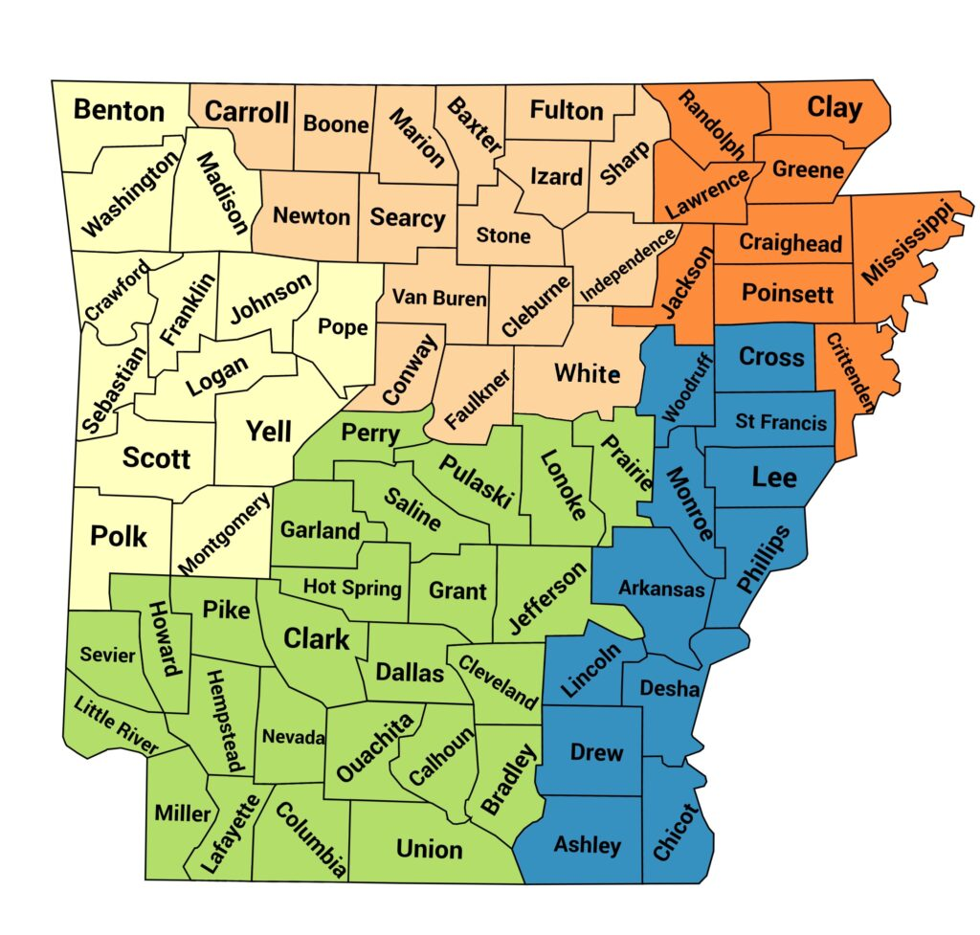
The Center for Exceptional Families
Loreena Hegenbart
(870) 897-4175
loreena.hegenbart@tcfef.org
Helpful resource that can provide consultation, trainings, and a parent mentor for IEP meetings and other support
https://thecenterforexceptionalfamilies.org/
Connect with the Parent Mentor in your county according to the map
Keith Watson
(870) 897-4174
keith.watson@tcfef.org
Teresa Hendrix
(870) 897-4254
teresa.hendrix@tcfef.org
Shelby Knight
Executive Director
shelby.knight@tcfef.org
Candie Corona
Parent Mentor & Hispanic Community Outreach
Serves all Counties
(501) 398-1646
candie.corona@tcfef.org
Karen Lutrick
(501) 398-1667
karen.lutrick@tcfef.org
Notes:
Helpful resource in your community who you can reach out to for support.

Slide 29
Thank
You

