Slide 1
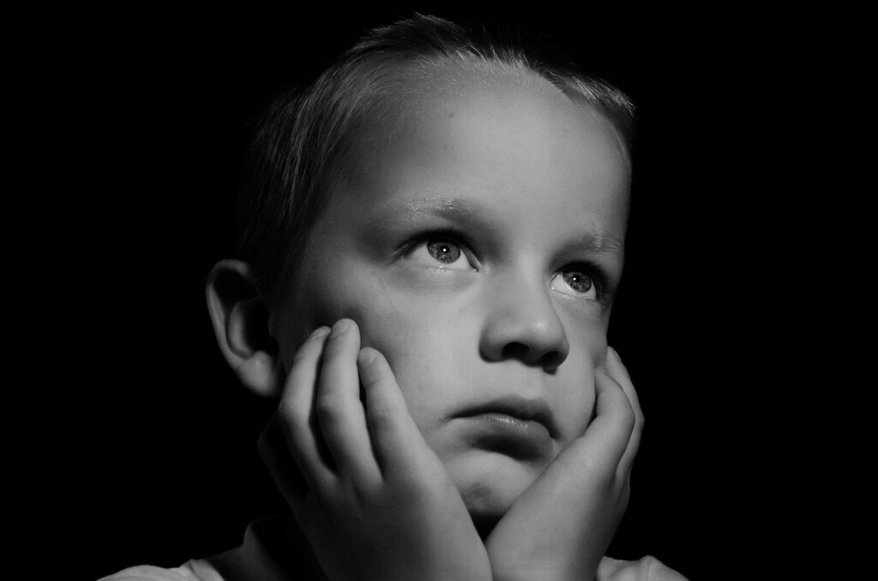
Indicators of Abuse & Neglect
Notes:
Adapted from “Do Right By Kids” Monroe County Department of Human Services

Slide 2
MidSOUTH Training Academy
Presented to you by…

Slide 3
Behavioral Indicators of Physical Abuse
Indicator | Example
Fear of going home | Child says he/she is afraid to go home because of fear of corporal punishment by parent
Reports injury by parents | Reports frequent injury from corporal punishment by parent Often blames self (e.g., “I was bad, so I was punished”)
Wearing clothing inappropriate to season | Child may wear long sleeves in summer or other clothing inappropriate for the season to hide physical bruises from abuse
Exhibits an extreme variety of behaviors | Extreme mood changes Unusually aggressive or withdrawn from peers Apprehensive when other children cry Hostile to parents, adults or other adults Wary of contacts with parents or other adults
Habit disorders | Self-injurious behaviors
Runaway attempts | Child runs away from home
Suicide attempts | Child threatens or attempts suicide

Slide 4
Physical Indicators of Abuse
Bruises, welts, and bite marks
Injuries that do not reflect the history provided by the Caregiver.
Clustered bruises, forming patterns that reflect the shape of an item (patterned injuries).
Injuries in the form of a hand on several different surface areas of skin
Injuries on both eyes or cheeks
Injuries on the torso, back, buttocks, and thighs
Bruises/Injuries that are in various stages of healing

Slide 6
indicators of emotional abuse
Indicator | Example
Emotionally Deprived | Parents do not provide the normal experiences producing feelings of being “loved, wanted, secure, and worthy.” Child makes negative statements about themselves
Physical Signs | Suffers from sleep, speech, or eating disorders Exhibits little to no verbal or physical communication with others Engages in self-destructive behaviors Highly aggressive
Socially Limited | Lag in physical, mental, and emotional development Overly rigid in conforming to instructions of teachers, doctors, and other adults Constantly “seeks out” other adults- such as teachers or neighbors- for attention and affection Clingy and forms indiscriminate attachments. Cruelty towards others
Notes:
Source: https://americanspcc.org/emotional-child-abuse/
An “indiscriminate attachment" refers to the tendency of an individual to form attachments to any available caregiver or source of support, regardless of the quality of the attachment or the suitability of the caregiver as a source of support.

Slide 7
The content of this training contains images that may be emotionally challenging and sensitive in nature.
Content Advisory:

Slide 8
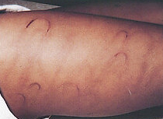
What Do You See?
6 y/o boy
Mechanism: Old and new belt marks, linear fist marks
Evidence of a recent beating w/ a belt.

Slide 9
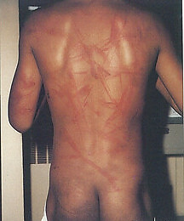
What Do You See?
Same child
Linear marks
Mechanism: fist
Round Marks
Mechanism: belt
Notes:
How would you describe these injuries?

Slide 10
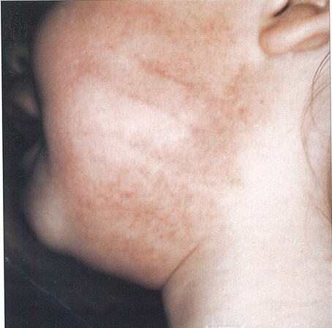
What Do You See?
Mechanism: hand slap
Imprint lines from human fingers

Slide 11
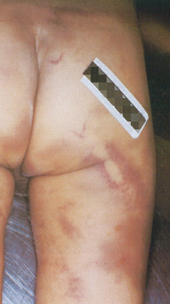
What Do You See?
Mechanism: Pool cue stick
Parallel lines with lighter spot in the center
Other diffuse areas of bruising that do not show distinct pattern

Slide 12
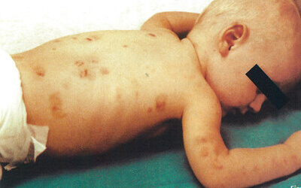
What Do You See?
4 m/o boy
Multiple pinch marks on the back and arms
Notes:
One on top of the other.
Pinch marks consist of two centrally placed vertical reddish cluster of petechiae, surrounded by contusion

Slide 13
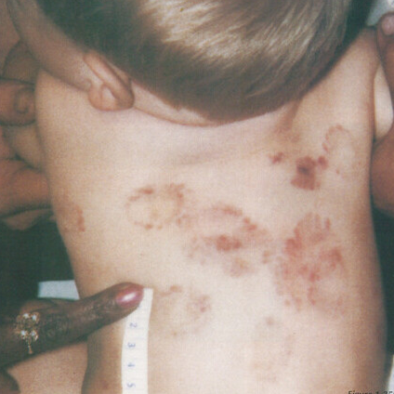
What Do You See?
15 m/o boy
Mechanism: Human mouth
Multiple Teeth/mouth patterns on back
Notes:
What is the history? Abuse? Neglect - lack of supervision?
Bite marks on back, abdomen, chest, and arm
Fun fact: A typical human mouth contains billions of bacteria and human bites present a high risk of infection. Human bites can be fatal without the proper medical attention.

Slide 14
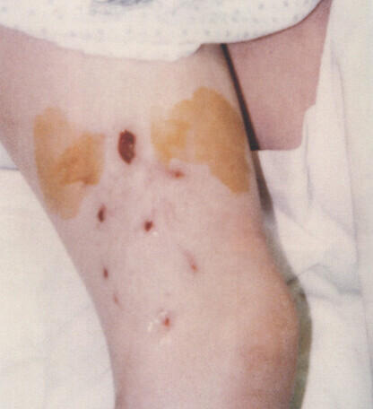
What Do You See?
8 y/o boy
Mechanism: Dog bite
Prominent canine puncture wounds
Notes:
MYTH: Dog mouths are cleaner than human mouths.
FACT: Both humans and dogs have mouths that are full of bacteria, and both contain around the same number of bacteria.

Slide 15
Physical Indicators Of Sexual Abuse
Indicator | Example
Pain, Soreness, & Itching | Pain or soreness in genital area, including rectum Redness or soreness of vagina, penis, and rectum Lower abdominal pain Difficulty walking or sitting due to discomfort in the genital area
Lesions & Discharge | Sores or bumps on skin of and around genitals Unusual sores or bumps on lips or around mouth Discharge from the vagina or rectum
Bruises, Burning in Urination | Bleeding from the vagina or rectum Blood in the urine or stool Stained or bloody underclothing Complaining of burning around the vagina or rectum Going to the bathroom more frequently Diagnosis of repeated urinary tract infections
Diagnosis of a sexually transmitted infection | Symptoms related to gonorrhea, syphilis, chlamydia, trichomoniasis, genital herpes, venereal warts, or HIV in young children Could be common in pre-teens and teens
Pregnancy | Could be common in pre-teens and teens

Slide 16
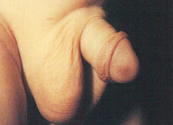
What Do You See?
Body part: penis
Mechanism: pinch
Reason: punishment for toilet training mistake

Slide 17
Behavioral Indicators Of Sexual Abuse
Indicator | Example
Excessive Modesty | Child very comfortable with nudity Unwilling to change for gym class or participate in physical education class Extreme fear of being touched Unwilling to submit to physical examination
Behavioral Extremes | Aggressive towards other children Poor peer relationships Overly passive and submissive (e.g., submits readily to genital examination during which most children would show reluctance or embarrassment) General fearfulness Manifestations of low self-esteem
Sexual Behavior More Advanced than Normal | Has sophisticated or unusual knowledge of sexual behaviors Tries to force other children to engage in sexual practices with them Demonstrates seductive or promiscuous sexual behavior Engages in prostitution

Slide 18
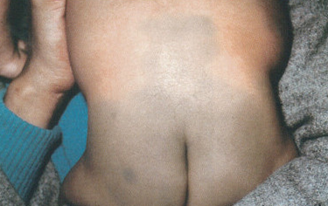
What Do You See?
Mechanism: birthmark
Mongolian spots Grey/Blue/Green marks on different parts of body.
Notes:
NOT an Abuse indicator
Mongolian spots (MS) are congenital birthmarks most commonly displayed over the lumbosacral area. They are bluish-green to black in color and oval to irregular in shape. They are most commonly found in individuals of African or Asian ethnic background
Bottom Left Picture: 11-month-old biracial child Mongolian spots on lighter skin
Reported to the hotline by a new daycare employee for bruising on his buttocks. Child was healthy and happy, mother stated this discoloration was present from birth. Staff determined discoloration was a Mongolian spot.

Slide 19
BRUISE OR Mongolian spot?
Notes:
Video link: https://youtu.be/32pBNsweXyk?feature=shared
How would you verify that this is a Mongolian Spot (or Birthmark)?

Slide 20
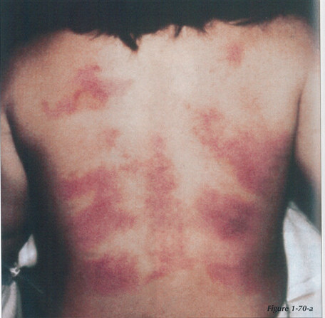
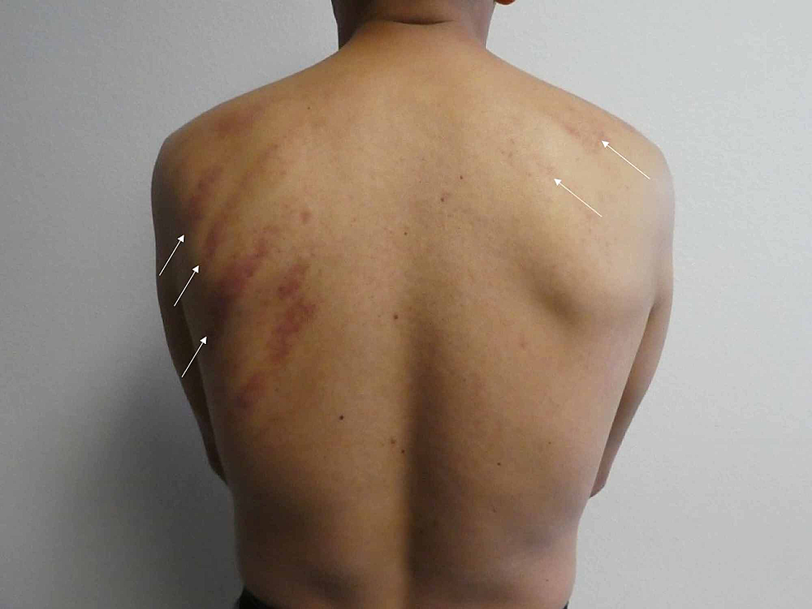
What Do You See?
Severe Example Of Coining
Folk Medicine Practice
Vietnamese child
Mechanism: Coining aka Cao Gio (Vietnamese)
Coin repeatedly rubbed against skin, causing friction-type bruise
Mild Example Of Coining
Notes:
Mechanism: Coining. For this particular child, it’s called Cao Gio
From the National Institute of Health: https://www.ncbi.nlm.nih.gov/pmc/articles/PMC7384708/
Coining originated in Southeast Asia. Coining is performed using either a coin or a similarly shaped object, such as a spoon [2]. Prior to vigorously rubbing the instrument on the affected area, lubricant is applied. Our patient had Tiger Balm, an ointment used for pain relief, applied prior to the coining procedure. The coining treatment then begins by pressing a smooth, rounded edge into the flesh enough to contact the fascial layer, but not so hard that it causes pain or discomfort. Stroking, beginning at the center line, is repeated in one direction until significant petechiae, preferably without extensive ecchymoses, appears. Coining is continued at adjacent stroke lines until the area to be treated is covered, taking approximately five to seven minutes [2]. The forceful rubbing experienced during coining by the patient is considered to be necessary to promote the resolution of symptoms. Therefore, the procedure tends to be painful. However, these symptoms usually resolve shortly after the procedure has been completed. The vigorous rubbing usually results in macular erythema, petechiae, and/or raised ecchymoses at the sites of treatment.
Can also be mistaken for a burn.
Hot oil may be used as lubricant on the skin
The parents may need counseling about treatment that is acceptable in their community.
Failure to follow recommended medical treatments should result in a report of medical neglect.

Slide 21
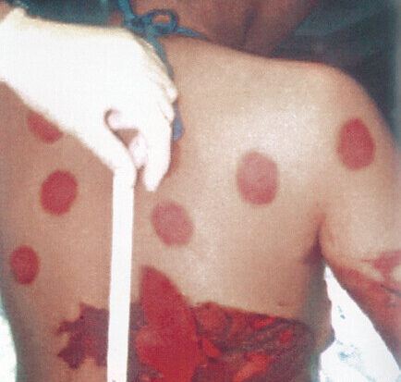
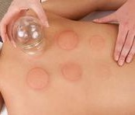
What Do You See?
Severe Example Of Cupping
Teenager
Folk Medicine Practice
Mechanism: Cupping
During cupping, the alcohol used to flame the cup splashed on teenager’s skin and ignited
(Which caused the burns on mid-backside and arm)
Mild Example Of Cupping
Notes:
From wedmd.com
Cupping therapy is an ancient form of alternative medicine in which a therapist puts special cups on your skin for a few minutes to create suction. People get it for many purposes, including to help with pain, inflammation, blood flow, relaxation and well-being, and as a type of deep-tissue massage.
Cupping therapy dates back to ancient Egyptian, Chinese, and Middle Eastern cultures. One of the oldest medical textbooks in the world, the Ebers Papyrus, describes how the ancient Egyptians used cupping therapy in 1,550 B.C. Cupping can be dry or wet. During both types of cupping, a flammable substance is put on the skin such as alcohol, herbs, or paper in a cup and set on fire. As the fire goes out, the cup is put upside down on your skin.
Should this behavior be substantiated as abuse?
Results of heating a cup or glass and applying it to the skin. A vacuum is created as the heated air cools, leaving round circular burns.
Folk medicine treatments should not result in burns or abrasions. If they do, it should be reported as suspected abuse, and parents will receive counseling about acceptable treatment methods within their community

Slide 22
GROUNDING BREAK
Notes:
Let's take a short break! Feel free to choose one of your favorite grounding techniques to manage any overwhelming emotions that may have come up during this presentation.

Slide 23
Burns
Accidental & Intentional

Slide 24
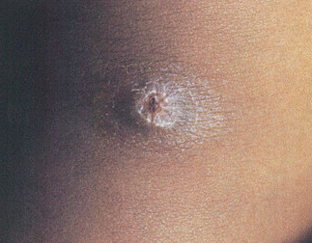
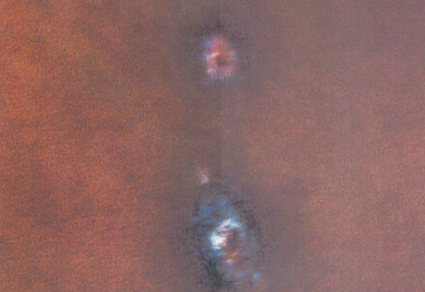
What Do You See?
4 y/o Girl
Cigarette burn
Mechanism: Lit cigarette
Old and new burns
Notes:
The young girl stated that her stepmother would discipline her with a lit cigarette.

Slide 25
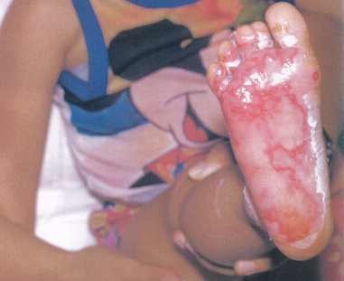
What Do You See?
4 y/o girl
Isolated plantar foot burn
Hx given: Stepped barefoot onto hot coals wile camping
Accidental
Notes:
What is the history?
How likely is the history?
While these incidents were ruled accidental, burns to the lower extremities can often be warning signs of child abuse

Slide 26
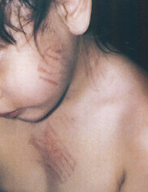
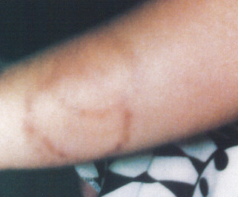
What Do You See?
30 m/o girl
Mechanism: Burns from blow dryer
Hx given: bio parent reported “Child clumsy and moved too much”
Notes:
Taken to emergency room by foster mother
Each time she would return from visitation with bio mother, she’d have a new injury/bruise.
Multiple patterned burns on face, chest, and arms.
Bruising on upper back and healed bruises on buttocks

Slide 27
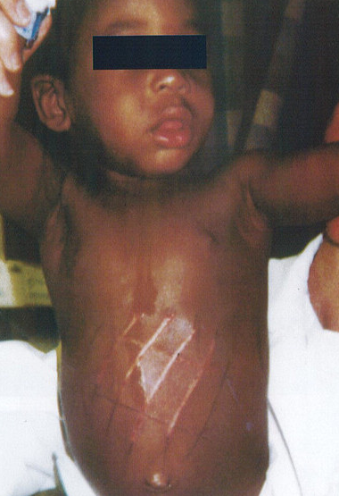
What Do You See?
18 m/o Boy
Patterned burn to abdomen
Notes:
What is the history? Accidental
How likely is the history?
Rushed to the emergency room with a [patterned burn on the abdomen.
Hx given by mother: Child fell off a rocking chair and landed on a heated floor grill.

Slide 28
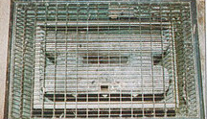
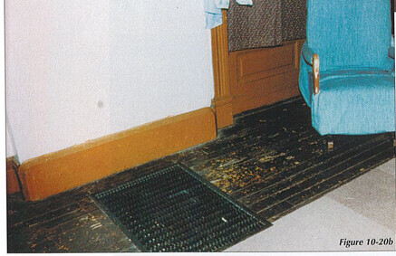
What Do You See?
Same 18 m/o Boy
Mechanism: Heated Floor Grill
Accidental
Notes:
Upon investigation of the home, it was discovered that the grill and rocker were placed as described. The grill was in fact hot enough to cause such a burn.
Incident was ruled accidental.

Slide 29
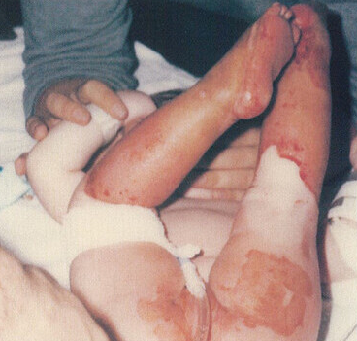
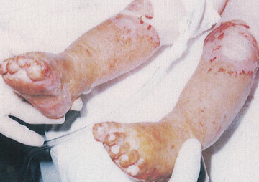
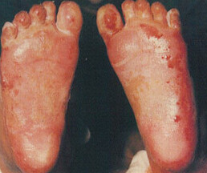
What Do You See?
20 m/o girl
Hx given: Caregiver stated “she was sitting in 4 inches of bath water, when she turned hot water on”
Mechanism: immersion burn
Stocking glove sign
Notes:
Child was in the care of her mother’s paramour.
History given did not match the injuries. Her legs were flexed at the time of the injury or was protected by his hand as he dipped her.

Slide 30
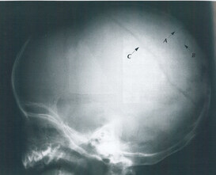
What Do You See?
Multiple fractures of the skull
Two fracture on the same side of the skull
Extends to base of the skull

Slide 31
What Do You See?
6 w/o infant
Mechanism: A sharp, clean transverse fracture of the humerus.
Notes:
Medical professionals noted that a fracture of this type could have only occurred by a direct blow.
Fractures of any long limb bones are always highly suspicious for abuse, unless the history is precise in explaining the incident.

Slide 32
13 Useful Grounding Techniques
Notes:
Video: https://youtu.be/0lmE8UCKfoU?feature=shared
Before we begin, lets discuss a few grounding techniques to prepare ourselves for some of the things that we may experience in the field.
Grounding techniques are important skills for assessors and all other behavioral health service providers who interact with traumatized clients.
These techniques can be used to assist the worker in coping with overwhelming emotions.
Knowledge of grounding can help you defuse an escalating situation or calm a client who is triggered by the assessment process.
Trainer Note: the video clip does have a few places where the audio cuts off a little early.

Slide 33
Neglect, Abandonment, & Failure to Thrive (FTT)
Neglect- The failure of the caregiver to provide the basic needs of their child.
Abandonment- The caregiver’s rejection of the child and the parental role.
Nonorganic Failure To Thrive- Parental skills, expectations, and home environment are intertwined with the child's developmental capabilities
Notes:
Neglect-
Varies in degree.
Harm by neglect has not yet been quantified.
B. Abandonment
Can also consist of emotional abandonment (when the caregiver completely withdraws from nurturing), refusal of parental custody, or lack of supervision.
C. Nonorganic Failure To Thrive-
Could relate to child abuse or neglect in some cases.
Physical/Intellectual Disabilities with a disturbed caregiver-infant relationship.
Children are usually slow to develop/learn, physically small, or may have flattened emotional responses- even to pain.

Slide 34
Behavioral & Physical Indicators Of Neglect
Indicator | Example
Child is not getting enough food | Child appears malnourished Child begging, stealing food Consistently acts hungry or complains of hunger Constant fatigue, listlessness, falling asleep in class
Child appears poorly cared for | Has poor hygiene (skin, teeth, ears, hair) Clothes are frequently dirty or torn
Lack of medical/dental care | Unattended physical problems or medical/dental needs
Lack of adult supervision | Child being left home alone without supervision, especially in dangerous activities or for long periods of time The child states there is no caretaker Extended stays at schools; child arrives early and stays late
Behavioral extremes | Compliant/passive, overly adaptive behavior Overly adult or infantile for age Delinquency
Child is showing a delay in normal development | Failure to thrive – physically or emotionally Measurable lag in physical growth Measurable lag mental/emotional development

Slide 35
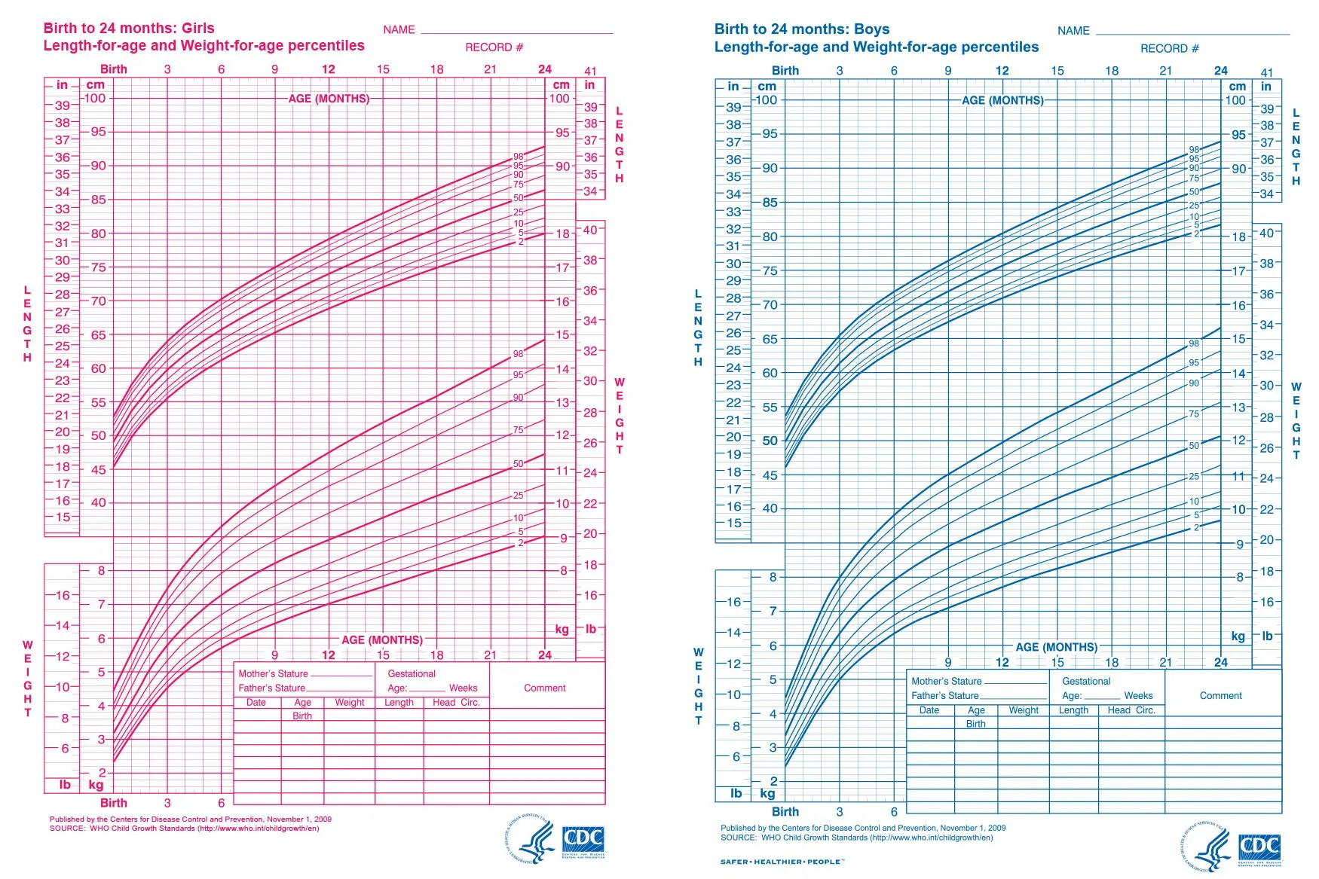
Failure To Thrive Growth Chart
Notes:
Growth chart- FTT does not show a normal growth curve
“Small babies may be below 50th% but still show a curve
These are the current standard growth charts for boys and girls, ages 0-24 months

Slide 36
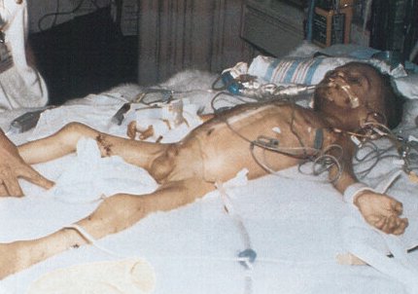
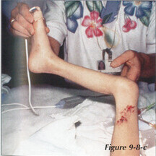
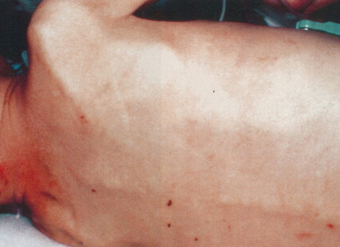
What Do You See?
2.5 y/o boy
Had multiple bruises, abrasions, and bite marks
Chronic physical abuse
Severe malnutrition
Notes:
Admitted in cardiac arrest after being found unresponsive at home
Physical and emotional neglect and repeated physical abuse
Lack of muscle and fat tissue
Severe malnutrition including electrolyte imbalance, liver dysfunction, anemia, and vitamin deficiency.
Animal scratch marks on legs

Slide 37
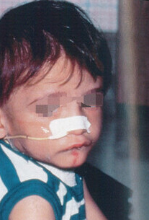
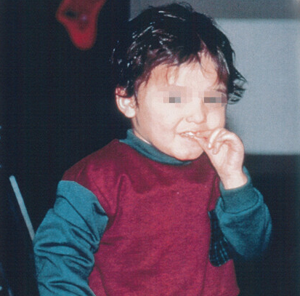
What Do You See?
Same child 1 month after hospitalization
Intensive interventions / therapies
Speech & Motor skill delay
Placed in home of relatives at 15 months - unsuccessful
Notes:
Required a gastrostomy tube feedings and oral motor therapy
He was fearful of caregivers, had angry outbursts during playtime therapies, and frequent nightmares
Relatives so overwhelmed while caring for him and his 3 siblings that they put him in an attic room and ignored him, except for periodic meals and beatings
Placed in foster home
Child was subsequently placed in foster care and faced several Foster home changes due to his behavioral issues

Slide 38
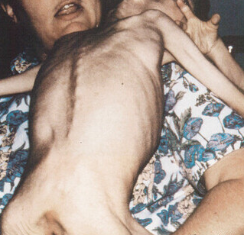
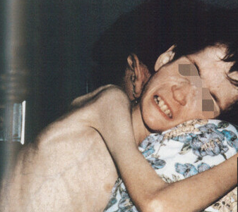
What Do You See?
11 y/o boy
Cerebral palsy
In foster care
Severe malnutrition
Hx given: Child was difficult to feed due to condition
Notes:
A second child with cerebral palsy was also found dead, with evidence of severe malnutrition in this same foster home
Both children with cerebral palsy were kept in a secluded room all day
Foster father admitted that children were poorly fed, also locked child in a closet.

Slide 39
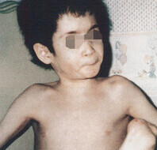
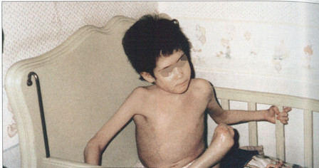
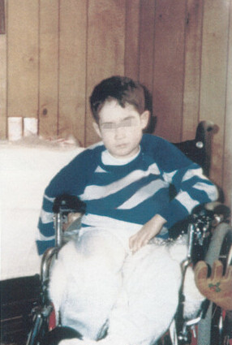
What Do You See?
Child recovered rapidly while in new placement home
Notes:
New foster parent had no experience in feeding children with limitations, successfully assisted child with gaining weight.

Slide 40
Sources: American Academy of Pediatrics George Washington Medical School WebMD National Institute of Health: Original material purchased by MidSOUTH for training purposes Child Maltreatment: A Clinical Guide and Reference (2nd and 3rd Edition) – J.A. Monteleone & A.E. Brodeur

Slide 41
Grounding techniques:
What are 5 things you can see? Look for small details such as a pattern on the ceiling, the way light reflects off a surface, or an object you never noticed.
What are 4 things you can feel? Notice the sensation of clothing on your body, the sun on your skin, or the feeling of the chair you are sitting in. Pick up an object and examine its weight, texture, and other physical qualities.
What are 3 things you can hear? Pay special attention to the sounds your mind has tuned out, such as a ticking clock, distant traffic, or trees blowing in the wind.
5-4-3-2-1 Technique
What are 2 things you can smell? Try to notice smells in the air around you, like an air freshener or freshly mowed grass. You may also look around for something that has a scent, such as a flower or an unlit candle.
What is 1 thing you can taste? Carry gum, candy, or small snacks for this step. Pop one in your mouth and focus your attention closely on the flavors.
Notes:
Practice using grounding techniques when you feel overwhelming emotion or exhaustion.
As a group, lets all practice the 5-4-3-2-1 technique to wind down after that presentation and send us off to break!

