Slide 1
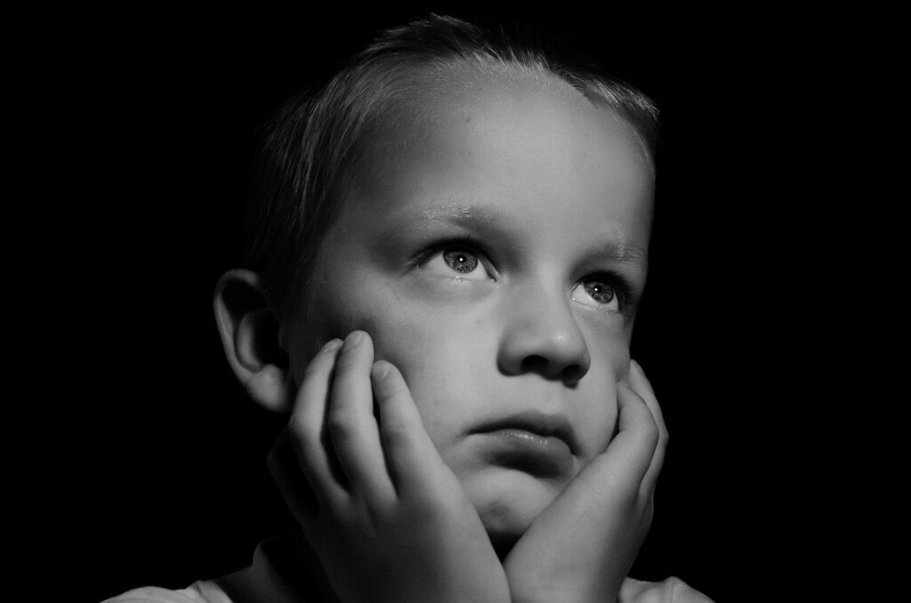
Indicators of Abuse & Neglect
Notes:
Adapted from “Do Right By Kids” Monroe County Department of Human Services

Slide 2
MidSOUTH Training Academy
Presented to you by…

Slide 3
Behavioral Indicators of Physical Abuse
Indicator | Example
Fear of going home | Child says he/she is afraid to go home because of fear of corporal punishment by parent
Reports injury by parents | Reports frequent injury from corporal punishment by parent Often blames self (e.g., “I was bad, so I was punished”)
Wearing clothing inappropriate to season | Child may wear long sleeves in summer or other clothing inappropriate for the season to hide physical bruises from abuse
Exhibits an extreme variety of behaviors | Extreme mood changes Unusually aggressive or withdrawn from peers Apprehensive when other children cry Hostile to parents, adults or other adults Wary of contacts with parents or other adults
Habit disorders | Self-injurious behaviors
Runaway attempts | Child runs away from home
Suicide attempts | Child threatens or attempts suicide

Slide 4
Physical Indicators of Abuse
Bruises, welts, and bite marks
Injuries that do not reflect the history provided by the Caregiver.
Clustered bruises, forming patterns that reflect the shape of an item (patterned injuries).
Injuries in the form of a hand on several different surface areas of skin
Injuries on both eyes or cheeks
Injuries on the torso, back, buttocks, and thighs
Bruises/Injuries that are in various stages of healing

Slide 6
indicators of emotional abuse
Indicator | Example
Emotionally Deprived | Parents do not provide the normal experiences producing feelings of being “loved, wanted, secure, and worthy.” Child makes negative statements about themselves
Physical Signs | Suffers from sleep, speech, or eating disorders Exhibits little to no verbal or physical communication with others Engages in self-destructive behaviors Highly aggressive
Socially Limited | Lag in physical, mental, and emotional development Overly rigid in conforming to instructions of teachers, doctors, and other adults Constantly “seeks out” other adults- such as teachers or neighbors- for attention and affection Clingy and forms indiscriminate attachments. Cruelty towards others
Notes:
Source: https://americanspcc.org/emotional-child-abuse/
An “indiscriminate attachment" refers to the tendency of an individual to form attachments to any available caregiver or source of support, regardless of the quality of the attachment or the suitability of the caregiver as a source of support.

Slide 7
The content of this training contains images that may be emotionally challenging and sensitive in nature.
Content Advisory:

Slide 8
13 Useful Grounding Techniques
Notes:
Video: https://youtu.be/0lmE8UCKfoU?feature=shared
Before we begin, lets discuss a few grounding techniques to prepare ourselves for some of the things that we may experience in the field.
Grounding techniques are important skills for assessors and all other behavioral health service providers who interact with traumatized clients.
These techniques can be used to assist the worker in coping with overwhelming emotions.
Knowledge of grounding can help you defuse an escalating situation or calm a client who is triggered by the assessment process.
Trainer Note: the video clip does have a few places where the audio cuts off a little early.

Slide 9
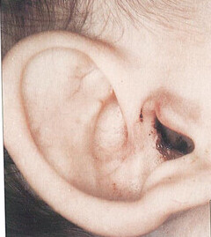
What Do You See?
2 y/o boy
Hx provided by parents: Fell out of highchair
Blood in ear
Mechanism: blunt force trauma to right ear
Notes:
Likely a slap.
Child diagnosed with a perforated right ear drum.
Parents noted child had “fallen out of a highchair”
Trainer Note: Hx means history.

Slide 10
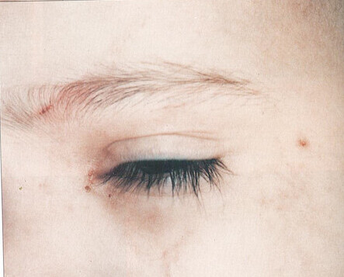
What Do You See?
Same child
Bruising under left eye
Old and fresh bruises were noted on the forehead
Notes:
Circumferential markings were also noted on his arm where he was restrained.
Was this evidence of abuse?

Slide 11
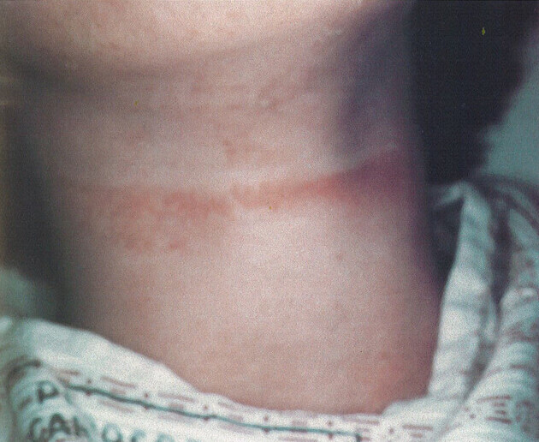
What Do You See?
12 y/o boy
Mechanism: Cord marks
Small petechial hemorrhages above the injury
Notes:
Instrument was flexible because it was able to wrap around the planes of the body
Frontal view of an attempted strangulation
Petechial: A spike in blood pressure in a certain area, which causes the rupture of the capillaries. Said ruptures can cause hemorrhages

Slide 12
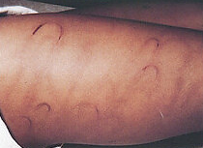
What Do You See?
6 y/o boy
Mechanism: Old and new belt marks, linear fist marks
Evidence of a recent beating w/ a belt.

Slide 13
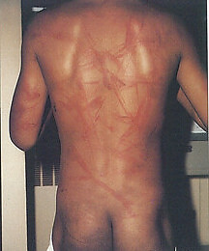
What Do You See?
Same child
Linear marks
Mechanism: fist
Round Marks
Mechanism: belt
Notes:
How would you describe these injuries?

Slide 14
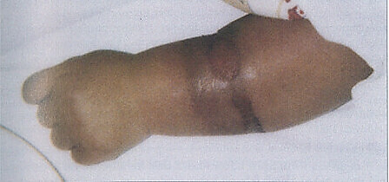
What Do You See?
Cord marks; Circular bruising of wrist
Mechanism: restraint
Notes:
How does this fit with the new definition of maltreatment related to tying a child to a fixed object?

Slide 15
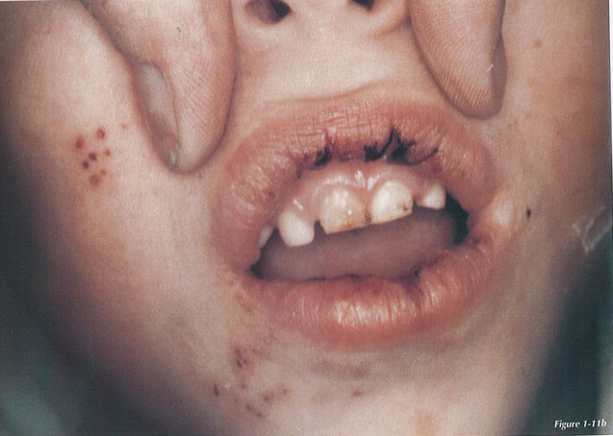
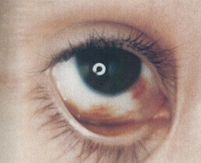
What Do You See?
4 y/o boy
Hx given by parents: “Fell downstairs”
5-point abrasion/Patterned injury
Mechanism: Ring
Multiple bruises in various stages of healing
Notes:
This child was reported to have a developmental delay and considered to have a behavioral issue (not specified)
Previous Medical Records include:
Spiral fracture of the humerus
Lead poisoning
Hearing deficiency
Conjunctival Hemorrhages in right eye

Slide 16
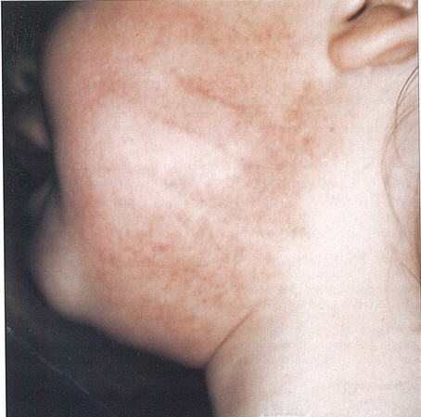
What Do You See?
Mechanism: hand slap
Imprint lines from human fingers

Slide 17
Physical Indicators Of Sexual Abuse
Indicator | Example
Pain, Soreness, & Itching | Pain or soreness in genital area, including rectum Redness or soreness of vagina, penis, and rectum Lower abdominal pain Difficulty walking or sitting due to discomfort in the genital area
Lesions & Discharge | Sores or bumps on skin of and around genitals Unusual sores or bumps on lips or around mouth Discharge from the vagina or rectum
Bruises, Burning in Urination | Bleeding from the vagina or rectum Blood in the urine or stool Stained or bloody underclothing Complaining of burning around the vagina or rectum Going to the bathroom more frequently Diagnosis of repeated urinary tract infections
Diagnosis of a sexually transmitted infection | Symptoms related to gonorrhea, syphilis, chlamydia, trichomoniasis, genital herpes, venereal warts, or HIV in young children Could be common in pre-teens and teens
Pregnancy | Could be common in pre-teens and teens

Slide 18
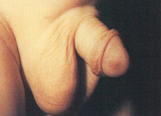
What Do You See?
Body part: penis
Mechanism: pinch
Reason: punishment for toilet training mistake

Slide 19
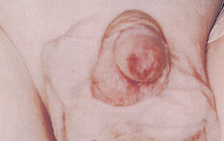
What Do You See?
11 m/o boy
Mechanism: pinch lesion of the glans penis
Dropped off at hospital by babysitter
Notes:
More severe than previous shot of same-type injury
Babysitter stated that child had fallen out of his crib, this statement was corroborated by the child’s 6-year-old older sibling.
Upon investigation, DCFS discovered that the older sibling lied about what happened. The child was beaten with a paddle by the babysitter among an array of other injuries, including the pinch.

Slide 20
Behavioral Indicators Of Sexual Abuse
Indicator | Example
Excessive Modesty | Child very comfortable with nudity Unwilling to change for gym class or participate in physical education class Extreme fear of being touched Unwilling to submit to physical examination
Behavioral Extremes | Aggressive towards other children Poor peer relationships Overly passive and submissive (e.g., submits readily to genital examination during which most children would show reluctance or embarrassment) General fearfulness Manifestations of low self-esteem
Sexual Behavior More Advanced than Normal | Has sophisticated or unusual knowledge of sexual behaviors Tries to force other children to engage in sexual practices with them Demonstrates seductive or promiscuous sexual behavior Engages in prostitution

Slide 21
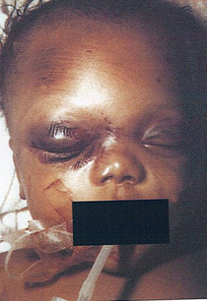
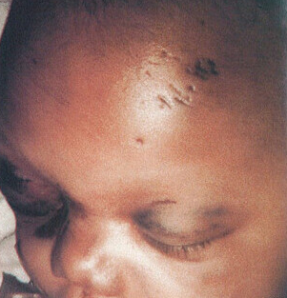
What Do You See?
5 m/o
Mechanism: Broom
Situation: Domestic dispute, child in mother’s arms
Notes:
An X-ray revealed that the child had multiple skull fractures.

Slide 22
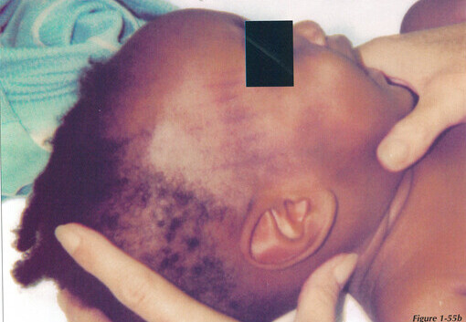
What Do You See?
10 m/o
Left in the care of an Adolescent male
Additional medical information:
Bruising of chest and abdomen
Elevated liver enzymes
Notes:
Brought to emergency room by his parents because he was irritable
What does it mean when someone has elevated liver enzymes?
Elevated liver enzymes MAY mean a person’s liver is not working properly. Damaged or inflamed liver cells release enzymes into the bloodstream, which can be detected by a blood test
What do you think caused this injury?

Slide 23
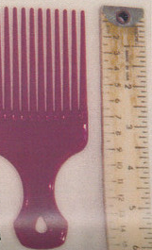
What Do You See?
10 m/o
Mechanism: pick comb
Notes:
Injury was caused by a pick comb

Slide 24
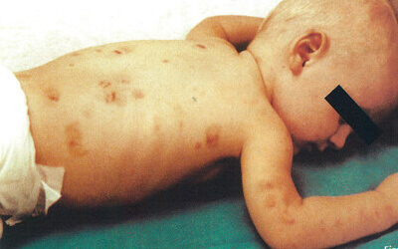
What Do You See?
4 m/o boy
Multiple pinch marks on the back and arms
Notes:
One on top of the other.
Pinch marks consist of two centrally placed vertical reddish cluster of petechiae, surrounded by contusion

Slide 25
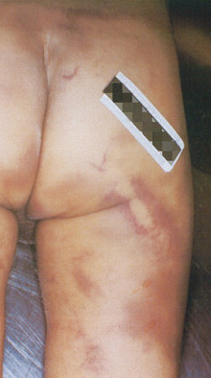
What Do You See?
Mechanism: Pool cue stick
Parallel lines with lighter spot in the center
Other diffuse areas of bruising that do not show distinct pattern

Slide 26
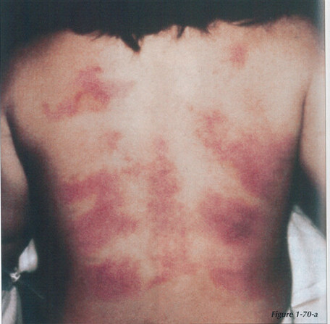
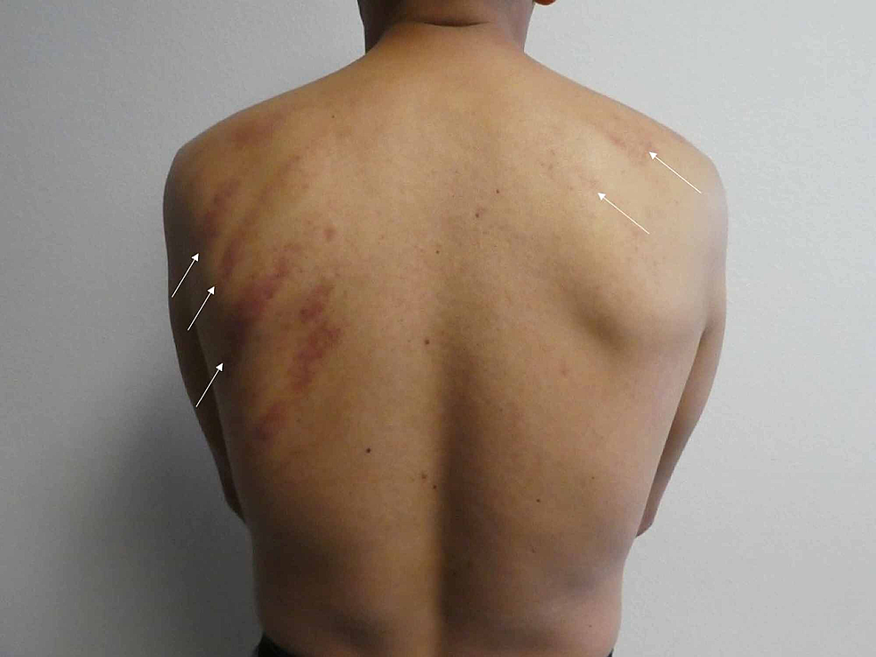
What Do You See?
Severe Example Of Coining
Folk Medicine Practice
Vietnamese child
Mechanism: Coining aka Cao Gio (Vietnamese)
Coin repeatedly rubbed against skin, causing friction-type bruise
Mild Example Of Coining
Notes:
Mechanism: Coining. For this particular child, it’s called Cao Gio
From the National Institute of Health: https://www.ncbi.nlm.nih.gov/pmc/articles/PMC7384708/
Coining originated in Southeast Asia. Coining is performed using either a coin or a similarly shaped object, such as a spoon [2]. Prior to vigorously rubbing the instrument on the affected area, lubricant is applied. Our patient had Tiger Balm, an ointment used for pain relief, applied prior to the coining procedure. The coining treatment then begins by pressing a smooth, rounded edge into the flesh enough to contact the fascial layer, but not so hard that it causes pain or discomfort. Stroking, beginning at the center line, is repeated in one direction until significant petechiae, preferably without extensive ecchymoses, appears. Coining is continued at adjacent stroke lines until the area to be treated is covered, taking approximately five to seven minutes [2]. The forceful rubbing experienced during coining by the patient is considered to be necessary to promote the resolution of symptoms. Therefore, the procedure tends to be painful. However, these symptoms usually resolve shortly after the procedure has been completed. The vigorous rubbing usually results in macular erythema, petechiae, and/or raised ecchymoses at the sites of treatment.
Can also be mistaken for a burn.
Hot oil may be used as lubricant on the skin
The parents may need counseling about treatment that is acceptable in their community.
Failure to follow recommended medical treatments should result in a report of medical neglect.

Slide 27
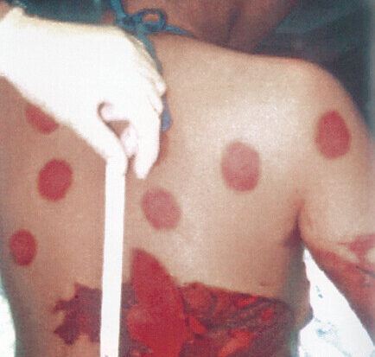
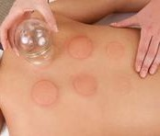
What Do You See?
Severe Example Of Cupping
Teenager
Folk Medicine Practice
Mechanism: Cupping
During cupping, the alcohol used to flame the cup splashed on teenager’s skin and ignited
(Which caused the burns on mid-backside and arm)
Mild Example Of Cupping
Notes:
From wedmd.com
Cupping therapy is an ancient form of alternative medicine in which a therapist puts special cups on your skin for a few minutes to create suction. People get it for many purposes, including to help with pain, inflammation, blood flow, relaxation and well-being, and as a type of deep-tissue massage.
Cupping therapy dates back to ancient Egyptian, Chinese, and Middle Eastern cultures. One of the oldest medical textbooks in the world, the Ebers Papyrus, describes how the ancient Egyptians used cupping therapy in 1,550 B.C. Cupping can be dry or wet. During both types of cupping, a flammable substance is put on the skin such as alcohol, herbs, or paper in a cup and set on fire. As the fire goes out, the cup is put upside down on your skin.
Should this behavior be substantiated as abuse?
Results of heating a cup or glass and applying it to the skin. A vacuum is created as the heated air cools, leaving round circular burns.
Folk medicine treatments should not result in burns or abrasions. If they do, it should be reported as suspected abuse, and parents will receive counseling about acceptable treatment methods within their community

Slide 28
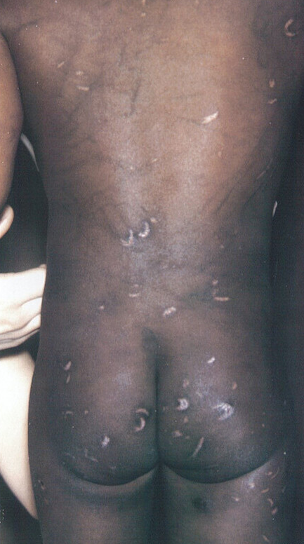
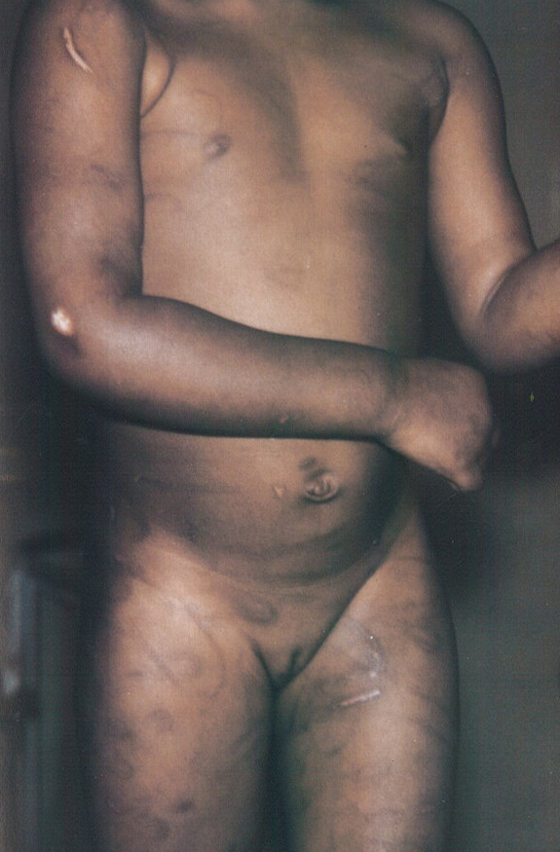
What Do You See?
3 y/o girl
Numerous old loops and linear marks
Mechanism: switch/belt
Reason: disrespectful behavior
Some cut through skin
Notes:
Originally brought to ER for an upper respiratory infection
She was also reported to be developmentally delayed and deaf
Is this reasonable and moderate?

Slide 29
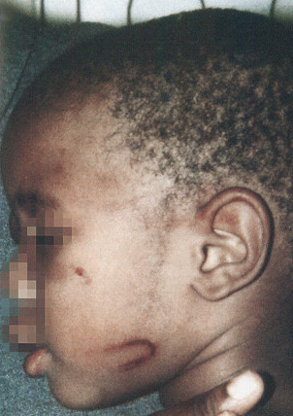
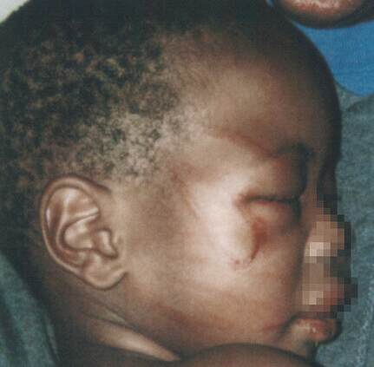
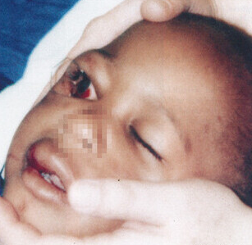
What Do You See?
23 m/o boy
Loop marks appear on child's face
Injuries a result of beating with Extension cord or belt

Slide 30
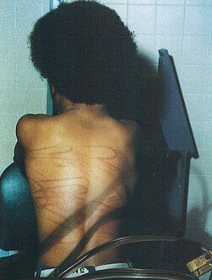
What Do You See?
13 y/o boy
Mechanism: television cable
Loop marks
Notes:
Television cable shown in photo

Slide 31
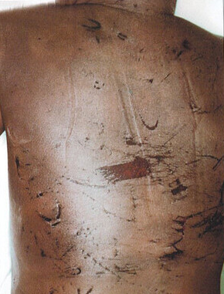
What Do You See?
5 y/o girl
Cause of death: Blunt soft tissue Trauma
Patterned injuries of loop marks (old & new)
Notes:
Injuries included multiple abrasions and contusions of the head, face, chest, abdomen, back, and extremities
Child was dead on arrival to hospital

Slide 32
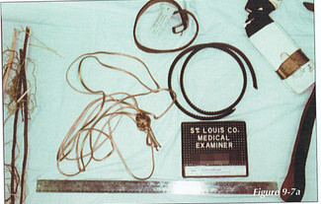
What Do You See?
Mechanism: Variety of instruments
Notes:
Instruments included in photo: A cord, belt, a paddle, a fan belt, and switches/tree branches

Slide 33
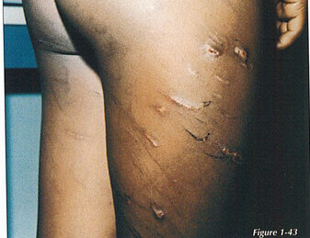
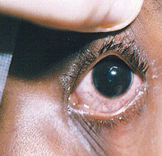
What Do You See?
6 y/o boy
Scarred linear and loop marks
Corneal abrasion
Notes:
Hx given: Brought to the emergency room with caregivers stating that he’d “hurt his eye”
Child stated that his eye was struck while being whipped, thus the corneal abrasion
Neighbor reported fresh loop marks on the child.

Slide 34
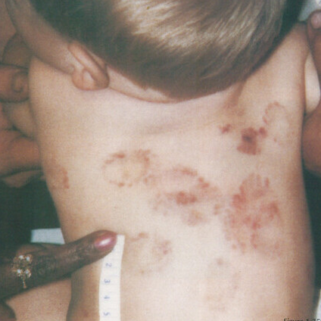
What Do You See?
15 m/o boy
Mechanism: Human mouth
Multiple Teeth/mouth patterns on back
Notes:
What is the history? Abuse? Neglect - lack of supervision?
Bite marks on back, abdomen, chest, and arm
Fun fact: A typical human mouth contains billions of bacteria and human bites present a high risk of infection. Human bites can be fatal without the proper medical attention.

Slide 35
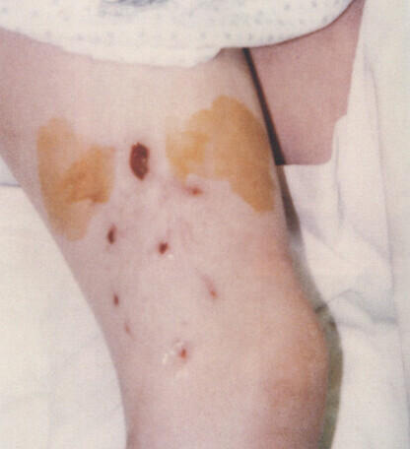
What Do You See?
8 y/o boy
Mechanism: Dog bite
Prominent canine puncture wounds
Notes:
MYTH: Dog mouths are cleaner than human mouths.
FACT: Both humans and dogs have mouths that are full of bacteria, and both contain around the same number of bacteria.

Slide 36
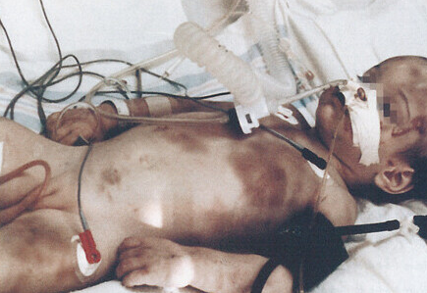
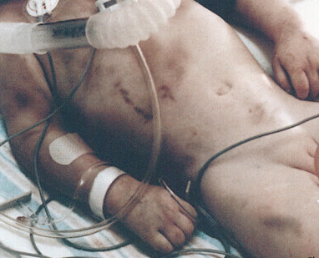
What Do You See?
3 y/o girl
Hx given: “Fell downstairs”
Blunt trauma to abdomen
Closed head injury with cerebral hemorrhage
Chronic vegetative state
Notes:
Fresh bruises all the same age
18 y/o mother was living with 21 y/o man (not bio father). Once the history provided was challenged the mother admitted that her and the boyfriend “got stoned and beat the child”
Child was seen 6 weeks prior at a different hospital with similar but less serious injuries
Child sent home with the understanding that the male would no longer have access to the child. The male later returned.
The failure to adequately protect the child was seen as an institutional one because they were not monitored closely enough

Slide 37
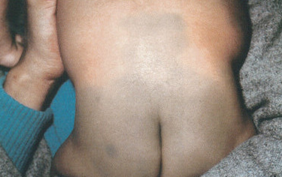
What Do You See?
Mechanism: birthmark
Mongolian spots Grey/Blue/Green marks on different parts of body.
Notes:
NOT an Abuse indicator
Mongolian spots (MS) are congenital birthmarks most commonly displayed over the lumbosacral area. They are bluish-green to black in color and oval to irregular in shape. They are most commonly found in individuals of African or Asian ethnic background
Bottom Left Picture: 11-month-old biracial child Mongolian spots on lighter skin
Reported to the hotline by a new daycare employee for bruising on his buttocks. Child was healthy and happy, mother stated this discoloration was present from birth. Staff determined discoloration was a Mongolian spot.

Slide 38
BRUISE OR Mongolian spot?
Notes:
Video link: https://youtu.be/32pBNsweXyk?feature=shared
How would you verify that this is a Mongolian Spot (or Birthmark)?

Slide 39
GROUNDING BREAK
Notes:
Let's take a short break! Feel free to choose one of your favorite grounding techniques to manage any overwhelming emotions that may have come up during this presentation.

Slide 40
Burns
Accidental & Intentional

Slide 41
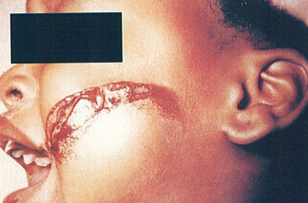
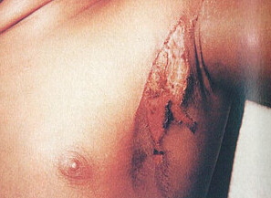
What Do You See?
Accidental iron burn to face
Irregular shape
Iron fell and caused burn to chest
Notes:
Series of burns – accidental
This little girl pulled the cord of a hot clothing iron onto her face, causing this glancing injury as it fell.

Slide 42
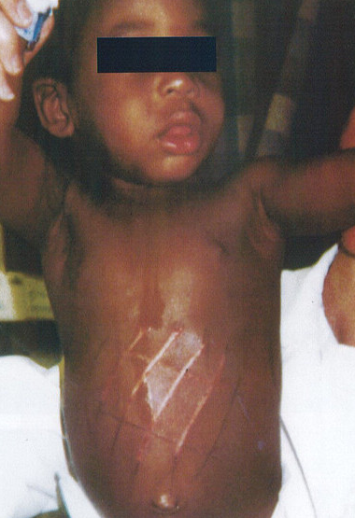
What Do You See?
18 m/o Boy
Patterned burn to abdomen
Notes:
What is the history? Accidental
How likely is the history?
Rushed to the emergency room with a [patterned burn on the abdomen.
Hx given by mother: Child fell off a rocking chair and landed on a heated floor grill.

Slide 43
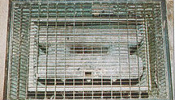
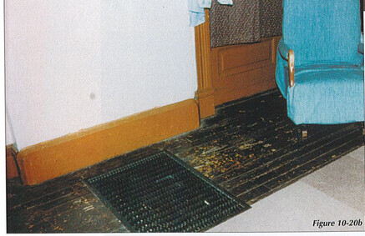
What Do You See?
18 m/o Boy
Mechanism: Heated Floor Grill
Accidental
Notes:
Upon investigation of the home, it was discovered that the grill and rocker were placed as described. The grill was in fact hot enough to cause such a burn.
Incident was ruled accidental.

Slide 44
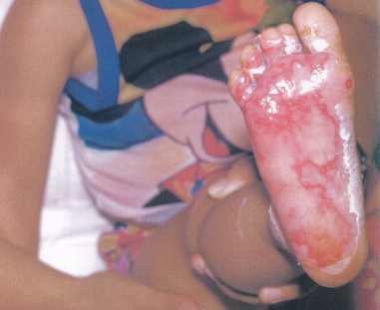
What Do You See?
4 y/o girl
Isolated plantar foot burn
Hx given: Stepped barefoot onto hot coals wile camping
Accidental
Notes:
What is the history?
How likely is the history?
While these incidents were ruled accidental, burns to the lower extremities can often be warning signs of child abuse

Slide 45
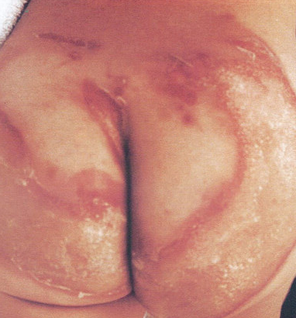
What Do You See?
3 y/o girl
Doughnut-Shaped burn
Mechanism: Immersion burn
Sparing in center is from being forcibly held against the cooler surface of the sink/tub
Notes:
What’s wrong with this picture?
Donut-shaped burn, Center is spared.

Slide 46
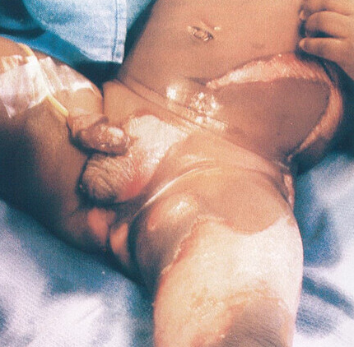
What Do You See?
1 y/o infant
Scald burn
Sparing due to flexion at the hip
Notes:
This type of burn occurs when a hot liquid is intentionally poured onto the body, or the victim is immersed in a hot liquid with the hips or other body parts maximally flexed.

Slide 47
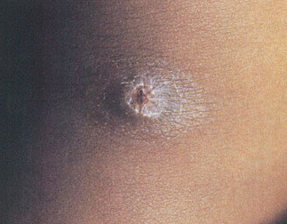
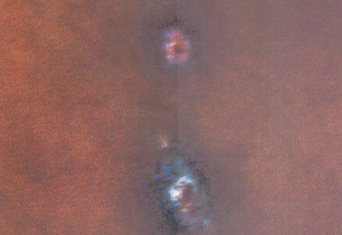
What Do You See?
4 y/o Girl
Cigarette burn
Mechanism: Lit cigarette
Old and new burns
Notes:
The young girl stated that her stepmother would discipline her with a lit cigarette.

Slide 48
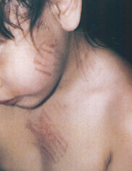
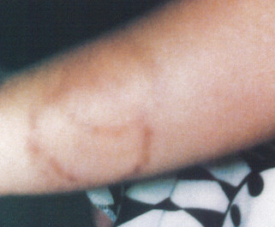
What Do You See?
30 m/o girl
Mechanism: Burns from blow dryer
Hx given: bio parent reported “Child clumsy and moved too much”
Notes:
Taken to emergency room by foster mother
Each time she would return from visitation with bio mother, she’d have a new injury/bruise.
Multiple patterned burns on face, chest, and arms.
Bruising on upper back and healed bruises on buttocks

Slide 49
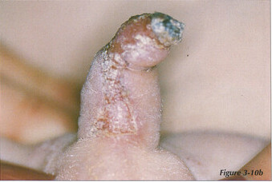
What Do You See?
Flame Burn to Penis
Mechanism: Cigarette Lighter

Slide 50
What Do You See?
20 m/o girl
Hx given: Caregiver stated “she was sitting in 4 inches of bath water, when she turned hot water on”
Mechanism: immersion burn
Stocking glove sign
Notes:
Child was in the care of her mother’s paramour.
History given did not match the injuries. Her legs were flexed at the time of the injury or was protected by his hand as he dipped her.

Slide 51
What Do You See?
3.5 y/o boy
Mechanism: Lit cigarette, patterned burns
Multiple burns on face, back, and buttocks
Choke marks on his neck
Notes:
Mother was a former mental hospital patient and had previously had two other children removed from her home due to abuse.
Would not take her medication (antipsychotic med regimen)
The mother had successfully eluded protective services multiple times
Child had no immunizations

Slide 52
What Do You See?
Flame burn to both palms
Bilateral injuries more suspicious
Mechanism: Cigarette lighter
Punished by father in same way father was punished as a child
Notes:
Many times, parents are punishing their children in the same way that they were punished as a child.

Slide 53
What Do You See?
Multiple fractures of the skull
Two fracture on the same side of the skull
Extends to base of the skull

Slide 54
What Do You See?
6 w/o infant
Mechanism: A sharp, clean transverse fracture of the humerus.
Notes:
Medical professionals noted that a fracture of this type could have only occurred by a direct blow.
Fractures of any long limb bones are always highly suspicious for abuse, unless the history is precise in explaining the incident.

Slide 55
What Do You See?
2 y/o boy
Examined for chest pain and multiple bruises
Notes:
Frontal chest radiograph demonstrating bilateral healing fractures of the ribs from the back.
Such injuries are painful and usually limit the motion of the arms, depending on the infected side.

Slide 56
Neglect, Abandonment, & Failure to Thrive (FTT)
Neglect- The failure of the caregiver to provide the basic needs of their child.
Abandonment- The caregiver’s rejection of the child and the parental role.
Nonorganic Failure To Thrive- Parental skills, expectations, and home environment are intertwined with the child's developmental capabilities
Varies in degree.
Harm by neglect has not yet been quantified.
Can also consist of emotional abandonment (when caregiver completely withdraws from nurturing), refusal of parental custody, or lack of supervision.
Could possibly relate to child abuse or neglect in some cases.
Physical/Intellectual Disabilities with a disturbed caregiver-infant relationship.
Children are usually slow to develop/learn, physically small, or may have flattened emotional responses- even to pain.

Slide 57
Behavioral & Physical Indicators Of Neglect
Indicator | Example
Child is not getting enough food | Child appears malnourished Child begging, stealing food Consistently acts hungry or complains of hunger Constant fatigue, listlessness, falling asleep in class
Child appears poorly cared for | Has poor hygiene (skin, teeth, ears, hair) Clothes are frequently dirty or torn
Lack of medical/dental care | Unattended physical problems or medical/dental needs
Lack of adult supervision | Child being left home alone without supervision, especially in dangerous activities or for long periods of time The child states there is no caretaker Extended stays at schools; child arrives early and stays late
Behavioral extremes | Compliant/passive, overly adaptive behavior Overly adult or infantile for age Delinquency
Child is showing a delay in normal development | Failure to thrive – physically or emotionally Measurable lag in physical growth Measurable lag mental/emotional development

Slide 58
Failure To Thrive Growth Chart
Notes:
Growth chart FTT does not show normal growth curve
“Small babies may be below 50th% but still show a curve

Slide 59
What Do You See?
4 y/o girl
Lack of subcutaneous fat
Protuberant abdomen
Later thrived in a foster home
Notes:
Had lesions in diaper area.
Subcutaneous Fat: A type of fat that's stored just beneath your skin. Your skin is made up of three layers – the epidermis, dermis and subcutaneous fat. Subcutaneous fat is the deepest layer of your skin.
Protuberant abdomen: unusual curving out of the abdomen.

Slide 60
What Do You See?
7 m/o boy
Well below the 3rd percentile in height and weight
Dehydrated, emaciated, and no subcutaneous fat
Cutaneous lesions on back and buttocks
Thrived in hospital after rehydration and diarrhea resolution
Notes:
Had diarrhea for 2 days, was unresponsive, and could not eat.
Protuberant abdomen
Placed in foster home
Continued to thrive, 5 months later measurements in the 10th percentile.
Cutaneous lesions: Refer to any skin area that has different characteristics from the surrounding skin, including color, shape, size, and texture.

Slide 61
What Do You See?
7 m/o boy (cont.)
Well below the 3rd percentile in height and weight
Dehydrated, emaciated, and no subcutaneous fat
Cutaneous lesions on back and buttocks
Thrived in hospital after rehydration and diarrhea resolution
Notes:
Had diarrhea for 2 days, was unresponsive, and could not eat.
Protuberant abdomen
Cutaneous lesions: Refer to any skin area that has different characteristics from the surrounding skin, including color, shape, size, and texture.

Slide 62
What Do You See?
2.5 y/o boy
Had multiple bruises, abrasions, and bite marks
Chronic physical abuse
Severe malnutrition
Notes:
Admitted in cardiac arrest after being found unresponsive at home
Physical and emotional neglect and repeated physical abuse
Lack of muscle and fat tissue
Severe malnutrition including electrolyte imbalance, liver dysfunction, anemia, and vitamin deficiency.
Animal scratch marks on legs

Slide 63
What Do You See?
Same child 1 month after hospitalization
Intensive interventions / therapies
Speech & Motor skill delay
Placed in home of relatives at 15 months - unsuccessful
Notes:
Required a gastrostomy tube feedings and oral motor therapy
He was fearful of caregivers, had angry outbursts during playtime therapies, and frequent nightmares
Relatives so overwhelmed while caring for him and his 3 siblings that they put him in an attic room and ignored him, except for periodic meals and beatings
Placed in foster home
Child was subsequently placed in foster care and faced several Foster home changes due to his behavioral issues

Slide 64
What Do You See?
11 y/o boy
Cerebral palsy
In foster care
Severe malnutrition
Hx given: Child was difficult to feed due to condition
Notes:
A second child with cerebral palsy was also found dead, with evidence of severe malnutrition in this same foster home
Both children with cerebral palsy were kept in a secluded room all day
Foster father admitted that children were poorly fed, also locked child in a closet.

Slide 65
What Do You See?
Child recovered rapidly while in new placement home
Notes:
New foster parent had no experience in feeding children with limitations, successfully assisted child with gaining weight.

Slide 66
Sources: American Academy of Pediatrics George Washington Medical School WebMD National Institute of Health: Original material purchased by MidSOUTH for training purposes Child Maltreatment: A Clinical Guide and Reference (2nd and 3rd Edition) – J.A. Monteleone & A.E. Brodeur

Slide 67
Grounding techniques:
What are 5 things you can see? Look for small details such as a pattern on the ceiling, the way light reflects off a surface, or an object you never noticed.
What are 4 things you can feel? Notice the sensation of clothing on your body, the sun on your skin, or the feeling of the chair you are sitting in. Pick up an object and examine its weight, texture, and other physical qualities.
What are 3 things you can hear? Pay special attention to the sounds your mind has tuned out, such as a ticking clock, distant traffic, or trees blowing in the wind.
5-4-3-2-1 Technique
What are 2 things you can smell? Try to notice smells in the air around you, like an air freshener or freshly mowed grass. You may also look around for something that has a scent, such as a flower or an unlit candle.
What is 1 thing you can taste? Carry gum, candy, or small snacks for this step. Pop one in your mouth and focus your attention closely on the flavors.
Notes:
Practice using grounding techniques when you feel overwhelming emotion or exhaustion.
As a group, lets all practice the 5-4-3-2-1 technique to wind down after that presentation and send us off to break!

