Slide 1
AR CANS/FAST TRAINING Arkansas Child and Adolescent Needs and Strengths Family Advocacy and Support Tool
Developed by AR Department of Human Services
Division of Children and Family Services
In partnership with UALR/MidSOUTH

Slide 2
Welcome to MidSOUTH
Introductions & Housekeeping
Parking
Tobacco free/vapor free building – smoking area
Sign-in sheet
Check am or pm
Correct any incorrect information on the sheet.
If your name is not on the sheet please sign in on the notebook on the table, then fill out and return the Registration form.
Restrooms
Beverages

Slide 3
Who We Are and What We Need
Name
Agency
Job Title
Location
What were you hoping to learn about CANS/FAST?
How do you see your role in CANS?
Are you using in your agency?

Slide 4
Purpose
Provide an overview of the CANS-FAST instruments
Provide an opportunity to discover how you can help DCFS make accurate child and family assessments

Slide 5
What is your definition of planning? Page 2
Planning is a thoughtful process of determining a method to achieve a goal or solve a problem.
It involves gathering information, evaluating the information, defining outcomes, planning for obstacles, prioritizing, and assigning activities, timeframes and methods.
Planning also includes a provision for monitoring and follow-up of the plan that is developed.

Slide 6
What is your definition of Reacting?
Reacting is responding without fully evaluating or thinking about the situation before acting. Reacting often involves emotion. Reactions are often determined by the demands of others.
Reaction is not always a bad thing – your child runs into a busy street.
But reacting to families experiencing abuse or neglect may not result in actions that decrease the risk of harm or help them move toward solutions.
Planning is gathering adequate information and thinking about the desired outcomes based on the information available at the time. Plans change as more information is gathered. The more information, the better the chance of making a plan that will work.

Slide 7
Planning
Gathering and evaluating information

Slide 8
Scenario DCFS has been working with a mother who has two children in foster care. She has a history of drug and alcohol use. The children came into care after she left them for 3 weeks with a friend who could not take care of them and who did not know when or if she would return. All of you are at the 2nd case staffing (approximately 6 months into the case) . DCFS sent mother a written reminder of the staffing. It is 10 minutes after the scheduled start time and mother is not there.

Slide 9
Steps in the Planning Process

Slide 10
Assessment: critical step in the planning process
If the assessment is faulty, the information used to make the plan is faulty or inadequate.
If the information is faulty, the plan may look beautiful on paper but it probably won’t work in the real world.
If assessment does not continue the process of involving the family in the problem solving process then the plan may not work.
You have information to inform the assessment.
Assessment goes on from the time the report is made to the Hotline until the day the case is closed.

Slide 11
CANS
Child and Adolescent
Needs and Strengths
FAST
Family Advocacy & Support Tool

Slide 12
Why CANS & FAST?
The CANS/FAST Assessment Model is
evidence-based and
provides a way to track progress
on an individual case level
and a system-wide level.
CANS will help DCFS identify gaps and successes in services.
CANS will help FSWs to prioritize child/family needs in order to address the most imminent needs first.
Information from family and providers is essential to this prioritization

Slide 13
Why CANS & FAST?
CANS is being used in Child Welfare agencies in at least 25 states across the country.
Arkansas has benefitted from collaborating with other states using the tools to improve successful implementation.
Providers within Arkansas are beginning to use, i.e., Methodist Children’s Homes

Slide 14
Arkansas is using CANS as part of the IV-E Waiver
A Waiver is a “demonstration” project allowing states to demonstrate how being flexible with funding and shifting resources can achieve better outcomes.
It’s not “new” money but allows states to use current IV-E dollars more flexibly.
The IV-E Waiver is for a 5-year period – goal is for states to use this time to shift resources, implement interventions, and build capacity so that the child welfare system can sustain the interventions at the end of this time period.
The AR DCFS IV-E Waiver began in 2012.

Slide 15
AR DCFS IV-E WAIVER
I.M.P.A.C.T.
Improving
Meaningful
Practice with
Arkansas
Children
Together

Slide 16
AR CANS-FAST History
1st - Identification of an Evidence Based Assessment
2nd - Creation of AR-specific Versions
3rd - Development of an Assessment Informed Case Plan
4th - Statewide Training and Implementation
Pulaski & Miller Counties - October 2014
Statewide - January 2015 and February 2015

Slide 17
DCFS Commitment
IV Waiver Initiatives
Differential Response
Permanency Roundtables
Team Decision Making
Foster Parent (recruitment/retention)
Nurturing Families of Arkansas
CANS/FAST
Permanency
Increased Parental Capacity
Hotline Investigation
Differential Response
Structured Decision Making

Slide 18
What does that mean for families?
The CANS helps Family Service Workers to prioritize or “triage” the families service needs to ensure that the safety/risk factors are addressed first.
When safety/risk factors have been addressed, the Department/court can re-evaluate the family situation and determine if the child can safely be returned while the Department continues to work with family.

Slide 19
What does that mean for families?
The FAST will provide a more in-depth look at our in-home cases
ensure that we are addressing family needs
NOT “putting a band aid” on the problem or only addressing the specific reason the case is open (i.e. the ‘true finding’).
Prevent families having repeat/multiple involvement with DCFS and prevent children from eventually entering foster care.

Slide 20
ULTIMATE GOAL?
Reduce the number of children in foster care by:
Preventing entry into foster care in the first place (FAST)
Shorten the length of stay in foster care by addressing specific safety factors/high priority needs first (CANS)

Slide 21
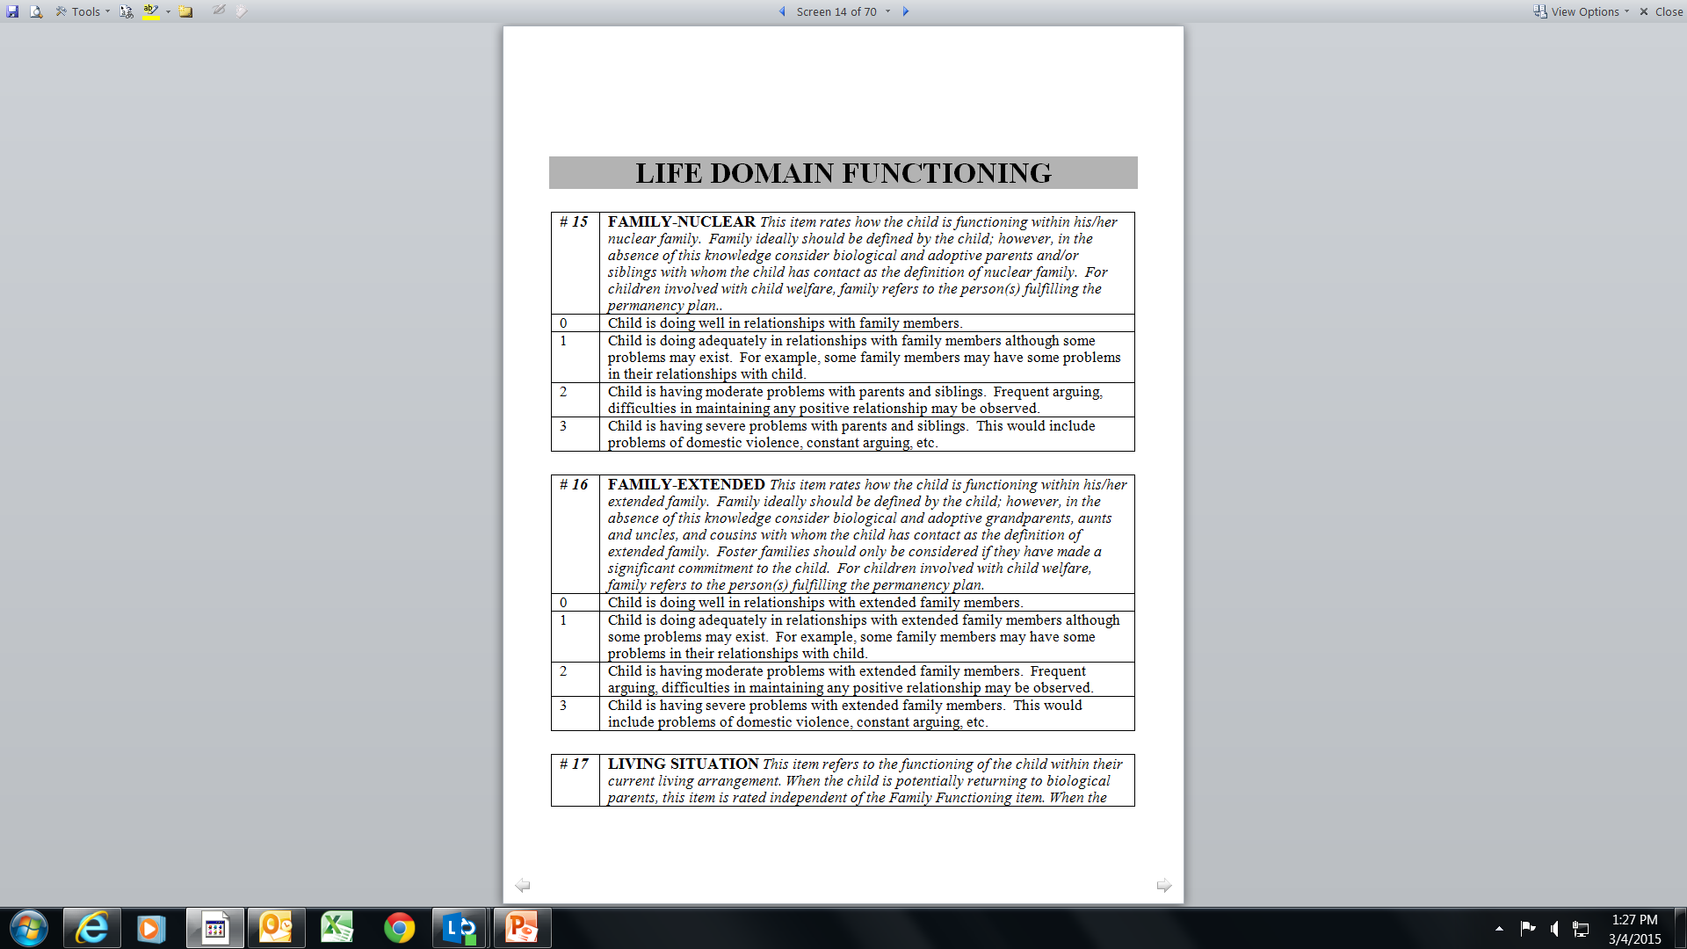
Domain
Item
Action Levels
(Ratings)
Item Definition
Anchor Definitions

Slide 22
Dr. John Lyons – CANS Developer
http://centervideo.forest.usf.edu/cans/CANSTraining.html
During the video please jot down a few ideas that “jump out at you” from the video to share with the class afterwards.

Slide 23
BRAIN BOOST
On my count begin moving until I say STOP
Begin the count
Call STOP
Turn to you neighbor and talk about 1 thing you learned from the video about the CANS/FAST

Slide 24
CANS-FAST
The purpose of the CANS-FAST is to identify and communicate a shared vision of strengths and needs for children and families across different child servicing system.
The CANS-FAST allows for different parties to communicate the shared vision.
Ratings in a CANS-FAST allow for the creation of a collaborative case plan that is measurable.

Slide 25
CANS-FAST
The CANS-FAST Assessments are outcomes management tools. In order to manage needs, we need to be able to measure needs.
“We can’t manage what we don’t measure.”
Use the CANS-FAST Assessments:
* to create more collaboration with families and with other people involved, i.e., therapists,
school, court teams, etc.
* at every staffing,
* it to “build transparency”,
* to share the full picture of what is going on,
* to share strengths.

Slide 26
AR DCFS Has 3 Child Welfare Assessment Tools
1) AR CANS for Birth – 4 Years
For every child in Foster Care
(Out of Home Placement Cases)
2) AR CANS for Children and Youth 5 Years and Older
For Protective Services
(In Home) Cases
3) AR FAST

Slide 27
What’s in this for me?

Slide 28
CANS-FAST Benefits for a Case Worker
Can use this approach to work smarter rather than harder by avoiding problems ahead of time.
Can better engage families and youth by creating a shared vision where all of our perspectives matter.
Can organize a personalized case plan.
Can measure the progress of children and families based on their specific needs.
Can use a common language with others in the systems serving children and families. This is where stakeholders come in.

Slide 29
CANS-FAST Benefits for a Parent or Guardian
The CANS-FAST helps parents understand their child and family better.
The CANS-FAST is an approach where the parent’s perspective matters too.
The CANS-FAST helps families and DCFS agree on what they need to work on together.

Slide 30
CANS-FAST Benefits for a Stakeholder
What benefits do you see from the CANS/FAST?

Slide 31
Six Key Characteristics
Items are included because they might impact service [case] planning
Level of items translate immediately into action levels
It is about the child not about the service
Consider culture and development
It is agnostic as to etiology (it is not based on the cause)—it is about the ‘what’ not about the ‘why’ (2 exceptions: trauma and child behavior)
The 30 day window is to remind us to keep assessments relevant and ‘fresh’
Click the Sign

Slide 32
NEEDS RANKING
Immediate Action Needed
No Evidence
Watchful Waiting
Action Needed
0
1
2
3
Centerpiece Strength
Potential Strength
None Identified
Useful Strength
STRENGTHS RANKING

Slide 33
Change in Thinking
Strengths/needs are not on opposite ends of a spectrum
This is a change in some of our linear thinking
Absence of a need does not equal a strength
Likewise absence of a strength does not equal a need
Notes:
Dr. Lyons’ example is a suicidal youth. Obviously an actively suicidal youth would be a 3 – need for immediate action. But the absence of suicidal ideation isn’t a strength. We are not going to build a plan around the fact that this youth is not suicidal. So, the relationship between strengths and needs in the CANS/FAST is not linear.

Slide 34
Six Key Characteristics
Items are included because they might impact service [case] planning
Level of items translate immediately into action levels
It is about the child not about the service
Consider culture and development
It is agnostic as to etiology (it is not based on the cause)—it is about the ‘what’ not about the ‘why’ (2 exceptions: trauma and child behavior)
The 30 day window is to remind us to keep assessments relevant and ‘fresh’

Slide 35
AR CANS-FAST
CANS-FAST User Guides And Forms

Slide 36
Child Strengths
Family-Nuclear
Family-Extended
Interpersonal
Educational
Talents/Interests
Spiritual/Religious
Community Life
Relationship Permanence
Child Involvement with Care
Natural Supports
Adaptability
Building Relationships
Resilience
Resourcefulness

Slide 37
Life Domain Functioning
Family-Nuclear
Family Extended
Living Situation
Sleep
Social Functioning-Peer
Social Functioning-Adult
Sexual Development
Developmental²
Communication
Cultural³
Legal
Medical
Physical Health
Daily Functioning

Slide 38
School
School Behavior
School Achievement
School Attendance
Special Education

Slide 39
Child Behavioral/Emotional Needs
Psychosis
Attachment
Impulsivity/Hyper-activity
Depression
Anxiety
Oppositional
Conduct
Adjustment to Trauma
Anger Control
Substance Use⁴

Slide 40
Child Risk Behaviors
Suicide Risk
Self-Injurious Behavior
Other Self-Harm
Danger to Others
Sexual Aggression
Runaway⁵
Delinquent Behavior
Bullying
Intentional Misbehavior
Aggressive Behavior
Exploited

Slide 41
Trauma
Sexual Abuse
Physical Abuse
Emotional Abuse
Neglect
Medical Trauma
Natural Disaster
Witness to Family Violence
Witness to Community Violence
Witness/Victim to Criminal Activity
War/Terrorism
Disruption in Caregiver
Grief and Loss

Slide 42
Permanency Planning - Caregiver Strengths & Needs
Supervision
Parenting Skills
Knowledge of Child
Knowledge of Rights & Responsibilities
Organization
Social Resources
Residential Stability
Empathy with Children
Boundaries
Involvement
Posttraumatic Reactions
If a child is in a temporary placement (foster home, treatment facility, and etc.) the “caregiver” section is not to be rated UNLESS the goal is REUNIFICATION or ADOPTION.

Slide 43
Permanency Planning - Caregiver Strengths & Needs Continued
Knowledge of Family/Child Needs
Knowledge of Service Options
Ability to Listen
Ability to Communicate
Satisfaction with Services Arrangement
Physical Health
Mental Health
Substance Use⁷
Developmental
Accessibility to Child Care Arrangement
Family Stress
Employment/Educational Functioning
Educational Attainment
Legal
Financial Resources
Transportation
Safety
Marital/Partner Violence

Slide 44
Modules for CANS (0-4)
MODULES Complete any specific module only if indicated on the initial page | ¹Developmental Needs (DD) Module
 | ²Acculturation Module
 | ³Sexual Abuse Module
 | ⁴Substance User Disorder (SUD) Module-Caregiver
Modules are completed only if selected Items are given a 1, 2, or 3 rating .

Slide 45
Modules for CANS 5+
MODULES Complete any specific module only if indicated on the initial page | ¹Transition Age Module-Triggered by DOB
 | ²Developmental Needs (DD) Module
 | ³Acculturation Module
 | ⁴Substance Use Needs (SUN) Module
 | ⁵Runaway Module
 | ⁶Sexual Abuse Module
 | ⁷Substance User Disorder (SUD) Module-Caregiver
Modules are completed only if selected Items are given a 1, 2, or 3 rating EXCEPT for the “Transition Age Module”…it is automatically triggered based on the child’s date of birth (if 14 yrs or older).

Slide 46
AR FAST
Family Advocacy and Support Tool

Slide 47
The Family Together
Parental/Caregiver Collaboration
Relationships Among Siblings
Extended Family Relationships
Family Conflict
Family Communication
Family Role Appropriateness
Family Safety
Financial Resources
Residential Stability
Home Maintenance

Slide 48
Caregiver Status
Empathy With Child
Boundaries
Involvement
Supervision
Discipline
Partner Relationships
Vocational Functioning
Mental Health
Alcohol and/or Drug Use
Posttraumatic Reactions
Knowledge of Child
Organization
Physical Health
Developmental
Accessibility to Child Care Services
Family Stress
Educational Attainment
Legal
Transportation
Safety

Slide 49
Caregiver Advocacy
Knowledge of Service Options
Knowledge of Rights & Responsibilities
Ability to Listen
Ability to Communicate
Natural Supports
Satisfaction with Youth’s Living Arrangement
Satisfaction with Youth’s Educational Arrangement
Satisfaction with Services Arrangement

Slide 50
Youth Status
Relationship w/ Bio Mother
Relationship w/ Bio Father
Relationship w/ Primary Caregiver
Relationship with other Adult Family Members
Health Status
Mental Health Status
Adjustment to Trauma
Cognitive Skills
Self-Regulation Skills
Interpersonal Skills
Educational Status

Slide 51
Lunch

Slide 52
Whodunit?
http://youtu.be/ubNF9QNEQLA

Slide 53
Collaboration and Teamwork
It’s easy to miss what you are not looking for.
The shared vision approach helps DCFS to NOT miss important details when working with families.
DCFS assessments will be better if they gather information from multiple sources. This means YOU!
We need your help to really do the CANS-FAST right.

Slide 54
Effective Communication with Families Using the CANS
Read pages 11-12 of your Participant Manual
Pick 3 key points from this reading you see as important and prepare to share with the group.

Slide 55
Practice Scenario
Deonte Scenario
Difficulties with scenarios and vignettes when scoring – don’t have all the information and cannot get it.
No mention = No evidence

Slide 56
Tips When Scoring a CANS-FAST
Understand the meaning of the Item and the Action Levels.
Item
Action Levels
Don’t get bogged down in the individual Anchor Definitions.

Slide 57
AR Case Plan
Arkansas is the first state to directly link the CANS assessment to the case plan.
There is a section of the new case plan for “additional or court-ordered services,” that we can use for any service that is requested by the court or a party of the case but cannot be directly linked to a CANS-identified need (such as a paternity/DNA test).

Slide 58
CANS-FAST: Informed Case Planning
Identify CANS-FAST Need items with action levels of 2 or 3.
Identify Need items that may need preventive services with a Watchful status of 1.
Prioritize these needs with child and family to develop short term and long term goals.
Identify action steps that support the short term and long term goals
Collaborate and partner with child and family.

Slide 59
CANS-FAST: Informed Case Planning
Identify CANS-FAST Strength items with a 0 or 1 for strengths-based case planning
Strength items with 2 or 3 are those attributes and skills that can be built.
Identify action steps that support the short term and long term goals
Collaborate and partner with child and family.

Slide 60
CANS Certification
Workers must be certified before they can complete a CANS/FAST or a case plan.
Workers must score a 70% to certify.
Workers must recertify every year.

Slide 61
Questions & Answers
Brooke Harris, CANS/FAST Program Manager
Office: (501) 682-8439
Cell: (501) 412-9883
Fax: (501) 683-1201
Brooke.Harris@dhs.arkansas.gov

