Slide 1
Trends and Issues in Adolescent Vaping
Nicole Ward, MNSc, APRN, WHNP-BC

Slide 2
Background

Slide 3
What is an e-cigarette?
Battery powered devices that use liquid cartridges to produce vapors for inhalation
First version of the e-cigarette patented in 1965
Modern version created and patented by Ruyan company in China in 2003
There are currently over 400 brands and 7,000 flavorings available in the marketplace
Bhatnagar et al., 2014
Notes:
Leaked documents from the tobacco industry show that as far back as the 60’s, tobacco companies were attempting to create a cigarette that would reduce exposure to cancer causing smoke. Project Ariel from British American Tobacco company is an example of an early version of an e-cigarette. These never became mainstream. The Ryun company in China patented the first modern e-cigarette and created disruptive innovation of the tobacco industry. There are now numerous types of e-cigarettes available on the market and literally thousands of liquids to choose from – however many of the big tobacco companies are purchasing the rights to manufacture e-cigarettes and the coming FDA regulation of these products will likely limit the number of e-cigarette manufacturers. This is good in that it will provide standardization and oversight of the manufacturing process of devices and liquids – but it also means that only large tobacco companies will likely have the resources to afford FDA approved requirements.

Slide 4
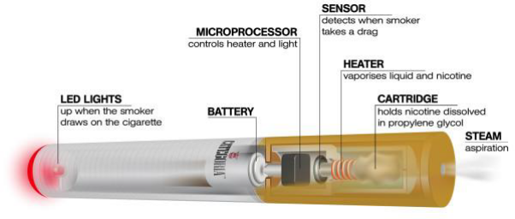
First Generation
Sometimes called “cigalikes”
Usually found at gas station counters – Blu™ is a common brand
Designed to look and feel like a cigarette, most are disposable
Less effective at delivering nicotine
May not be as satisfying to a smoker
Notes:
These are sometimes called “cigalikes”. They are the first of the modern cigarettes and are still sold – they are usually the disposable e-cigarettes you see at the gas station counter. Blu™ is a common brand of this type of e-cigarette. These are not as effective at nicotine delivery as newer, larger devices. Additionally, smokers may not be satisfied with the “smoking” qualities from these early e-cigs – amount of smoke inhaled, “throat hit”. Sometimes they say it is like smoking air in a straw.

Slide 5
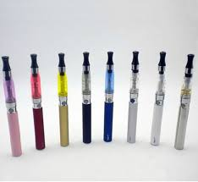
Second Generation
Mid size, pen style e-cigs
Reusable, requires a chargeable battery and liquid refills
Lager battery than 1st generation
Some models allow user to adjust heat – this alters the amount of vapor or changes the flavor of the juice
Notes:
Sometimes referred to as a “tank system” because in some models the liquid chamber or “tank” can be refilled rather than thrown away like with the 1st generation models.

Slide 6
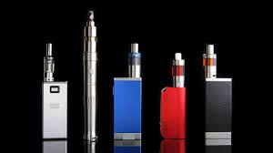
3rd Generation
Larger tank style systems
Sometimes referred to as “mods” or APV’s (advanced personal vaporizers)
Have a much more powerful battery
The level of Ohms produced by the battery is adjustable
These are the most likely to have a battery explosion
More effective at nicotine delivery
Notes:
The third generation e-cigarettes deliver nicotine much more effectively which may benefit smokers using them to quit because it reduces the withdrawal symptoms and may reduce continued smoking. However, there are other safety hazards to consider with this type of e-cig – fires and battery explosions are more likely with these types because of the larger, more powerful battery. Some of these larger “mods” are homemade, increasing the likelihood of a battery malfunction. These vary in complexity, but all require some knowledge of how electricity and batteries work – incorrect use or battery set up is often what causes the trauma injuries you see on the news.

Slide 7
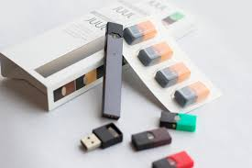
JUUL
Considered an e-cigarette BUT..
Contains a much higher nicotine content
Very potent
Very effective at nicotine delivery with less vapor – so there is less non-nicotine content inhaled and almost no “cloud”
Notes:
JUUL is becoming more and more popular with young people – it looks like a USB drive so it is discreet and it doesn’t make much cloud so kids are able to easily use it in school bathrooms – even in class. This product is especially concerning for children because of it’s nicotine content and delivery – EACH POD OF JUUL (A POD IS THE INDIVIDUAL CARDTRIDGE SHOWN IN THE PICTURE) CONTAINS THE EQUIVALENT NICOTINE OF ONE PACK OF CIGARETTES. IF A TEEN IS USING ONE JUUL PER DAY, THAT IS LIKE SMOKING ONE PACK PER DAY!!! Make sure you educate your patients about this.

Slide 8
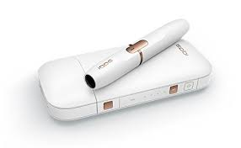
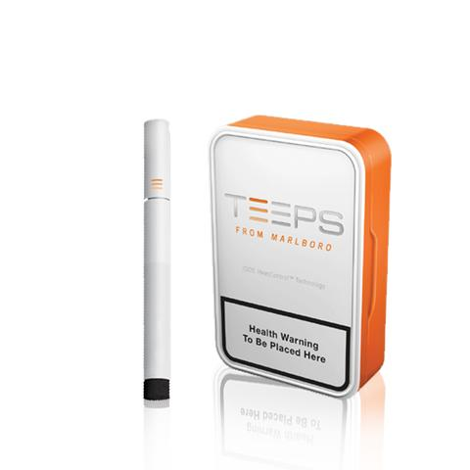
IQOS/TEEPS/Heatsticks
New to the market – just approved for marketing by the FDA
Widespread use in foreign countries
Different than an e-cigarette
Contains “heat not burn” tobacco
Significantly lower levels of acrolein and formaldehyde
Manufactured by Phillip Morris and will be marketed as a “safer” alternative to smoking
Notes:
Meet Phillip Morris’ new cigarette, pronounced “I – cause”. It heats the tobacco at half the temperature of a burning cigarette – just enough to create a vapor, but not contain the combusted carcinogenic smoke. Still contains nicotine. Phillip Morris is applying to the FDA to market their product in the U.S. with claims that it is safer than smoking. TEEPS is also manufactured by Phillip Morris, and is the same type of product but the mechanical set up and function is a little different than IQOS – but the outcome is the same.

Slide 9
Harm vs. Harm Reduction

Slide 10
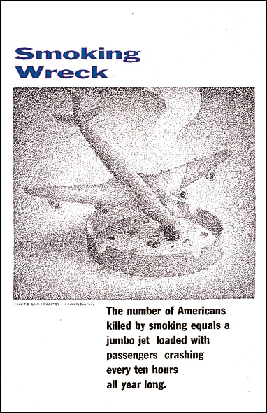
Smoking is the Leading Cause of Preventable Deaths in the U.S.
876 crashes per year
VS.
44 crashes per year
440,000 Deaths/Year
Costs about $300 BILLION per year in healthcare dollars

Slide 11
Nicotine Addiction
Notes:
Although not generally harmful, nicotine is the addictive component in tobacco.
Just like any other addictive drug or behavior, nicotine affects the endogenous reward system in the brain. Nicotine activates the α4β2 nicotinic receptors in the Ventral Tegmental Area (VTA). This causes an immediate dopamine release in the Nucleus Accumbens¹ (nAcc). This immediate dopamine release is key to the feelings of well-being associated with tobacco use. This can be an inherently rewarding sensation.
References
Picciotto MR, Zoli M, Changeux J. Use of knock-out mice to determine the molecular basis for the actions of nicotine. Nicotine Tob Res. 1999;Suppl 2:S121-125.
Changeux JP, Bertrand D, Corringer P, et al. Brain nicotinic receptors: structure and regulation, role in learning and reinforcement. Brain Research Reviews. 1998;26:198-216.
Coe JW, Brooks PR, Vetelino MG, et al. Varenicline: An α4β2 nicotinic receptor partial agonist for smoking cessation. J. Med Chem. 2005;48:3474-3477.
Ref1/Picciotto/ S123/2/3/1-6
Ref3/Coe/ 3474/2/1/1-7
Ref2/Changeux/
200/1/2/7-12

Slide 12
Nicotine Addiction
Biological
Social
Psychological
Behavioral

Slide 13
Nicotine Delivery
Continuum Of Risk
Nicotine Replacement
Combustible Cigarettes

Slide 14
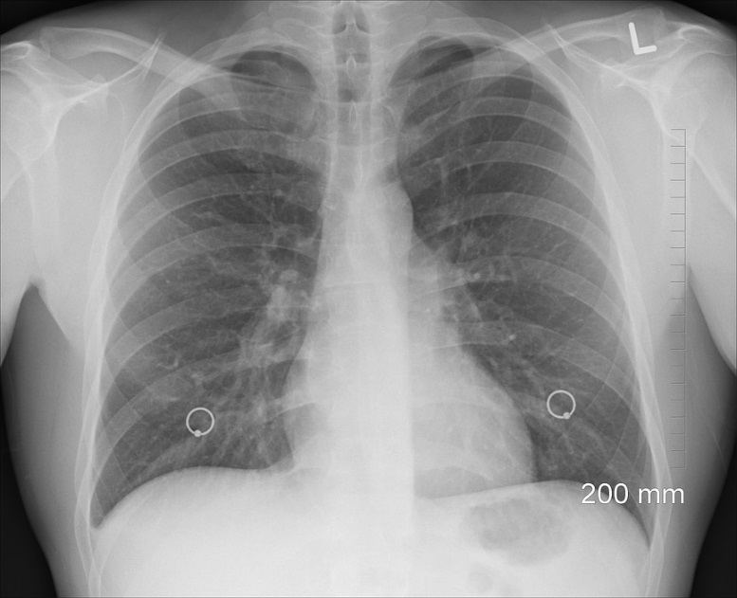
Ingredients
Some e-cigarette liquid contains diacetyl – used in flavorings. This chemical causes bronchiolitis obliterans – “popcorn lung”, a chronic irreversible lung disease.
E-cigarettes Contain:
Propylene Glycol or Glycerin Base
Nicotine (some are nicotine free)
Flavorings
Heavy Metals
Numerous other toxic substances
Heat degradation of liquid of some products produces acrolein, formaldehyde, and carbonyls – all carcinogens
Notes:
Ingredients are highly variable across brands of e-liquid. Additionally, some users make their own “home brews”, so it is really difficult to know what a user is being exposed to. These are the ingredients that have been confirmed. Further, the mechanical properties of the e-cigarette device itself influences how much vapor is produced and at what temperature the liquid is heated to – this all effects the level of toxic exposure across individual users. FDA regulation has been made to require manufacturers to accurately label liquids – but is not in place yet and won’t be for a few more years. This means you do not know what is in a liquid because the maker can label it as whatever they want – and omit concerning ingredients from the label. Some liquids labeled as nicotine free have been found to contain nicotine, and some liquids have been found to have much higher nicotine content than listed on the label. Further – many liquids are labeled as “FDA approved ingredients” – THIS IS MISLEADING!! The ingredients may very well be FDA approved for ORAL INGESTION, but NOT for heating and inhaling.

Slide 15
Cardiovascular Issues
Increased heart rate and blood pressure from nicotine exposure
Limited evidence of short-term changes in endothelial dysfunction and arterial stiffness
Insufficient evidence of long term changes in heart rate, blood pressure, or cardiac size or function
No available evidence of altered cardiovascular outcomes resulting from long term use
Interpretation – No one has used an e-cig long enough to develop CVD or CAD but as the story unfolds it is definitely possible……

Slide 16
Pulmonary Diseases
No available evidence showing causation of respiratory diseases in humans – but again, they haven’t been used for a long period of time
Limited evidence of respiratory harm in animal studies
In adolescents – increased coughing, wheezing, and asthma exacerbations
Limited evidence of improved lung function and reduction of COPD exacerbations in adult smokers who quit or reduce smoking while using the e-cigarette
Interpretation – Kids should not use these as they may develop problems, adult smokers who have already destroyed their lungs may see improvement in symptoms (but not because of the e-cig, it’s because they reduce their smoking)

Slide 17
Cancer
Limited evidence from animal studies that cancer could develop over time, but no human evidence
Limited evidence that vapor can cause DNA damage resulting in cancer development
Substantial evidence that e-cigarettes contain chemicals that cause cancer – but it is unknown if e-cigarettes create enough exposure to cause cancer
Interpretation – We don’t really know – but it’s possible over time

Slide 18
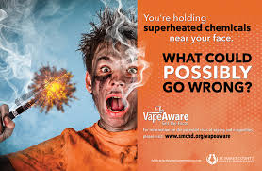
Trauma
Between 2012 and 2015, 92 traumatic events were reported (probably under reported)
Batteries can malfunction and explode unexpectedly
Causes facial trauma and thermal injuries
Not to mention the injuries caused if it explodes in your pocket…..just saying

Slide 19
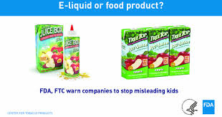
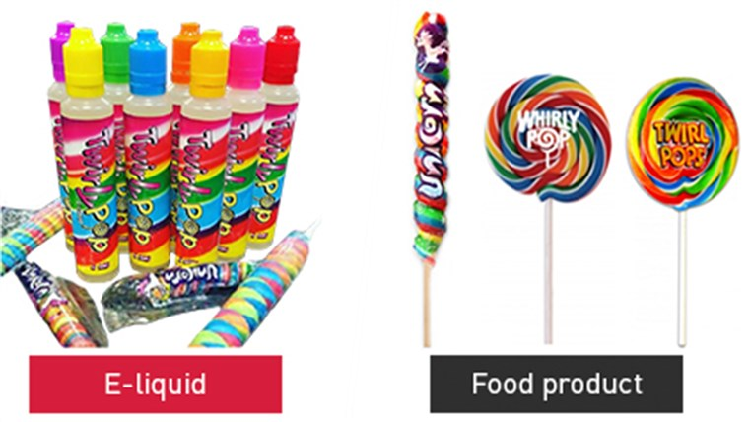
Poisoning
Nicotine in E-liquid is highly concentrated
Nicotine is poisonous to children and pets
It can be absorbed through the skin
Many liquids are marketed in flavors and packaging easily mistaken for candy
Regulations are now in place for safety packaging – but there is poor oversight
EDUCATE YOUR E-CIGARETTE USERS ABOUT THIS DANGER
CDC, 2014
Notes:
E-liquid bottles are often small and many people may think it is not enough content to hurt anyone – make sure they understand the liquids are very potent and can kill a child or pet. Keep out of reach of children. The FDA is targeting e-liquid makers who package their products in ways that are appealing to children and vape stores sometimes refuse to sell products that would look appealing to children. FDA requires safety caps, but there is poor oversight in this industry and still people who make “home brews” and sell that are not regulated and won’t have the safety mechanisms to protect children.

Slide 20
Passive Exposure
Smoking
Vaping
E-cigarettes do create airborne particulates and nicotine that can cause exposure to bystanders
BUT
It is at a lower amount than what is created by smoking
E-cigarettes are not automatically included in clean indoor air laws
Businesses and Public Areas must create policies to prevent e-cigarette use on their premises
Notes:
Safer is not safe – even though the amount of toxic exposure is less with e-cigarettes, it is still there and the long term effects are unknown. There is no conclusive evidence that passive exposure is safe for people who have asthma and other respiratory disorders. The problem is that e-cigarettes are viewed as safe and many people use them in doors where they would normally not smoke and around their kids, in their cars and so on… E-cigarettes are also easier to conceal than smoking because they do not smell like a cigarette and there is no side stream smoke, therefore many people use them specifically to circumvent no smoking policies.

Slide 21
Adolescent Use

Slide 22
Current Tobacco Product Use Among U.S. High School Students – NYTS 2018

Slide 23
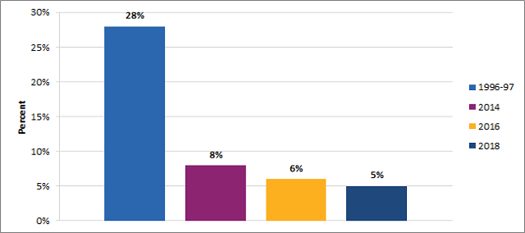
Increase in Use from 2011-2018
Percent reporting smoking in past 30 days

Slide 24
Reported use on 20 of the past 30 days among High School Students
Those who are using, are doing so more frequently

Slide 25
Perceived Risks of E-cigarette Use Among Youth – NYTS 2016

Slide 26
What Do Teens Say Is In Their E-cig?
Just Flavoring

Slide 27
Reasons for Youth E-Cigarette Use NYTS 2016

Slide 28
Smoke and Mirrors
Smoke and Mirrors – A Juul Documentary
https://www.youtube.com/watch?v=KTKu0A2ym0M

Slide 29
Key Phrases
Buzz/Head rush
Now don’t feel it – unless I need it
Product looks really slick
Juul is different than vaping – “vaping” is lame
It’s the cool thing
Don’t have to go outside, smoking isn’t as much fun
Pod per day = 1 pack per day
Don’t know how to stop
Not any medical research, so it must be safe

Slide 30
Why is this concerning?
Biological
Social
Psychological
Behavioral
Notes:
Adolescent Brains are still developing and are much more susceptible to addiction. They are developing an irreversible change in their neurochemistry.

Slide 31
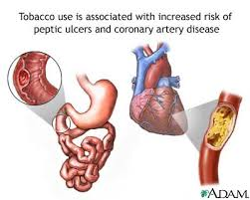
What is the impact of Long Term High Dose Nicotine Exposure?
While nicotine itself in controlled short-term doses may not be the most harmful part of smoking, it DOES have risks.
Long term use may have implications for future Cardiovascular and GI health…. Among other things.
Very risk for kids with underlying undiagnosed conditions – Marfan’s, murmur’s etc.
Notes:
Hypertension over a long period of time leads to renal disease, eye disease

Slide 32
Is it a Gateway to Smoking?
Depends on who you ask….
The UK data says no
Studies in the US show anywhere from 2-4X’s the likelihood of experimenting with cigarettes.
There are studies showing a higher correlation of early e-cigarette use and experimentation with other addictive substances.

Slide 33
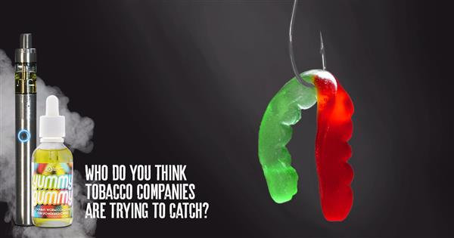
Top Reasons Adolescents Shouldn’t Vape
It Develops a Lifetime Addiction to Nicotine – which will require more and more nicotine
The long-term effects of high dose nicotine use are potentially deadly

Slide 34
Vaping Marijuana

Slide 35
Vaporizing Marijuana NYTS, 2016

Slide 36
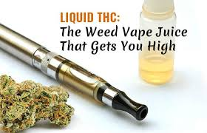
Vaping Marijuana
No Smell, no smoke, easy to conceal
More than 50% of teens will try marijuana before they try cigarettes or alcohol
Vaping results in higher concentrations of THC → greater impairment
Triggers dopamine release similar to nicotine, although not as addictive
Affects structure and function of the brain, reduces brain volume, and has an impact on cognitive abilities
Regular use → Increased risk of mental health disorders
Some vapes are pre-sold with CBD oil, JUUL™ does not but can be “hacked”

Slide 37
Recognizing and Treating

Slide 38
Recognizing Vaping at School and Home
How Teachers can Recognize E-cigarette Use at School:
https://www.youtube.com/watch?v=WLD7kW_uVEY
Parents
www.youtube.com/watch?v=Qsa7B7NfPBA

Slide 39
Issues for Parents
Watch for signs such as:
Drop in academic performance
Moody
Isolated
Asking for money
Sounds familiar if you have ever raised a teen!
This leaves parents in a place where it is hard to detect vaping and nicotine addiction

Slide 40
Additional Signs to Watch For
Increased Thirst – vaping dries out the mouth
Food is bland – A dry mouth can reduce the ability to taste food flavors – “vapor’s tongue”
Nosebleeds – dry skin in the nose may lead to more frequent nose bleeds
Acne – bad breakouts in otherwise clear skin
Reducing caffeine suddenly
Pneumonia or recurrent upper respiratory infections
Finding spare parts laying around – unusual flash drives, battery chargers

Slide 41
Treatment
“A few years ago, it would’ve been incredible to me that we would be here today discussing the potential for drug therapy to help addicted young people quit” Dr. Scott Gottlieb
No existing FDA approved treatment
No guidance on dosing for NRT
No idea if it really will even work
Cold Turkey is not good if teen is frequent user
Urgent national call for research on how to address nicotine addiction in adolescents – methods may need to be different

Slide 42
Policy Issues

Slide 43
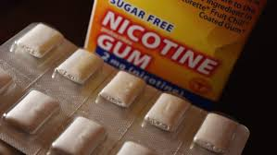
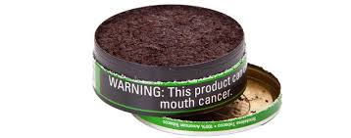
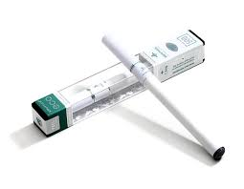
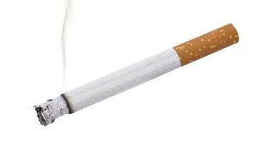
FDA Comprehensive Plan
The FDA views nicotine as “highly addictive but delivered through products that represent a continuum of risk and is most harmful when delivered through smoke particles in combustible cigarettes”
FDA Commissioner Scott Gottleib, 2017
The FDA’s Comprehensive Plan on Tobacco Focuses On:
Reducing nicotine in cigarettes to below addictive levels
Promoting innovative nicotine delivery methods
Addressing youth smoking and nicotine use

Slide 44
Policy Changes
How to keep the off ramp open while closing the on ramp.
Vital that products are available for smokers who want to quit
The message about harm reduction needs to change to harm reduction and not “safe”
Increased enforcement – online sales, sales in places where minors can access
Tobacco 21

Slide 45
Take Aways
E-cigarettes will reduce harm for people who are unable or unwilling to stop smoking with any other means
E-cigarettes are not FDA approved for smoking cessation, but through shared decision making are being slowly accepted into healthcare guidelines
Imperative that youth initiation on e-cigarettes is controlled → at what cost is where the debate starts
Adolescents are highly susceptible to nicotine addiction and suffer from withdrawal the same way adults do
Treatment for nicotine addiction in adolescents is extremely limited
Cessation strategies for vaping/juuling may need to be different than current strategies used for adult smokers
Vaping Marijuana may be the next epidemic level problem with more and more states relaxing marijuana laws

Slide 46
Questions?

