Slide 1
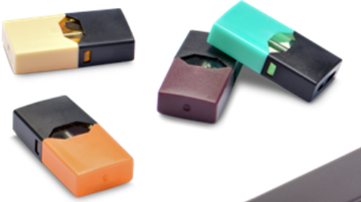
JUUL: The 411
The emerging use of the JUUL electronic cigarette among youth and young adults
Education Series for Community Partners
Arkansas Department of Health
Tobacco Prevention & Cessation Program
Notes:
Introductions
Today you will be getting the 411 on an alarmingly popular, but harmful product, that has recently entered the e-cigarette market: The JUUL electronic cigarette

Slide 2
Objectives
E-Cigarette Basics
Public Health Effects and Concerns
Introduction to the JUUL E-Cigarette
Targeted Marketing
Regulation
Implications for Community Work
Notes:
What does this presentation entail?
We will begin with a pre-test to asses your knowledge
You will get a basic overview of e-cigarettes and an introduction to the JUUL
We will discuss in detail what we currently know about the health effects of e-cigarettes like the JUUL, and the concerns they cause for youth and public health at large
We’ll talk about the JUUL company’s targeting of youth
We’ll talk about regulation and gaps in regulation
Then finally we’ll end with a call to action that includes implications for community work
Afterwards, you’ll get a chance to show me what you learned during a post test
If you have any questions or comments, I’ll be happy to address them at the end of the presentation!

Slide 3
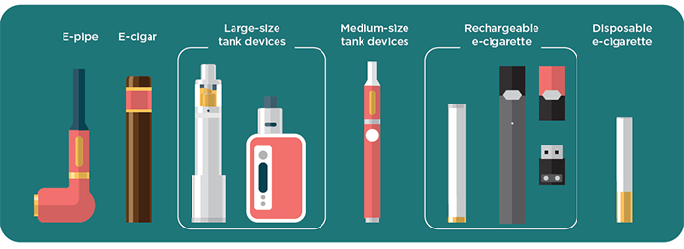
What are Electronic Smoking Devices?
Source: CDC
Notes:
Teacher Talking Points: Let’s start with some e-cigarette basics
As you can see, they come in many shapes and sizes.
First generation electronic smoking devices looked like traditional cigarettes and cigars; Newer generation devices, like the JUUL, now resemble your everyday items like pens, cell phones and USB sticks
The devices are battery operated, and they are used to inhale an aerosol. Typically that aerosol is going to contain nicotine (the addictive drug in combustible cigarettes) , flavorings, and other chemicals.
I should point out that e-cigarettes can be used to deliver marijuana and other drugs besides nicotine; This presentation will focus on the JUUL, which is always used to deliver nicotine.
ESDs are known by many other names. They are sometimes called “e-cigs,” “e-hookahs,” “pod- mods,” “vape pens,” “vapes,” “tank systems,” and “electronic nicotine delivery systems (ENDS).”

Slide 4
E-Cigarette Anatomy
Atomizer/coil
Nicotine aerosol
Battery
Absorbent material/cotton:
Nicotine
Propylene glycol
Vegetable glycerin
Flavorants
Notes:
Teacher Talking Points: Let’s take a closer look at how they work
E-cigarettes are made of a battery, (click) an atomizer with a heating coil, (click) and an absorbent material (click) that absorbs a liquid that can contain nicotine, flavoring and chemicals (click).
The battery allows the atomizer to heat the liquid, called e-juice, which creates an aerosol that is breathed into the lungs and breathed out into the air repeatedly.
You can see that these devices are designed to mimic the experience of smoking a combustible cigarette

Slide 5
What is Vaping
Vaping:
The act of inhaling and exhaling aerosol, often referred to as “vapor”, which is produced by an e-cigarette or similar device. ⁴
Notes:
Teacher talking points: E-cigarette use is often referred to as vaping. And vaping is….

Slide 6
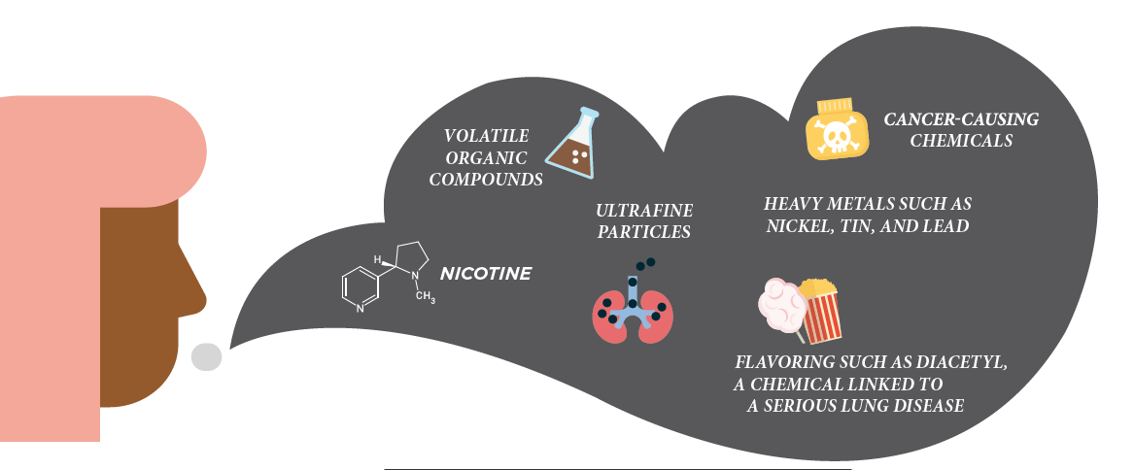
What’s in aerosol?
Source: CDC
Notes:
What exactly is in that aerosol?
It is difficult for consumers to know exactly what these products contain. In 2017 the Food and Drug Administration announced that it would delay the requirement that e-cigarette companies submit their products, including all ingredients, for review.
For example, some e-cigarettes marketed as containing zero percent nicotine were later found to actually contain nicotine
Also, (this is a borrowed analogy from Dr. Wheeler) e-cigarettes are like snowflakes. No two are exactly alike in terms of chemical makeup and nicotine concentration.
Because of this intentional information asymmetry between consumers and the industry, there is a misperception that users and bystanders are just inhaling harmless water vapor. This is INCORRECT.
They’re actually inhaling:
Nicotine
Ultrafine particles
Flavoring that contains diacetyl, a chemical linked to a serious lung disease
Volatile organic compounds
Cancer-causing chemicals
Heavy metals like nickel, tin, and lead
Question number 10 on test

Slide 7
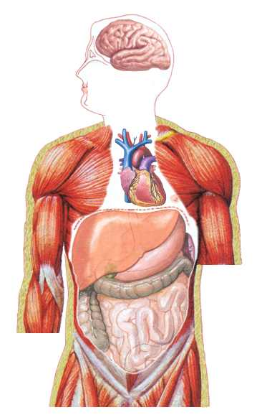
Effects of Nicotine
Nervous system
Increases activity level
Mimics neurotransmitters
Decreases reflex actions
Activates brain’s “Reward Pathway”
Respiratory System
Increases mucus production
Decreases muscle action in the lungs’ airways
Causes breathing to become more shallow.
Cardiovascular System
Increases heart rate & forces contractions
Increases blood pressure
Reduces blood flow to skin
Increases risk of blood clot
Digestive System
Increases saliva production
Decreases the amount of insulin released from the pancreas
Increases bowel activity
Notes:
As I mentioned earlier, most e-cigarettes contain nicotine (even the ones that claim otherwise)
And we know that Nicotine has negative effects in locations all over our body
Makes it harder for us to breathe
Increases blood pressure and heart rate
It weakens our reflexes
Decreases the amount of insulin released from the pancreas →
Activates the brain’s “reward pathway”, making it addictive
Among other things!
These negative effects of nicotine, particularly it’s addictive properties, are exacerbated in the developing brains of young people.
Number 4 on the quiz

Slide 8
Nicotine: The Gateway Drug
Conclusion: Youth who use e-cigarettes/vape pens with higher nicotine concentrations are likely to experience an increase in subsequent intensity of smoking and vaping.
Notes:
This study conveys what I mean:
This was a cohort survey study done among 10th graders
They found that youth who vaped higher levels of nicotine at baseline, participated in more frequent and intense use of cigarettes and e-cigarettes down the road
What did they consider high nicotine concentration? → 18 mg of nicotine or more → The JUUL has 42 mg of nicotine in it
Teens don’t always know how much nicotine they are inhaling due to that information asymmetry we discussed earlier
Based on the little data we have regarding JUUL and other e-cigarette use, this is the picture that we are seeing consistently being painted → It’s not the story of the former adult cigarette smoker making the switch → overwhelmingly, it’s the story of the young, misinformed e-cigarette user becoming increasingly addicted to nicotine
Question number 7 on test

Slide 9
E-Cigarette/Vape Bridge to Cigarettes
Adolescents who vaped were 4 times more likely
to report cigarette smoking
E-Cig/Vape
Bridge
Non-User Side
Cigarette User Side
Notes:
Teacher Talking Points: Essentially it’s the vape bridge to cigarettes
And it is a major concern among health professionals that using e-cigarettes at a young age can lead (click) to use of traditional cigarettes (click) down the road.
tobaccopreventiontoolkit.Stanford.edu
Sources:
https://www.drugabuse.gov/related-topics/trends-statistics/infographics/teens-e-cigarettes
http://tobaccocontrol.bmj.com/content/early/2017/01/04/tobaccocontrol-2016-053291
https://www.hhs.gov/ash/oah/adolescent-development/substance-use/drugs/tobacco/trends/index.html

Slide 10
Ingestion vs. Inhalation
Propylene glycol has been approved by the government for use in food …but has NOT been approved for inhaling!
Breathing In
Consuming
NOT APPROVED
Digestive Tract
Respiratory Tract
Notes:
Teacher Talking Points: Let’s talk ingestion vs. inhalation, because this is an important distinction to make.
When we ingest food, our digestive tract breaks down the chemicals that we’ve ingested. Inhaling doesn’t involve a breakdown of chemicals.
Imagine all the chemicals from a vape aerosol clogging up the lungs, with no breakdown occurring. The lungs were not built like the stomach.
Because of this, the government has approved certain chemicals for ingestion, but NOT for inhalation.
Yet e-cigarette companies, like the creators of the JUUL, make the claim that certain chemicals are safe for inhaling.
(Click) Propylene glycol is a chemical commonly found in e-liquid. The government has approved this chemical for ingesting but not for inhaling (click).

Slide 11
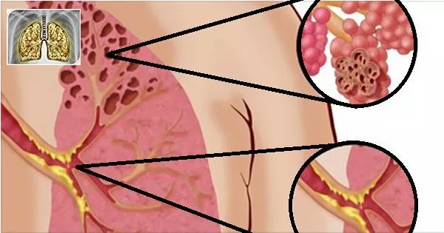
Bronchiolitis Obliterans: Popcorn Lung
75% of e-cigarette flavorings contain the chemical diacetyl.
Diacetyl is commonly used in buttery flavoring.
The chemical can lead to an irreversible lung disease known as “popcorn lung” when inhaled. This can be FATAL!
Notes:
Remember: Our lungs are not built like our stomachs!
A majority of e-cigarette flavorings (75%) contain the chemical diacetyl → diacteyl is used in buttery flavoring →when inhaled, it can lead to bronchiolitis obliterans, an irreversible lung disease commonly known as “popcorn lung”
The diacetyl enters the body and causes inflammation, scarring and constriction of the airways in the lungs
This can be FATAL
The disease is nicknamed popcorn lung b/c over a decade ago, workers in a microwave popcorn factory were sickened by breathing in diacetyl (which was used in foods like popcorn, caramel and dairy products) → The chemical ended up being linked to deaths and hundreds of cases of bronchiolitis obliterans) → the major popcorn manufacturers removed diacetyl from their products, but now people are still exposed to this chemical through e-cigarette vapor
Question 5 on the test

Slide 12
Long-term Effects of E-Cigarettes
?
Notes:
Teacher Talking Points: What do we know about the long term effects of e-cigarettes?
Since these products are so new and health professionals can’t fast forward into the future, all of the long-term consequences are impossible to predict
Based on what we do know today from research on the chemicals found in e-cigarettes, we can say that these products are not harmless to the user or the people around them.
Think about it, for close to 20 years, health professionals did not know the long term effects of cigarette smoke either.
Just imagine what else we will know about e-cigarettes in another 10 years

Slide 13
ADH on the Dangers of E-Cigarettes
E-cigarettes contain and emit harmful chemicals and pose known and unknown health risks to users and non-users alike.
Secondhand aerosol contains chemicals that can be inhaled by non-users. Bystanders can inhale nicotine, propylene glycol and tobacco-related contaminants.
Flavorings used in ESDs contain propylene glycol, glycerin and food flavorings like diacetyl which are NOT recognized as safe for inhalation. The FDA recognizes these products as “Generally Recognized as Safe” (GRAS) for ingestion ONLY.
Notes:
Arkansas Department of Health released a public health advisory on the dangers of E-cigarettes: These bullet points summarize the advisory
A lot is unknown about the long-term health effects of e-cigarettes at this time, because they are still so new to the market. But this is what we DO know.
they pose both known and unknown health risks to both users and non-users
2nd hand aerosol contains nicotine, propylene glycol and other tobacco related contaminants that bystanders can inhale
The flavorings used in e liquids have not been recognized as safe for inhalation by the FDA
Bottom line: These products are not harmless

Slide 14
Relevant Terminology
Products:
E-cigarette
JUUL
Vape pen
V8 Stick
Mod or Pod Mod
Suorin
BO/BO caps
E-Juice
Terms:
Rip
Hit
Drip or Dripping
Juuling
Ghosting
Coil
Juice
Nic
Notes:
Displayed here is a list of major relevant products and terms
This is an ever changing and ever growing market; New products continue to arrive on the market, and young people are constantly coming up with new slang for these harmful products
Highlighted are some of the terms that are associated with JUUL
Keep in mind, with the market still evolving, the favored terminology used by young people changes quickly

Slide 15
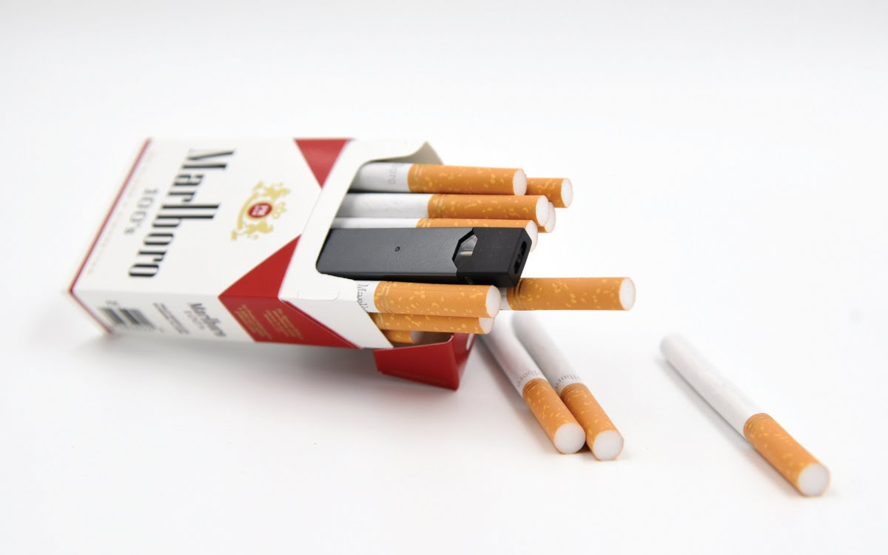
A “Hidden Juul”
https://katv.com/news/local/new-vaping-device-resembles-flash-drive-and-growing-popular-among-teens
Notes:
So that was your e-cig 101
Now, I’ll introduce you to the JUUL
I want to start by showing you a short KATV news clip on JUUL’s growing popularity among teens
Our own, Dr. Wheeler, was actually interviewed for this piece

Slide 16
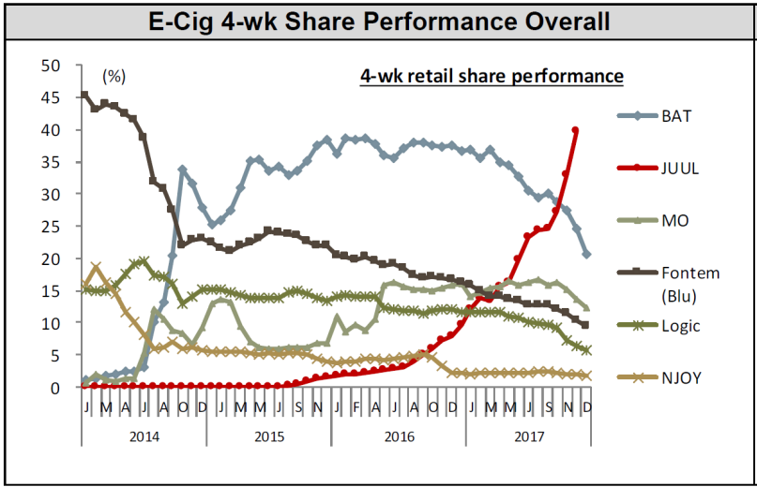
JUUL – Market Growth
Source: Nielsen Total US xAOC/Convenience Database & Wells Fargo Securities, LLC
Notes:
The popularity of the Juul has exploded in the last 2 years If you look at the graph you see that sales increased more than 600% in 2017→ it surpassed all of the other e-cigs
According to data from Wells Fargo, Juul sales currently represent 64% of the market share → Juul is dominating the market now → if we’re going to battle e-cigs, we’ve found a good target
And just to speak a little bit more to the popularity of this product (hold up newspaper article) USA today published an article last Friday on the JUUL; The article is titled “A new epidemic: Rampant use of JUULS at schools”. I encourage all of you to go find it and read it on your own time

Slide 17
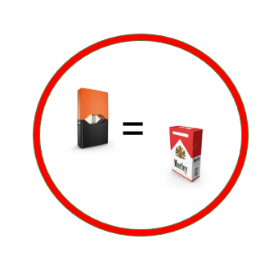
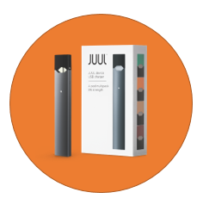
What is JUUL?
A JUUL pod contains as much nicotine as a pack of cigarettes.
A sleek, high-tech e-cig that looks like a USB flash drive and charges in a computer
JUUL has amassed over half the e-cigarette market.
Notes:
Quick recap of what we heard in the clip
It’s a an e-cigarette that looks like a USB flash drive and charges in a computer
A JUUL pod contains as much nicotine as an entire pack of cigarettes
And it now accounts for more than half of the e-cigarette market
The JUUL is particularly popular among middle and high school students
History
The device was created in 2007 by students from the Stanford design program as part of their thesis. (it’s worth noting that Stanford is the alma mater of many Apple designers; we can clearly see that influence in the design of the JUUL)
The product made its debut in 2015 under the name of JUUL - distributed by PAX Lab.
As of 2017, JUUL has become an independent company, JUUL Labs Inc. under the umbrella of PAX Labs.
Number 11 on the quiz
Number 1 on the quiz
Number 2 on the quiz

Slide 18
Anatomy of a JUUL
Juul pod
Cartridge
Outer Shell -contains e-juice / liquid with NICOTINE!
Device with Rechargeable
Battery
Juul pod Cover
Notes:
Teacher Talking Points:
The JUUL is made up of two components (click): the part on the left is the power source (click) and contains the battery that can be charged through a USB port.
The smaller piece on the right (click) is the JUULpod. The cartridge provides 200 puffs and contains a variety of different flavored e-juices, all with an alarming amount of nicotine.
These flavors and colorful JUULpod covers (click) are concerning since they attract youth.
(Click) Each JUULpod is packed with nicotine, the same amount of found in a pack of cigarettes.
The JUULpod holds it’s e-juice in the outer shell. When plugged into the battery piece the e-juice can be heated to produce an aerosol. This aerosol is most likely invasive to your lungs. (Click)
In terms of pricing:
The device with the rechargeable battery is priced at $34.99, while a JUULpod pack with 4 pods costs $15.99.
One of the reasons we are so concerned, besides the dangerous amounts of nicotine this product delivers, is the price!
After the initial investment, the pods are cheaper than a pack of cigarettes. It’s a big concern that youth are presented with an opportunity to become addicted quicker at a welcoming price.
Reference: https://support.juulvapor.com/home/learn/faqs/juulpods-juice
Images: https://www.theverge.com/2015/4/21/8458629/pax-labs-e-cigarette-juul
https://thevape.guide/juul-ecig-review/

Slide 19
“JUICE” PODS
Cool Mint
Fruit Medley
Crème Brulee
Virginia Tobacco
Notes:
Design is one driving component of the product’s success and popularity (especially among youth), the other driving force are the flavorings
JUUL Pods come in flavors like cool mint, fruit medley, crème brulee, mango and virginia tobacco
And more youth targeted dessert, fruity and cocktail flavors are sold on 3rd party websites

Slide 20
Juul Flavorings
Flavors make it easier to start smoking or vaping and harder to quit.
E-liquid flavors contain propylene glycol, glycerol and benzoic acid
More young people are using flavored products.
Some chemical additives in flavorings like vanilla, cinnamon, cherry or butter cause adverse health effects.
Notes:
Flavorings are problematic b/c they attract new users and make it harder to quit. Additionally, the majority of young people use flavored products when they smoke or vape.
E-liquid flavors contain propylene glycol and glycerol, two chemicals that have been linked to the formation of benzene (a human carcinogen) when heated; We don’t yet know the long-term effects of vaping benzoic acid when heated
Again, some of the chemical additives in e-liquid flavorings are linked to adverse health effects; Remember diacetyl and popcorn lung? Other potentially dangerous flavorings include vanilla, cinnamon and cherry.
Question 5 on the test

Slide 21
Not Really an Alternative
Notes:
Teacher Talking Points: Is this product really an alternative?
The JUUL is labeled as a smoking ”alternative”, yet it actually imitates combustible cigarettes.
It uses salt-based nicotine to mimic the absorption of nicotine in the bloodstream seen in traditional cigarettes.
This graph from PAX Labs (the creators of JUUL) shows the rate at which nicotine is absorbed and stays in a test subject’s blood. The blood circulates throughout the body and reaches the brain and other important organs.
The gold line represents how nicotine from cigarettes is absorbed and stays in the bloodstream. The pink line represents the JUUL device. Notice how it resembles the yellow line. They designed the JUUL this way, to deliver nicotine like a cigarette (click).
Reference: https://www.prnewswire.com/news-releases/pax-labs-inc-granted-us-patent-for-nicotine-salt-e-cigarette-300196459.html
Graph: https://www.engadget.com/2015/06/03/pax-labs-juul-e-cigarette/

Slide 22
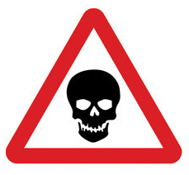
Is the JUUL Safe?
It’s not harmless- A single JUUL cartridge contains 42 mg of nicotine per pod, a lethal dose for children AND adults!
Notes:
We learned earlier that a single JUUL cartridge is equal to an entire pack of cigarettes or 200 puffs.
this equates to approximately 42 mg of nicotine → to offer some perspective, market e-liquids range from 0-36mg of nicotine → this shows you how much more powerful and harmful the JUUL really is in comparison to the other brands
A lethal dose of nicotine when ingested is 30-60 mg for adults and just 10 mg for children!!!!!! → and currently there are no standards set in place for childproof packaging of JUULpods
So is JUUL safe? We can’t really make the claim that it is. We can say that it is NOT harmless
Question 5 on the test
Question 9 on the test

Slide 23
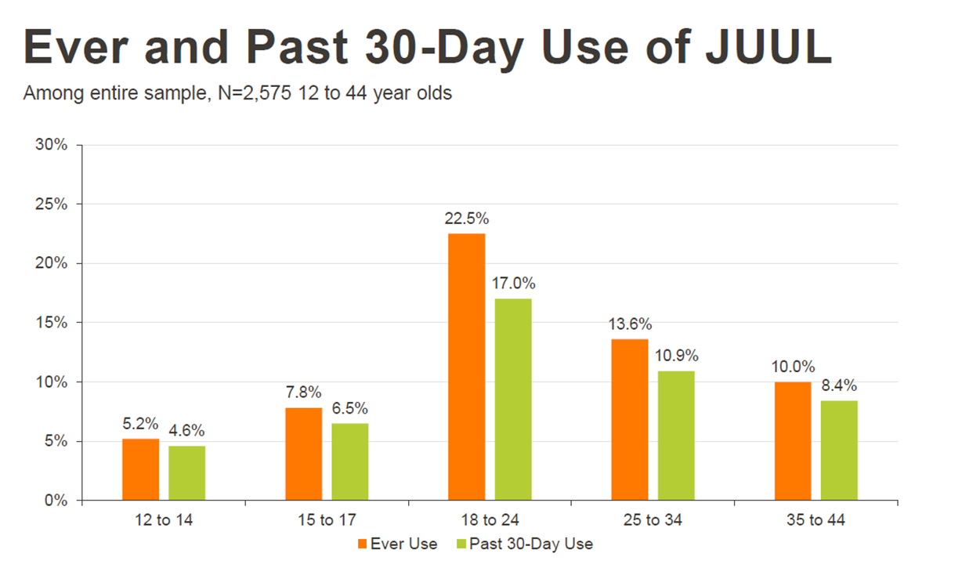
2017 Truth Initiative Study: Who Uses JUUL?
Notes:
In 2017 Truth Initiative carried out two studies on JUUL, one in November and one in April. The studies explored the who, what, when, and where of the product. These next few slides display information taken from those studies.
This particular graph displays the breakdown of ever and current use (measured here as past 30 day use) by age groups
I want to highlight that youth and young adults make up the majority of JUUL users → this raises an alarm b/c we know that nearly 90% of all adult smokers begin smoking by age 18 and a whopping 95% begin by the age of 21

Slide 24
2017 Truth Initiative Study: Who Uses JUUL?
Notes:
.
As we saw in the KARK video, we know that Juul e-cigarettes have infiltrated the schools
Kids are juuling in the bathrooms, during lunch and recreational periods, even right in the classroom
B/c the device looks so much like a usb flashdrive, it goes unnoticed in the school setting
The graph shows us that JUUL use is seen in both the middle school and high school settings
It’s important to note:
While there have been declines in tobacco use among youth, e-cig use among middle and high school students has been on the rise
Products like the JUUL have the potential to reverse the strides we’ve made with youth on this issue

Slide 25
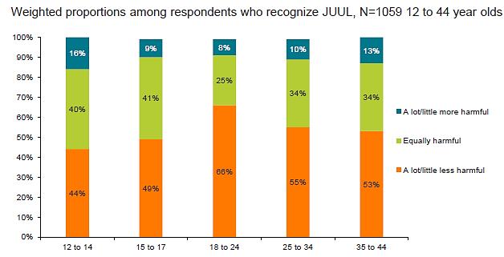
2017 Truth Initiative Study: Perceived Harm
Notes:
The majority of respondents in the study reported that they perceived JUUL to be a lot or a little less harmful compared to cigarettes
Some other things that the study revealed was that:
The majority of youth e-cigarette users think they vaped only flavoring, not nicotine the last time they used the product
Of those who currently use JUUL, 63% didn’t know the device contained nicotine
One quarter of youth and young adult JUUL users don’t refer to JUUL use as “e-cigarette use” or “vaping” –Instead, they use the term “juuling”
Our youth aren’t making the connection between e-cigarette use, JUUL use, and addiction
They aren’t making the connection between current vaping and future smoking

Slide 26
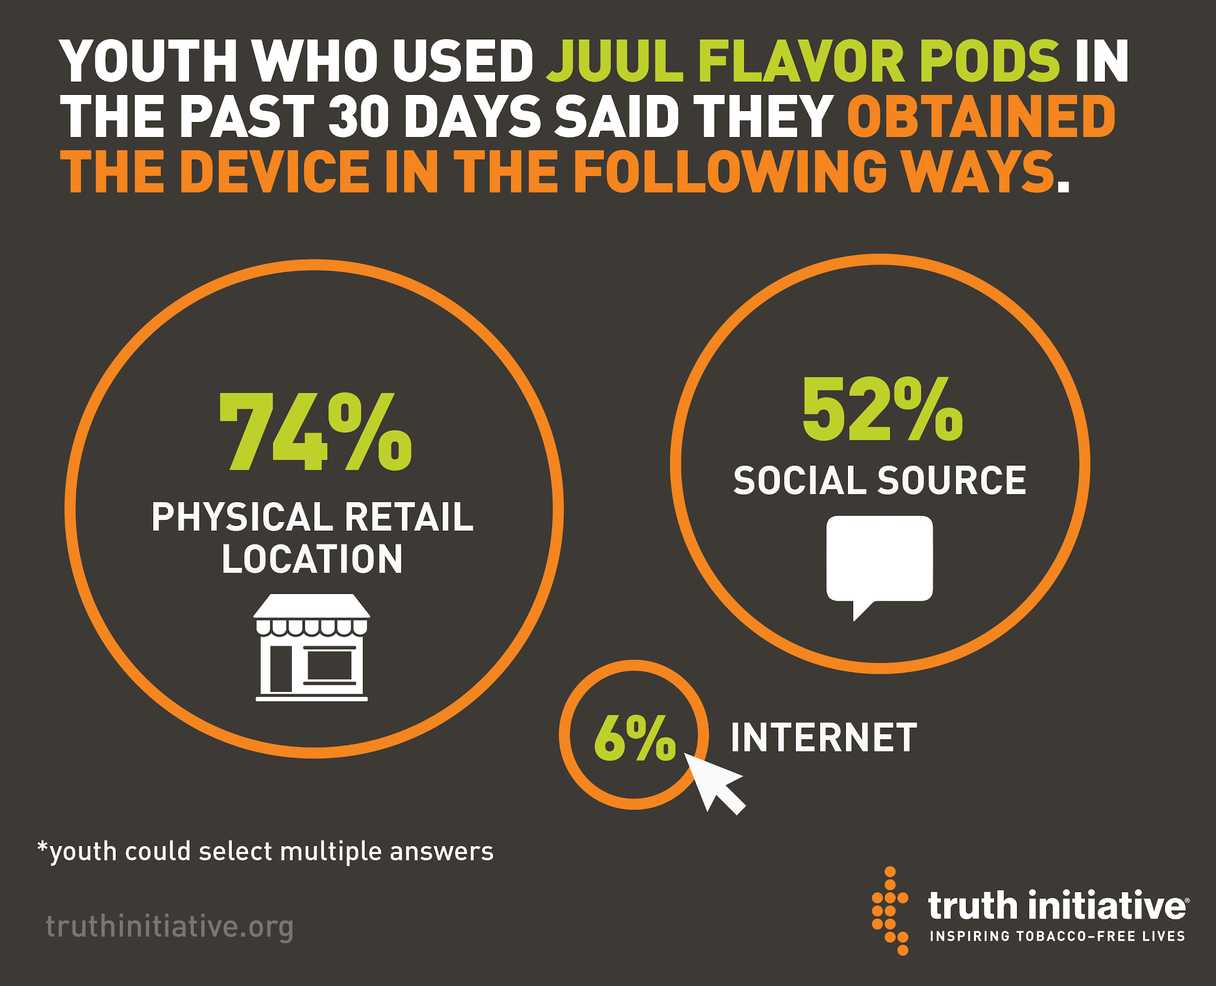
Truth Initiative: Study Product Access
Notes:
Where are they accessing the product? The JUUL is not hard to get!
The majority, 74%, are walking right into a retail location and purchasing it
The rest are getting them from friends and family
And a small amount, about 6%, are purchasing online off of websites like eBay
A lot of websites do require age verification, however often it’s just a matter of checking a box that states you’re 21 or older and you’re in.
I will say that JUUL’s website requires the last 4 digits of a social security number
But this is info that kids can easily get from an older sibling or friend; Or they can just purchase the device off of a different website

Slide 27
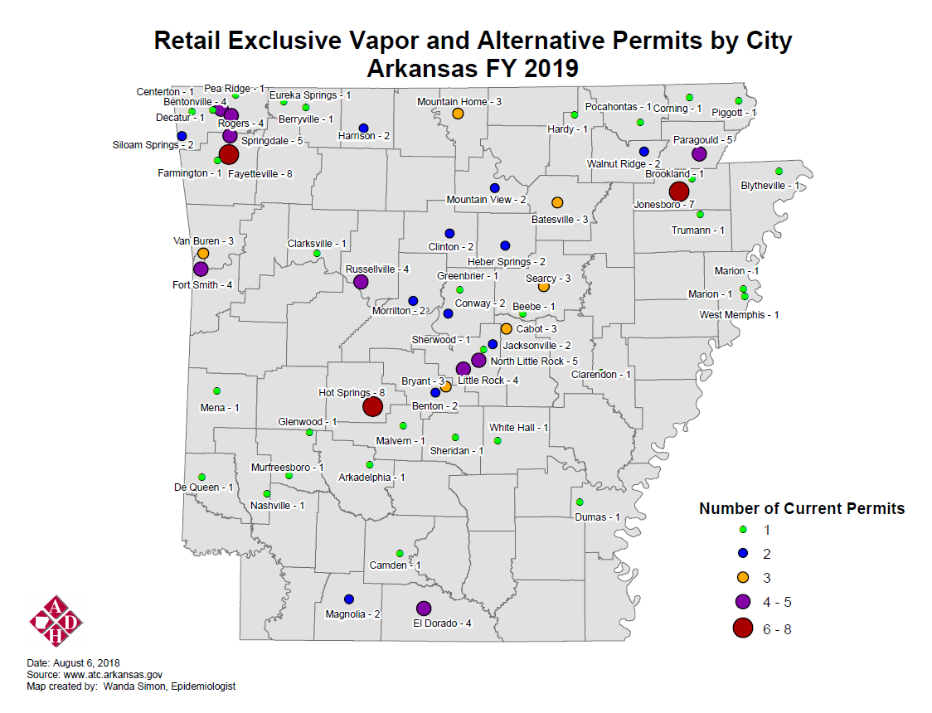
Total = 132
Notes:
What does access look like in Arkansas?
This map displays the locations of specialty vape retail shops in the state that sell e-cigarette devices; The map doesn’t account for traditional tobacco retail stores i.e. gas stations that may also sell the products → if that was accounted for here, you would see a lot more dots on the map!
As you can see, Arkansas has a total of 132 shops that have an exclusive vapor and alternative nicotine products permit, covering more than half of the state
I can also tell you that age verification is not always enforced; The Arkansas Tobacco Control Board is constantly uncovering sales to minor violations

Slide 28
What the Industry Knows…
Flavors
Changing social norms
Life stressors
Perceived reduced risk
Marketing
Lack of addiction
education
Notes:
Teacher Talking Points:
There are many reasons why young people start using these devices, such as (click):
Flavors, changing social norms, life stressors, perceived reduced risk, marketing, and lack of addiction education.
The industry is smart in their approach and focuses on these three points (click) to push their agenda and attract young consumers.
Images:
https://jwnutritional.com/manufacturing/services/sports-nutrition/
https://www.pinterest.com/pin/572097958890170701/
http://chittagongit.com/icon/stressed-icon-25.html
http://www.businessinsurance.com/article/20140616/NEWS06/140619851/Risk-managers-must-help-board-members-keep-proper-risk-focus-Panel
http://www.tjrr.jus.br/images/ascom2017/08ago/matria_sge_metas.jpg
https://www.mhlg.org/archives/other-mental-health-addiction-issues/

Slide 29
Targeted Marketing
Notes:
JUUL’s earliest advertisements were clearly targeted toward youth
What are your immediate reactions upon viewing these ads?
Bright colors, young models wearing trendy attire → JUUL aside, these could just as easily be ads for Target or Old Navy
Question number 6 on test

Slide 30
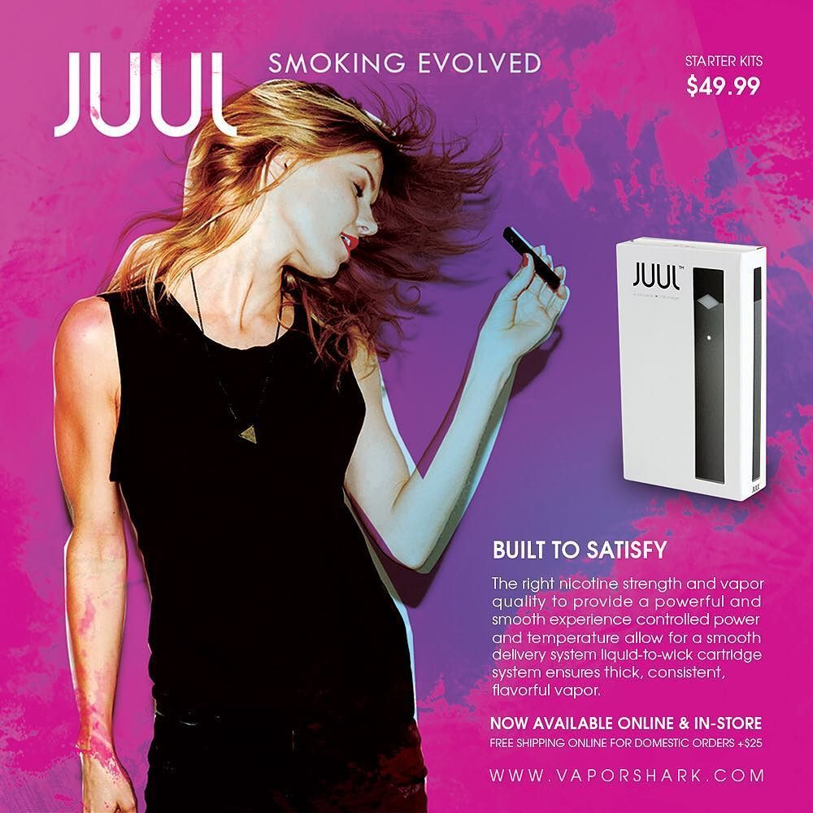
Targeted Marketing
Notes:
JUUL and other e-cig brands have used marketing tactics parallel to Big Tobacco: The glamorous millennial model

Slide 31
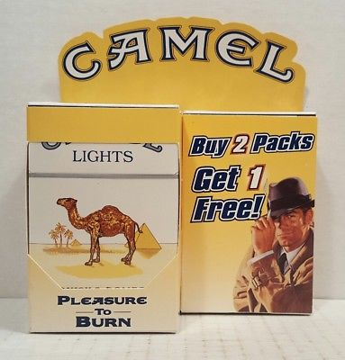
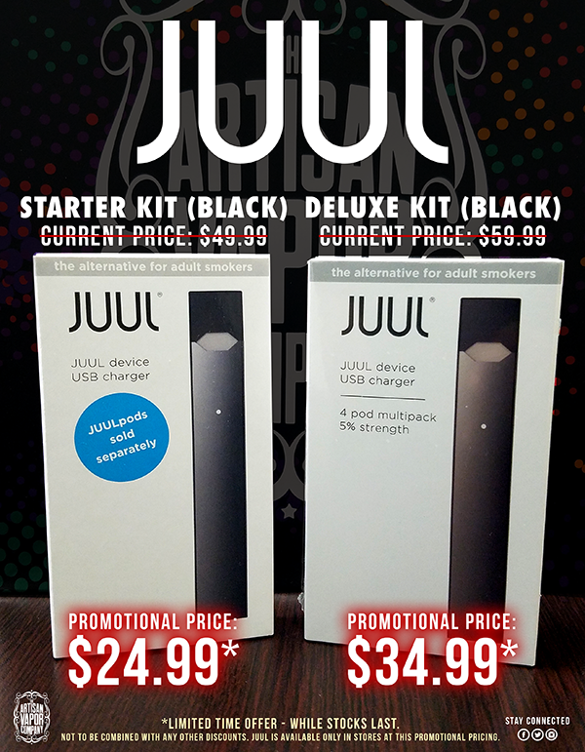
Notes:
JUUL and other e-cig brands have used marketing tactics parallel to Big Tobacco: price promotions

Slide 32
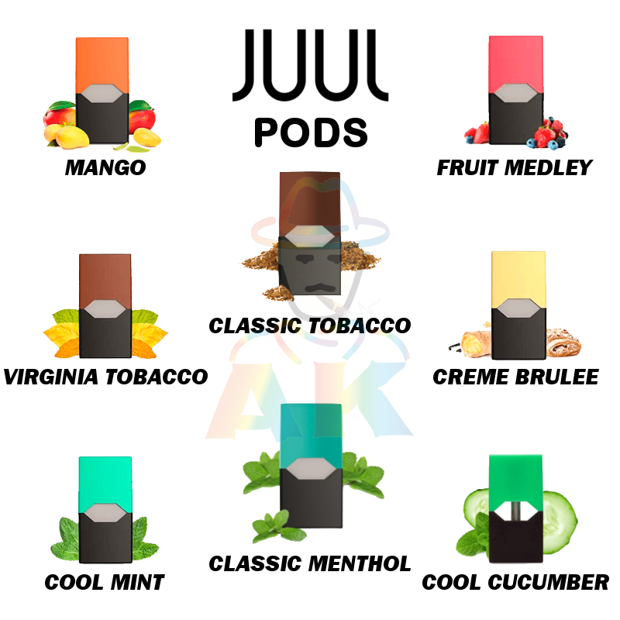
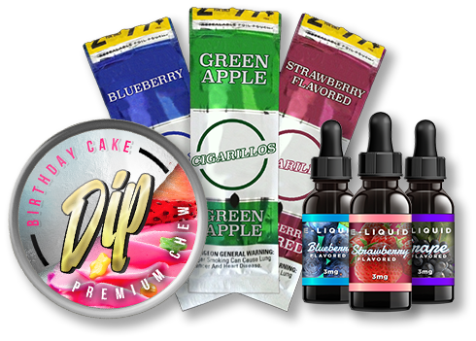
Notes:
JUUL and other e-cig brands have used marketing tactics parallel to Big Tobacco: flavorings

Slide 33
Social Media Targeting
Bigger Instagram accounts giving “shout-outs” and reposting of Snapchat videos of young people using
Problematic memes and cartoons are also distributed via Twitter, which give youth the impression that using is okay
These Messages are Harmful to Young People!
Notes:
Teacher Talking Points: There have been increasing concerns regarding targeting of youth on social media
Social media accounts post videos of young people using these products, while giving shout-outs to pod-based brands like the JUUL
(Click) Social media allows for the industry to have widespread advertising at almost no cost. By sharing these cartoons and memes, young people have essentially done the advertising for them.
(Click) These messages are harmful to young people
Images:
https://www.instagram.com/juulnation/?hl=en

Slide 34
JUUL or Flashdrive?
Notes:
The makers of JUUL purposefully designed the device to be easily hidden; To the untrained eye, the JUUL e-cigarette and its components look like an everyday usb flashdrive → this is one of the driving factors of the product’s popularity among youth → it’s simply easy for them to hide from teachers and parents
This is the USB component of the JUUL!

Slide 35
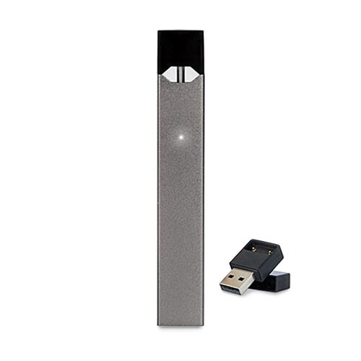
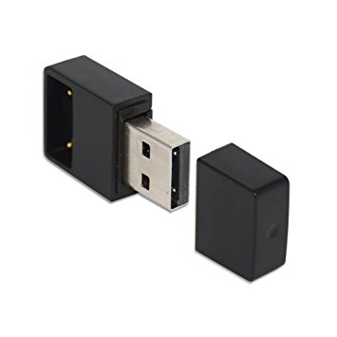
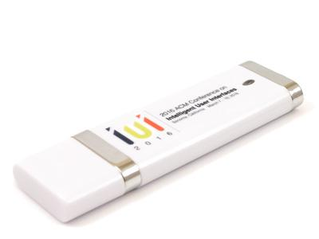
Find the Hidden JUULS
1.)
2.)
3.)
4.)
5.)
6.)
Notes:
So, quick test:
Can you find the hidden Juuls?

Slide 36
JUULS
1.)
3.)
4.)
Notes:
If you guessed numbers 1,3, and 4 you were correct!
2,5, and 6 are all flash drives
Whether you got it wrong or right, you can see the point I’m making here. This product is hard to detect.

Slide 37
FDA Regulation: Deeming Rule
Timeline for FDA Regulation and Review:
May 8, 2018
Manufacturers are required to disclose ingredients
November 8, 2019
Manufactures are required to disclose potentially harmful constituents
August 8, 2022
Manufactures of non-combustible tobacco products must file a marketing application
Notes:
So what is the Food and Drug Administration doing to regulate this product?
Well in May of 2016, the FDA deemed e-cigarettes to be regulated “tobacco products” under the Family Smoking Prevention and Tobacco Control Act of 2009
As a result of this, e-cigarette manufacturers and retailers are prohibited from telling consumers that e-cigarettes are less dangerous than combustible cigarettes
This claim can only be made w/ FDA approval (which has not yet been given to date)
However, under a “deeming rule”, the FDA is delaying its product reviews of e-cigarettes
Because of this deeming rule:
Manufacturers were not required to disclose the ingredients in their products until 2 years after the FDA was granted authority over e-cigarettes
Consumers will not have information regarding the potentially harmful constituents in e-cigarettes like the JUUL until November of next year
In addition, the FDA is allowing all market products introduced prior to August 8, 2016 to be sold as long as the manufacture files an application by August 8, 2022.

Slide 38
Gaps in FDA Regulation
Seven public health and medical groups filed a lawsuit against the FDA on March 27, 2018
Lawsuit addresses the following concerns:
Flavored tobacco products target children and teens
Consumers will be exposed to years of “lethal and addictive components” that are produced while using e-cigarettes
Notes:
The deeming rule is problematic, because it allows for gaps in regulation. And in the meantime, the current generation of youth are being aggressively targeted and exposed to harmful constituents.
7 public health and medical groups groups called on the FDA to take action on JUUL in a lawsuit that is still ongoing. The lawsuit addresses two major concerns: flavored products that clearly target youth and delayed regulation that leaves consumers exposed to harmful constituents
The groups are asking for 5 specified actions
Reverse the decision to delay e-cigarette regulation (deeming rule)
removing certain JUUL flavors
Suspending internet sales
Prohibit branded merchandise - ex: skins, hoodies, t-shirt, etc.
Order the removal of JUUL look-alikes (ex: Phix)
Raymond , N., & Mincer, J. (2018, March 27). Health, Medical Groups Sue FDA Over E-Cigarette Rule Delay. Boston, Massachusetts, United States of America.

Slide 39
Arkansas General Assembly
Act 1451
Prohibits sales to minors
Act 1099
Prohibits use on school grounds and at school functions
Act 1235
Enforcement of sales to minors law,
Child–resistant packaging,
Regulation and licensing of vape shops,
Prohibits ESDs use on any school, childcare or healthcare facility
Act 1722
Prohibits use on college campuses
Notes:
While there are gaps in federal regulation, states do have the authority to regulate E-cigarettes, and there are opportunities to fill those gaps at the state level. What has that looked like in AR? These are the laws that came out of the AR General Assembly
List Acts
Also, Multiple businesses, county and city properties across the state now prohibit ESD use.
We’ve gotten a lot done, but there is still room for improvement in the state of AR when it comes to E-cigarettes.
For example,
We still haven’t banned flavored tobacco products
We don’t have a statewide comprehensive smoke free law that includes ESDs in the policy

Slide 40
Public Health Standard
2014 U.S. Surgeon General’s Report notes importance of public health standard.
Clean air- free of both smoke and ENDS aerosol – satisfies the public health standard because it protects the health of bystanders, prevents tobacco use initiation among youth, and encourages complete smoking cessation.
Notes:
The notion that e-cigarette companies, like JUUL Labs Inc. are in the business of helping adult smokers quit is misguided
These companies are in the business of getting current and non-users of one harmful product to become regular users of their own harmful products (b/c e-cigarettes are the future of Big Tobacco)
They are also in the business of sustainability, meaning that they have a vested interest in getting youth to start using their products to ensure viability in the future
This misinformed idea of harm reduction is not currently scientifically backed. And until we see scientific evidence that supports it, we have to move away from that and stick with the public health standard.
As it relates to e-cigarettes:

Slide 41
Implications for Community Work
Surveillance & Evaluation
Regulation
Media Campaigns
Policies
Notes:
So, now you know what it is. Now you know the public health concerns associated with it.
What can we do about JUUL? E-cigarettes are taking a page from the Big Tobacco Playbook, so we must continue continue to use our own playbook: CDC’s Best Practices for Comprehensive Tobacco Control Programs
That means:
Surveillance - “juuling” has been viewed as a category of its own among our youth → this has revealed itself as a problem for recent surveys that ask kids about their e-cigarette use → remember, juul is an e-cigarette → we have to make this clear in our surveys
Regulation– For example, Currently the minimum age of sale for tobacco products is 18; If that age was increased to 21, it could have a dramatic effect on youth uptake of devices like the juul, and as a result, prevent nicotine addiction in vulnerable adolescents
Counter-Marketing Media Campaign –initiate counter marketing campaigns; kids are just as susceptible to messages that encourage them NOT to quit
Comprehensive Smoke-Free Policies – And finally, smoke free laws and policies should be comprehensive and should include ENDS and ESDs → For example, right now the Arkansas Clean Indoor Air Act, which bans smoking in public places, does not cover electronic smoking devices → so there is room for revision here

Slide 42
Call to Action: What can you do?
EDUCATE
RECRUIT/ ENGAGE YOUTH
POLICY
Educate yourselves, stakeholders, & communities
Enlist youth to advocate for your program
Implement comprehensive policies
Notes:
These are some specific ways you can engage in the Best Practices Tactics as a sub-grantee:
You want to continue to educate yourselves, stakeholders, and the communities you work with
All of you will get this presentation, with presenters notes and sources included emailed to you after kickoff → You will also get an updated emerging trends powerpoint that has JUUL and some of the other latest products added to it → go out into the community, present and share this information with your stakeholders
Continue to recruit and engage our youth
young people are persuasive advocates w/ peers/fam members/policymakers → continue to enlist youth in the community to advocate for your program and help w/ smoke-free policies that cover ESDs in their schools and communities
Finally, understand that policy plays a critical role in improving the health of our communities
Go out into the community and help businesses, faith based organizations, and municipalities revise and implement comprehensive tobacco free policies that include electronic cigarettes
These are all things you can be doing right now

Slide 43
Your Arkansas Resource
Quit tobacco or nicotine
Manage your diabetes
Manage your high blood pressure
Notes:
The Arkansas Department of Health is transforming the tobacco quitline to a new service, Be Well Arkansas.
What is staying the same:
•Arkansans can receive tobacco and nicotine cessation services to help them quit addiction.
•The fax number for patient referrals is still 1-888-827-7057.
•The phone number 1-800-QUIT-NOW still works and will now route callers to Be Well Arkansas.
•Be Well Arkansas will continue to allow for online intake for patients.
What is different:
•Be Well Arkansas will offer more than cessation services; it will link people to diabetes management and hypertension control resources.
•There is a new and additional toll-free phone number that patients can call at 1-833-283-WELL.
•There is an all new website www.bewellarkansas.org in development that will have updated resources for patients and providers.
•Be Well Arkansas has added an online chat component for cessation services.
•Be Well Arkansas now offers local, in-person cessation counseling as an option for patients.
•The hours for call-backs will be normal business hours, similar to other programs like this across the country.
•Be Well Arkansas has added a cessation texting service with advice and tips, and an app for 24/7 support.

Slide 44
Notes:
Remember, poison is poison!

Slide 45
References:
Photo obtained from juul.com 8/20/18
Photo obtained from kahoot.com 8/20/18
Photo obtained from cdc.gov 8/20/18
Image Credit: Dr. Gideon St. Helen 8/20/18
Photo obtained from cdc.gov 8/20/18
Image credit: Joleen Rodgers “Tobacco Products and Objectives” Obtained 8/20/18
https://www.ncbi.nlm.nih.gov/pubmed/29059261
Image credit: tobaccopreventiontoolkit.stanford.edu. Obtained 8/20/18
Image Credit: http://sphweb.bumc.bu.edu/otlt/mph-modules/exposureassessment/expRoute.png
Photo obtained from pinterest.com on 8/20/18
Image Credit: via http://clipart-library.com/clipart/2052401.htm
Photo obtained from smeharbinger.net on 8/20/18
Source: Nielsen Total US xAOC/Convenience Database & Wells Fargo Securities, LLC
Photo obtained from juul.com 8/20/18 (juul starter kit)
Photo obtained from vapeinthebox.com 8/20/18 (juul pod
Source: Stanford Tobacco Prevention Toolkit
Photo obtained from maxejuice.com on 8/20/18
Photo obtained from vapegodshop.com on 8/20/18
Reference: https://www.prnewswire.com/news-releases/pax-labs-inc-granted-us-patent-for-nicotine-salt-e-cigarette-300196459.html
Graph: https://www.engadget.com/2015/06/03/pax-labs-juul-e-cigarette/
Photo obtained from indiamart.com on 8/20/18
Images:
https://jwnutritional.com/manufacturing/services/sports-nutrition/
https://www.pinterest.com/pin/572097958890170701/
http://chittagongit.com/icon/stressed-icon-25.html
http://www.businessinsurance.com/article/20140616/NEWS06/140619851/Risk-managers-must-help-board-members-keep-proper-risk-focus-Panel
http://www.tjrr.jus.br/images/ascom2017/08ago/matria_sge_metas.jpg
https://www.mhlg.org/archives/other-mental-health-addiction-issues/

