Slide 1
Fetal Alcohol Spectrum Disorders
Angie Kyzer
Research Associate
UAMS Department of Family & Preventive Medicine
Board Member of Arkansas None for Nine

Slide 2
Today’s Focus
Understanding Fetal Alcohol Spectrum Disorders (FASDs)
Individuals with FASD: Strengths, difficulties, & approaches
Working with individuals with FASD
Preventing alcohol exposed pregnancies

Slide 3
Fetal Alcohol Spectrum Disorders
Fetal alcohol syndrome
Alcohol related birth defects
Partial fetal alcohol syndrome
Alcohol related neurodevelopmental
disorder
Other specified neurodevelopmental
disorder

Slide 4
Key Facts about FASDs
FASDs are the most common cause of preventable developmental disabilities.
Some research indicates that almost 1 out of 100 children are born with an FASD. ¹
There is no safe time, no safe amount, and no safe type of alcohol when you’re pregnant.
The effects of FASDs are costly and last a lifetime.²

Slide 5
Diagnostic Terminology
Fetal Alcohol Syndrome
Was coined in the U.S. in 1973 by Drs. David Smith & Ken Lyons Jones at the University of Washington.
Is a specific birth defect caused by alcohol use during pregnancy.
Is a medical diagnosis (Q86.0) in the International Classification of Diseases (ICD-10).

Slide 6
Diagnostic Terminology
Partial fetal alcohol syndrome (pFAS)
Alcohol related neurodevelopmental disorder (ARND)
Alcohol related birth defects (ARBD)
Other specified neurodevelopmental
disorder
Neurodevelopmental disorder
associated with prenatal alcohol
exposure (ND-PAE)

Slide 7
Why is Prevention Important?
Almost half of all pregnancies are unplanned.
1 in 9 pregnant women reports alcohol use.
Alcohol use during pregnancy is also linked to miscarriage, stillbirth, preterm birth, and SUIDS.
5% of women in substance abuse treatment are pregnant.

Slide 8
WHEN IS IT SAFE TO DRINK?

Slide 9
049
NO SAFE TIME…

Slide 11
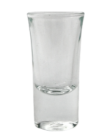
One drink is equal to:
NO SAFE AMOUNT…
12 oz. of beer
5 oz. of wine
1.5 oz. hard liquor

Slide 12
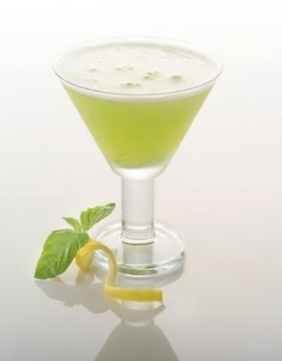
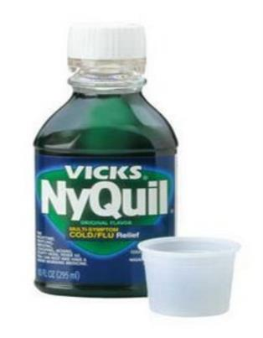
NO SAFE KIND OF ALCOHOL…
Alcohol is alcohol is alcohol.

Slide 13
Alcohol Screening Tools³
Universal
AUDIT
Hazardous alcohol use
Dependence symptoms
Harmful alcohol use
Pregnant women
T-ACE & TWEAK
Tolerance
Annoyed/Worried
Eye-opener
Amnesia
Cut down

Slide 14
Why is an FASD Diagnosis So Important?

Slide 15
With permission: Susan Astley, PhD, University of Washington

Slide 16
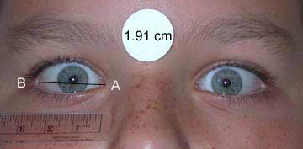
CDC Criteria (2004)
Facial abnormalities:
Smooth philtrum (guide numbers 4-5)
Thin vermillion (guide number 4-5)
Palpebral fissures (≤10th percentile)

Slide 19
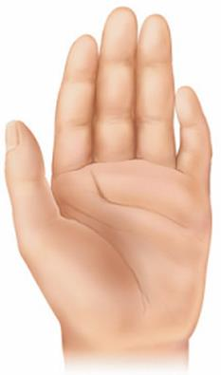
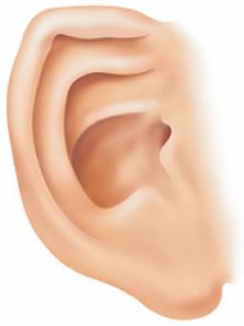
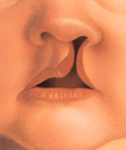
Prenatal Alcohol Use Also Affects...
Hearing and vision
Heart and kidneys
Cleft palate
Liver
Sinus problems
Skeletal muscles
Mild facial anomalies

Slide 20
Comprehensive Evaluation
Fetal Alcohol Behavior Scale*
Life History Screen*
Child Behavior Checklist
Vineland Adaptive Behavior Scales*
Peabody Individual Achievement Test-Revised*
Bayley Scales of Infant Development
Kaufman Assessment Battery for Children
Wechsler Intelligence Scale*
Social Skills Rating System
*Can be used with adults

Slide 21
Frontal lobe
Information processing
Working memory
Planning
Problem solving
Decision making
Self-control
Abstract reasoning
Movement & speech

Slide 22
Hippocampus
Long term memory
Spatial navigation
Learning
Mood control

Slide 24
Infancy⁴
Feeding problems
Developmental milestones missed
Susceptible to illnesses
Cries a lot
Small
Sleep problems
Bonding troubles

Slide 25
Preschool⁴
Poor gross/fine motor
Quickly moving from one activity to another
Problems with social skills, reading social cues
Overly friendly
Sleeping problems
Receptive language delayed
Fearless
Hard with transitions
Sensory sensitivities

Slide 26
Middle Childhood⁴
Difficulty understanding consequences
Appearance of capability
Poor comprehension
Hyperactivity, memory deficits, impulsivity
Poor social development
Attention difficulties
Academic failure/school trouble
Gullibility
Notes:
26

Slide 27
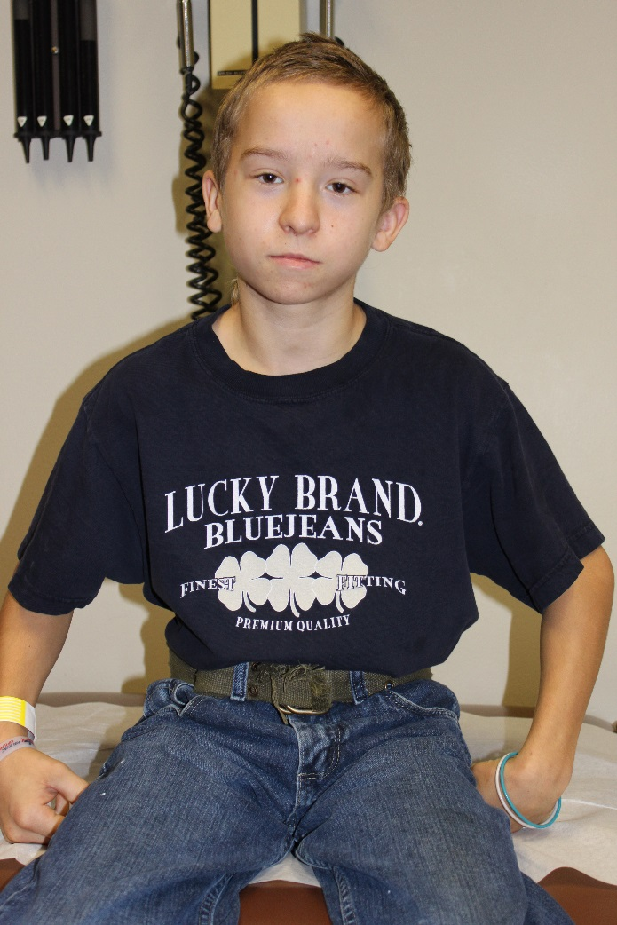
Adolescence⁴
Poor academic achievement
Lying, stealing
Failing to understand consequences
Low self-image and motivation
Inappropriate sexual behavior
Impulsive
Relationship difficulties
Mental health problems
Notes:
27

Slide 28
Adults⁴
Problems with money/time management
Difficulty identifying dangerous people/situations
Risky behaviors (sexual, substance use, etc.)
Poor insight and judgment
Childlike behaviors
Poor boundaries
Homelessness or dependent living
Legal involvement
Photo: Susan Astley, PhD, University of Washington

Slide 29
What Can I Do?
Recognize that this is organic brain damage.
Focus on fixing the environment.
Focus on the whole family.
Work with the person at his/her level.
Recognize and build on strengths.
Emphasize prevention.

Slide 30
Preventing Alcohol Exposed Pregnancies⁵
Universal
Screening & Brief Intervention (SBI & SBIRT)
Non-pregnant women
Project CHOICES
Pregnant women
Parent-Child Assistance Program (PCAP)

Slide 31
The 8 Magic Keys⁶
Concrete.
Specific.
Repetition.
Consistency.
Routine.
Simplicity.
Structure.
Supervision.

Slide 32
It’s time to get ready!
Put on your shoes.
Concrete & Specific
Quit fiddling around!
Put the blocks in the basket.
Stop running!
Walk, please.

Slide 34
Repetition

Slide 35
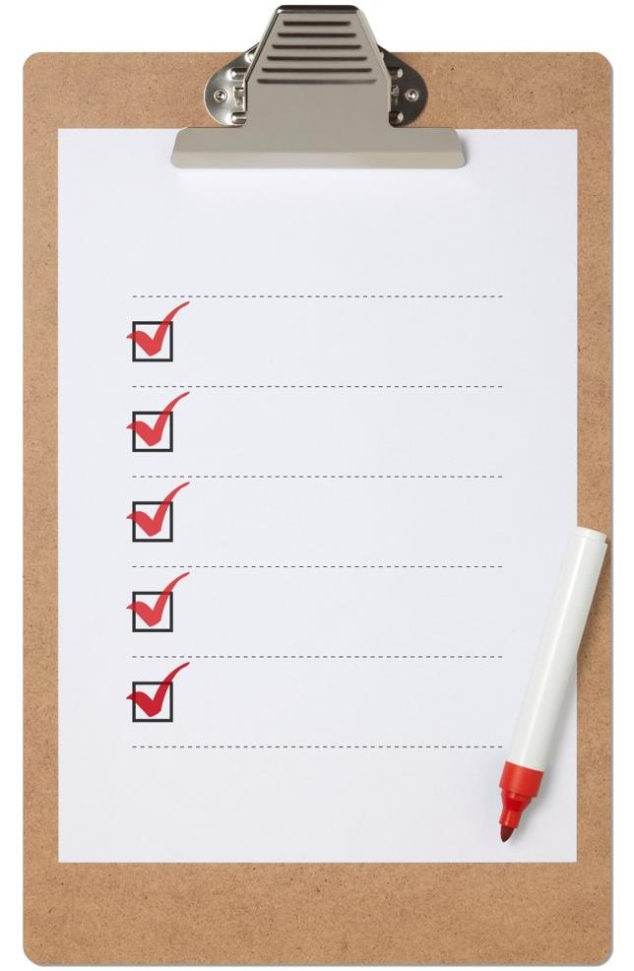
Plan for the Day
Eat breakfast
Consistency
& Routine
Go to school
Soccer practice
Eat dinner
Take a bath

Slide 36
Simplicity

Slide 37
Structure
& Supervision

Slide 39
Evidence-Based Interventions⁷
Social skills—Child Friendship Training; Project Bruin Buddies
Math skills—Math Interactive Learning Experience (MILE)
Behavior regulation—ALERT
Parenting skills—Families Moving Forward

Slide 40
Alternative Interventions
Parent Child Interaction Therapy
Social skills training
Behavior regulation
Parenting, stress, and behavior management for family
Animal-assisted therapy
Yoga or acupuncture
Diet or supplements such as choline
Art/play therapy
Movement/dance therapy

Slide 42
Call to Action
Develop a working knowledge of FASD’s impairments.
Incorporate screening and assessment protocols.
Reconsider how treatment compliance and success are defined.

Slide 43
State Resources
Arkansas’ State Task Force on FASDs & Arkansas None for Nine
Carol Rangel: rangelcf@archildrens.org
Facebook Parent Support Group
Contact Carol Rangel as well.
Dr. G. Bradley Schaefer—ACH Genetics (Northwest AR): schaefergb@uams.edu
Dr. Jeffrey Snow—ACH Pediatric Psychology (Little Rock): snowjeffreyh@uams.edu
David Deere—Partners for Inclusive Communities & UAMS Lend Program: deere@uark.edu

Slide 44
Follow us!
Arkansas None for Nine
@arnonefornine
www.arkansasnonefornine.org

Slide 45
References
May, P. A., Chambers, C.D., Kalberg, W.O, Zellner, J., Feldman, H., Buckley, D.,…Hoyme, H.E. (2018). Prevalence of fetal alcohol spectrum disorders in 4 U.S. Communities. Journal of the American Medical Association, 319(5), 474-482.
Lupton, C., Burd, L., & Harwood, R. (2004). Cost of fetal alcohol spectrum disorders. American Journal of Medical Genetics Part C. 127C:42-50.
Chang, G. (2001). Alcohol-screening instruments for pregnant women. Alcohol Research & Health, 25(3), 204-209.
Fetal alcohol spectrum disorders handbook. University of South Dakota, Sanford School of Medicine. Retrieved from: http://tinyurl.com/hvey5my

Slide 46
References
Substance Abuse and Mental Health Services Administration. Addressing Fetal Alcohol Spectrum Disorders (FASD). Treatment Improvement Protocol (TIP) Series 58. HHS Publication No. (SMA) 13-4803. Rockville, MD: Substance Abuse and Mental Health Services Administration, 2014.
Evensen, D. & Lutke, J. (1997). Eight magic keys: Developing successful interventions for students with FAS. Retrieved from: http://www.fasalaska.com/8keys.html
Petrenko, C.L.M. & Alto, M.E. (2016). Interventions in fetal alcohol spectrum disorders: An international perspective. European Journal of Medical Genetics, 60(1), 79-91.

Slide 48
THANK YOU!

