Slide 1
HOPE Changing brains through support, structure, and confronting shame
Dr. Margo Turner
Dr.margo.turner@gmail.com

Slide 2
What are 5…?
Notes:
http://stateofopportunity.michiganradio.org/post/five-things-know-about-early-childhood-brain-development Dr. Jack Shonkoff, director of the Center on the Developing Child at Harvard University.

Slide 3
Connections
At birth, most of the brain cells (neurons)we will have in life BUT…
a baby forms 700 new neural connections per second in the first years of life...
And pruning occurs = PLASTICITY.
Notes:
Pruning is the shaping of the connections of the brain…due to environment
http://stateofopportunity.michiganradio.org/post/five-things-know-about-early-childhood-brain-development

Slide 4
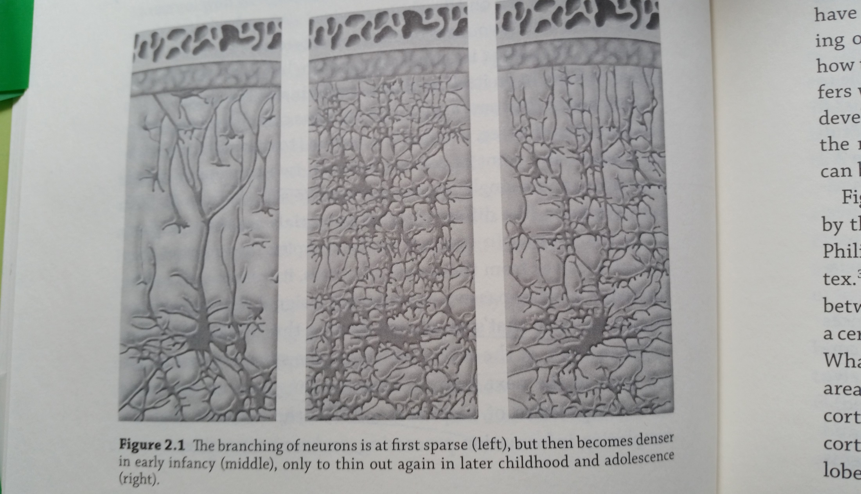
THE LEARNING BRAIN by Torkel Klingberg
Notes:
The Learning Brain: Memory and Brain Development in Children
Book by Torkel Klingberg

Slide 5
Environment
"During the critical years of birth through age 5, 90 percent of a child’s brain is developed and essential learning patterns are established which affect school-readiness…Children spend an average of 35 hours a week in child care which means child care is a key early learning program." Ollie M. Smith, Child Care Aware® America’s Interim Executive Director
Notes:
Shapes architecture

Slide 6
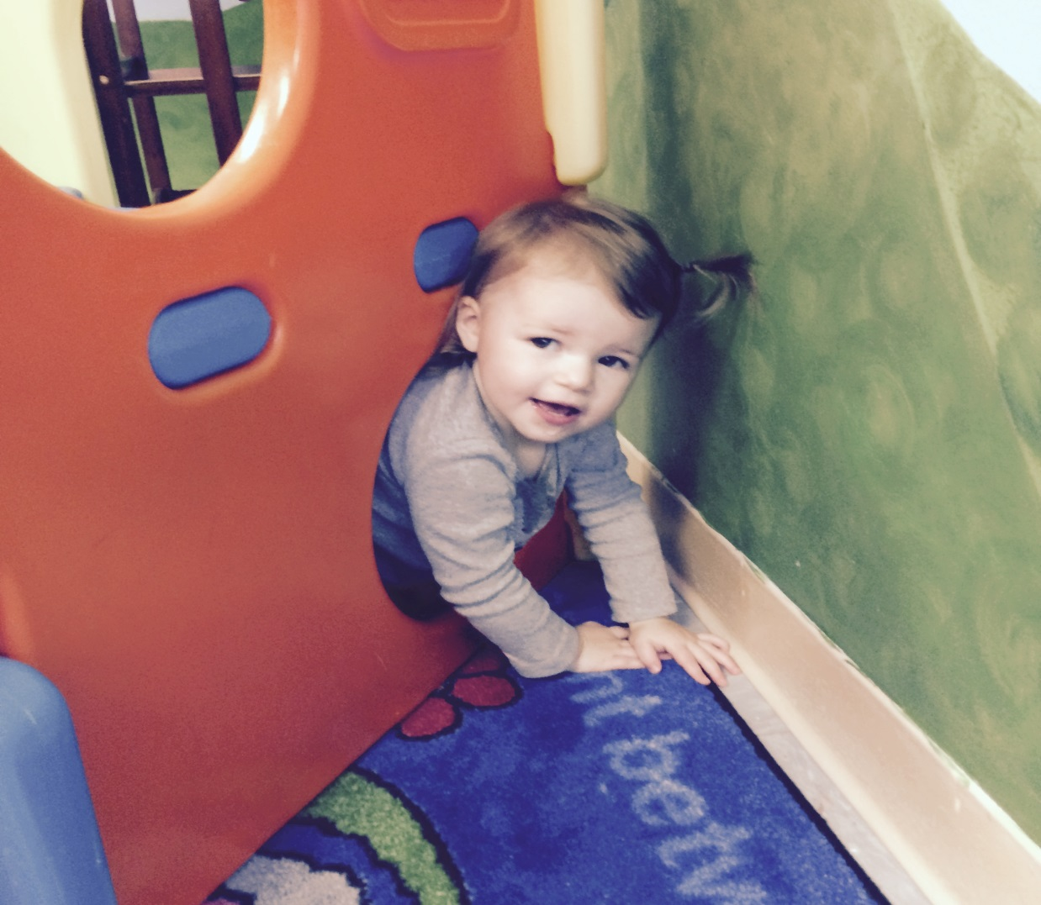
Responsiveness - Interactions
At 19 months, Claire is doing more climbing as well as learning the word and concept of "under."

Slide 7
Language

Slide 9
Group work
4 square – 2 facts and 1 question

Slide 10
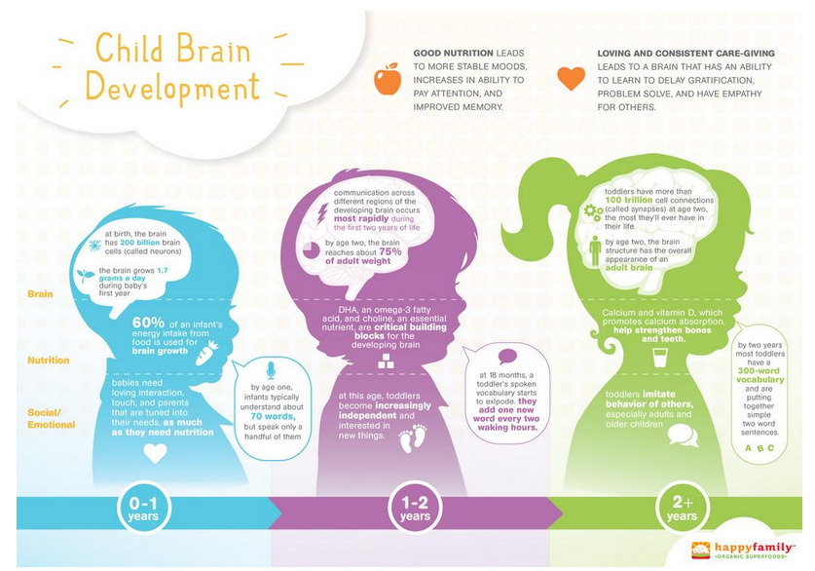
Notes:
http://www.mikewirthart.com/project/child-brain-development-happy-family-brands/

Slide 11
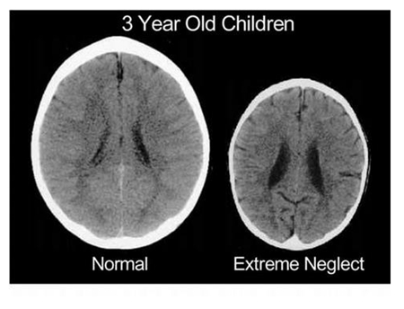
Stresses of Poverty affect brain development
Neurologists say that the sizeable difference between these two brains of two different 3-year-olds has one primary cause: the way that their mothers treated them.
- Bruce D. Perry, M.D., Ph.D./Child Trauma Academy
Notes:
Emotional and Social Challenges.
Acute and Chronic Stressors.
Cognitive Lags.
Health and Safety Issues.
Jensen teaching with poverty in mind 2009 ascd

Slide 12
Chronic or acute stress can cut neuron production by 50%..less blood flow to PFC
Notes:
What is the pfc?

Slide 13
Recognition/Belonging

Slide 14
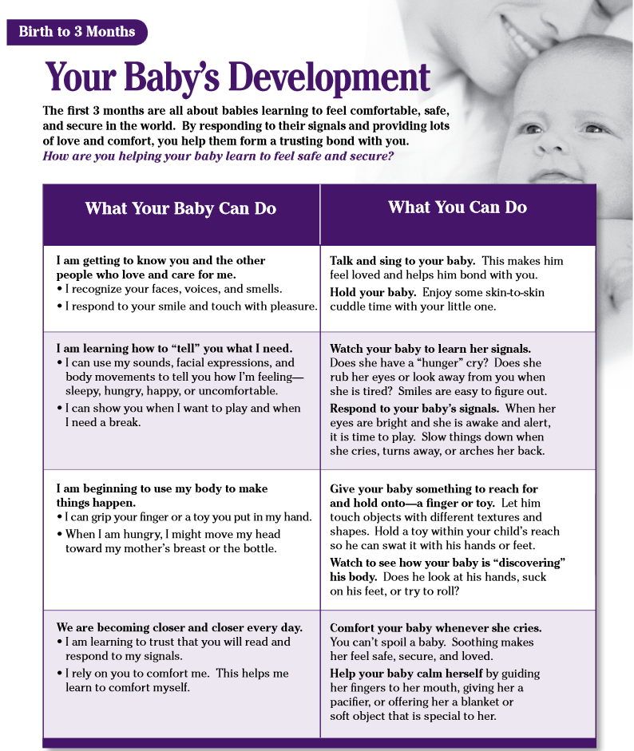
Notes:
http://www.zerotothree.org/child-development/brain-development/baby-brain-map.html
Names, names , songs with names, attending, being present

Slide 16
Time to practice!

Slide 17
Skill-Building/Self-Regulation

Slide 18
The thermostat
identifying each child’s self-regulation zone of proximal development and planning the kinds of modeling, hints, and cues the child needs to continue his or her development
watching for opportunities in everyday classroom experiences to scaffold self-regulation
provide structure, routines, procedures that are consistent, practiced and reinforced
withdrawing direct support as children begin to demonstrate new skills
monitoring children’s activities to ensure they are successful
- from Dr. Ida Rose Florez
Notes:
https://www.naeyc.org/files/yc/file/201107/Self-Regulation_Florez_OnlineJuly2011.pdf
Younger children may need more explicit hints and cues. Cuing children to hold their hands or put them in their pockets helps them regulate impulses to touch, grab, or hit. Key phrases such as “look here,” “look at me,” or “look where I am pointing” are explicit cues teachers can use to help young children focus their attention. Beginning in infancy, teachers can help children recognize and name their emotions by calmly saying to frustrated or angry babies and toddlers, “You sound angry” or “I wonder if you’re frustrated,” and then cuing them to start self-calming by using gentle touch and saying, “Let’s relax” or “I’m here to help you.” As children begin to use language, adults can provide cues about when and how to ask for help, when to take a break, or when to try a different strategy

Slide 19
Time to practice!

Slide 20
Space/Time
Notes:
Appropriate expectations!!!

Slide 21
Books
Notes:
https://www.zerotothree.org/resources/304-how-to-introduce-toddlers-and-babies-to-books

Slide 22
Confronting the shame
take a genuine interest in the child
model healthy, mature, empowered behavior,,
watching for opportunities to re-direct when the child has faulty thinking, blaming, and impulsive acting out = self-sabotaging behaviors
monitoring with reachable goals and documentation
Dr. Michael Obsatz
Notes:
http://www.angeresources.com/helpkids.html
To overcome shame, a child must begin to feel loved for the very one that they are. This means a rebirth of self, of spirit, of personal and interpersonal connection. Anyone working with kids can help them overcome shame. They must be reinforced for being worthy and loveable. This needs to happen often from someone they can learn to trust. Trust is the first step, and empowerment is the second step. Kids need to feel competent and capable, and have a sense of their own healthy power. This is a long and complicated process.
First, an adult role model, mentor, teacher, or parent must take a genuine interest in the child. Then, that adult must model healthy, mature, empowered behavior. Then, the child must be encouraged to stop all shame-based and self-sabotaging behaviors. This includes faulty thinking, blaming, and impulsive acting out.

Slide 23
Time to practice!

Slide 24
So what?
The science is clear…you affect the very development, the wiring of the brains of children
How you do that is completely up to you.
What will you do?

Slide 25
A Preschool Teachers Prayer
Posted on 08/16/2011
Today I wake up, already weary.
The day before still wreaks havoc on my heart, the stress of the day had barely let me sleep.
In a still moment before my feet hit the floor, I pray “Lord, please let today be better.”
Then, I take a few more moments, moments to really focus.
Moments to make myself remember.
If it were my child . . .
In that stolen moment, that solemn reminder session from my heavenly father,
my heart begins to ache.
Lord, when my feet hit the pavement in the parking lot,
remind me why I’m there.
Help my heart to smile and my mouth speak peace.
Let my arms be soft and my attitude stern.
Fill my room with laughter and love.
Let each child feel special and important.
Allow me to work in your grace and mercy.
Show yourself in my actions and in my words.
Help me reveal you to them.
Help me be the best three year old teacher those kids will ever encounter. . .
Isaiah 40:11
” He tends his flock like a shepherd: He gathers the lambs in his arms and carries them close to his heart .. .

Slide 26
“Hope is not an emotion; it's a way of thinking or a cognitive process.” ― Brené Brown, The Gifts of Imperfection: Let Go of Who You Think You're Supposed to Be and Embrace Who You Are

Slide 27
Resources
http://stateofopportunity.michiganradio.org/post/five-things-know-about-early-childhood-brain-development Dr. Jack Shonkoff, director of the Center on the Developing Child at Harvard University.
The Learning Brain: Memory and Brain Development in Children by Torkel Klingberg
http://www.ascd.org/publications/educational-leadership/may13/vol70/num08/How-Poverty-Affects-Classroom-Engagement.aspx
Eric Jensen, (Teaching with Poverty in Mind), 2009 ASCD
http://www.zerotothree.org/child-development/brain-development/baby-brain-map.html
http://www.angeresources.com/helpkids.html
https://www.zerotothree.org/resources/304-how-to-introduce-toddlers-and-babies-to-books
https://www.naeyc.org/files/yc/file/201107/Self-Regulation_Florez_OnlineJuly2011.pdf
http://www.mikewirthart.com/project/child-brain-development-happy-family-brands/
Dr. Bruce Perry, www.childtrauma.org

